Slide 1
1920’s and 1930’s
Paulding County: U.S. History

Slide 2
Standards
SSUSH16 Investigate how political, economic, and cultural developments after WW I led to a shared national identity.
SSUSH17 Analyze the causes and consequences of the Great Depression.
SSUSH18 Evaluate Franklin D. Roosevelt’s New Deal as a response to the Great Depression and compare how governmental programs aided those in need.

Slide 3
Key Concepts
The Roaring 1920’s
Communism
Socialism
Red Scare
Eighteenth Amendment
Nineteenth Amendments
Henry Ford
Impact of the Radio and Movie
Jazz
The Harlem Renaissance
Overproduction
Underconsumption
Stock Market Speculation
Stock Market Crash of 1929
The Dustbowl
Hoovervilles
Franklin D. Roosevelt
New Deal Program
Second New Deal
Social Security Act
Huey Long
U.S. Neutrality
Court-Packing Bill
Eleanor Roosevelt

Slide 4
Document Analysis
We are no longer a homogeneous people. There are some fourteen millions of foreign-born among us, whose ideals are not ours. When we seek to Americanize them, they tell us in their foreign tongues that the country is as much theirs as ours, and that they propose to remain themselves, to remain European, and even to Europeanize our social, moral, and political state of affairs. When we protest, these people accuse us of intolerance. And they are not beside the mark in doing so, for clearly we do not tolerate them as they are. But, on the other hand⎯a thing not so often mentioned ⎯they do not tolerate us: our literature, art, morals, habits of life, our ideals, religion, traditions, and the Republic we have created.
Source: Langdon Mitchell “The New Secession” The Atlantic Monthly August 1926,

Slide 5
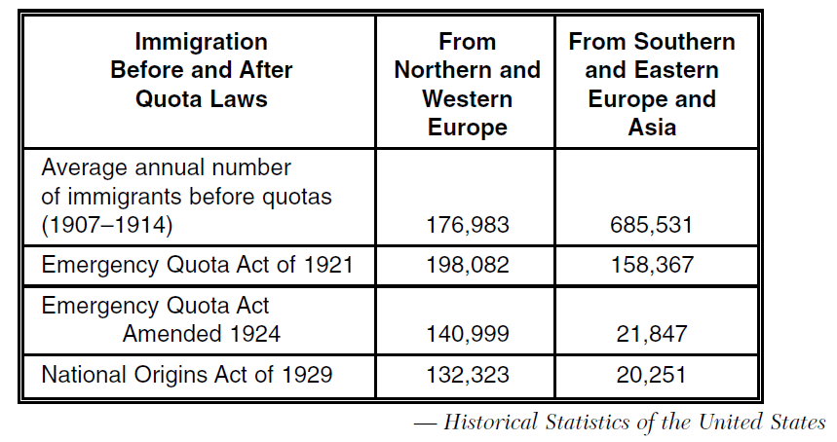

Slide 6
The Rise of Communism and Socialism (SSUSH16a)
The Rise of Communism and Socialism (SSUSH16a)
In the late 1800s and early 1900s, a new political ideology called communism became a popular form of government.
Basis of Communism
Single-party government ruled by a dictator
There is no private ownership; all property is owned by the state

Slide 7
The Rise of Communism and Socialism (SSUSH16a)
In 1919, the communist party led by the Bolsheviks overthrew the czar in Russia, established the Soviet Union, and called for a worldwide revolution to destroy capitalism, people in the United States began to fear communists.
This fear of the spread of communism was called the Red Scare because red was the color of the communist flag.
The Red Scare led to the U.S. government’s pursuit of suspected communists.

Slide 8
The Red Scare (SSUSH16a)
The Red Scare was one factor that led to the development of Nativism and new restrictions on immigration
Major points of Nativism
People born in America were superior to immigrants
America should keep its traditional culture intact.

Slide 9
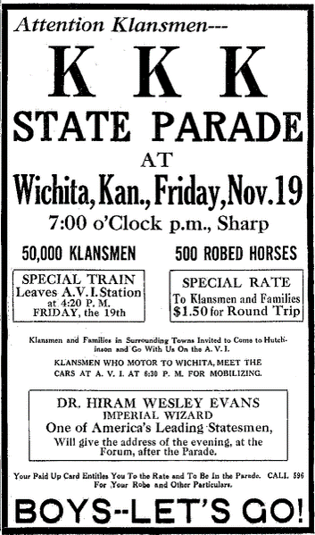

Slide 11
Document Analysis
CREED OF KLANSWOMEN
America for Americans, As Interpreted by the Women of the KKK Little Rock, Arkansas , 19—
WE BELIEVE in the fatherhood of God, the brotherhood of Jesus Christ, and the eternal tenets of the Christian religion as practiced by enlightened Protestant churches…
WE BELIEVE that the current of pure American blood must be kept uncontaminated by mongrel strains and protected from racial pollution…
WE BELIEVE that the perpetuity of our nation rests upon the solidarity and purity of our native-born, white, Gentile, Protestant men and women…
WE BELIEVE that under God, the Women of the Ku Klux Klan is a militant body of American free-women……

Slide 12
The Red Scare (SSUSH16a)
Results of Nativism
Return of the Ku Klux Klan (Not just the South)
New restriction on immigrants (low the number of immigrants) Anti-immigrant

Slide 13
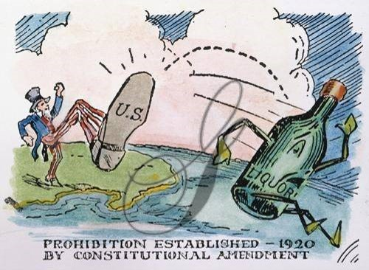

Slide 15
The Impact of the Eighteenth Amendment (SSUSH16b)
Reason: Americans’ anti-German feelings led to a campaign to outlaw beer and other alcoholic beverages.
Result: 18th Amendment (Prohibition) which prohibited “the manufacture, sale, or transportation of intoxicating liquors.”
Prohibition proved difficult to enforce and it led to an increase in crime and other social problems–to the contrary, it led to a rise in organized crime

Slide 17
The Impact of the Nineteenth Amendment (SSUSH16b)
Reason: Women had supported their country during WWI by taking jobs in factories.
Result: 19th Amendment gave women the right to vote.
Women also wanted income equality

Slide 18
Review Questions
Define: Communism
Define: Socialism
What was the significance of the Red Scare?
How did the Red Scare impact immigration?
What was the purpose of the 18th Amendment?
What was the negative result of the 18th Amendment?
What was the purpose of the 19th Amendment?

Slide 19
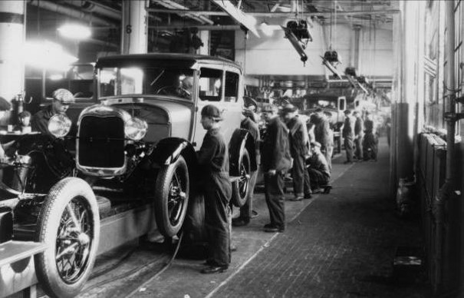

Slide 20
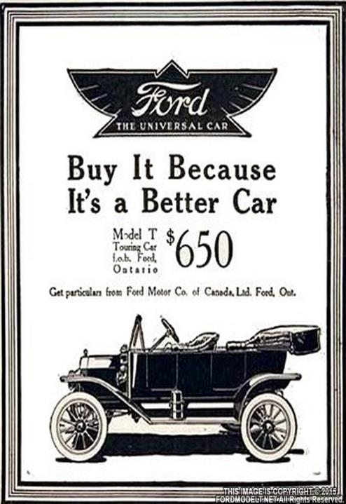

Slide 21
Henry Ford and the Automobile (SSUSH16c)
Advertising of cars and new household appliances was largely through nationwide campaigns on the radio, in magazines, and at the movies.
People began to see themselves as "needing" certain items of convenience rather than simply "wanting" them.
Henry Ford develops the assembly line which lead to the mass production of cars
The mass production of cars helped lower the price of cars (everyone wants a car)

Slide 22
Document Analysis
Just set your dial, And stay a while, With W-X-Y-Z.
There it is, up in the air, absolutely free, waiting for you to pull it down with the aid of electricity. Opera and symphonic music, jazz, twenty minutes of good reading, how to cook by Aunty Jane, tales for the kiddies and prayers set to music, even “Now I lay me down to sleep”; sermons and exhortations not to drink, gamble, and blaspheme, with music by the white-robed choir; advice on how to spread your income by investment brokers; advice on how to make your shoes last longer by shoe salesmen; talks by the mayor on civic duty, on “Your Boy” by the master of the Boy Scouts; on the right sort of boys by the head of the Y.M.C.A., and the right sort of girls by the head of the Y.W.C.A.; barn dances, recitals of music schools, whole acts of plays, speeches, speeches, speeches.
Source: Harry Hansen “Some Meditations on the Radio” The Nation, March 25, 1925, Retrieved from http://americainclass.org/sources/becomingmodern/machine/text5/colcommentaryradio.pdf

Slide 23
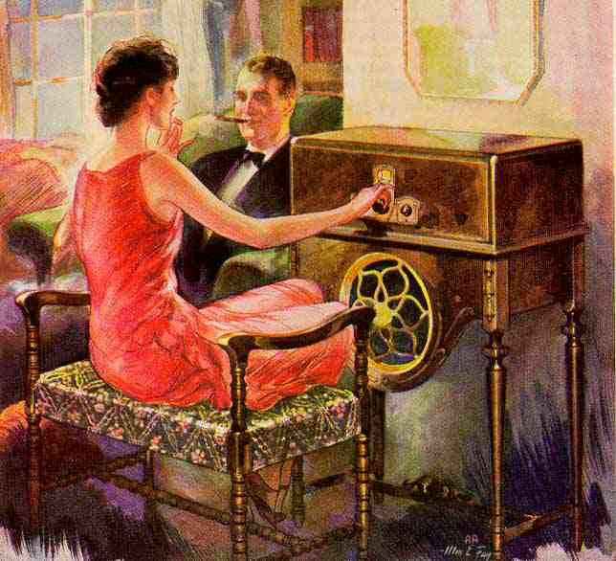

Slide 24
Impact of Radio and the Movies on American Culture (SSUSH16d)
Long before television, radios became the first source of mass communication and entertainment available to people in their own homes.
Radio united the nation and molded a national culture like never before as people across the country enjoyed the same shows and heard the same news reports.
During this same period, the movie industry boomed in the United States.

Slide 25
Impact of Radio and the Movies on American Culture (SSUSH16d)
First to silent pictures, then to movies with sound (called "talkies"), people flocked to be entertained by the big screen.
The fashions and lifestyles portrayed in the movies helped define a national culture.

Slide 26
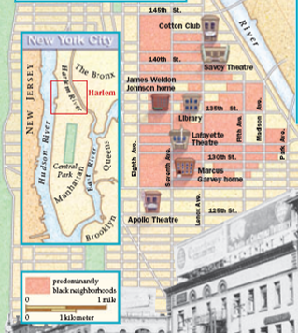

Slide 27
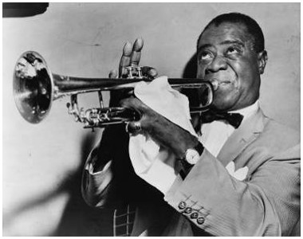

Slide 28
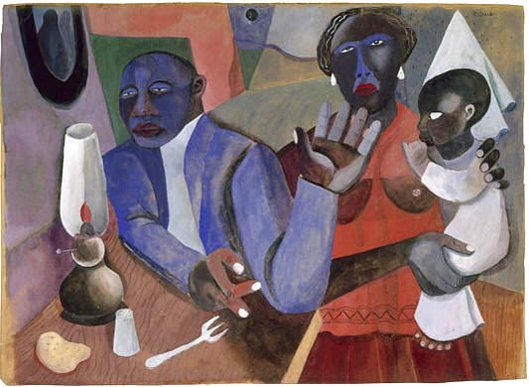

Slide 29
Modern Forms of Cultural Expression (SSUSH16e)
The Harlem Renaissance (SSUSH16e)
Great Migration increased the African American population in Northern cities
Harlem Renaissance marked the first significant artistic movement coming out of Black culture.
Harlem Renaissance was a rebirth of African American culture in America. Writing, painting, music, dance and more
Langston Hughes: Famous poet of the movement, poems had the tempo of jazz or blues, wrote about the working class African Americans.

Slide 30
Modern Forms of Cultural Expression (SSUSH16e)
Origins of Jazz (SSUSH16e)
Another form of cultural expression was Jazz.
It was the first true American music.
Louis Armstrong: biggest star of jazz music

Slide 31
Review Questions
What was the result of mass production and advertising during the 1920s?
How did Henry Ford impact American Society?
What was the impact of radio and movies during the 1920s?
What two forms of modern cultural expression emerged during the 1920s?

Slide 32
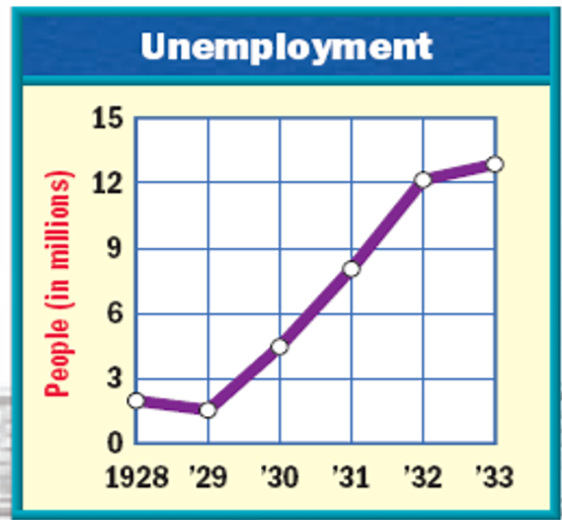

Slide 33
Document Analysis
Prosperity was assisted, too, by two new stimulants to purchasing, each of which mortgaged the future but kept the factories roaring while it was being injected. The first was the increase in the installment buying. People were getting to consider it old-fashioned to limit their purchases to the amount of their cash balance; the thing to do was to “exercise their credit.” By the latter part of the decade, economists figured that fifteen percent of all retail sales were on an installment basis, and that there were some six billions of “easy payment” paper outstanding. The other stimulant was stock market speculation. When stocks were skyrocketing in 1928 and 1929 it is probable that hundreds of thousands of people were buying goods with money which represented, essentially, a gamble on the business profits of the nineteen-thirties. It was fun while it lasted.
Source: Frederick Lewis Allen Only Yesterday: An Informal History of the Nineteen Twenties, 1931

Slide 34
The Causes of the Great Depression (SSUSH17a)
Overproduction: The decrease in consumer spending resulted in business overproducing goods (surplus).
Underconsumption: The working class lost the ability to purchase goods because their wages stayed the same as prices rose.
Stock Market Speculation: Buying risky stock
The Stock Market Crash of 1929: As more people sold their stock, other people panicked and sold their stock as well, driving down their prices and causing a stock market crash.

Slide 35
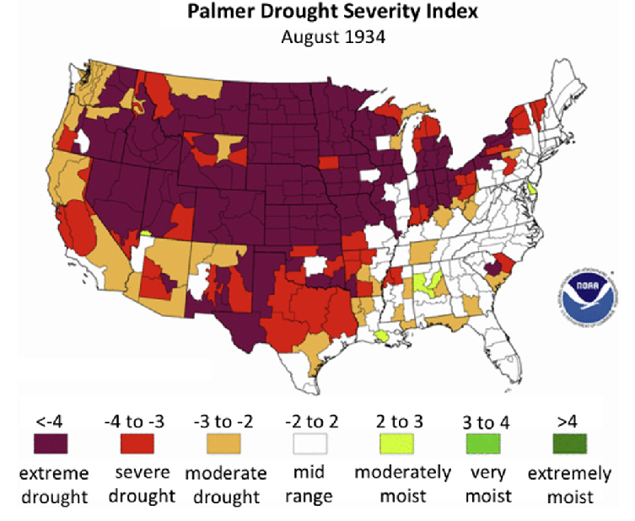

Slide 39
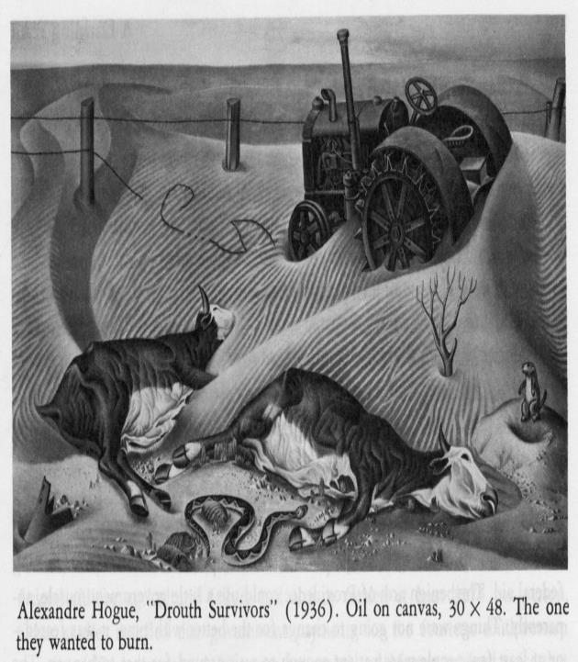

Slide 43
The Dust Bowl (SSUSH17b)
The Dustbowl was a series of severe dust storms that greatly damaged the Great Plains of the United States.
Two Factors that led to the dust bowl
Over-farming: Farmers turned too much of the grasslands into a cultivated cropland.
Climate: In the 1930, the Great Plains experience a great drought.
The result of dust bowl was that it forced tens of thousands of families to abandon their farms and migrate west to California

Slide 44
Review Questions
List the 4 causes of the Great Depression
Define: Overproduction
Define: Underconsumption
Define: Stock Market Speculation
What two factors led to the Dust Bowl?
List three states that were affected by the Dust Bowl?
What was the result of the Dust Bowl?

Slide 48
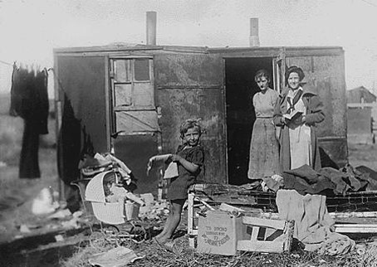

Slide 49
The Social and Political Impact of the Great Depression (SSUSH17c)
The Great Depression––a severe economic recession in the 1930s that affected all the industrialized nations profits, business profits, and personal incomes.
Two major results
Widespread Unemployment ( 25% of people unemployed)
Increase in homeless population
Led to the creation of Hoovervilles, homeless camps during Great Depression
Named after President Herbert Hoover, negative attack on Hoover.

Slide 50
What is the Artist trying to explain with the image to the left?

Slide 52
Franklin D. Roosevelt’s New Deal Plan (SSUSH18a)
Roosevelt’s New Deal Plan were government programs designed to create Relief, Recovery, and Reform for the American Economy.
Relief: immediate action taken to halt the economies deterioration.
Recovery: “Pump-priming” temporary programs to restart the flow of consumer demand
Reform: Permanent programs to avoid another depression and insure citizens against economic disasters
Important Programs: Tennessee Valley Authority (TVA), Agricultural Adjustment Administration (AAA), and Civil Conservation Corps (CCC)

Slide 53
The Second New Deal (SSUSH18b)
After showing cautious restraint through much of 1934, FDR chose to launch a bold new set of programs that came to be called the Second New Deal.
One of the most significant Second New Deal programs was the Social Security Act

Slide 54
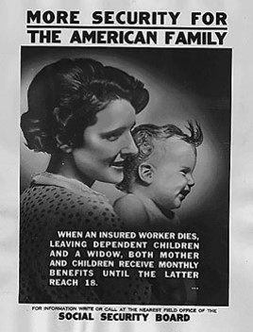

Slide 55
The Social Security Act (SSUSH18b)
Old-age insurance for retirees aged 65 or older
Unemployment compensation paid by a federal tax on employers and administered by the states
Aid for the disabled and for families with dependent children paid by the federal government and administered by the states

Slide 56
Review Questions
How did the Great Depression impact society?
What was the purpose of Hooverville's?
What were the 3 reasons Franklin Roosevelt wanted to implement his New Deal programs?
Did FDR’s New Deal programs increase or decrease the role of government in America?
List the 3 benefits of the Social Security Act

Slide 57
Document Analysis There is nothing wrong with the United States. We have more food than we can eat. We have more clothes and things out of which to make clothes than we can wear. We have more houses and lands than the whole 120 million can use if they all had good homes. So what is the trouble? Nothing except that a handful of men have everything and the balance of the people have nothing if their debts were paid. There should be every man a king in this land flowing with milk and honey instead of the lords of finance at the top and slaves and peasants at the bottom. Source: Huey Long, National Network of Share Our Wealth Clubs, Retrieved from https://www.lsrhs.net/departments/history/ShenM/Site/20th_classwork,_handouts_files/Criticism%20of%20the%20New%20Deal%202011-%2020th%20notes%20handout.pdf

Slide 58
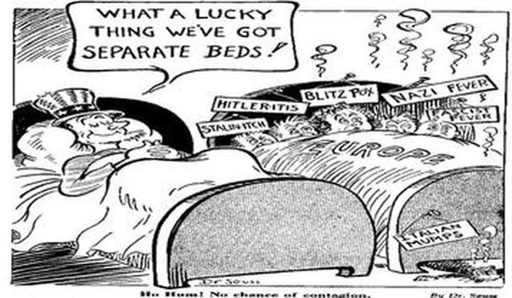

Slide 59
Roosevelt’s Political Challenges (SSUSH18c)
Opponents of the New Deal came from all parts of the political spectrum.
Senator Huey Long of Louisiana
Roosevelt’s biggest liberal critic
Every American a home, food, clothes, and an education, among other things.
Roosevelt is denied entry into World War II
To prevent Roosevelt from entering WWII, Congress passes the Neutrality Acts.
Neutrality Acts make it illegal to sell arms or make loans to nations at war.

Slide 60
Roosevelt’s Political Challenges (SSUSH18c)
Court-Packing bill (Judiciary Reorganization Bill)
The bill was a law Roosevelt proposed to give presidents the power to appoint an extra Supreme Court justice for every sitting justice over the age of 70 ½.
Roosevelt wanted to add more of his supporters to the Supreme Court to pass his New Deal programs
Congress denies Roosevelt’s because his bill would weaken the idea of checks and balances.

Slide 61
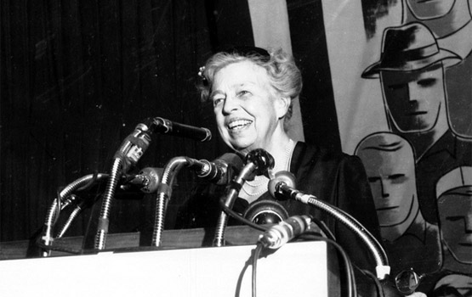

Slide 62
Document Analysis
Montvale, N.J., Aug 28 1934
Dear Mrs. Roosevelt,
Thank you much for helping me to keep my house. If it wasn’t for you I know I would have lost it. I hope and pray that Mr. Roosevelt will keep his position a long time. You have saved my life. I would have killed myself if I would have lost my house. I will never forget you and will always pray for you and your family. I went to the Home Loan and they said everything would be alright. Forgive me if I caused you any trouble. I remain.
Yours Truly, Mrs. J. G.
Source: Retrieved from http://history.msu.edu/hst203/files/2011/02/Letters-to-Roosevelt.pdf

Slide 63
Document Analysis
Granette, Ark. ,Nov. 6, 1936
Dear Mrs. Roosevelt
I am writing to you for some of your old soiled dresses if you have any. As I am a poor girl who has to stay out of school. On account of dresses & slips and a coat. I am in the seventh grade but I have to stay out of school because I have no books or clothes to ware. I am in need of dresses & slips and a coat very bad. If you have any soiled clothes that you don't want to ware I would be very glad to get them. But please do not let the news paper reporters get hold of this in any way and I will keep it from geting out here so there will be no one else to get hold of it. But do not let my name get out in the paper. I am thirteen years old.
Yours Truly, Miss L. H. Gravette, Ark.
Source: Retrieved from http://civics.sites.unc.edu/files/2012/04/EleanorRoosevelt.pdf

Slide 64
Eleanor Roosevelt and the Role of the First Lady (SSUSH18d)
President Roosevelt’s wife, Eleanor, was very influential in her own right.
She help press conferences to address social issue and the critics of FDR.
She was interested in humanitarian causes and social progress
As a supporter of women’s activism, she was also instrumental in convincing Roosevelt to appoint more women to government positions.

Slide 65
Review Questions
How did critics impact Roosevelt’s Presidency?
What was the role of Eleanor Roosevelt during FDR’s presidency?

