Slide 1
American Imperialism and WWI
Paulding Country U.S. History

Slide 2
Standards
SSUSH14 Explain America’s evolving relationship with the world at the turn of the twentieth century.
SSUSH15 Analyze the origins and impact of U.S. involvement in World War I.

Slide 3
Key Concepts
American Imperialism
Anti-Imperialist
Spanish-American War
Roosevelt Corollary
Panama Canal
Presidency of Woodrow Wilson
U.S. Neutrality
Unrestricted Submarine Warfare
Zimmerman Telegram
The Great Migration
The Espionage Act
Eugene Debs
Wilson’s Fourteen Points
League of Nations
Wilson’s View of League of Nation
Congress’s View of League of Nations

Slide 4
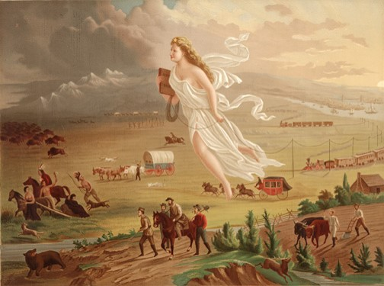

Slide 5
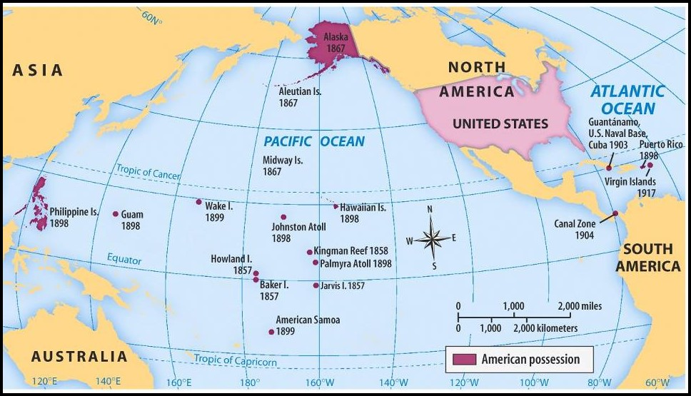

Slide 8
American Imperialism (SSUSH14a)
Toward the end of the nineteenth century, a growing number of citizens believed that the United States needed to look beyond its own borders and acquire more territory, such an attitude is known as imperialism.
Reasons for American Imperialism
Needed more natural resources
Needed to expand in order to maintain its national security (military bases in Southwest Asia)
It was Americas destiny to take over other countries

Slide 9
The Spanish-American War (SSUSH14a)
Reason: Spain refused to grant independence to rebels fighting in Cuba and sinking of the battle ship Maine.
Result: Cuba becomes independent country and the U.S. gains Puerto Rico, Guam and the Philippines.

Slide 10
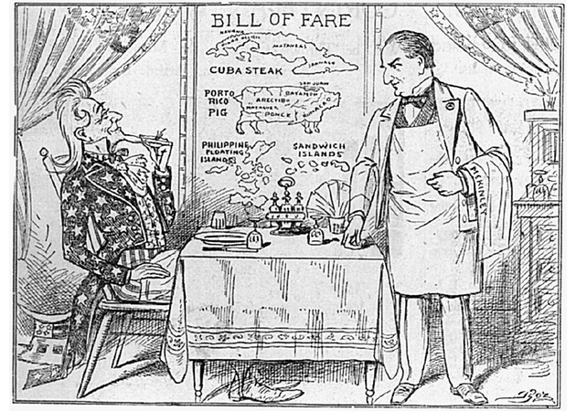

Slide 11
Primary Source Analysis
The government of foreign people against their will is not a constitutional purpose but a purpose expressly forbidden by the Constitution. Therefore I deny the right to acquire this territory and to hold it by the government for that purpose."
Source: Sen. George Hoar (1899)

Slide 12
The Debate over American Imperialism (SSUSH14a)
Yet, while more and more US citizens were advocating imperialism, the anti-imperialist preached isolationism.
They believed that it was not in the best interest of the United States to acquire and exercise control over foreign territories.
They felt that such acquisitions would inevitably pull the US into foreign conflicts.

Slide 13
Primary Source Analysis
"If I had my way we would annex those islands [Hawaii] tomorrow. If that is impossible I would establish a protectorate over them. I believe we should build the Nicaraguan canal at once, and in the meantime, that we should build a dozen new battleships . . . I am fully alive to the danger from Japan. . . .But there are big problems in the West Indies also. Until we definitely turn Spain out of these islands (and if I had my way that would be done tomorrow), we will always be menaced by trouble there. We should acquire the Danish Islands [Virgin Islands]"
Source: Theodore Roosevelt (in a letter to Alfred Thayer Mahan) (1897)

Slide 14
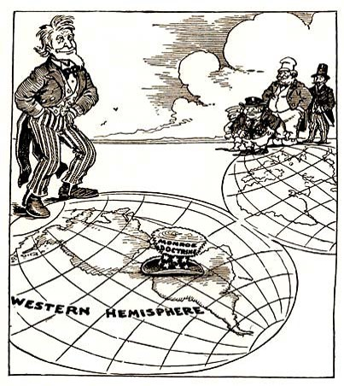

Slide 15
The Roosevelt Corollary to the Monroe Doctrine (SSUSH14b)
Reason: Latin American governments were unstable and owed large amounts of money to European countries. U.S. feared that European countries would control Latin and South American governments.
Result: The Roosevelt Corollary (addition to Monroe Doctrine) announced to the world that the United States would exercise international policing power in the Western Hemisphere in order to protect its interests in the area.

Slide 17
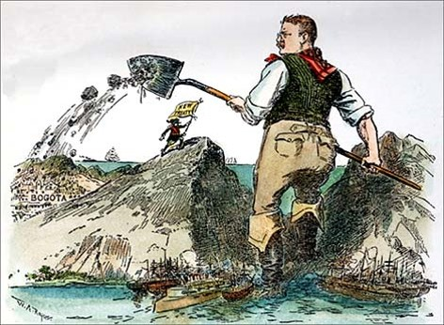

Slide 20
Panama Canal (SSUSH14b)
Reason: U.S. Government wants to build a shipping canal across the country of Panama. The purpose of the canal was to create a faster sea route that connected the Atlantic and Pacific Oceans.
The U.S. helped Panama during their rebellion against Columbia, in exchange Panama gave the U.S. rights to the Panama Canal.
Result: The purpose of the canal was to create a faster sea route that connected the Atlantic and Pacific Oceans.
Result 2: U.S. has a greater reason to enforce the Roosevelt Corollary and the biggest engineering project of the era and

Slide 21
Review Questions
Define Imperialism
What was the significance of the Spanish-American War?
What territories were gained during the Spanish-American War?
What was the significance of the Roosevelt Corollary to the Monroe Doctrine?
What was the geographic significance of the Panama Canal?
What was the economic significance of the Panama Canal?

Slide 22
World War I (SSUSH14a)
Neutrality (SSUSH14a)
When World War I began in Europe in 1914, President Woodrow Wilson was determined to guarantee U.S. neutrality and to keep the United States out of the war.

Slide 25
Reasons U.S. Enters WWI (SSUSH14a)
Sinking of Lusitania: Germans sink cruise ship with over 100 U.S. citizens on board.
Unrestricted Submarine Warfare: Germans use submarines to attack were ever they wanted in the Atlantic Ocean.

Slide 26
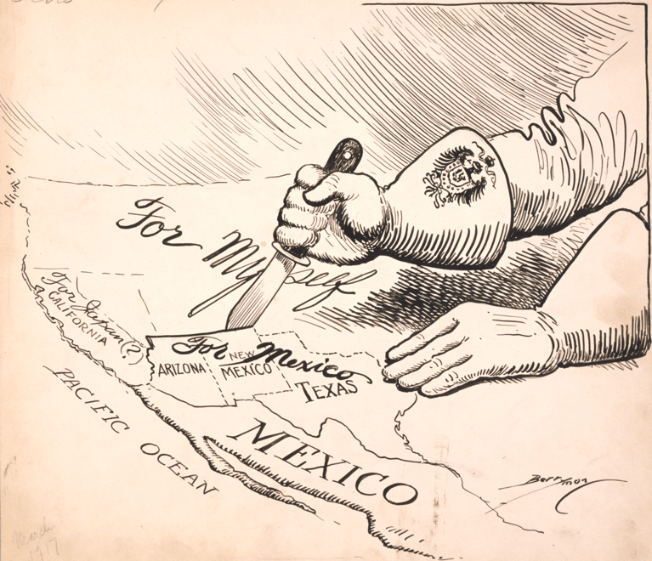

Slide 27
Reasons U.S. Enters WWI (SSUSH14a)
The Zimmerman Telegram
Arthur Zimmerman, the German Foreign Minister, sent a telegram to the German embassy in Mexico.
In his telegram, Zimmerman told embassy officials to ask Mexico to attack the US if it declared war on Germany.
In return, Germany promised to help Mexico win back land the US had acquired as a result of the Mexican-American War.

Slide 28
Review Questions
What was the purpose of Woodrow Wilson’s neutrality policy?
List 3 reasons American entered World War I?
What was the significance of the Zimmerman Telegram?

Slide 29
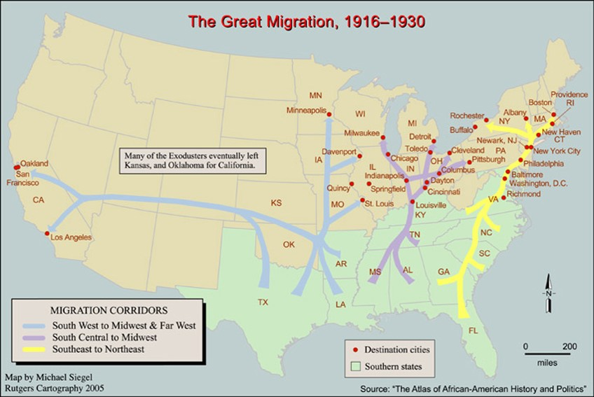

Slide 30
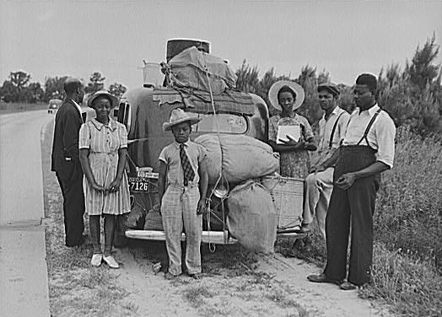

Slide 31
Primary Source Analysis
With the aid of God I am making very good I make $75 per month. . . . I don’t have to work hard. dont have to mister every little white boy comes along . . . I can ride in the electric street and steam cars any where I get a seat. I dont care to mix with white folk what I mean I am not crazy about being with white folks, but if I have to pay the same fare I have learn to want to the same acomidation.*
Source: Retrieved from http://americanexperience.si.edu/wp-content/uploads/2014/07/The-Great-Migration.pdf

Slide 32
Domestic Impact of World War I (SSUSH14b)
The Great Migration (SSUSH14b)
Reason: WWI created jobs in northeastern and mid-western cities.
Result: The Great Migration was when African Americans moved from the South to take jobs and create African American communities in the North

Slide 33
Primary Source Analysis
I realize that, in speaking to you this afternoon, there are certain limitations placed upon the right of free speech. I must be exceedingly careful, prudent, as to what I say, and even more careful and prudent as to how I say it. I may not be able to say all I think; but I am not going to say anything that I do not think. I would rather a thousand times be a free soul in jail than to be a sycophant and coward in the streets. They may put those boys in jail—and some of the rest of us in jail—but they can not put the Socialist movement in jail. Those prison bars separate their bodies from ours, but their souls are here this afternoon. They are simply paying the penalty that all men have paid in all the ages of history for standing erect, and for seeking to pave the way to better conditions for mankind.
Source: Eugene Debs, The Call, 1918, Retrieved from https://www.marxists.org/archive/debs/works/1918/canton.htm

Slide 34
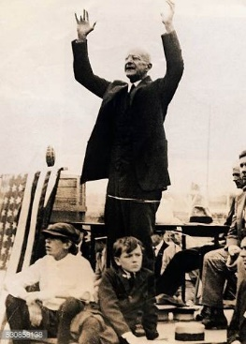

Slide 35
Domestic Impact of World War I (SSUSH14b)
The Espionage Act (SSUSH14b)
Reason: During the war, President Wilson want to silence critics of the war and pacifist.
Result: The Espionage Act made it a crime to communicate any information that would interfere with U.S. military operations or aid its enemies. Later, Eugene Debs (a famous socialist politician) was convicted for hindering military recruiting by making a speech against it; he was sentenced to 10 years in prison.

Slide 38
Wilson’s Fourteen Points Plan (SSUSH14c)
Wilson’s Fourteen Points Plan (SSUSH14c)
Before the United States entered WWI, President Wilson gave a speech in which he described his Fourteen Points Plan.
Wilson’s Fourteen Points Plan
Creation of the League of Nation, an international peacekeeping organization
Wanted to prevent future wars by having countries work together

Slide 39
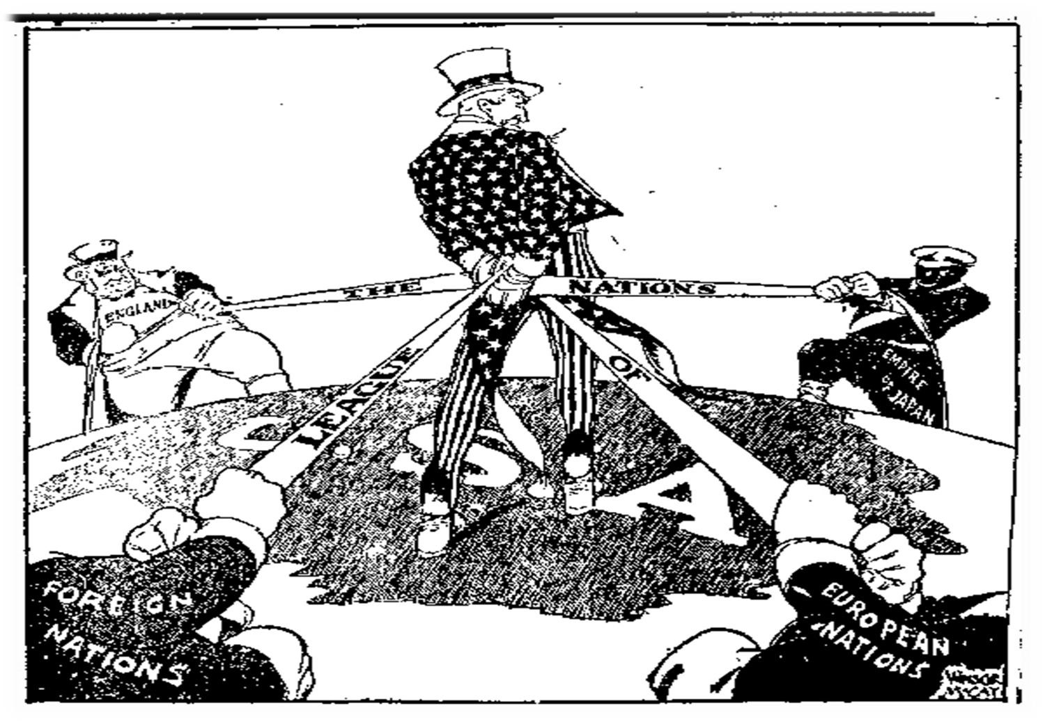

Slide 41
Wilson’s Fourteen Points Plan (SSUSH14c)
U.S. Senate and the Fourteen Points Plan
The U.S. Senate to refuse to ratify the treaty
The Isolationist Senate believe the plan force the U.S. to get involved in future wars
Result: The United States never joined the League of Nations.

Slide 42
Review Questions
What was the significance of the Great Migration?
What was the significance of the Espionage Act?
What was the significance of Eugene Debs?
What was the significance of Woodrow Wilson’s Fourteen Points Plan?
What was the purpose of the League of Nations?
How did Congress react to Wilson’s Fourteen Points and League of Nations?

