Slide 1
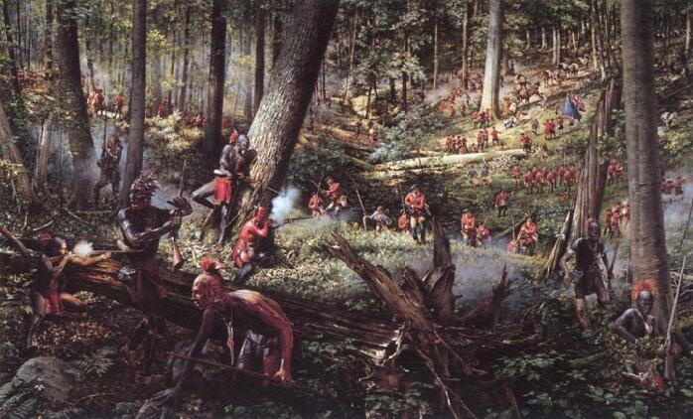
The French and Indian War

Slide 2
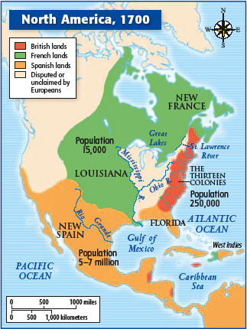
The French and Indian War: Causes
Who?
French & Indian allies v.
British/American colonists
When?
1754 – 1763
Why?
land & resources wanted by both the British & French
Ohio River Valley claimed by both
French built Fort Duquesne which angered British – start
of the war

Slide 3
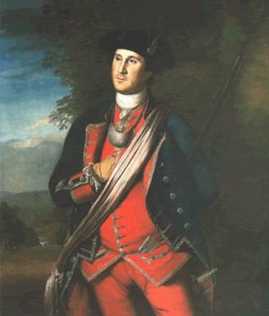
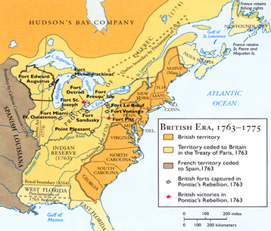
The French and Indian War
What happened?
George Washington - commander of the VA Militia; 1754 assigned to remove French from Ohio Valley at Fort Duquesne
France won early victories against British forts in NY
British assembled large army & defeated French at Montreal & Quebec City
War: British victory
Treaty of Paris (1763):
ended war & France lost land in N. America
western boundary
Mississippi

Slide 4
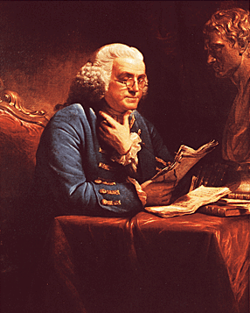
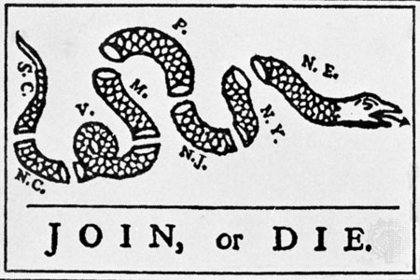
Albany Plan of Union
1754
attempt made by Ben Franklin to organize colonies under one government & cooperate with each other during the war
no colony accepted terms of the plan fearing the loss of their own autonomy

Slide 5
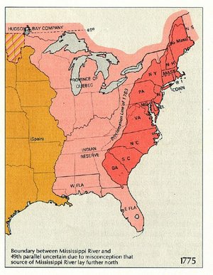
The French and Indian War
Consequences of the War:
Proclamation of 1763 – ordered colonial settlers to stay east of Appalachian Mountains; unsuccessful & irritated colonists

Slide 6
French and Indian War American Revolution
How did the French and Indian War help lay the groundwork for the American Revolution?
British sacrifices:
lives of soldiers
money to fight war
War debt – thought colonists should help pay for cost of war (new taxes)
Protecting colonists in new territories – huge additional expense
After investing so much, felt they should have more control over colonies

Slide 7
Road to the American Revolution
French and Indian War | 1754-1763 | War in North America between France and England; England wins but goes into debt
Proclamation of 1763 | 1763 | Line English colonists could not pass (over the Appalachian Mountains); colonists resented it
Sugar Act | 1764 | Lowered tax on foreign molasses by collecting taxes already in effect, but assigned customs officers & courts to collect the taxes

Slide 8
Road to the American Revolution
Quartering Act | 1765 | Had to provide housing and supplies for British troops
Stamp Act | 1765 | Had to pay a tax on almost all printed materials; first direct tax
Sons of Liberty & Daughters of Liberty | 1765 | Sons - Formed b/c of Stamp Act, led protests against taxes, famous leader Samuel Adams Daughters – helped during British boycotts by making “homespun” cloth to substitute for British-manufactured cloth

Slide 9
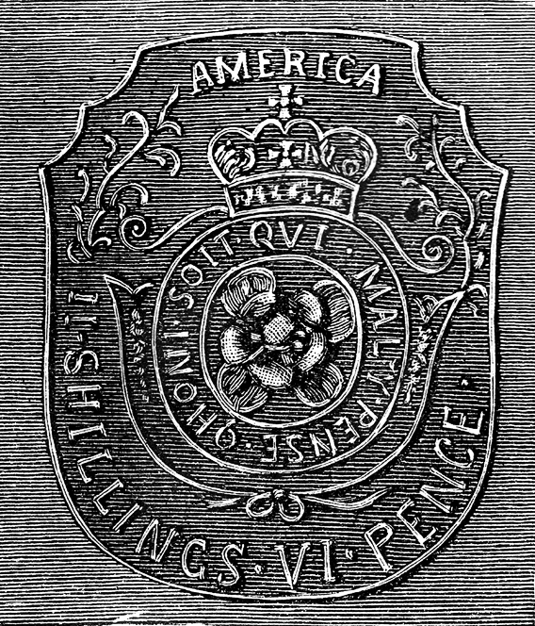
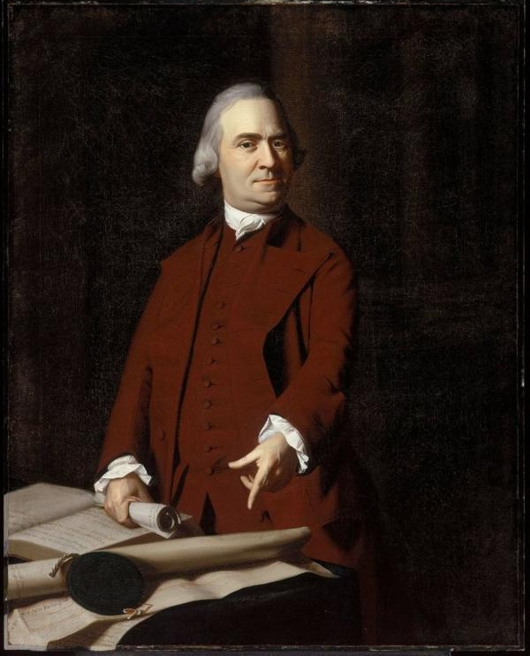
Stamp that had to be attached to any deed, contract, bill of sale, will, etc. in America before it could be legal
Samuel Adams

Slide 10
Road to the American Revolution
Stamp Act Congress | 1765 | 9 colonies met and agreed to boycott British goods (nonimportation agreements); 1766 Stamp Act repealed
Townshend Acts | 1767 | Taxed everyday items (glass, lead, paint, paper, tea)
Boston Massacre | 1770 | Colonists threw rocks at British soldiers in Boston; British fired killing 5 colonists; British dropped Townshend taxes except tax on tea
Committees of Correspondence | began in 1770 | Organized by Samuel Adams first in Mass. as a response to the Boston Massacre; provided leadership & promoted cooperation; other colonies created committees – built unity

Slide 11
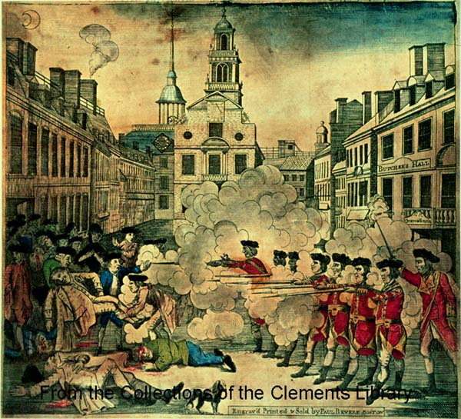
Boston Massacre engraving created by Paul Revere in 1770
“The Bloody Massacre”

Slide 12
Road to the American Revolution
Boston Tea Party | 1773 | Boston Patriots dressed as Indians, boarded British ships and dumped tea into harbor to protest tea tax
Coercive/ Intolerable Acts | 1774 | Closed Boston’s ports, increased governor’s power, required colonists to house British troops
First Continental Congress | 1774 | Delegates met in Philadelphia Announced a boycott of all British imports

Slide 13
Declaring Independence
Chapter 4, Section 2

Slide 14
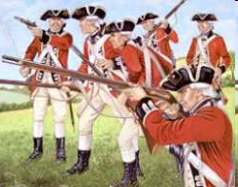
War Begins
Terms to know:
Militia - local patriot fighters (full-time farmers, part-time soldiers)
Redcoats – British soldiers
Loyalists – colonists who remained loyal to Britain
Patriots – colonists who rebelled against Britain

Slide 15
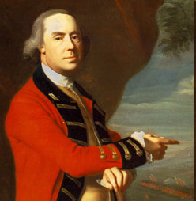
Background:
1775 General Thomas Gage (military commander) made governor of Massachusetts (Intolerable Acts)
John Hancock, Samuel Adams, organized a Provincial Congress in Lexington, Mass. to govern Massachusetts without Gage
Patriots began to stockpile arms and ammunition in Concord, Mass.
Thomas Gage

Slide 16
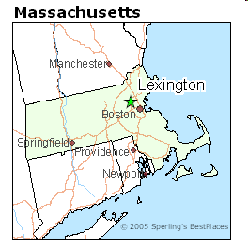
The Battles of Lexington
April 1775 – Thomas Gage sent troops to arrest Hancock & Adams then take Patriot weapons
Paul Revere rode to warn Patriots who organized to push British back
British ordered militia to break up at Lexington – shot fired & ended with 8 Patriots dead

Slide 17
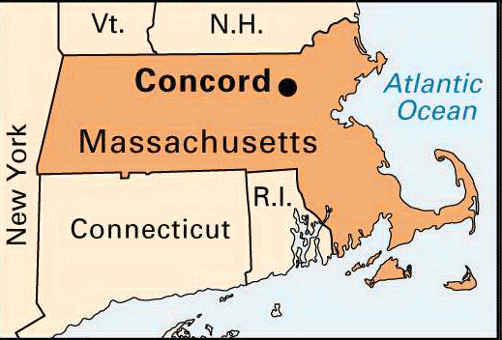
The Battles of Concord
British march on to Concord – brief fight
Headed back to Boston when hundreds of Patriot militia minutemen fired killing or wounding more than 200 British soldiers
Patriot assemblies seized control of New England colonies

Slide 18
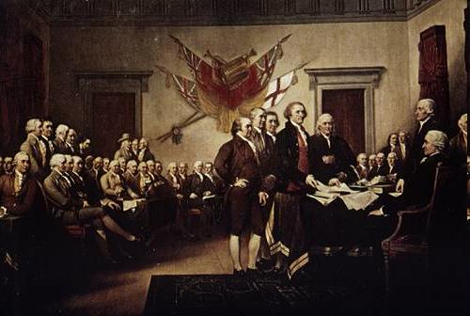
The Second Continental Congress
May 1775 – all colonies assembled in Philadelphia
Three Actions:
Congress assumed responsibility for the war
Congress gave command of the new Continental Army to George Washington
Congress sent an “Olive Branch Petition” to King George III
Meeting of the Second Continental Congress

Slide 19
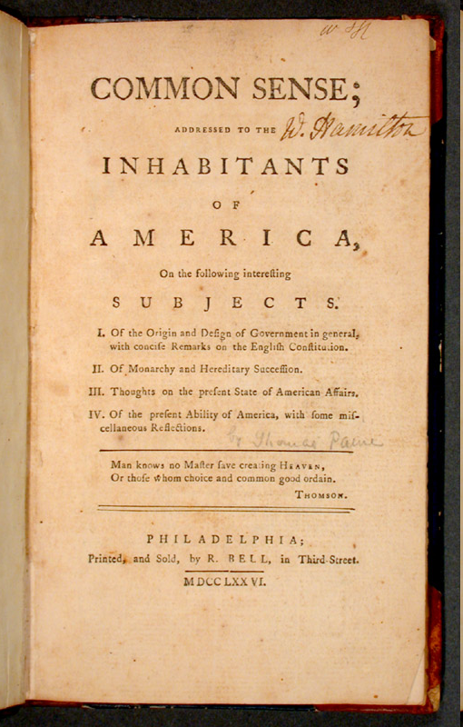
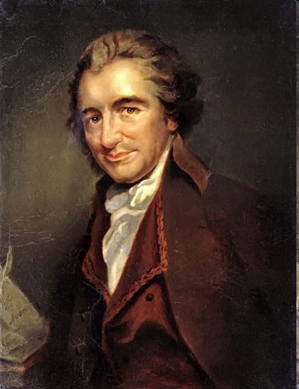
Opinion Swings Toward Independence
Jan. 1776 Thomas Paine published book Common Sense

Slide 20
Common Sense
Thomas Paine’s Radical Proposal:
Independence from Britain, republican state governments, and a union of the new states
Wanted common people to elect all of their government
Claimed a republic would provide opportunities for social mobility (rewarding merit rather than inherited family titles)

Slide 21
Declaration of Independence

Slide 22
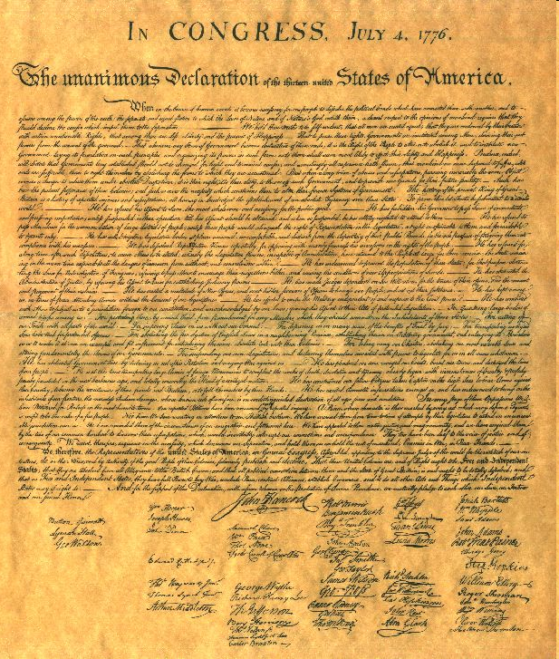
The Colonists Declare Independence
Spring 1776 Congress selected a committee to draft a document declaring American independence & explaining the reasons for it
July 2, Congress voted that America was free; July 4, approved the Declaration of Independence (pg. 113)

Slide 23
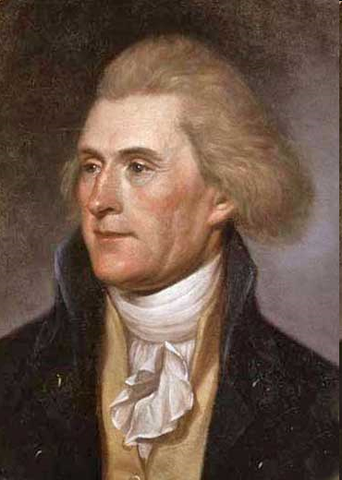
The Declaration of Independence
Drafted by Thomas Jefferson
Organization & Components:
called the king a tyrant
included list of colonists’ complaints
idea that “all men are created equal”
Enlightenment Ideas:
John Locke
all men are born w/ natural rights, “unalienable rights,” that cannot be taken away by a government
Thomas Jefferson

Slide 24
Declaration of Independence Video
https://www.youtube.com/watch?v=jYyttEu_NLU

Slide 25
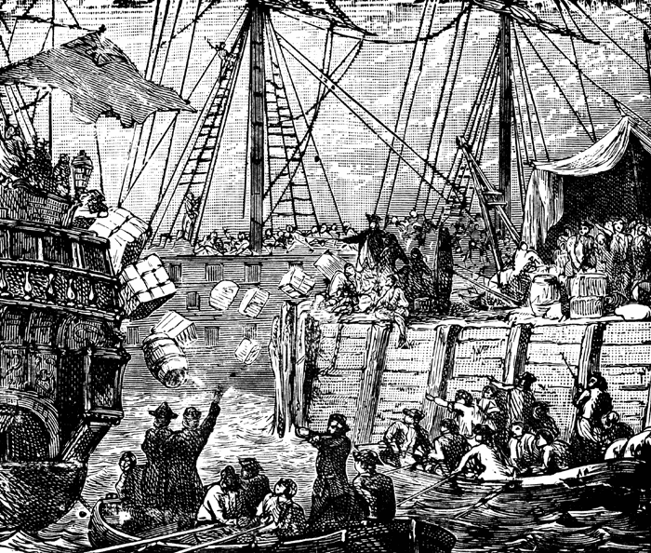
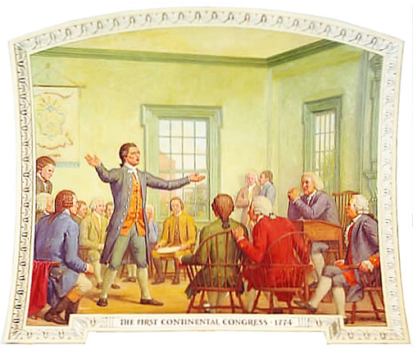
Boston Tea Party protesting the English tax on tea
Meeting of the First Continental Congress

Slide 26
Write Your Own Declaration of Independence
Consider declaring independence from a group you are currently a part.
Write your own Declaration of Independence using the same sections the real Declaration of Independence we have been discussing in class.

Slide 27
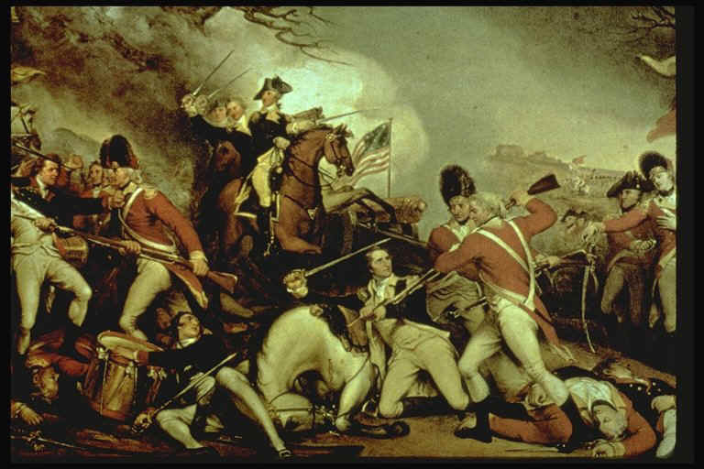
Military Highlights of the American Revolution
Chapter 4, Sections 3 & 4

Slide 28
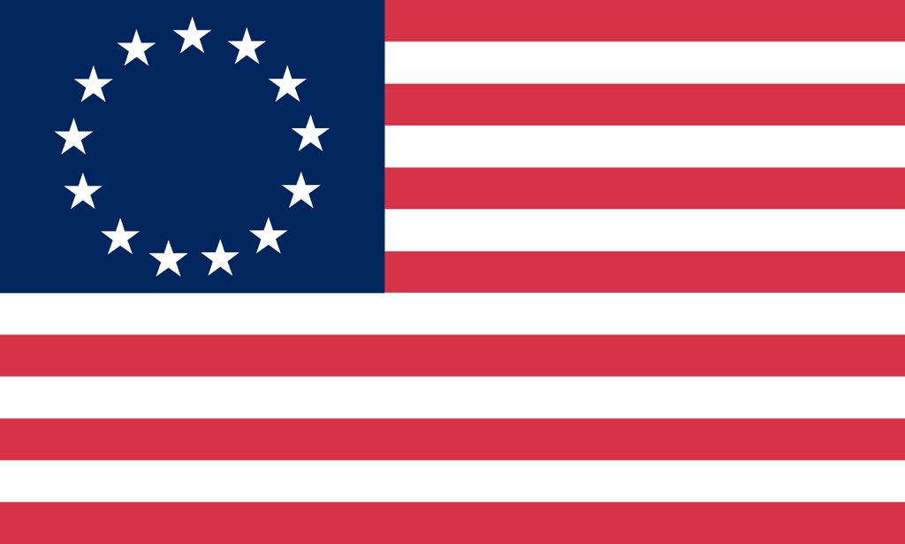
The Opposing Sides
American Strengths
defending their homes
good shots - hunting
great leadership (ex. Washington)
British Strengths
trained & experienced troops
strongest Navy in world
leader in manufacturing
established government
Hessian Mercenaries - soldiers who were hired to fight

Slide 29
The Opposing Sides
American Weaknesses
untrained
little ammunition
NO NAVY!
struggled to pay for the war (lacked authority to collect taxes)
British Weaknesses
3,000 miles away from home
risk of attack outside of city

Slide 30
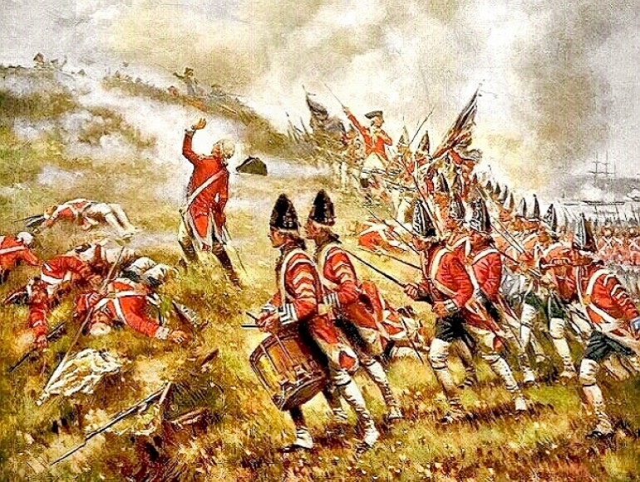
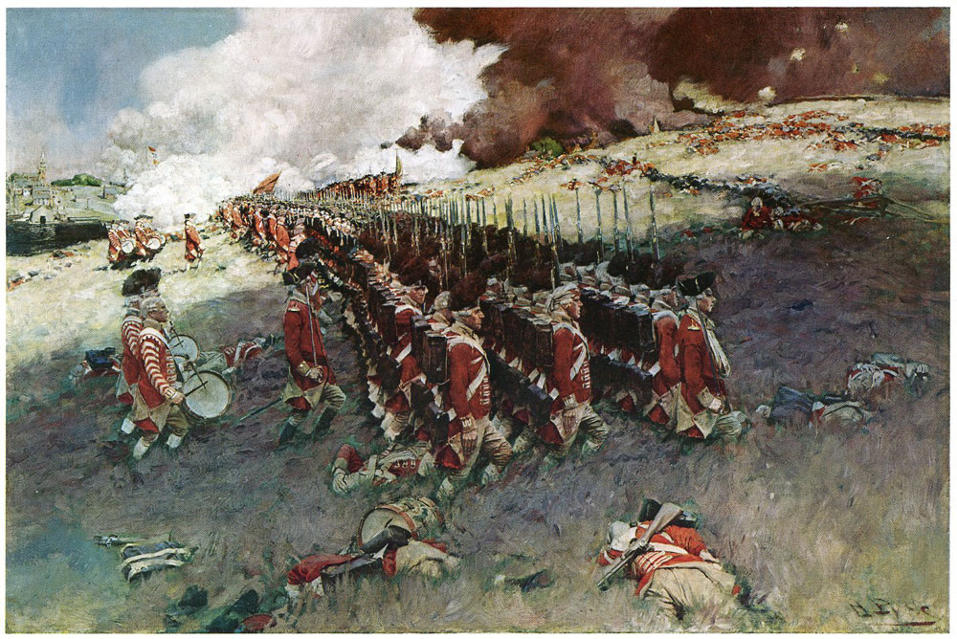
Battle of Bunker Hill
Where? outside Boston
When? 1775
What happened?
Howe ordered men to march uphill into Patriot fire in the middle of day;
captured hill b/c Patriots ran out of ammunition
Who won? British, but b/c of heavy casualties, Patriots won psychological victory
British leave Boston

Slide 31
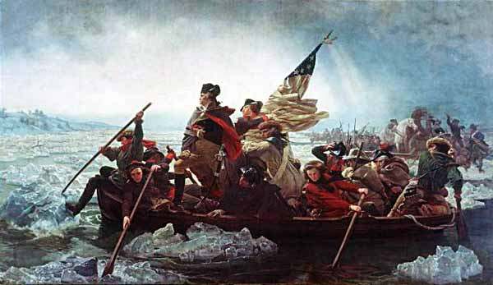
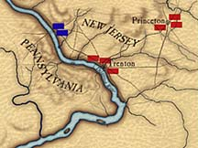
Battle of Trenton
Where? New Jersey
When? Dec. 26, 1776
What happened?
NYC captured in Sept.
George Washington
& Patriots crossed the
Delaware River to take
it back; surprised & defeated a group of 1,000 German mercenaries at the Battle of Trenton
Who won? Patriots - victory
raised morale

Slide 32
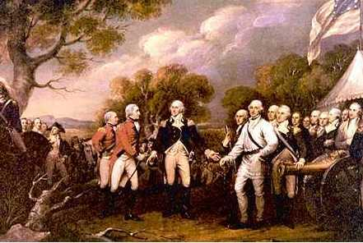
Battle of Saratoga
Where? New York
When? 1777
What happened?
colonists had lost Philadelphia (capital);
Patriots defeated British as they tried to invade NY
Who won?
Patriots
(biggest victory &
turning point of
the war)

Slide 33
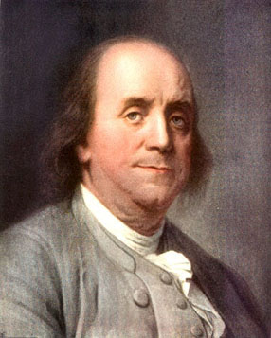
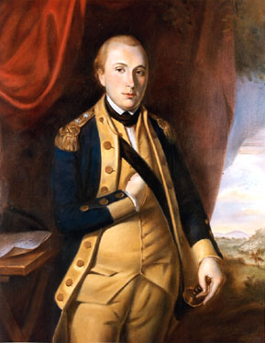
Why was Saratoga the turning point?
France became a Patriot ally
Benjamin Franklin - leading American negotiator in Paris
Provided:
navy
troops
supplies
money
Marquis de Lafayette – French volunteer who fought for Patriots & provided military expertise
Spain, Netherlands followed

Slide 34
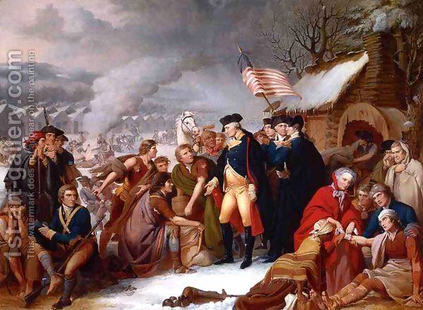
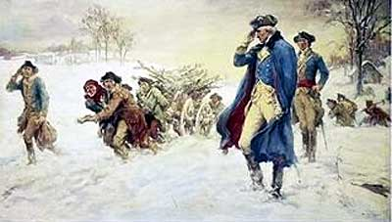
Valley Forge
Where? Pennsylvania
When? Winter 1777-1778
What happened?
Washington’s army
spent the winter at Valley Forge – harsh cold conditions, men hungry, 1/3 of soldiers had no coat or shoes

Slide 35
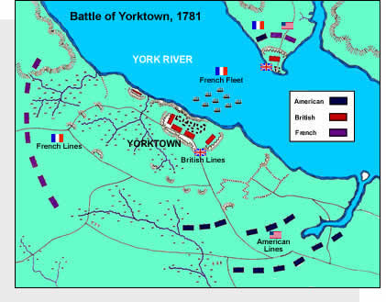
Battle of Yorktown
Where? 1781
When? Virginia
What happened?
Washington & troops planned to trap Cornwallis’s army at Yorktown; French fleet of ships arrived trapping British from
evacuating by sea
Who won? Patriot victory
Cornwallis surrendered =
end of the war
(Map - page 125)

Slide 36
The War Ends
Why did the Patriots win the war?
British underestimated the Patriots
British misunderstood political nature of conflict
Patriots highly motivated
Patriots benefitted from Washington’s leadership
Patriots received critical assistance from France

Slide 37
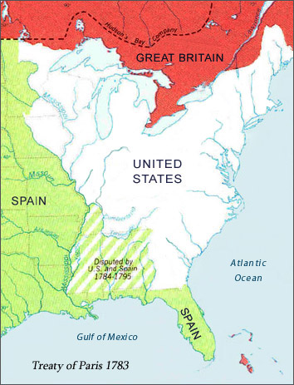
The Treaty of Paris (1783)
American delegation including (Franklin) negotiated a treaty with Britain
1783 Treaty of Paris:
recognized American independence
set U.S. boundaries
(map – page 126)

Slide 38
American Revolution Newsroom
Break into groups and select any one event from the American Revolution
Present the major points from this event as though you were presenting information on the 9 o’clock news.
Creativity is appreciated!

