Slide 1
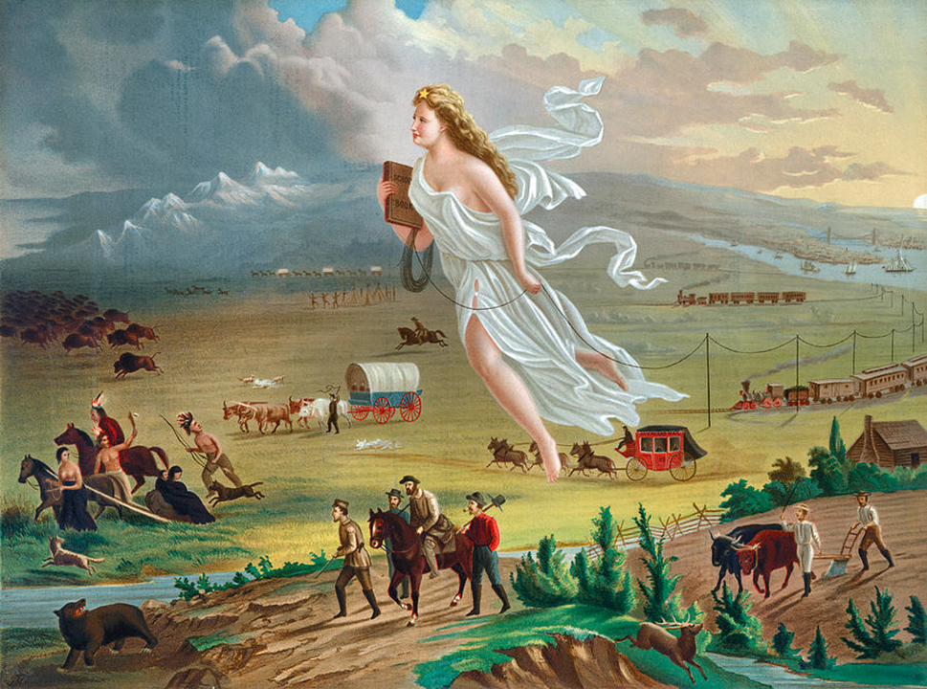

Slide 3
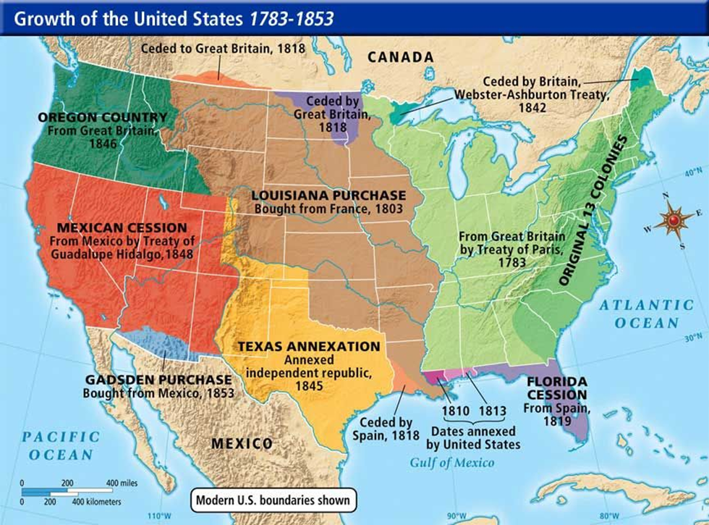

Slide 5
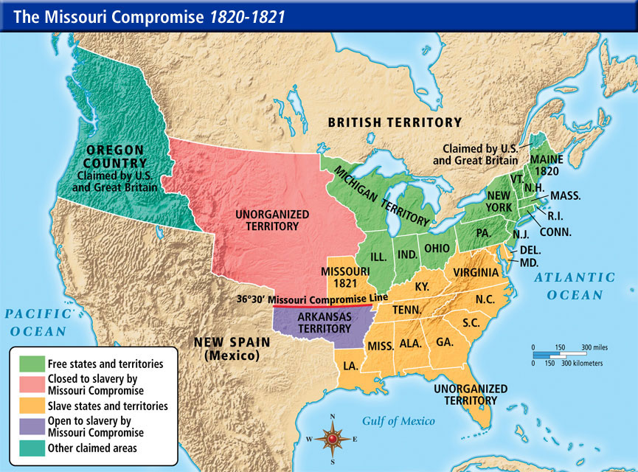

Slide 6
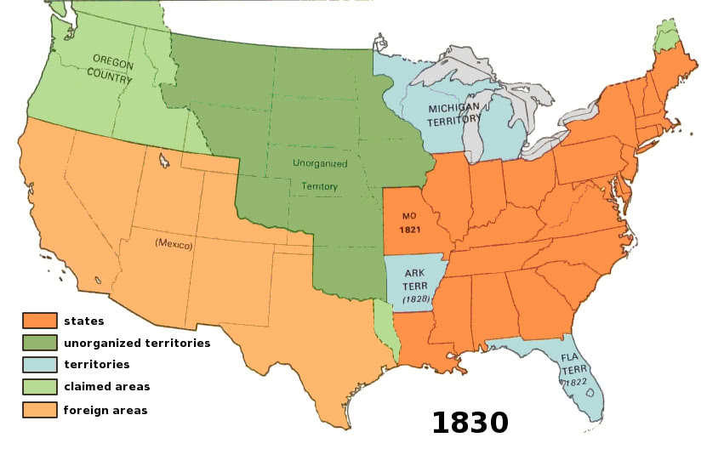

Slide 7
Texas Revolution
In the 1820’s Mexico allowed Americans families to settle in the sparsely populated region of Texas
The Mexican government set the following rules for American settlers:
Convert to Catholicism (most Americans were Protestant)
No slavery (most Americans wanted to farm cotton in Texas and brought slaves)
Declare loyalty to Mexico
The American settlers ignored these policies and began a revolution, seeking independence from Mexico
Around 200 Texan revolutionaries were killed at the Battle of the Alamo
Mexican dictator, Santa Anna, sought to crush the rebellion but was defeated at the Battle of San Jacinto in 1836 and Texas became an independent nation under president Sam Houston

Slide 8
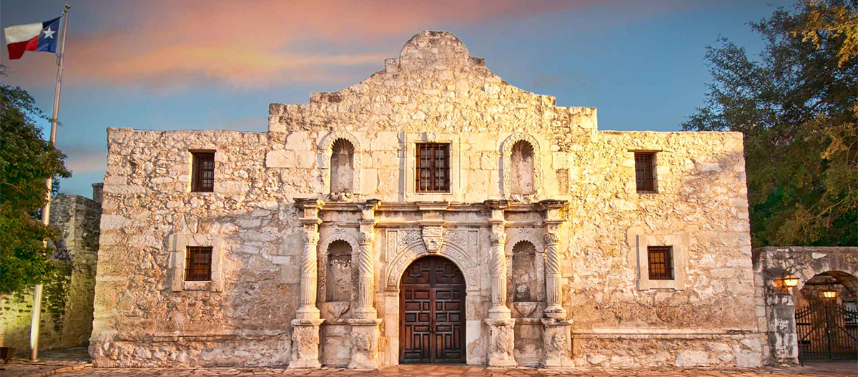

Slide 9
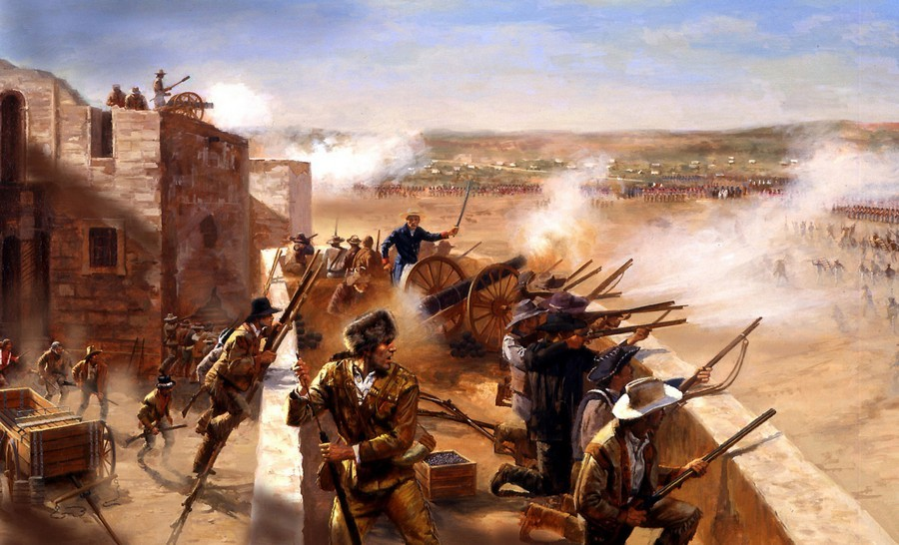

Slide 10
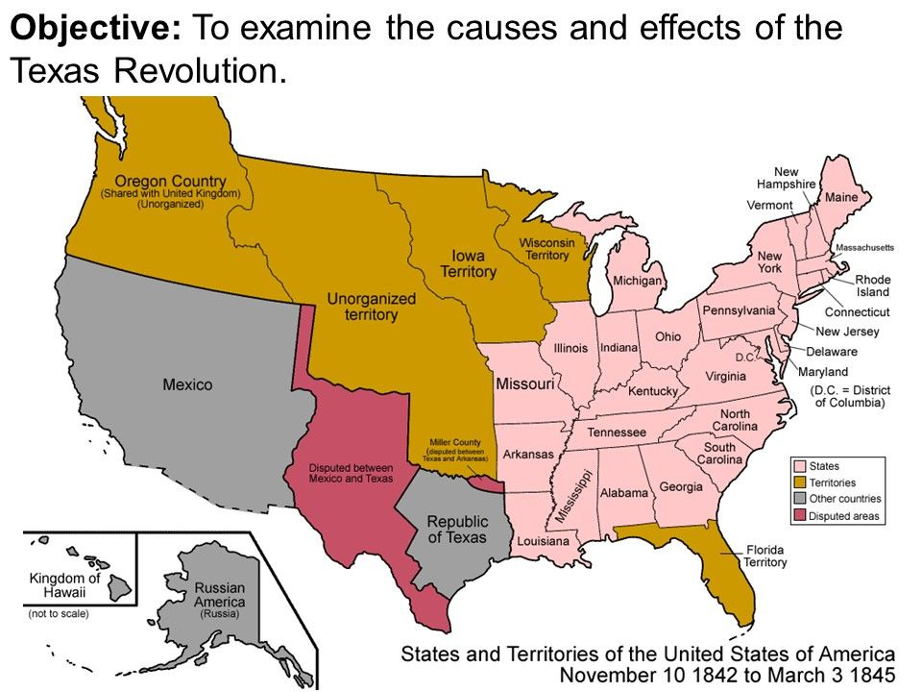

Slide 11
Congressional Gag-Rule
Until the 1830s, slavery was not discussed much in American government
With abolitionist sentiment on the rise, numerous anti-slavery petitions began to be introduced in Congress
These petitions were championed by former President John Quincy Adams
In May 1836, Congress instituted a “gag rule”, stating all petitions, memorials, or resolutions regarding slavery should be automatically be tabled and no further action be taken on them
JQA argued that this policy was unconstitutional (“right to petition the gov. for redress of grievances”)
More Northern congressmen supported Adams’s argument and the gag rule was rescinded in 1844

Slide 12
James K. Polk and Territorial Expansion
In 1844, Democrat James K. Polk was elected the 11th President of the United States
Polk was a strong proponent of Manifest Destiny
Ran with campaign slogan “54° 40’ or Fight!”
Texas was annexed by the U.S. in 1845, after several years of debate in Congress (Texas was a slave state and this caused concern in North)
The U.S. acquired the Oregon Territory after signing a treaty with Britain in 1846 (agreed to divide the Oregon Country on 49° parallel, no fight…)

Slide 13
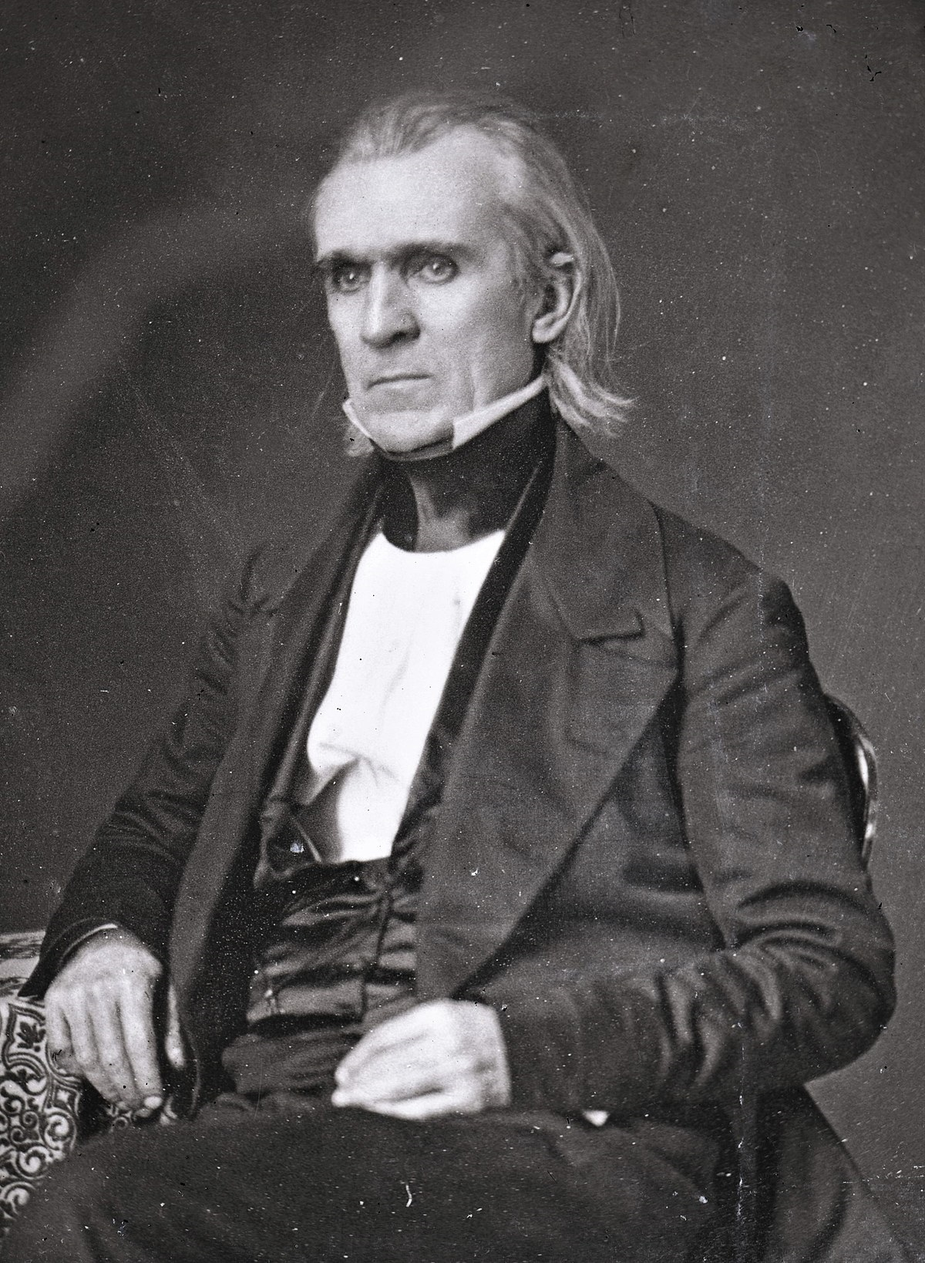
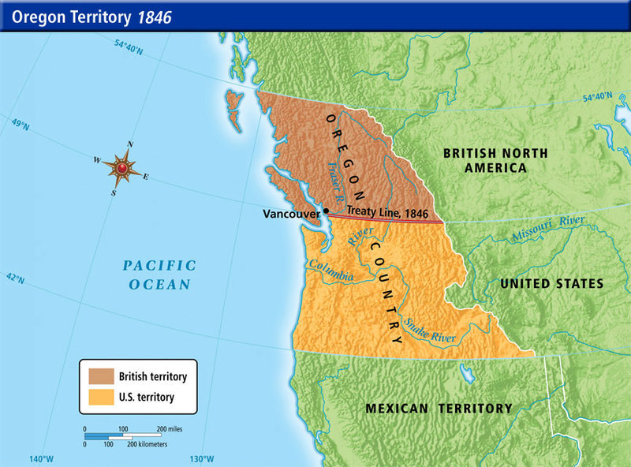

Slide 14
Mexican-American War
Polk wanted to acquire California from Mexico and offered to purchase it, but his offer was rejected
Dispute over location of Mexico/Texas border:
Mexico said the southern border of Texas was the Nueces River
U.S. said the southern border of Texas was the Rio Grande
President Polk sent General Zachary Taylor and American troops into the disputed border region and a skirmish with the Mexican army ensued = Excuse for war!!!
The U.S. quickly seized California and invaded Mexico City
Mexico was defeated and the Treaty of Guadalupe-Hidalgo was signed in 1848
Mexico was forced to hand over its northern half to the US in exchange for $15 million (this would later become the states of California, Nevada, Utah, Arizona, and New Mexico)
Fulfillment of Manifest Destiny

Slide 15
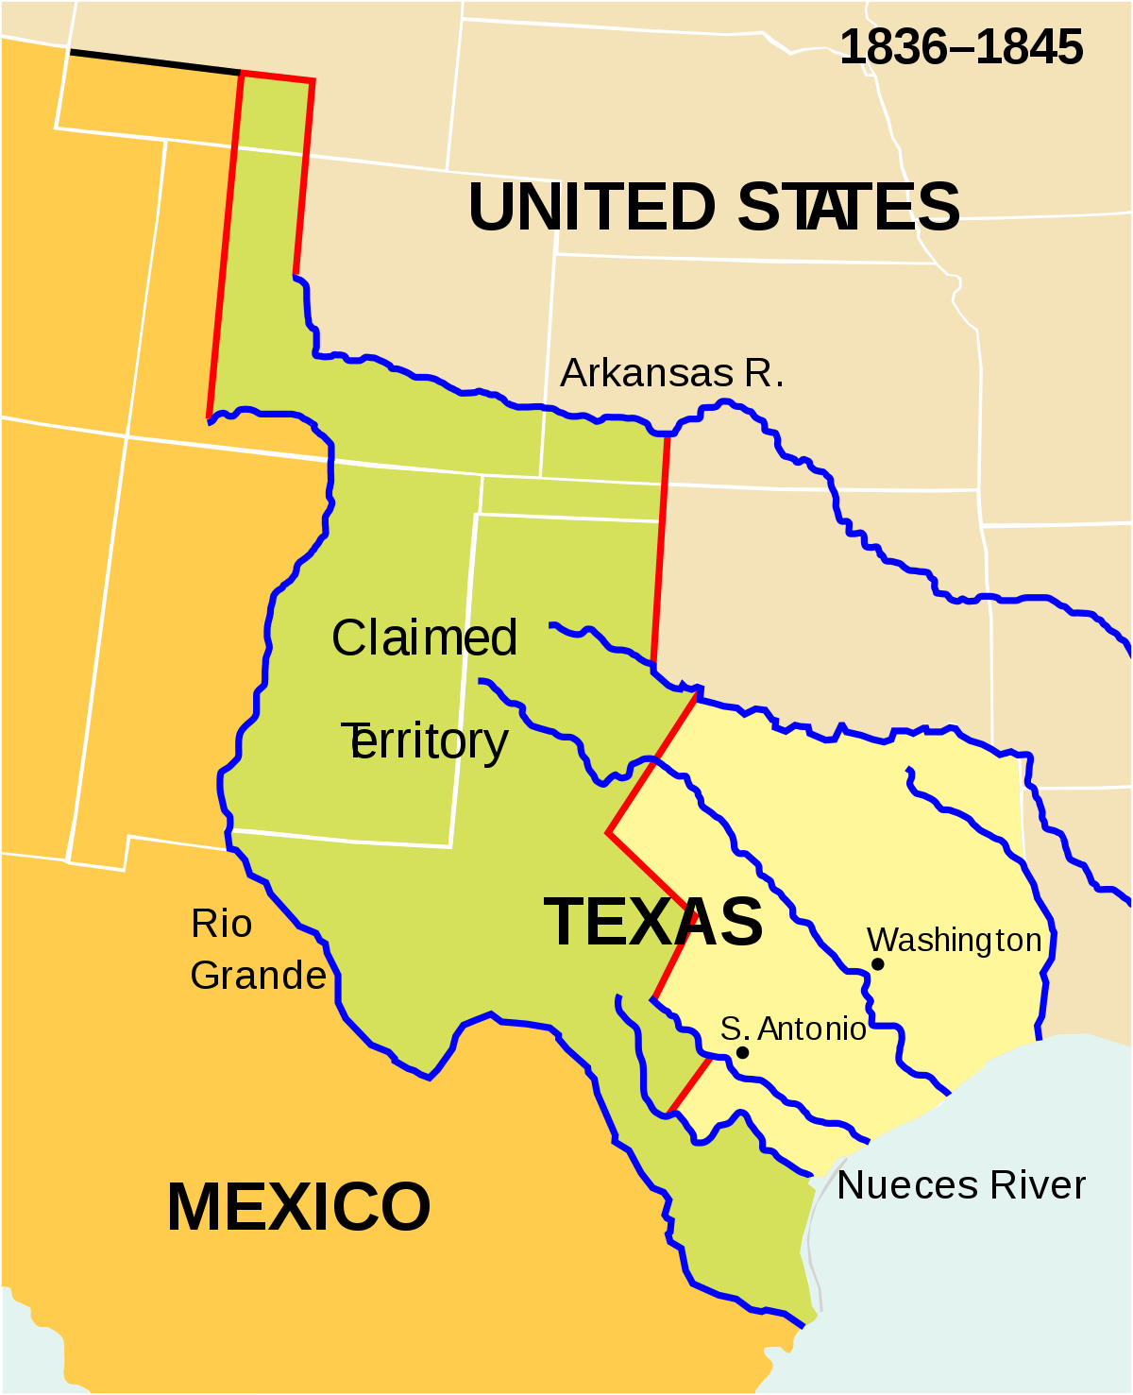
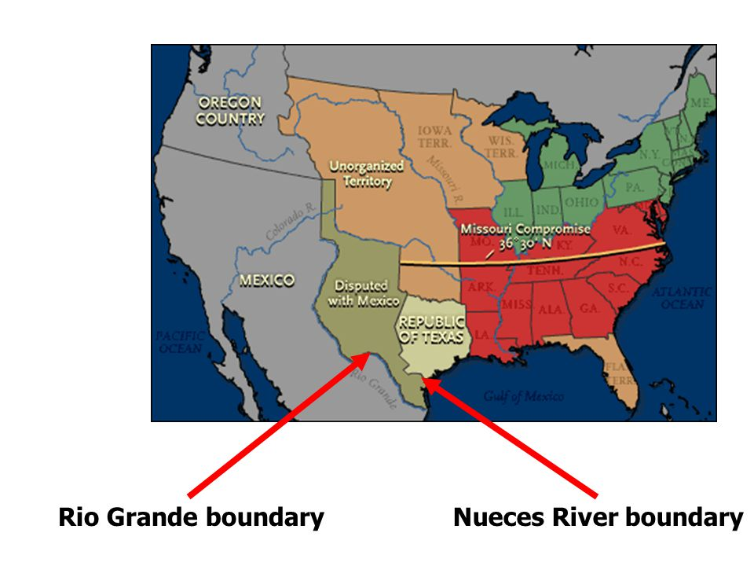

Slide 16
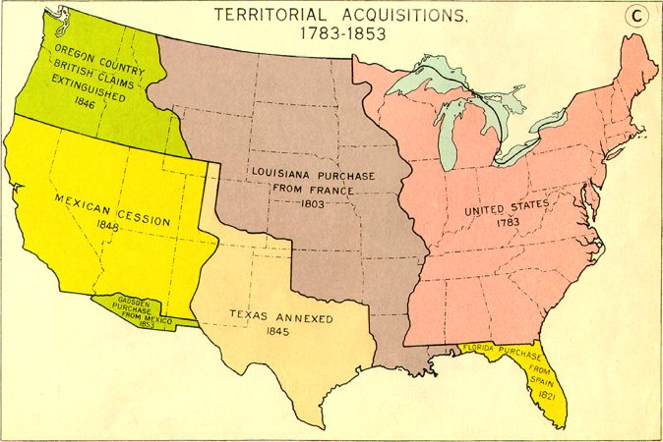

Slide 17
Wilmot Proviso
Causes
The land acquired from the Mexican American war reignited the debate over slavery in the U.S.
Should this new territory be opened or closed to slavery?
Many northerners were “Free-Soilers”:
Didn’t support abolition of slavery where it existed, but didn’t want it to spread to the western territories
What Was It?
David Wilmot, a Pennsylvania Congressman, proposed legislation in Congress that would forbid slavery in the land acquired in the Mexican-American War
Congress debated this proposal for the next three years
Consequences
The bill never passed due to intense opposition from the slave-holding states
Vote over bill was along sectional lines rather than party lines
The debate over whether to allow slavery in the newly acquired territories or not remained unresolved and sectional tensions increased

Slide 18
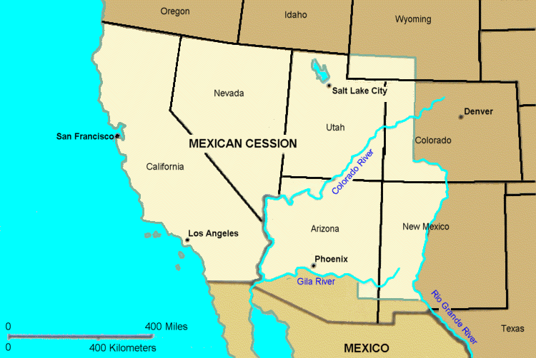

Slide 19
Gold at Sutter’s Mill
In 1848, gold was discovered in Sutter’s Mill, California
News of the discovery spread quickly and thousands of would-be miners, called ’49ers, rushed into California
The America population in California skyrocketed from 800 to 100,000 in just over a year
As a result of the rapid population growth, California was ready to apply to join the Union by the end of 1849
California’s state constitution outlawed slavery, setting off another crisis in Congress between pro and anti-slavery politicians (remember the issue of slavery in the Mexican Cession was still unresolved)

Slide 20
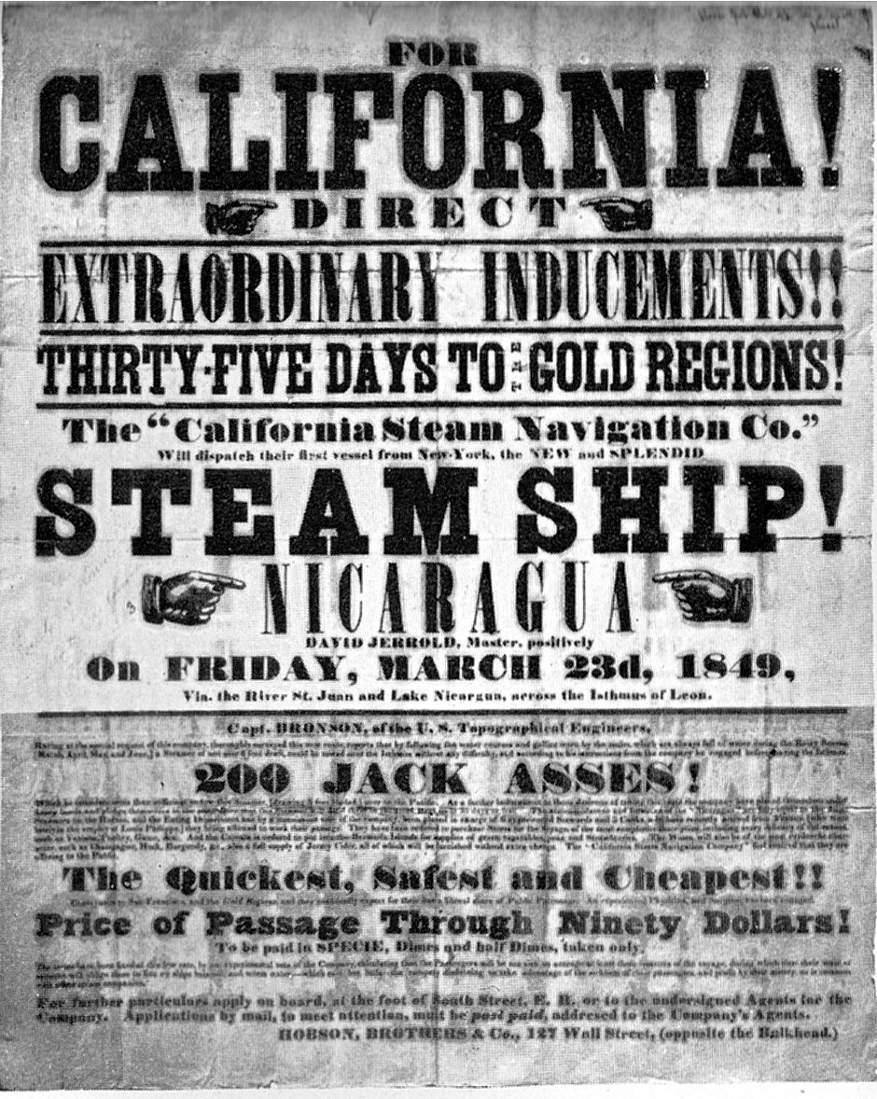
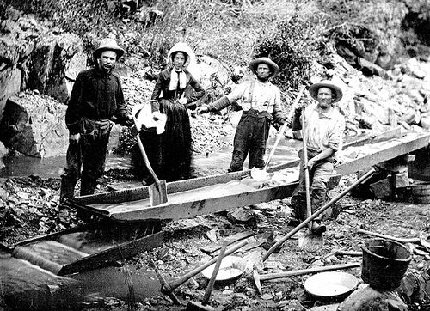

Slide 21
Compromise of 1850
Causes
As battle over the status of slavery in the Mexican Cession (land gained from Mexican-American War) continued to rage, California applied to become a free state in 1849
Congress was now forced to deal with the issue of slavery in the Mexican Cession…
What Was It?
Henry Clay, the “Great Compromiser”, proposed the Compromise of 1850:
California joins U.S. as a free state
New Mexico and Utah Territories would use popular sovereignty (citizens vote) to decide the issue of slavery
New Fugitive Slave Law, requires citizens to apprehend and return runaway slaves or face fine and jail time
Slave trade, but not slavery, is outlawed in Washington D.C.
Settled boundary dispute between Texas and New Mexico in NM’s favor

Slide 22
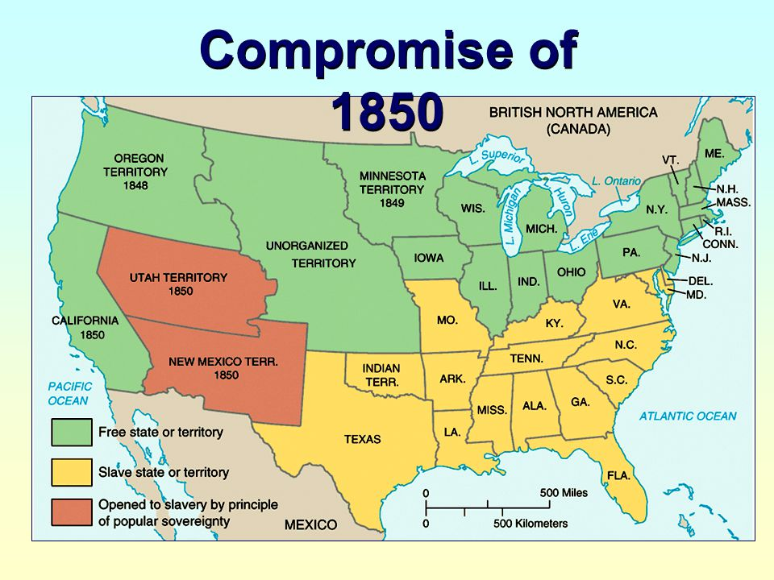

Slide 23
Uncle Tom’s Cabin
What Was It?
Harriet Beecher Stowe, abolitionist, published Uncle Tom’s Cabin in 1851
This novel portrayed slave families forced to cope with separation by masters through sale (i.e. exposed the horrors of the institution of slavery)
The novel was the second highest selling book of the 19th century, behind Bible
Consequences
It increased support for abolitionism in the North
The book was banned in much of the South, and denounced as a false portrayal of slavery, lies created by abolitionists to misrepresent the south

Slide 24
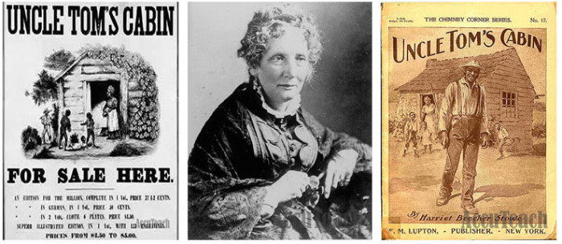

Slide 25
Gadsden Purchase
U.S. agrees to purchase a small trip of land form Mexico for $10 million in 1853
U.S. desired land for future construction of southern transcontinental railroad route
Causes further sectional tension:
Northerners want transcontinental railroad line through north
Southerners want transcontinental railroad line through south

Slide 26
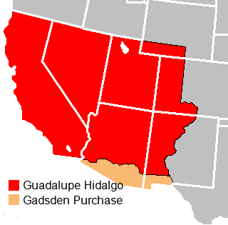

Slide 27
Kansas-Nebraska Act
Causes
Illinois Senator Stephen Douglas wants to build railroad through Kansas/Nebraska, needs southern support
Kansas and Nebraska Territories (northern part of the Louisiana Territory) were originally supposed to be free territories according to the Missouri Compromise
What Was It?
In 1854, Congress passed the Kansas-Nebraska Act, authored by Stephen Douglas:
Instead of the federal government designating Kansas and Nebraska as free or slave, it allowed the citizens of Kansas and Nebraska to vote on whether or not they wanted to allow slavery in their territories
This was known as popular sovereignty (rule of the people)
Consequences
The Kansas-Nebraska Act essentially repealed the Missouri Compromise (line doesn’t matter…)

Slide 28
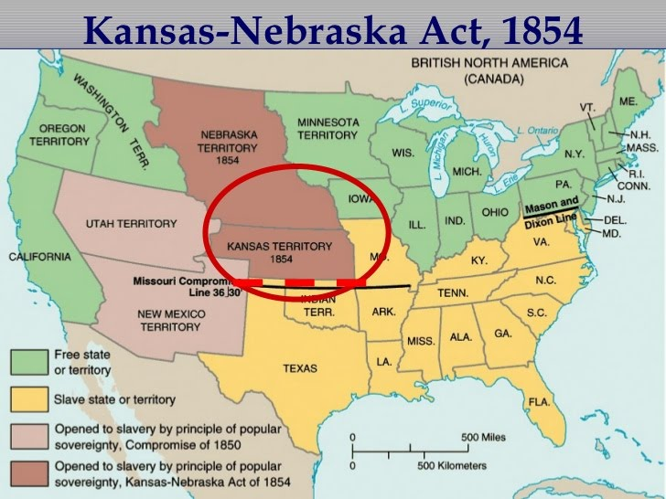

Slide 29
“Bleeding Kansas”
Causes
Pro-slavery and anti-slavery supporters flooded into Kansas in an attempt to influence the vote over the issue of slavery
Pro-Slavery settlers from Missouri called “Border Ruffians”
What Was It?
Pro-slavery forces set up a capitol in Lecompton and anti-slavery forces set up a capitol in Topeka
Violence broke out between the pro-slavery and anti-slavery factions in Kansas, leading to bloodshed in the streets
Kansas became known as “Bleeding Kansas”
Consequences
Popular Sovereignty had failed in Kansas
Led to the formation of the new Republican Party (made up of anti-slavery Democrats and Whigs) which championed “free soil”/stopping the expansion of slavery into the western territories

Slide 30
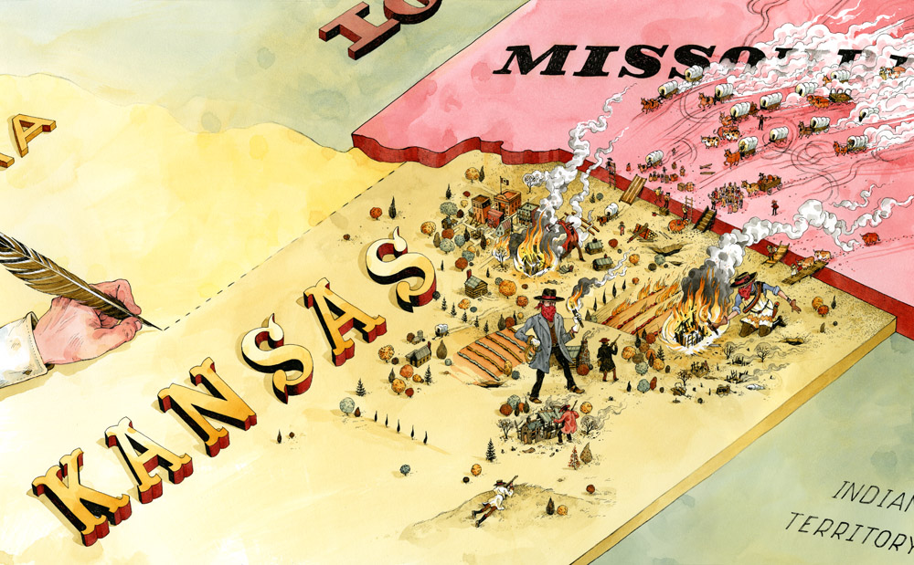

Slide 31
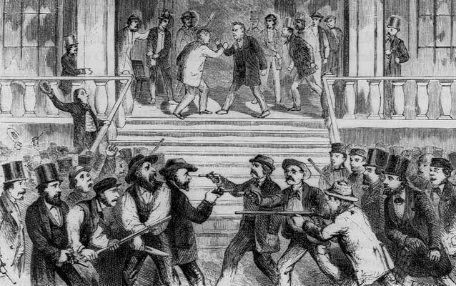

Slide 32
Caning of Charles Sumner
In response to pro-slavery violence in Kansas…
Senator Charles Sumner, a Massachusetts anti-slavery Republican, attacked Democratic senator Andrew Butler (SC) in famous “Crime Against Kansas” speech
Sumner charged Butler with taking “a mistress… who, though ugly to others, is always lovely to him; though polluted in the sight of the world, is chaste in his sight– I mean, the harlot, Slavery.”
Three days later, Andrew Butler’s cousin, Preston Brooks, seeking to defend Butler’s honor, attacked Sumner on the Senate chamber with his metal-topped cane
The violence in Kansas had spilled over onto the Senate floor

Slide 33
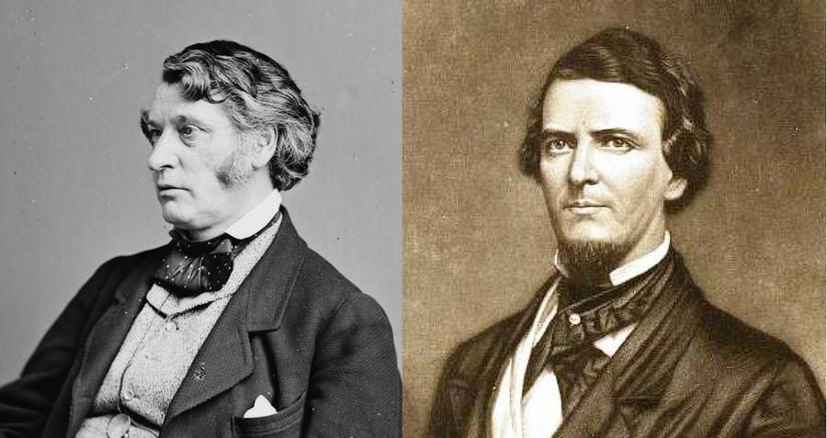

Slide 34
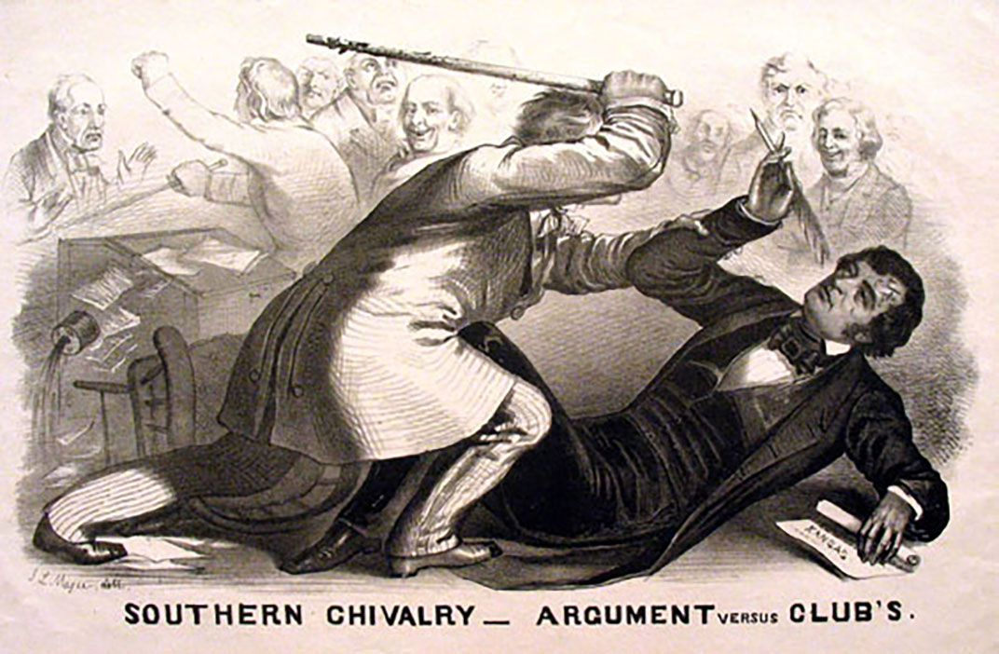

Slide 35
Formation of the Republican Party
Sectionalism had split the Democratic and Whig Parties, effectively destroying the second party system
In the aftermath of the Kansas-Nebraska Act, the Whig Party collapsed
Northern Whigs joined with Northern Democrats (both opposed to slavery), Free-Soilers, and abolitionists to form new Republican Party
Opposed to the expansion of slavery in the western territories
In 1856 , the Republican Party ran its first presidential candidate, John C. Fremont
Lost to Democrat James Buchannan, but gained 33% of popular vote

Slide 36
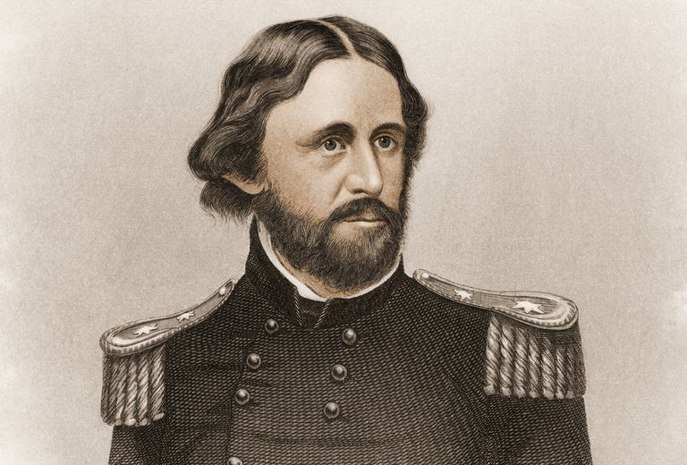

Slide 37
Dred Scott Decision
Dred Scott was a slave from Missouri who had lived in several slave and free states
When his master died, Scott sued, claiming he had a right to be free since he had lived in states where slavery was illegal
Scott’s case went to the Supreme Court and the court’s decision said the following:
Slaves and free African-Americans are not citizens and have no right to sue in court
Slaves are property→ the Constitution protects property→ so the federal government doesn’t have the power to ban slavery in a territory or state
Missouri Compromise and popular sovereignty were unconstitutional

Slide 38
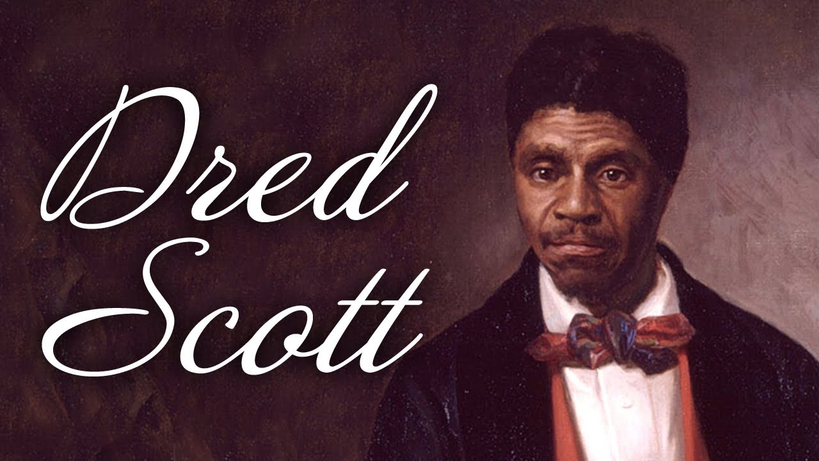

Slide 39
Lincoln-Douglas Debates
Abraham Lincoln (Republican) debates Stephen Douglas (Democrat) for the Illinois Senate in 1858
7 public debates held
All debates focused around fate of slavery in America
Lincoln supports “free-soil”
Douglas supports “popular sovereignty”
Lincoln challenges Douglas on Dred Scott decision
Is “popular sovereignty” even a viable policy if the Supreme Court says slavery is legal everywhere? (Does the Dredd Scott decision eliminate the Compromise of 1850 and Kansas-Nebraska Act?)
Freeport Doctrine: Douglas says that slavery can still be prohibited by local legislatures
Results:
Douglas keeps Senate seat, but destroys political future with
Lincoln performance launches him as a national figure

Slide 40
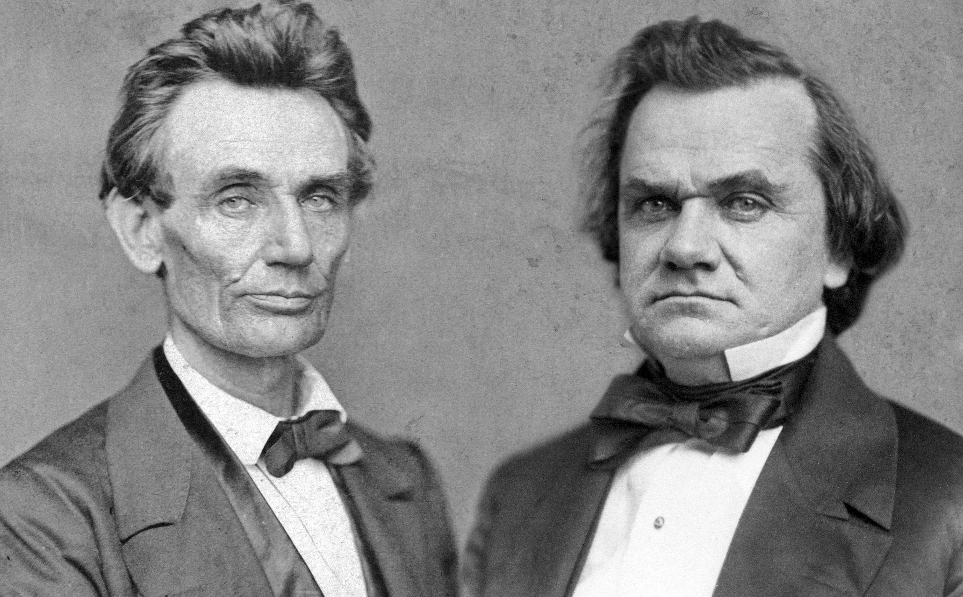

Slide 41
John Brown’s Raid on Harpers Ferry
John Brown was a radical abolitionist who believed it was his destiny to end slavery through violent revolution
Brown and his sons had murdered 5 pro-slavery supporters during the events of “Bleeding Kansas” = Potawatomie Creek Massacre
In 1859, Brown, his five sons, and several other supporters led a raid on Harpers Ferry, Virginia, the sight of a federal armory
Brown planned to take weapons from the armory and lead slaves in a revolt
The raid failed and John Brown was captured, convicted of treason, and executed
Many northerners viewed Brown as a martyr for the abolitionist cause
Southerners viewed Brown as a terrorist, and sign of things to come from the North

Slide 42
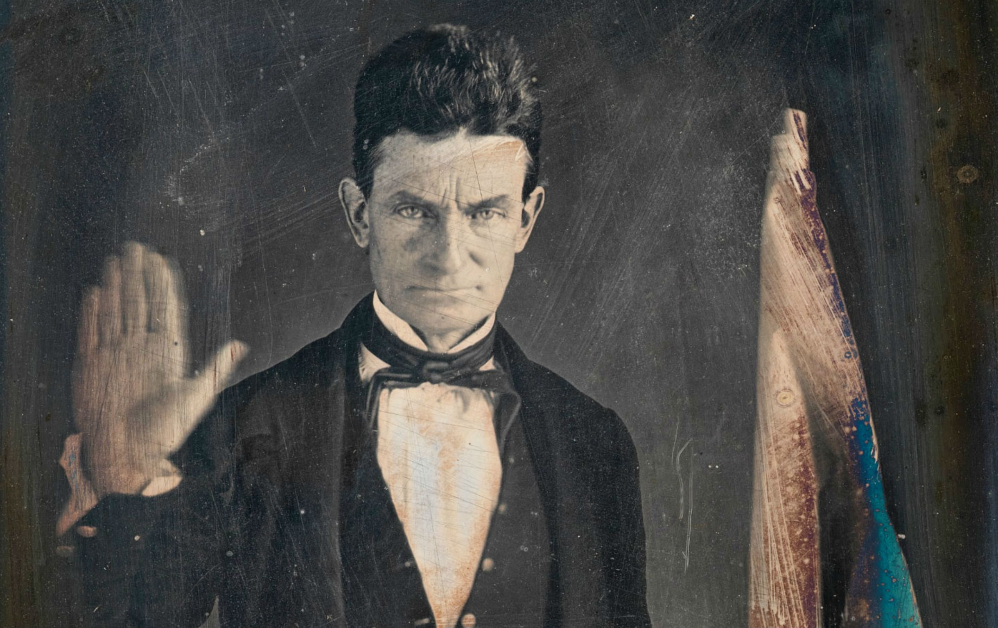

Slide 43
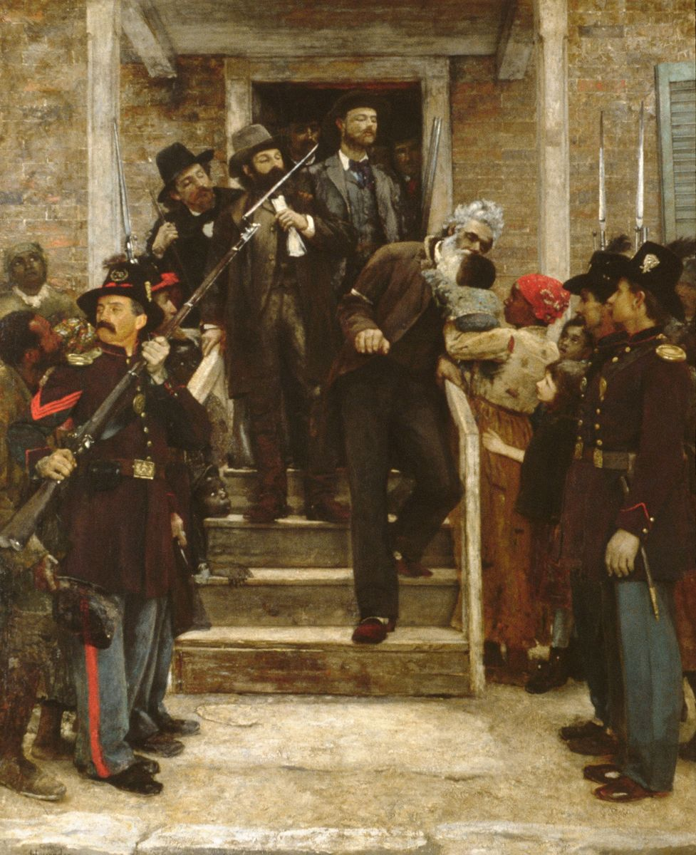

Slide 44
Presidential Election of 1860
Candidates:
Republican Party: Abraham Lincoln believed slavery should not be allowed to expand, but would not challenge slavery where it already existed
Northern Democratic Party: Stephen Douglas believed popular sovereignty should be the policy regarding slavery
Southern Democratic Party: John Breckenridge believed slaves were property and government could not interfere with slavery anywhere
Constitutional Union Party: John Bell did not have a clear stance on slavery but wanted to protect Union
Lincoln and the Republican Party won, dominating in the highly populated Northern states

Slide 45
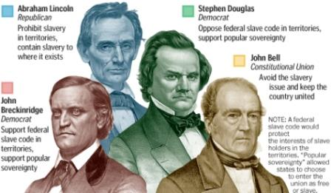

Slide 46
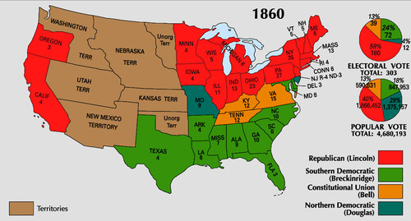

Slide 47
Aftermath of the Election of 1860
Lincoln had not even been on the ballot in many southern states and 60% of voters had not voted for Lincoln
Many southerners feared that Lincoln and the Republican party would seek to abolish slavery everywhere, refused to accept the election results and saw secession as their only option
Kentucky Senator John J. Crittenden introduced a compromise (Crittenden Compromise) in a last ditch effort to resolve the looming secession crisis:
Proposed the reinstatement of the Missouri Compromise Line
Amendments to limit power of central gov. to interfere with slavery
Lincoln and Republicans reject this
On December 20, 1960, South Carolina became the first state to secede from the United States
6 more southern states, Georgia, Alabama, Mississippi, Louisiana, Florida, and Texas, seceded by February 1
These states formed the Confederate States of America

Slide 48
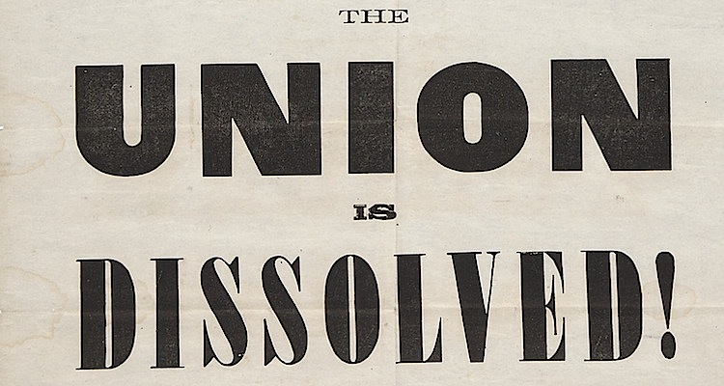

Slide 49
