Slide 1
Mastery
Domain 1

Slide 2
Domain Test
-3 or less Do Tier III
-4 or More Do Tier II
THEN
Take Schoology Domain I Quiz After

Slide 4
How did mercantilism impact the Colonist?

Slide 5
Colonist provided raw materials to Britain in exchange for finished goods

Slide 6
How did mercantilism impact the British?

Slide 7
The British made finished goods and sold them to the colonist in exchange for profit

Slide 8
What was the significance of the trans-Atlantic trade on the Colonies?

Slide 9
Led to cultural and economic diversity

Slide 10
What three continents were included in Trans-Atlantic trade?

Slide 11
Europe, North America, Africa

Slide 12
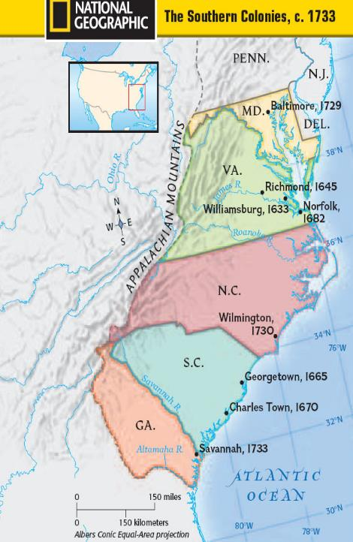
Explain the development of the Southern Colonies
Reason established:
Impact of location and place:
Relations with American Indians:
Economic development:

Slide 13
Reason established: Gold
Impact of location and place: Climate for Agriculture
Relations with American Indians: Bad
Economic development: Agriculture led to increase in slavery

Slide 14
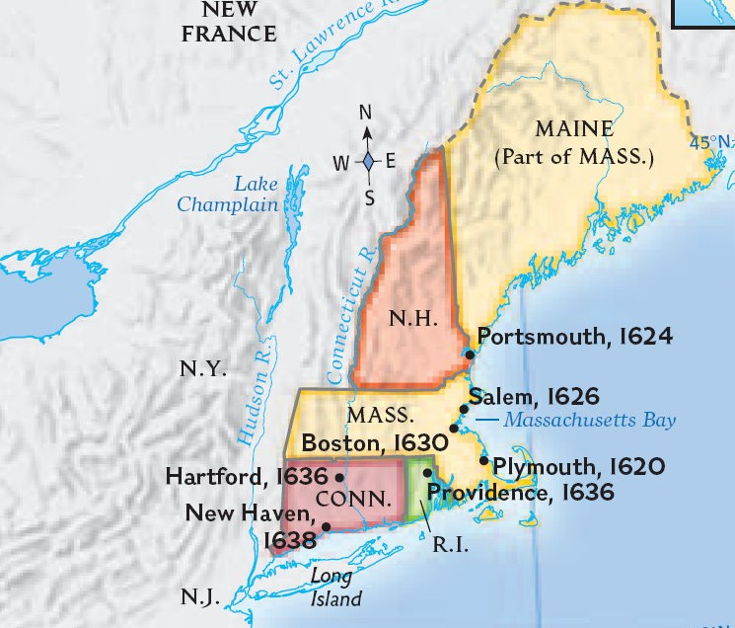
Explain the development of the New England Colonies
Reason established:
Impact of location and place:
Relations with American Indians:
Economic development:

Slide 15
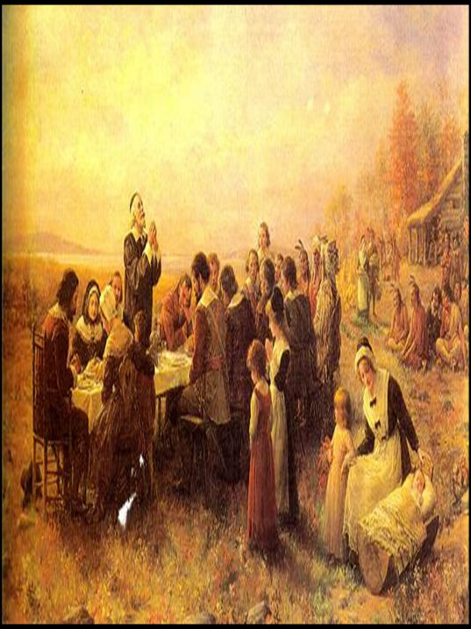
Reason established: God, Puritans
Impact of location and place: Fishing and trading due to short growing season
Relations with American Indians: Bad
Economic development: Fishing and trading

Slide 16
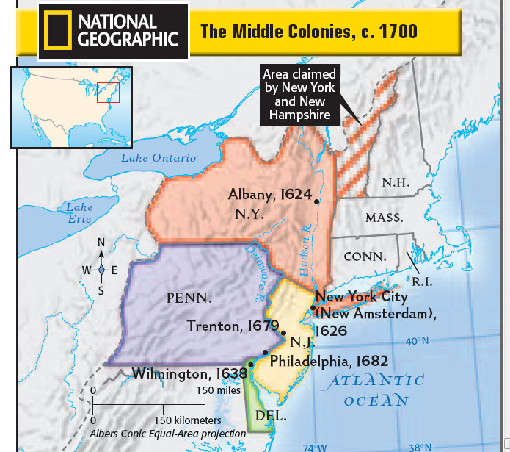
Explain the development of the Mid-Atlantic Colonies
Reason established:
Impact of location and place:
Relations with American Indians: Economic development:

Slide 17
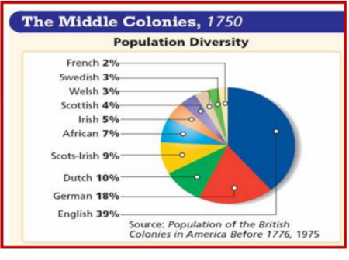
Explain the development of the Mid-Atlantic Colonies
Reason established: Gold, God and Glory
Impact of location and place: Agriculture and trade
Relations with American Indians: Good
Economic development: Agriculture and trade

Slide 18
How did the European immigrants impact colonial society?

Slide 19
Increased cultural diversity, including different ethnic and religious groups

Slide 20
Define Middle Passage

Slide 21
African Americans forced into slavery and traded to North America, part of the trans-Atlantic trade

Slide 22
What was the significance of the Middle Passage?

Slide 23
Increased African American (Slave) population in the Americas

Slide 24
What are 3 contributions of African Americans during the Colonial Era?

Slide 25
Architecture, agriculture, and foodways

Slide 26
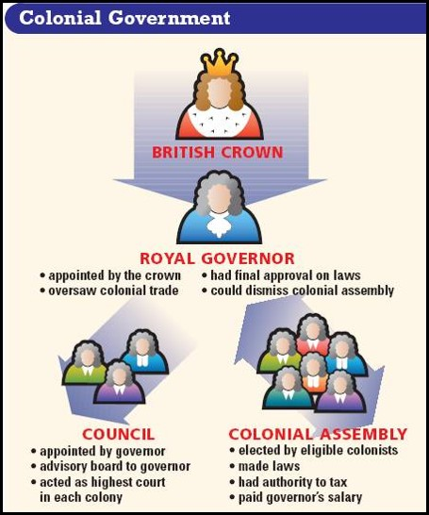
Define: Salutary Neglect

Slide 27
British practice of allowing the Colonist to govern themselves

Slide 28
List 3 example of salutary neglect.

Slide 29
House of Burgesses, Mayflower Compact, and town meetings

Slide 30
How did Salutary Neglect impact colonist?

Slide 31
Led to different methods of colonial self-governance

Slide 32
Define the Great Awakening

Slide 33
Reform movement for colonial churches

Slide 34
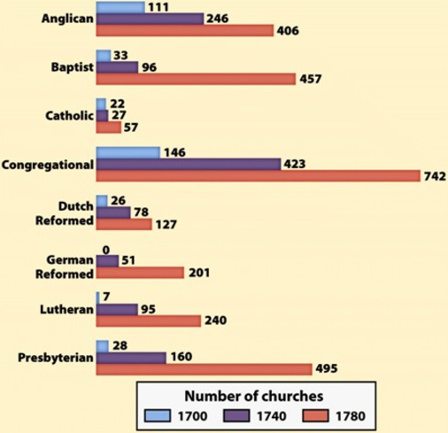
What was the significance of the Great Awakening?

Slide 35
Encouraged colonist to question the role of the church and traditional authority

Slide 36
What countries participated in the French and Indian War?

Slide 37
France (American Indian) and Britain (Colonist)

Slide 38
What was the significance of the 1763 Treaty of Paris?

Slide 39
France was removed from most of North America and Britain gains land all the way to the Mississippi River

Slide 40
How did the 1763 Treaty of Paris lay the groundwork for the American Revolution?

Slide 41
The British claimed they were protecting the Colonist during the War and therefor the Colonist need to repay the British for protection

Slide 42
What was the significance of the Proclamation of 1763?

Slide 43
The British restricted Colonist from moving west of the Appalachian Mountains, so that Colonist would not start another war with the American Indians.

Slide 44
What was the significance of the Stamp Act?

Slide 45
The act required a tax on all paper goods in the colonies

Slide 46
What was the significance of the Intolerable Acts?

Slide 47
Closed the Port of Boston and made quartering of troops legal

Slide 48
List two colonial groups that were created as a response to the Proclamation of 1763, the Stamp Act and the Intolerable Acts?

Slide 49
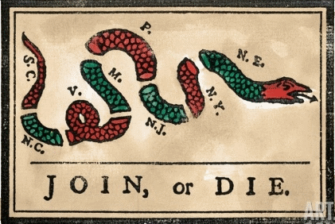
Sons of Liberty and the Committees of Correspondence

Slide 50
Define: Committees of Correspondence

Slide 51
13 colonies coming together to rebel against the British

Slide 52
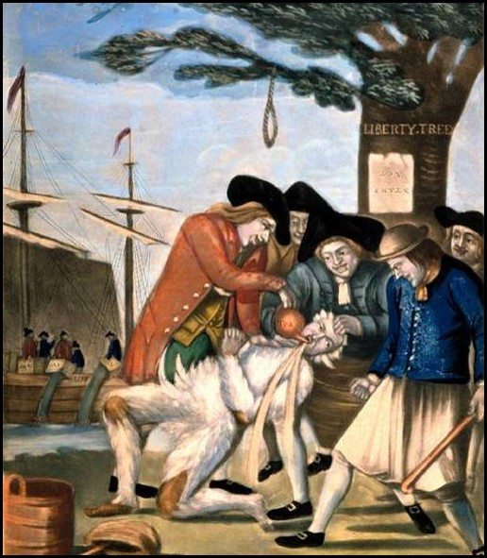
Define: Sons and Daughters of Liberty

Slide 53
The Sons led violent rebellions, Daughters made goods to support boycotts

Slide 54
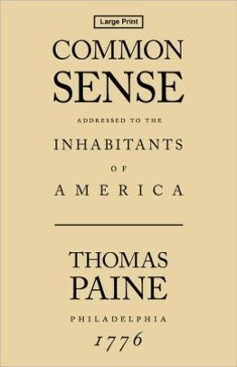
Who wrote the pamphlet Common Sense?

Slide 55
Thomas Paine

Slide 56
What was the significance of Thomas Paine’s pamphlet Common Sense?

Slide 57
It questioned the authority of Britain and explained why the Colonist should rebel against the British

Slide 58
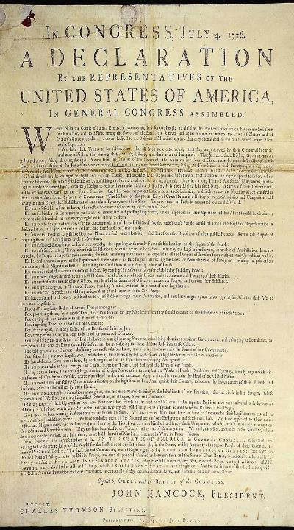
Who wrote the Declaration of Independence?

Slide 59
Thomas Jefferson

Slide 60
What group helped write the Declaration of Independence?

Slide 61
Committee of Five

Slide 62
List the members of the Committee of Five?

Slide 63
Thomas Jefferson, John Livingston, Ben Franklin, John Adams, Roger Sherman

Slide 64
What individual influenced Thomas Jefferson and the Committee of Five, when writing the Declaration of Independence?

Slide 65
John Locke

Slide 66
What was the significance of John Locke’s Natural Rights?

Slide 67
The people have the right to life, liberty and property

Slide 68
What was the significance of John Locke’s Social Contract?

Slide 69
The people have the right to rebel, if the government doesn’t protect your natural rights

Slide 70
How did Benjamin Franklin and John Adams impact the American Revolution?

Slide 71
Convinced France to help the Colonist in the American Revolution

Slide 72
What was the role of George Washington during the American Revolution?

Slide 73
Military leader, was able to secure resources and train soldiers to be better than local militias.

Slide 74
What was the significance of Baron von Steuben?

Slide 75
Prussian military officer and helped create a professional army for the Colonies

Slide 76
What was the significance of Marquis de LaFayette?

Slide 77
French military officer and helped the Colonist in the American Revolution

Slide 78
What was the significance of Valley Forge?

Slide 79
Continental Army fights through the winter and becomes a professional military

Slide 80
What was the geographic significance of the Battle of Trenton?

Slide 81
Continental Army crosses the Delaware River to beat the British and turning point in American Revolution?

Slide 82
What was the geographic significance of the Battle of Saratoga

Slide 83
British forces struggle to fight through forest of New York and divide the Colonies, loose high ground in battle

Slide 84
What was the geographic significance of the Battle of Yorktown?

Slide 85
British General Cornwallis is trapped on a peninsula by Colonial and French troops, British forced to surrender, last major battle in the American Revolution

Slide 86
What was the role of women during the American Revolution?

Slide 87
Participated in the Daughters of Liberty and helped supply colonist with goods during the boycott of British goods.

Slide 88
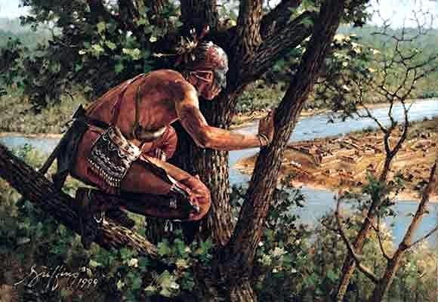
What was the role of American Indians during the American Revolution?

Slide 89
Scouts and spies for the Colonist

Slide 90
What was the role of enslaved and free blacks during the American Revolution?

Slide 91
African-Americans uniformly supported the patriot cause of freedom from Britain.

Slide 92
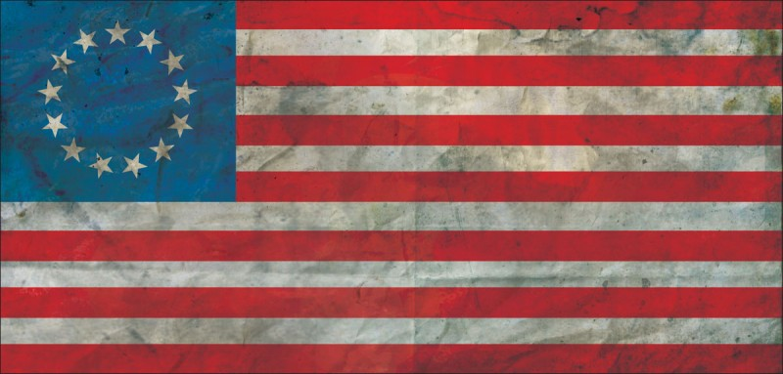
What was the significance of the Treaty of Paris?

Slide 93
Confirmed American independence and set the boundaries of the new nation

Slide 94
What were the Articles of Confederation?

Slide 95
First national government, gave power to the States

Slide 96
Which of the following were benefits of the Articles of Confederation?

Slide 97
Created the Northwest Ordinance, created the Post Office, and establishes States’ Rights

Slide 98
List four benefits of the Northwest Ordinance?

Slide 99
Led to sectionalism, influenced westward migration, no slavery and create rules for adding new states

Slide 100
List three negatives of the Articles of Confederation?

Slide 101
Could not tax, Could not create a military and it developed a weak national government

Slide 102
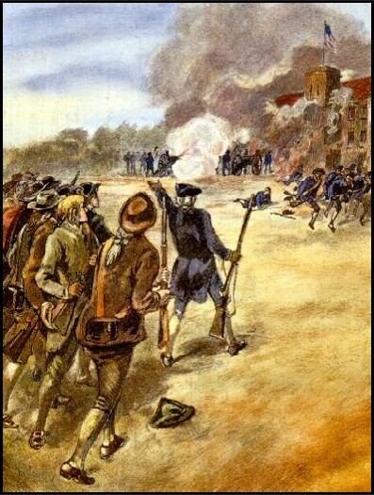
How did Daniel Shay’s Rebellion impact the Articles of Confederation?

Slide 103
Exposed the fundamental weaknesses in government under the Articles of Confederation.

Slide 104
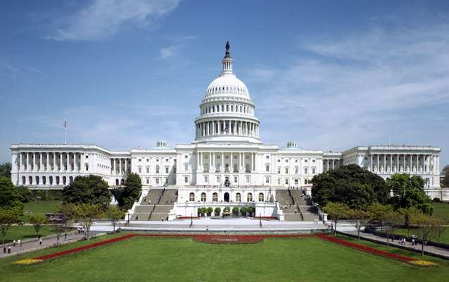
What was the purpose of the Constitution?

Slide 105
To develop a strong national government with limits on the overall power of the government

Slide 106
How did the Great Compromise solve the issue of state representation in the new federal government?

Slide 107
It used the Virginia Plan to base representation on population and the New Jersey Plan to base representation on equality (2 representative per state).

Slide 108
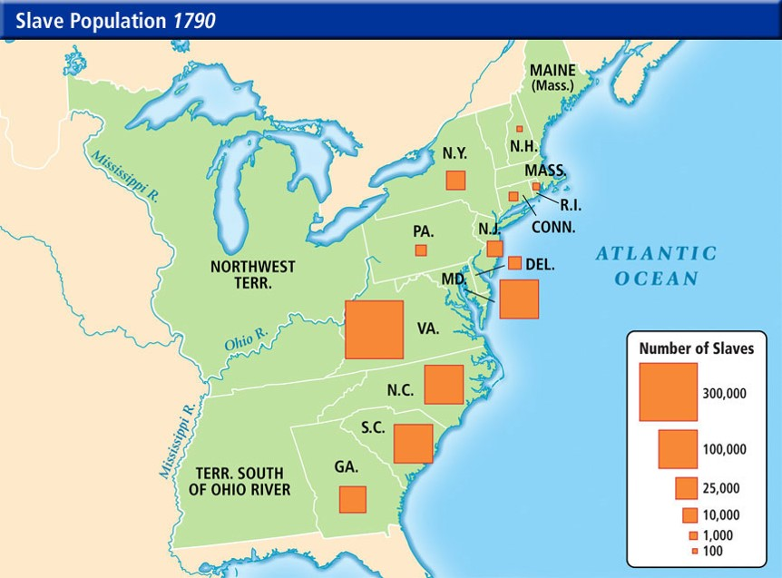
How did the Three-Fifths Compromise solve the issue of state representation in the new federal government?

Slide 109
It reduced the fear of loss of representation by Southern States with large slave populations.

Slide 110
List three limits to the power of the federal government in the Constitution.

Slide 111
Separation of powers, checks and balances and federalism

Slide 112
What were the political believes of the Anti-Federalist?
Weak Federal Government
Strong Federal Government

Slide 113
They want a Constitution with a weak federal government and a Bill of Rights to protect the people

Slide 114
List 2 famous Anti-Federalist?

Slide 115
Thomas Jefferson and Patrick Henry

Slide 116
What were the political believes of the Federalist?
Weak Federal Government
Strong Federal Government

Slide 117
They want a Constitution that limits the power of the federal government

Slide 118
List two famous Federalist?

Slide 119
Alexander Hamilton and James Madison

Slide 120
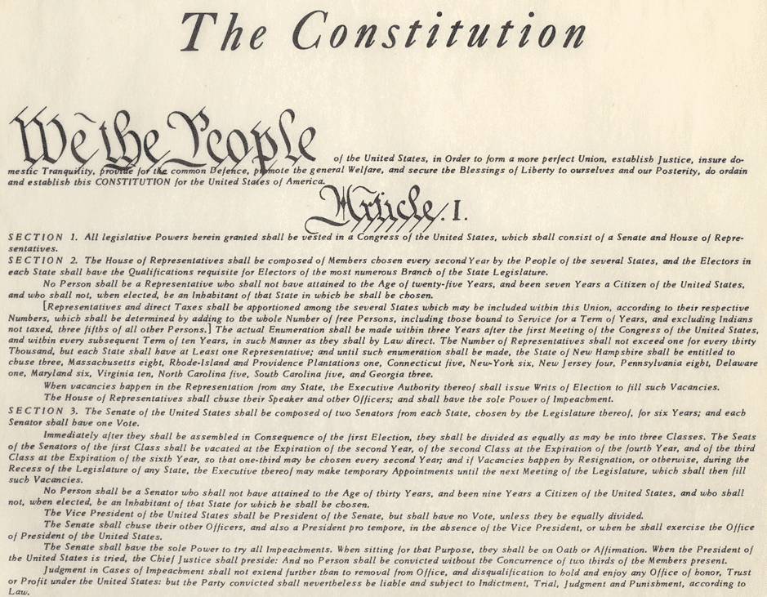
Define ratification?

Slide 121
To accept (the Constitution)

Slide 122
What was the purpose of the Federalist Papers?

Slide 123
To encourage colonist and anti-federalist to ratify the Constitution

Slide 124
What did the Anti-Federalist want added to the Constitution, in exchange for ratifying the Constitution?

Slide 125
The Bill of Rights

Slide 126
What was the purpose of the Bill of Rights?

Slide 127
To provide individual and state’s rights

