Slide 1
Mastery
Domain 3

Slide 2
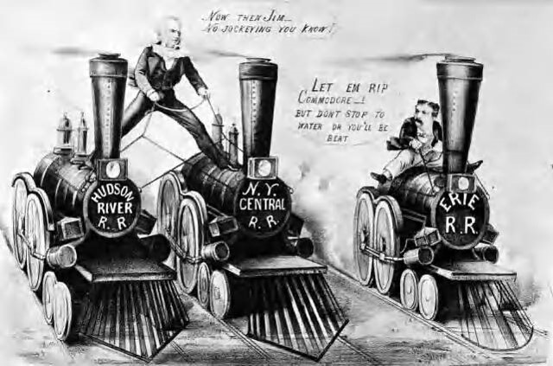
What was the significance of the Railroad boom right after the Civil War?

Slide 3
Steel and oil industries boomed as a result of the Railroad Industry

Slide 4
What was the significance of John D. Rockefeller?

Slide 5
Founder of Standard Oil Company, later gains a monopoly on U.S. production of Oil. Robber Baron or Captain of Industry?

Slide 6
What was the significance of Andrew Carnegie?

Slide 7
Gilded Age steel tycoon Known for Vertical Integration, the combining of companies that supply equipment and services needed for a particular industry

Slide 8
How did Rockefeller and Carnegie impact American industry?

Slide 9
Both led to the growth of monopolies and trusts in American business Both were philanthropists that donated money to build schools, libraries, etc.

Slide 10
Define Monopoly

Slide 11
A single company that controlled virtually all of the production and distribution of a product.

Slide 12
Define Trust

Slide 13
Management and control of the member corporations are combined in a single board of trustees

Slide 14
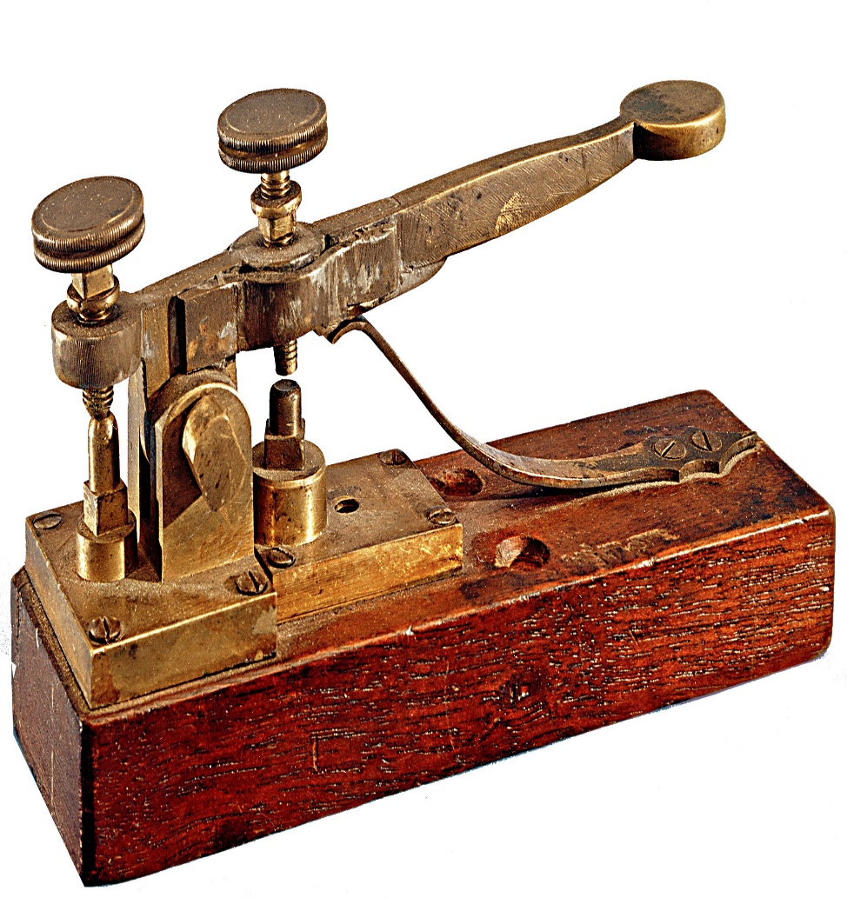
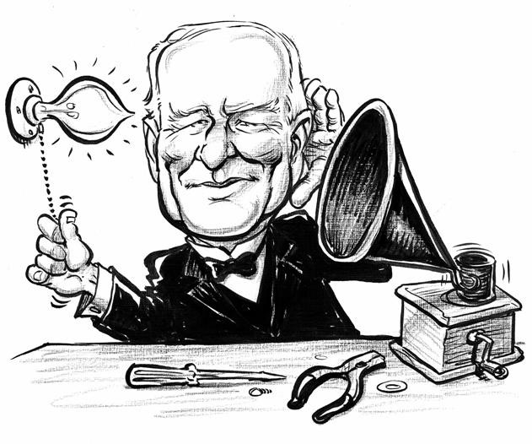
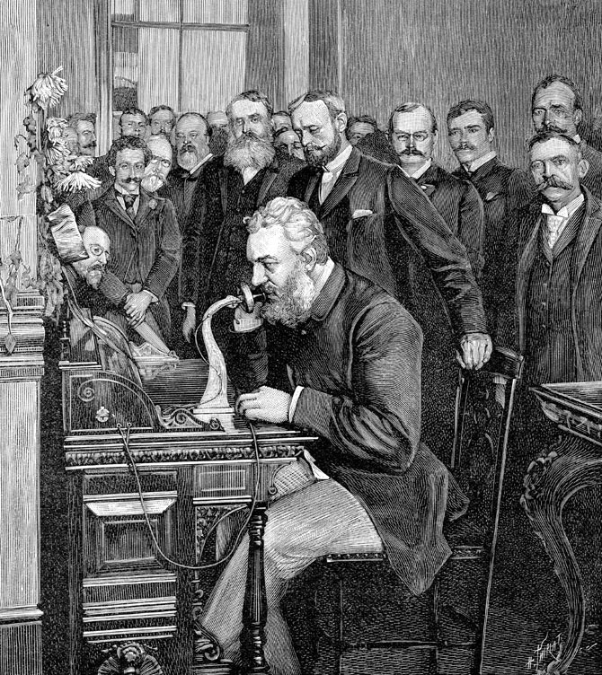
What three inventions that improved American Infrastructure during the Industrial era?

Slide 15
The Telegraph, telephone, and electric light bulb

Slide 16
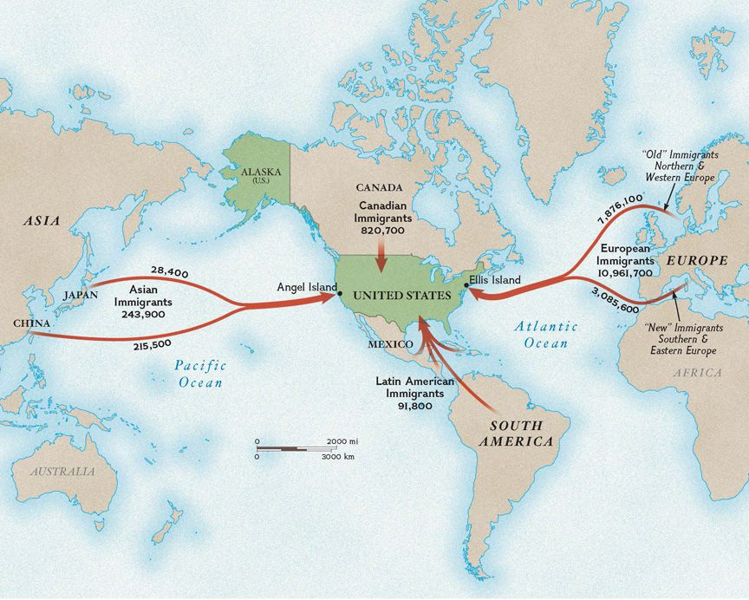
What were the names of the two islands used to receive new immigrants?

Slide 17
Ellis and Angel Islands

Slide 18
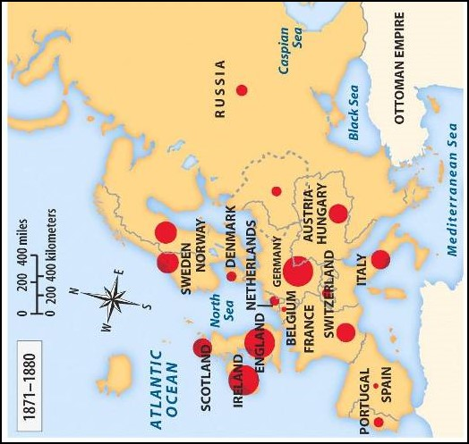
Which of the following best describes the new immigrants

Slide 19
From Western and Southern Europe, spoke no English and were Jewish and Catholic

Slide 20
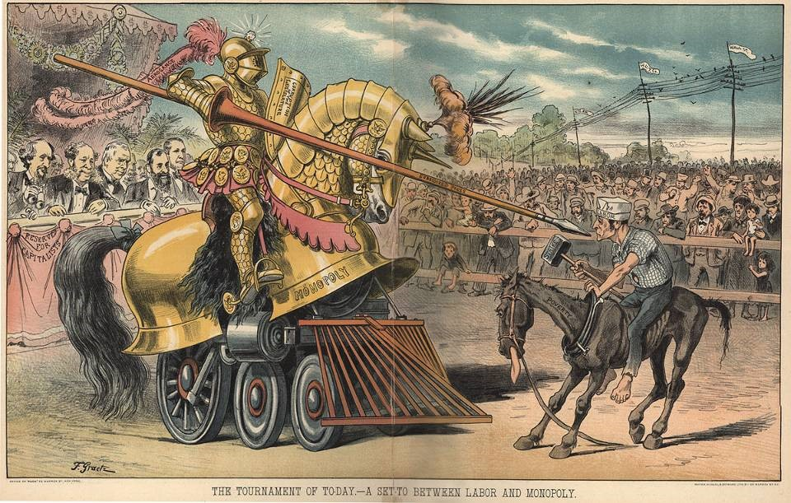
What was the purpose of the American Federation of Labor?

Slide 21
A labor union, designed to convince employers to give workers shorter workdays and better working conditions.

Slide 22
What were some of the tactics used by the American Federation of Labor?

Slide 23
Collective bargaining, strikes

Slide 24
What immigrant groups helped build the transcontinental railroad?

Slide 25
Chinese and Irish immigrants

Slide 26
How did the trans-continental railroad impact western population?

Slide 27
Increase the population in the west and led to the removal of the Plains Indians

Slide 28
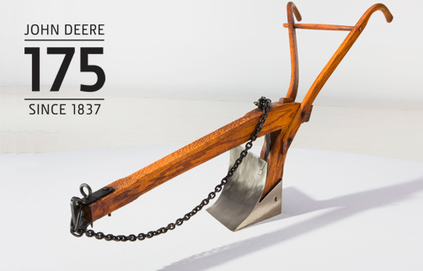
List three innovations that impacted farming and ranching in the West?

Slide 29
Steel plow, barbed wire, and mechanical reaper

Slide 30
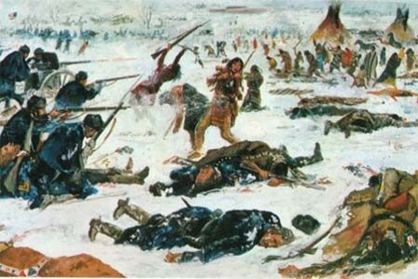
How did the Plains Indians’ resist westward expansion?

Slide 31
They signed treaties and fought against U.S. Army troops. Battle of Little Bighorn Wounded Knee Massacre

Slide 32
What was one consequence of the Plains Indians’ resistance to western expansion?

Slide 33
The removal of Plains Indians from their home land to reservations

Slide 34
What was the significance of the Progressive Era?

Slide 35
Helped reform American society and politics during the early 1900’s Response to the social problems created during the Gilded Age (1870-1900)

Slide 36
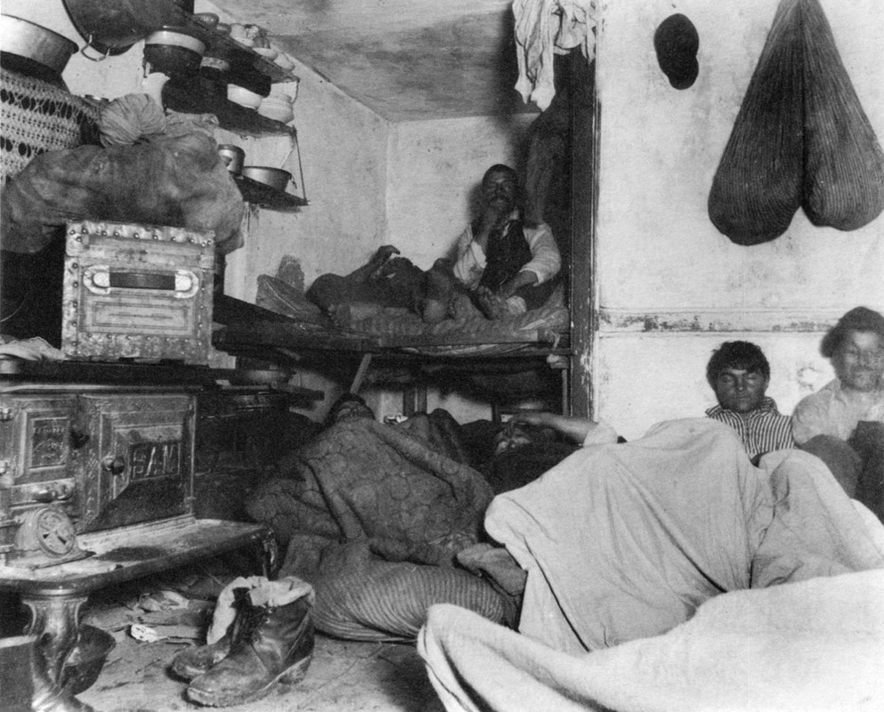
How did the muckrakers impact society?

Slide 37
Journalist who brought attention to the social and political problems of the early 1900’s

Slide 38
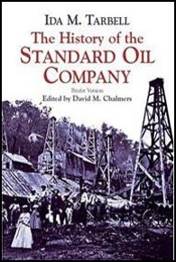
What was the role of women during the Progressive Era?

Slide 39
Women progressives sponsored laws ending child labor, requiring government inspections of the workplace, and provided social services for immigrants

Slide 40
What were the Jim Crow laws?

Slide 41
Segregation laws that required separate public and private facilities for African Americans

Slide 42
What was the significance of Plessy v. Ferguson?

Slide 43
U.S. Supreme Court case that upheld the constitutionality of Jim Crow laws, created the “Separate but Equal” doctrine.

Slide 44
What was the purpose of the NAACP?

Slide 45
A political group that fought for the full social and economic equality for African Americans

Slide 46
What were three ways progressives improved citizen’s political power?

Slide 47
Increased citizens voting rights, improved labor laws, and development of the conservation movement

Slide 48
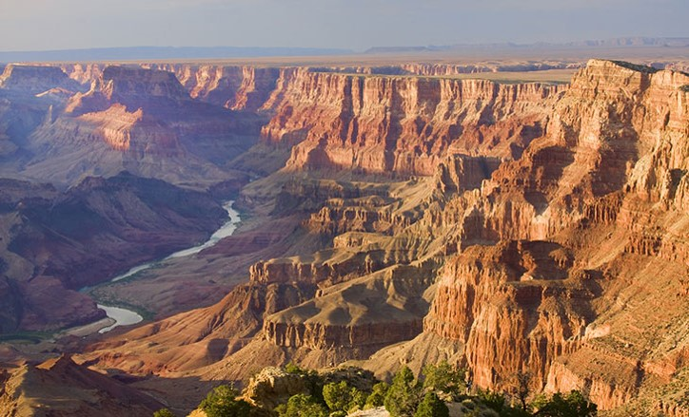
What was the significance of Teddy Roosevelt’s Conservation Movement?

Slide 49
Conserved millions of acres of wilderness land such as the Grand Canyon and Yellowstone Park.

Slide 50
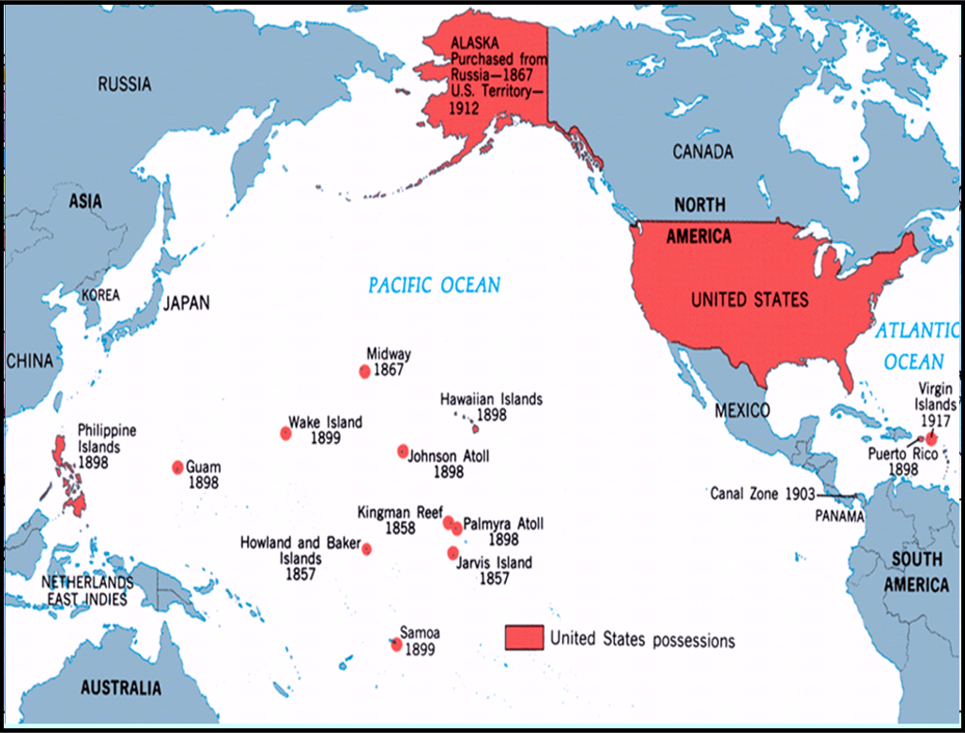
Define Imperialism

Slide 51
An action that involves a country extending its power by acquiring new territories

Slide 52
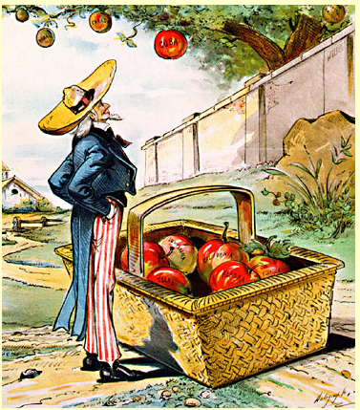

Slide 53
What was the significance of the Spanish-American War?

Slide 54
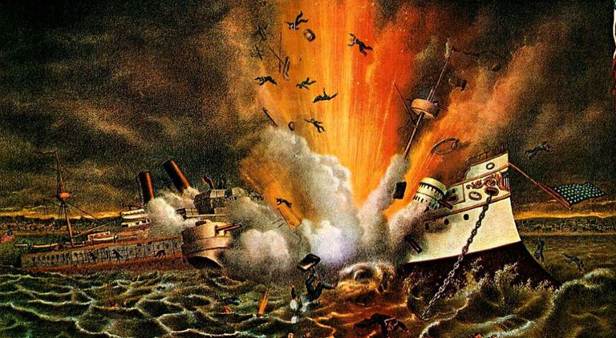

Slide 55
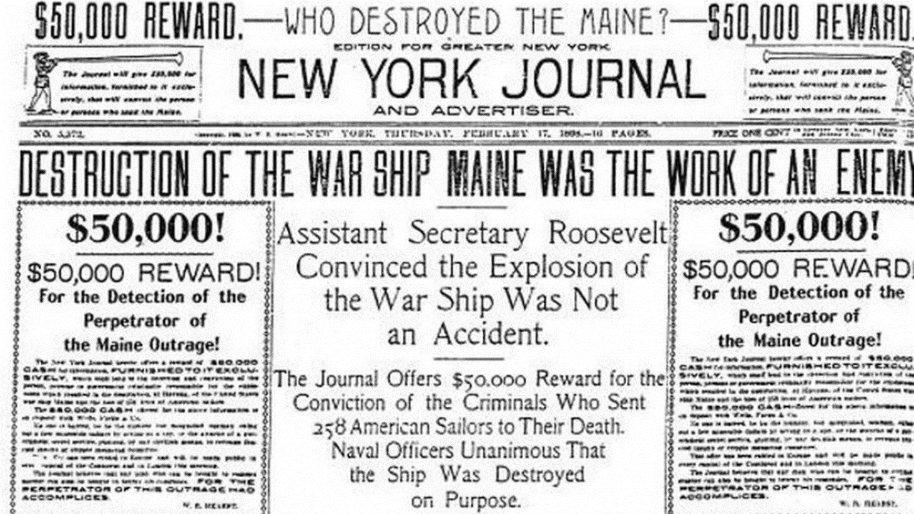

Slide 56
American imperialism leads to a war with Spain and spread democracy to Spanish territories

Slide 57
What territories were gained during the Spanish-American War?

Slide 58
Guam, Puerto Rico, and the Philippines

Slide 59
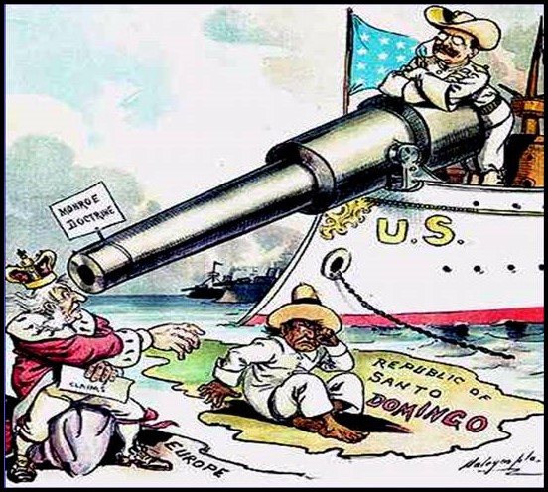
What was the significance of the Roosevelt Corollary to the Monroe Doctrine?

Slide 60
The U.S. stated that it was the “policeman” of the Americas. If Latin American countries owed European nations a debt, the U.S. would intervene and make them pay up

Slide 61
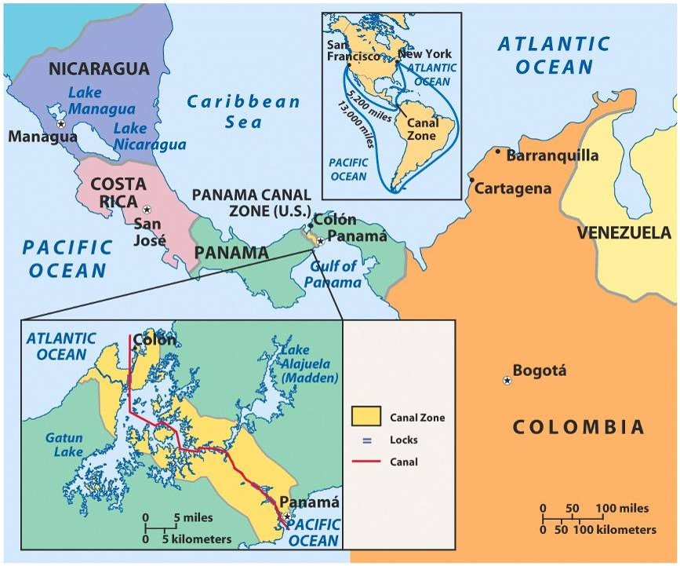
What was the geographic significance of the Panama Canal?

Slide 62
U.S. gains a faster route from the Atlantic to Pacific Ocean.

Slide 63
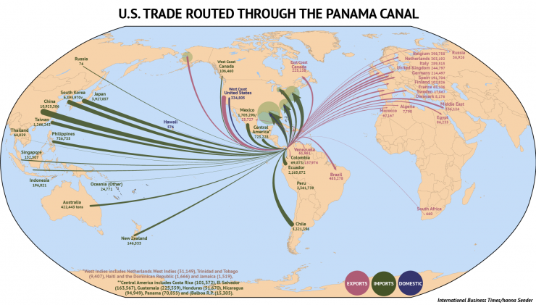
What was the economic significance of the Panama Canal?

Slide 64
Increases trade and lowers the cost of goods.

Slide 65
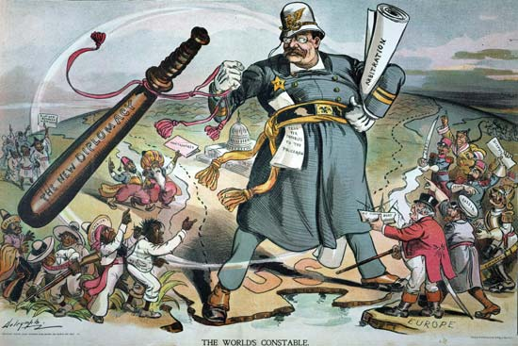
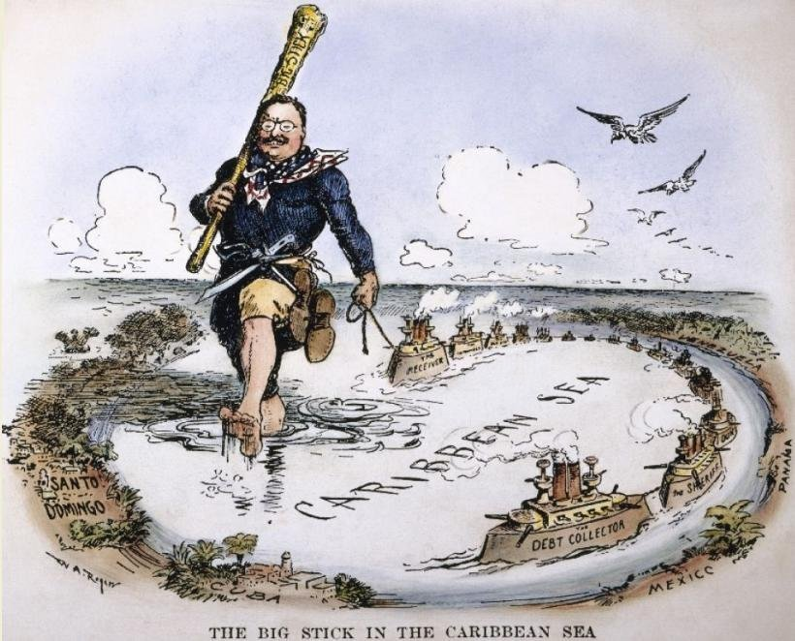
Explain Theodore Roosevelt’s “Big Stick Diplomacy”

Slide 66
Teddy Roosevelt’s foreign policy that advocated peaceful diplomatic negotiations (“speak softly”), but being militarily prepared should the need for force arise (“carry a big stick”)
Willingness to use military might to achieve foreign policy goals
The U.S. Navy was the “Big Stick”

