Slide 1
Mastery
Domain 4

Slide 2
What was the purpose of Woodrow Wilson’s neutrality policy?

Slide 3
Keep America out of World War I

Slide 4
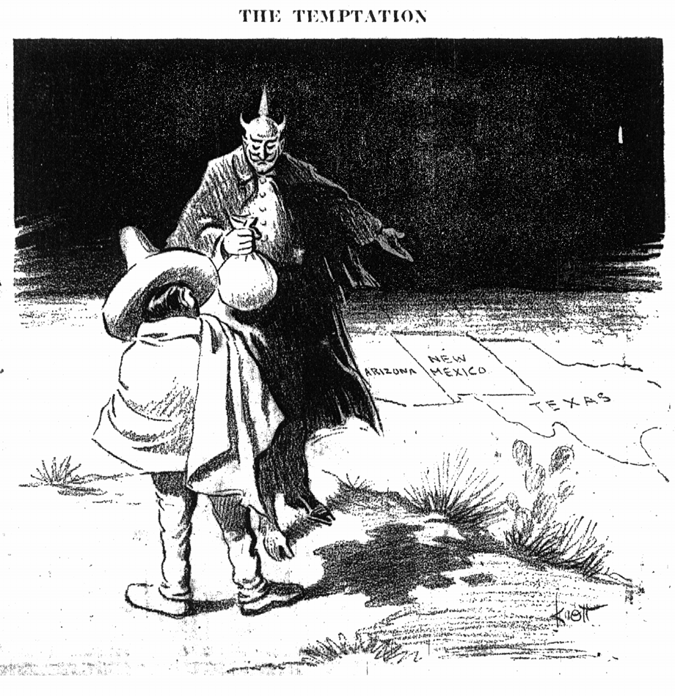
List 3 reasons American entered World War I?

Slide 5
Unrestricted Submarine Warfare, Sinking of Lusitania, Zimmerman Telegram

Slide 6
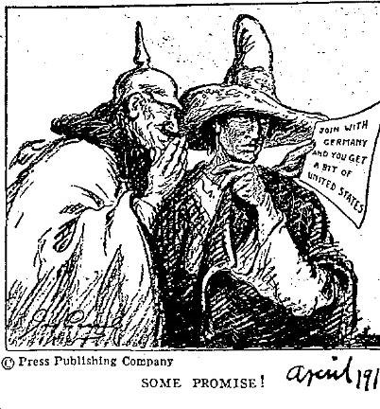
What was the significance of the Zimmerman Telegram?

Slide 7
Proposed military alliance between Germany and Mexico, that would give Texas, Arizona and New Mexico back to Mexico, leads U.S. to enter World War I

Slide 8
What was the significance of the Great Migration?

Slide 9
African Americans move north (HARLEM) to gain political, social, and economic freedom during World War I.

Slide 10
What was the significance of the Espionage Act?

Slide 11
Wilson’s administration made it a crime to communicate any information that would interfere with U.S. military operations or aid its enemies during World War I.

Slide 12
What was the significance of Eugene Debs?

Slide 13
Believed war should be for the people not politics or the profit, He was convicted for hindering military recruiting by making speeches against it, violated the Espionage Act

Slide 14
What was the significance of Woodrow Wilson’s Fourteen Points Plan?

Slide 15
Wilson attempts to end future wars with a treaty that brought powerful nations together

Slide 16
What was the purpose of the League of Nations?

Slide 17
Part of Wilson’s Fourteen Points Plan, called for the creation of an international peacekeeping organization.

Slide 18
How did Congress react to Wilson’s Fourteen Points and League of Nations?

Slide 19
Isolationist in Congress rejected the plan because they believed it would cause the U.S. to get involved in future wars.

Slide 20
Define: Communism

Slide 21
A government where there is no private ownership, all property is owned by the government; creates a classless society

Slide 22
Define: Socialism

Slide 23
A government where there is a mix of government and individual ownership of property; encourages social ownership of property

Slide 24
What was the significance of the Red Scare?

Slide 25
The fear that communism would spread to American, this led to the U.S. governments pursuit of suspected communist and socialist

Slide 26
How did the Red Scare impact immigration?

Slide 27
It led to federal laws restricting immigrants from communist and socialist countries, Eastern Europe

Slide 28
What was the purpose of the 18th Amendment?

Slide 29
To prohibit the manufacture, sale or transportation of intoxicating liquors

Slide 30
What was the negative result of the 18th Amendment?

Slide 31
It led to an enormous increase in organized crime

Slide 32
What was the purpose of the 19th Amendment?

Slide 33
Gave women the right to vote

Slide 34
What was the result of mass production and advertising during the 1920s?

Slide 35
Increase in American consumerism, society bought radios, tickets to movies, and cars

Slide 36
How did Henry Ford impact American Society?

Slide 37
He used mass production techniques to increase car production and make cars affordable

Slide 38
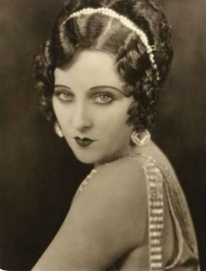
What was the impact of radio and movies during the 1920s?

Slide 39
They were used to unify the national culture by increasing communication between citizens

Slide 40
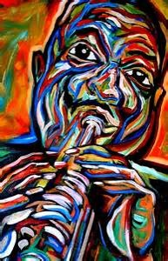
What two forms of modern cultural expression emerged during the 1920s?

Slide 41
Origins of jazz and the Harlem Renaissance

Slide 42
What was the significance of the Harlem Renaissance?

Slide 43
It was the rebirth of African American Culture in Harlem, New York; caused by the Great Migration

Slide 44
List the 4 causes of the Great Depression

Slide 45
Overproduction, Underconsumption, stock market speculation, Stock Market Crash

Slide 46
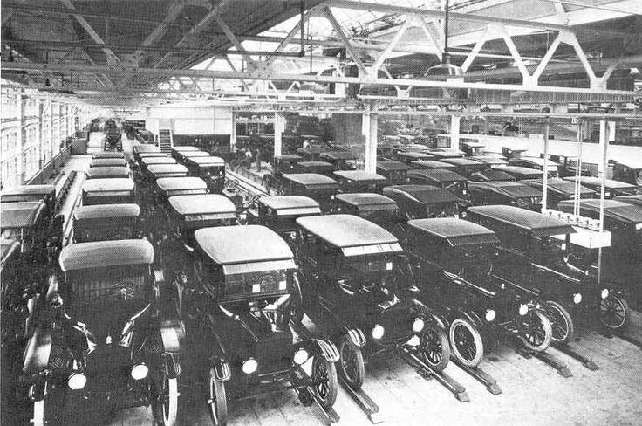
Define: Overproduction

Slide 47
When businesses make too much of good or service, creates a surplus

Slide 48
Define: Underconsumption

Slide 49
When individuals choose not to purchase goods and services provided by businesses, creates a surplus

Slide 50
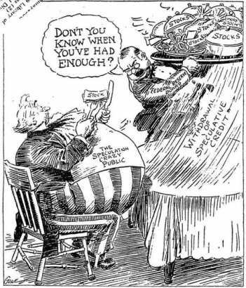
Define: Stock Market Speculation

Slide 51
When individuals choose not to purchase goods and services provided by businesses, creates a surplus

Slide 52
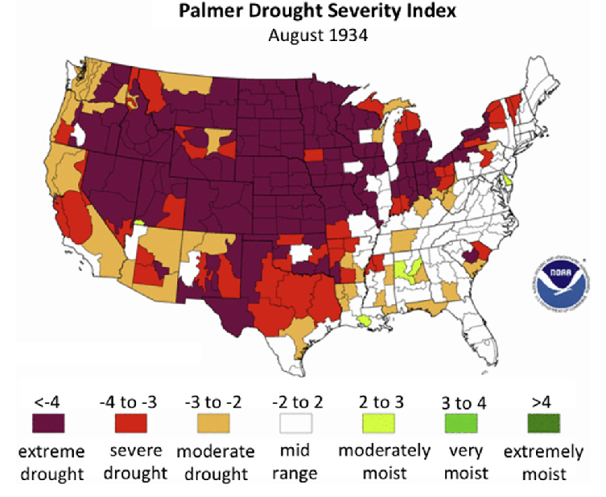
What two factors led to the Dust Bowl?

Slide 53
Over-plowing of fertile soil and a severe drought

Slide 54
List three states that were affected by the Dust Bowl?

Slide 55
Kansas, Oklahoma, Texas and Nebraska

Slide 56
What was the result of the Dust Bowl?

Slide 57
The Dust Bowlers moved to California in search for jobs and a better future

Slide 58
How did the Great Depression impact society?

Slide 59
It led to a severe economic recession and widespread unemployment

Slide 60
What was the purpose of Hoovervilles?

Slide 61
Homeless and unemployed workers camped in these shacks and tents in rundown areas, named after president Hoover

Slide 62
What were the 3 reasons Franklin Roosevelt wanted to implement his New Deal programs?

Slide 63
He wanted to provide relief, recovery and reform for the American economy

Slide 64
Did FDR’s New Deal programs increase or decrease the role of government in America?

Slide 65
Increase

Slide 66
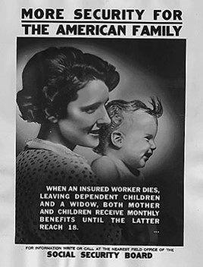
List the 3 benefits of the Social Security Act

Slide 67
Old-age insurance for people over 65, unemployment compensation, and aid for the disabled

Slide 68
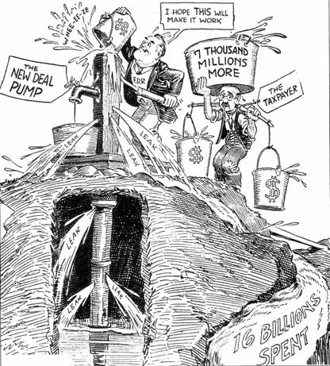
How did critics impact Roosevelt’s Presidency?

Slide 69
They challenged his leadership and New Deal programs Huey Long

Slide 70
What was the role of Eleanor Roosevelt during FDR’s presidency?

Slide 71
She help press conferences and addressed social issues and FDR’s critics

Slide 72
What was the significance of the Lend-Lease Act?

Slide 73
Promoted by FDR, Nine months before Pearl Harbor, U.S. passes laws that allow us to lend military equipment and supplies to our allies during World War II.

Slide 74
What was the significance of the Japanese attack on Pearl Harbor?

Slide 75
America officially enters World War II, on the side of Britain, France, and Russia

Slide 76
List a difficulty U.S. troops faced during World War II

Slide 77
Delivering of weapons, food and medical supplies to troops

Slide 78
In the Pacific Theater, what was the significance of the Battle of Midway?

Slide 79
U.S. destroys Japan’s offensive power and they never recover, Turning point in the war in the Pacific Theater

Slide 80
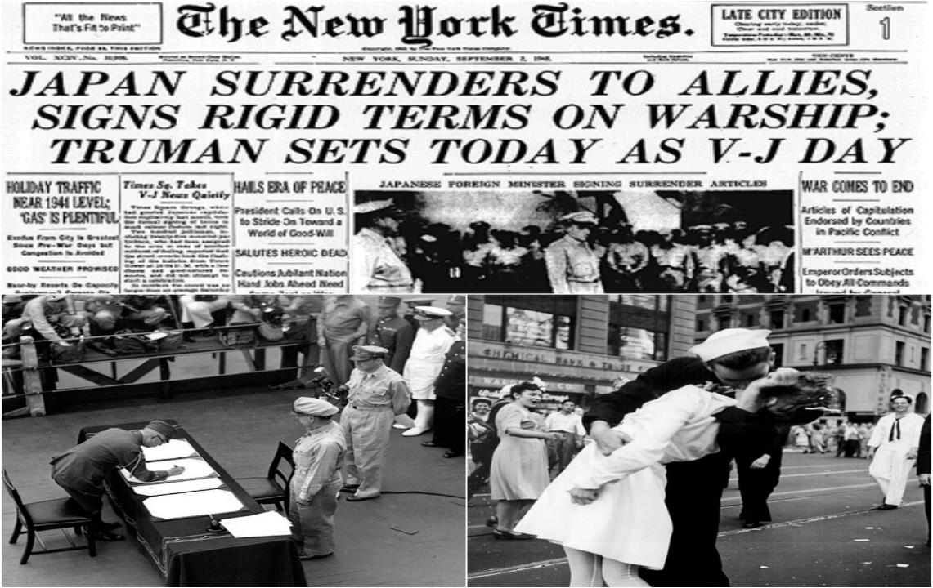
In the Pacific Theater, what was the significances of dropping the atomic bomb on Hiroshima and Nagasaki?

Slide 81
Ending of the War in Japan (V-J Day)

Slide 82
What was the significance of the Manhattan Project?

Slide 83
Secret plan to develop and test the Atomic bomb in Los Alamos, New Mexico

Slide 84
In the European Theater, what was the significance of D-Day?

Slide 85
Turning point, U.S. gains access to Europe and the ability to resupply troops.

Slide 86
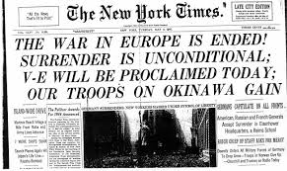
In the European Theater, what was the significance of the Fall of Berlin?

Slide 87
End of the War in Europe (V-E Day) and allows Soviets to take over eastern Europe

Slide 88
How did rationing impact war time mobilization?

Slide 89
Citizens were given coupon books that were used to buy scarce items such as meat, sugar, gas, and coffee to help save resources for military use

Slide 90
How did women impact war time mobilization?

Slide 91
More than 6 million workers in the plants, factories, and shipyards were women during World War II.

Slide 92
How did blacks impact war time mobilization?

Slide 93
African Americans took jobs in military industries to help support World War II.

Slide 94
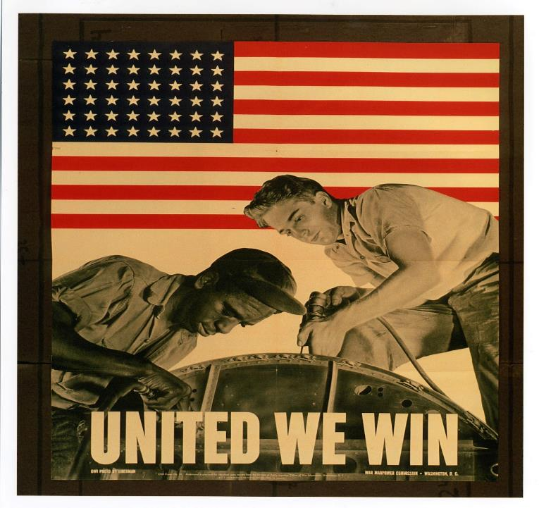
How did Roosevelt use his executive power to impact defense industries?

Slide 95
African Americans took jobs in military industries to help support World War II.

Slide 96
How did Roosevelt use his executive power to impact Japanese-Americans?

Slide 97
Roosevelt requires Japanese-Americans to enter internment camps, because the Military fears Japanese spies and sabotage during World War II.

