Slide 1
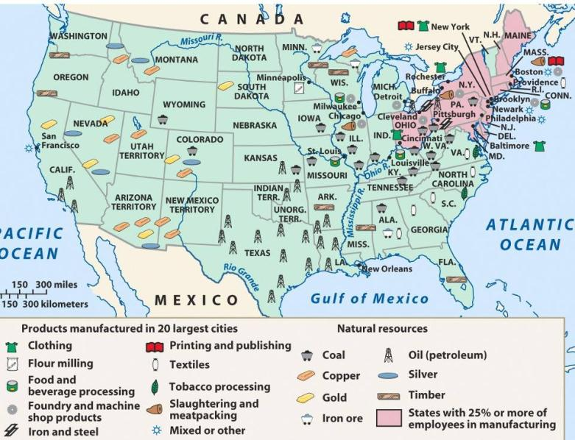
During the Gilded Age, the United States experienced an industrial revolution

Slide 2
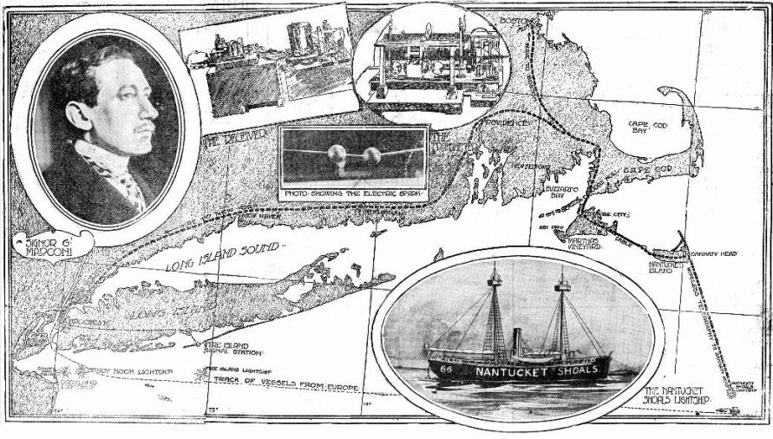
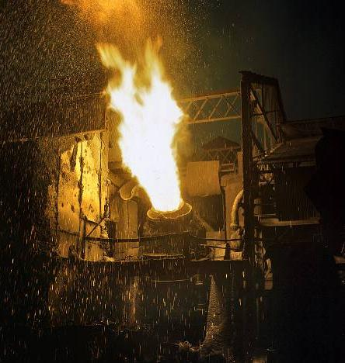
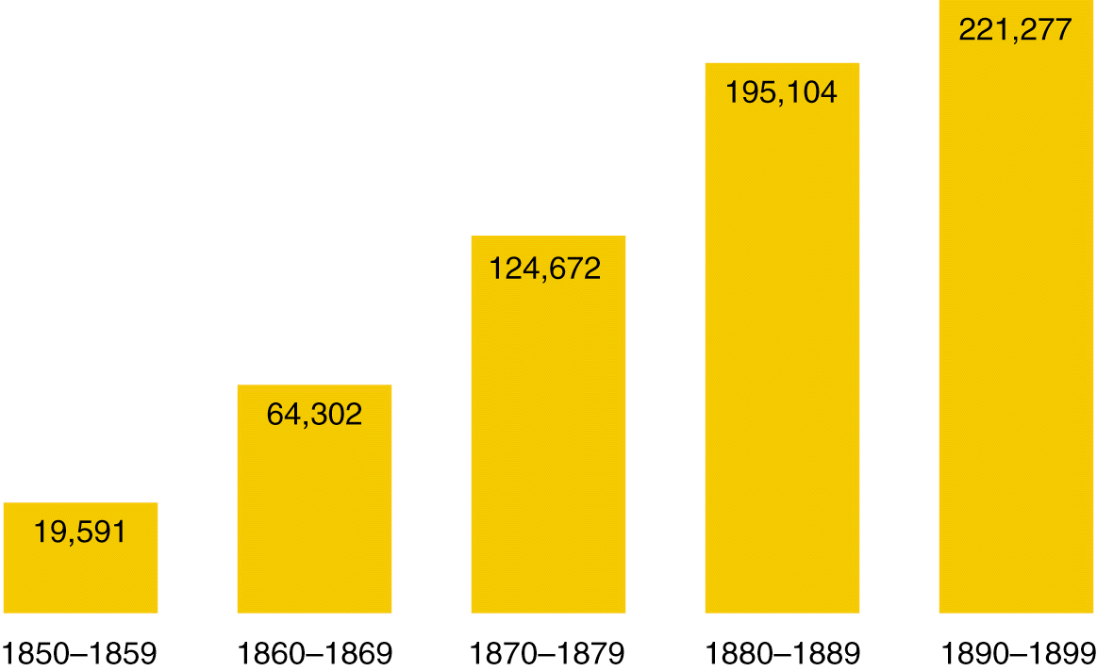
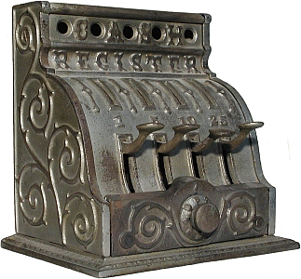
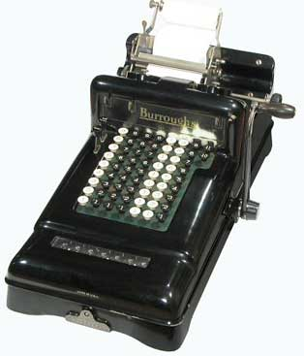
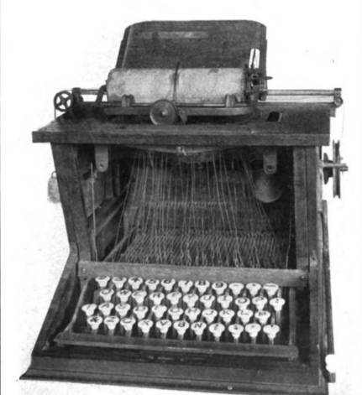
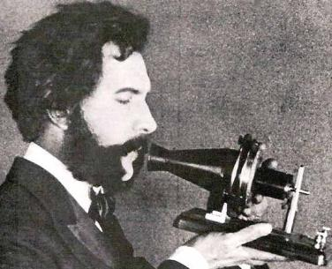
America’s industrial revolution began as a wave of inventions
Cash registers, typewriters adding machines, made businesses more efficient
Guess the Gilded Age invention
Guglielmo Marconi’s wireless transmitter and Alexander Graham Bell’s telephone revolutionized communication
U.S. Patents Issued (1850-1899)
The Bessemer process created a cheap way to transform iron into stronger, lighter steel
New inventions allowed for improved industrialization

Slide 3
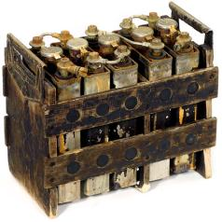
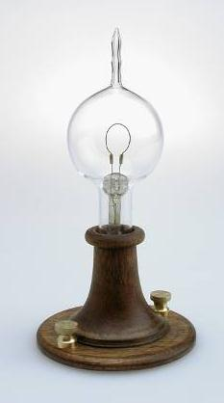
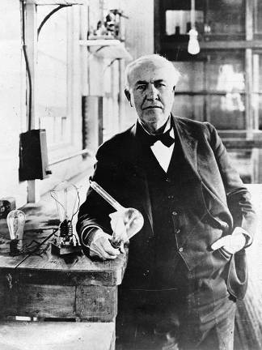
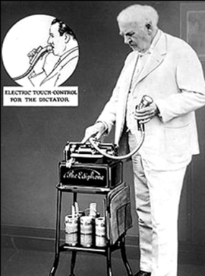
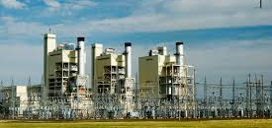
Thomas Edison (the “Wizard of Menlo Park”) was the greatest inventor of the 1800s
He invented the phonograph, audio recorder, and battery
Most influential invention = electric light bulb
Developed the process of electric power plants to create enough electricity to use as an energy source

Slide 4
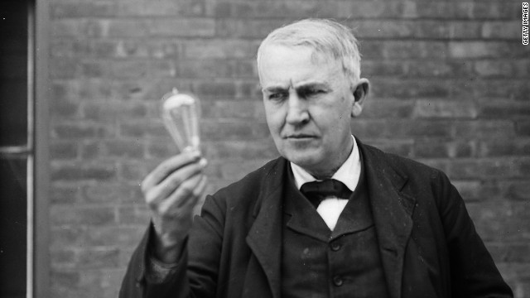

Slide 5
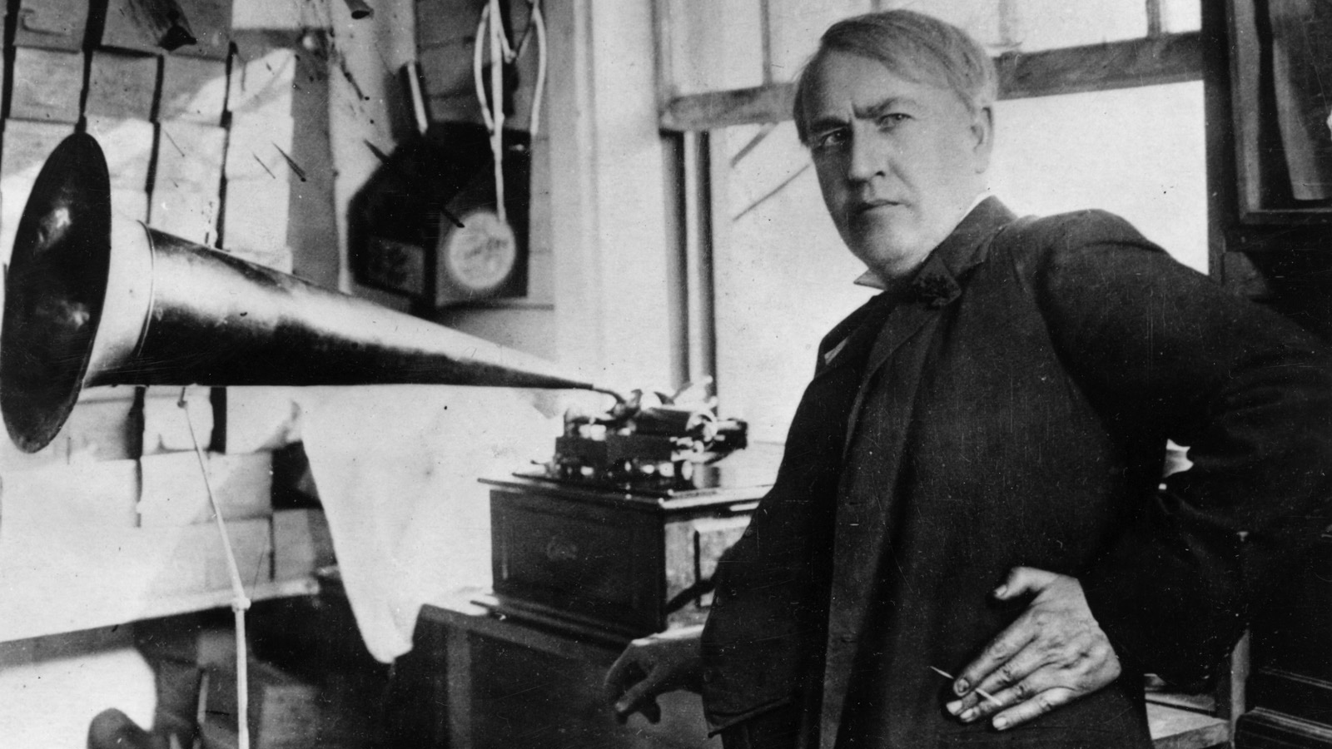

Slide 6
America’s industrial revolution was fueled by 5 major industries (R.O.B.E.S.) Railroads, Oil, Banking, Steel, Electricity

Slide 7
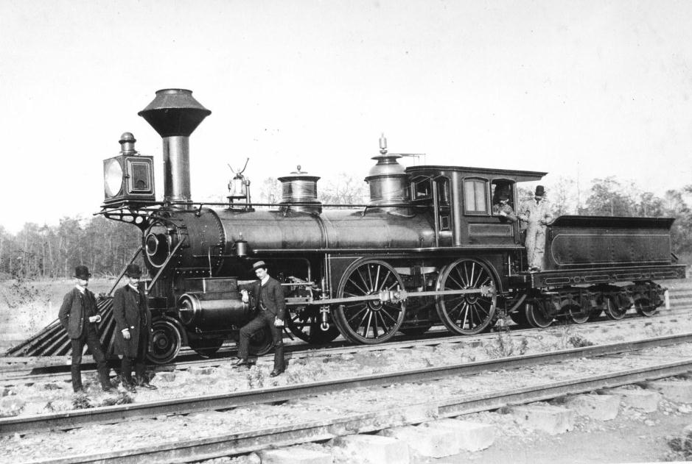
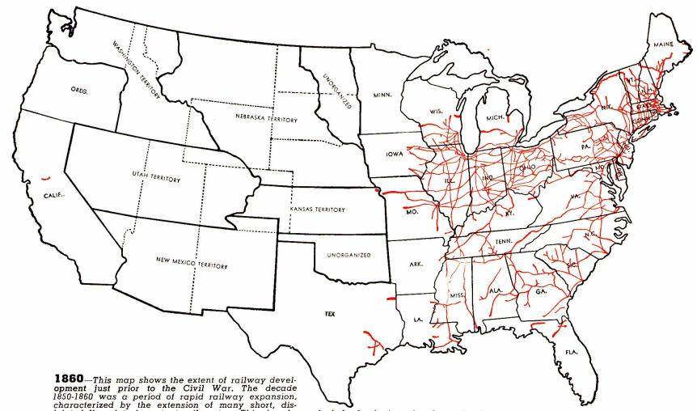
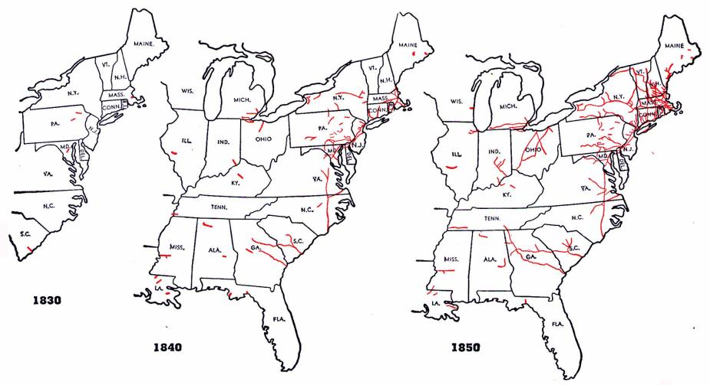
The railroad was America’s first “big business”
Railroad construction grew in the years before the Civil War…
…But, tracks were owned by different companies and were not standardized

Slide 8
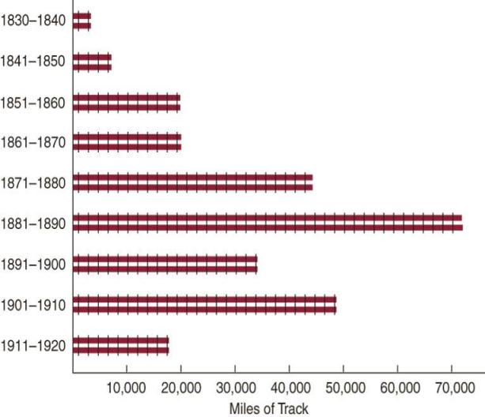
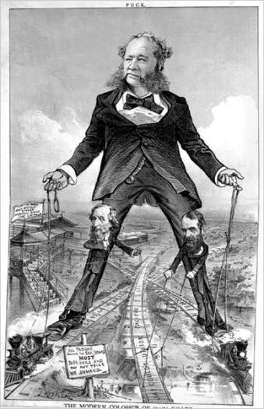
Large companies bought small railroads, standardized gauges and schedules, and pooled cars
Railroad construction boomed, led by tycoons like Cornelius Vanderbilt

Slide 9
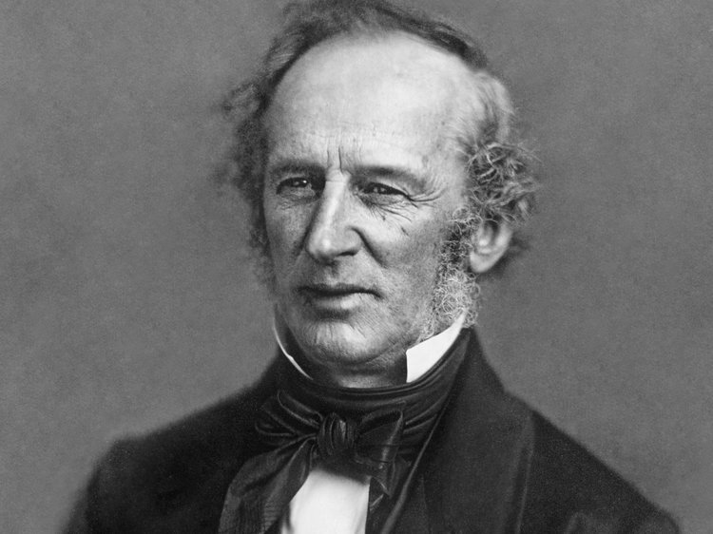

Slide 10
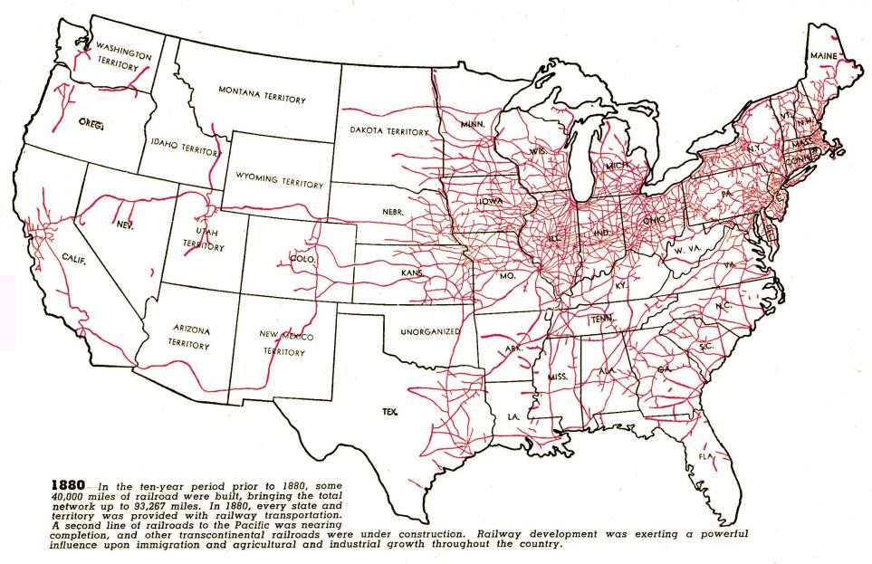
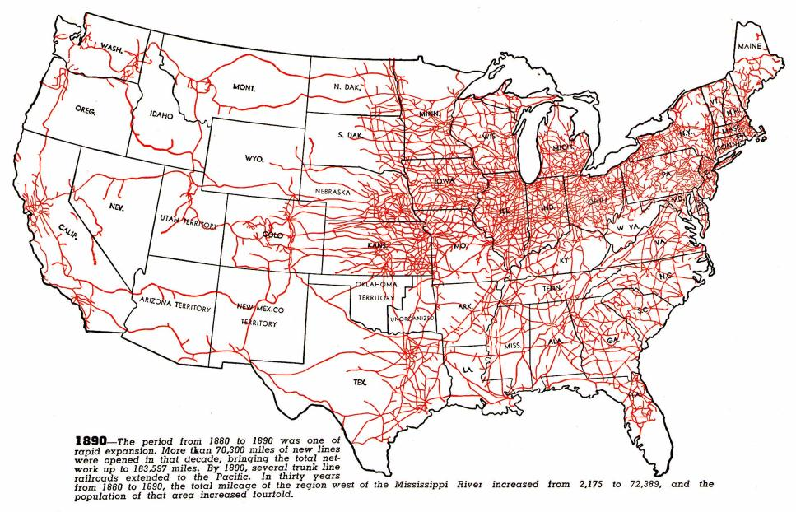
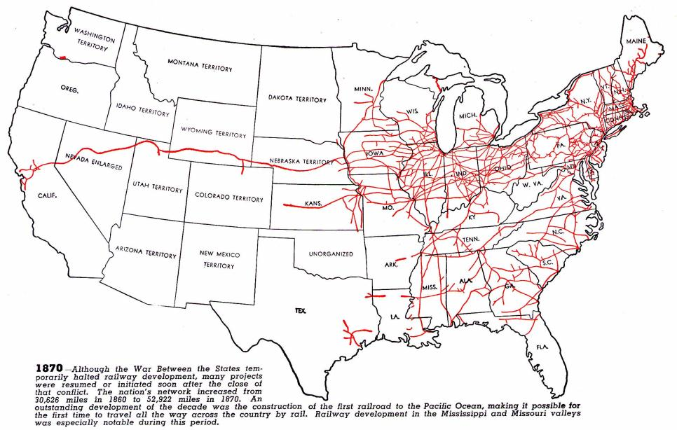
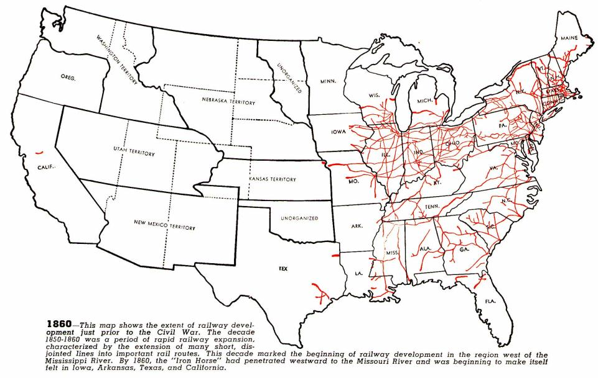
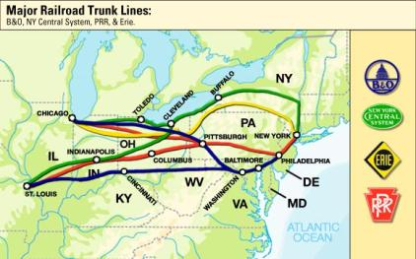
Railroad expansion led to a boom in the economy
Railroads connected the East, South, and West and allowed for national trade and regional specialization
The 1st transcontinental railroad was finished in 1869
Eastern railroads were connected to the West by 4 great trunk lines
Railroads stimulated demand for coal, oil, iron, and steel

Slide 11
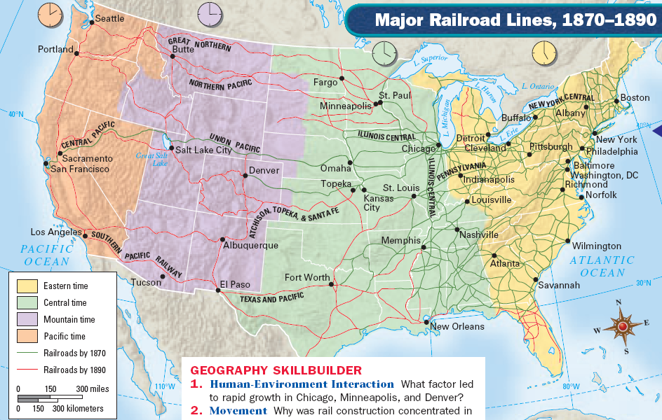

Slide 12
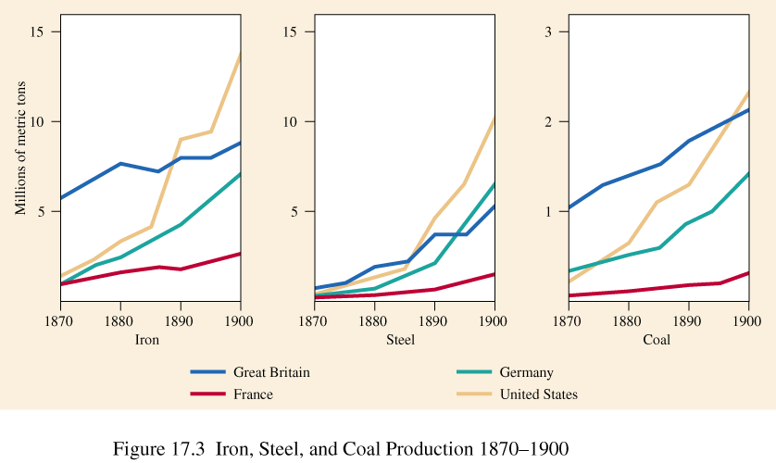
Industrialization led to a demand for iron and steel

Slide 13
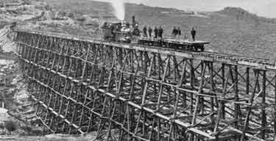
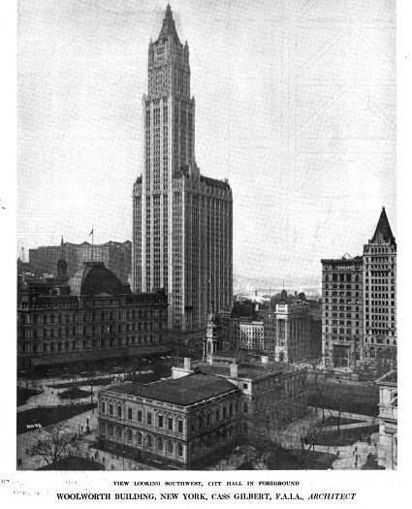
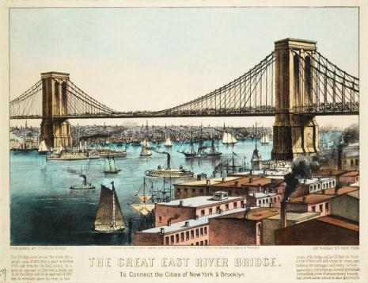
Steel led to skyscrapers, longer bridges, stronger railroads, and heavier machinery

Slide 14
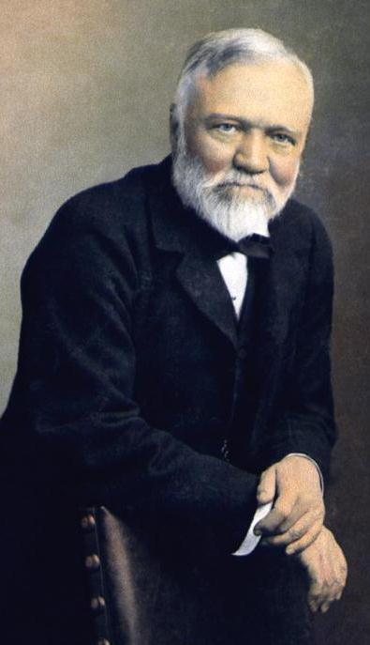
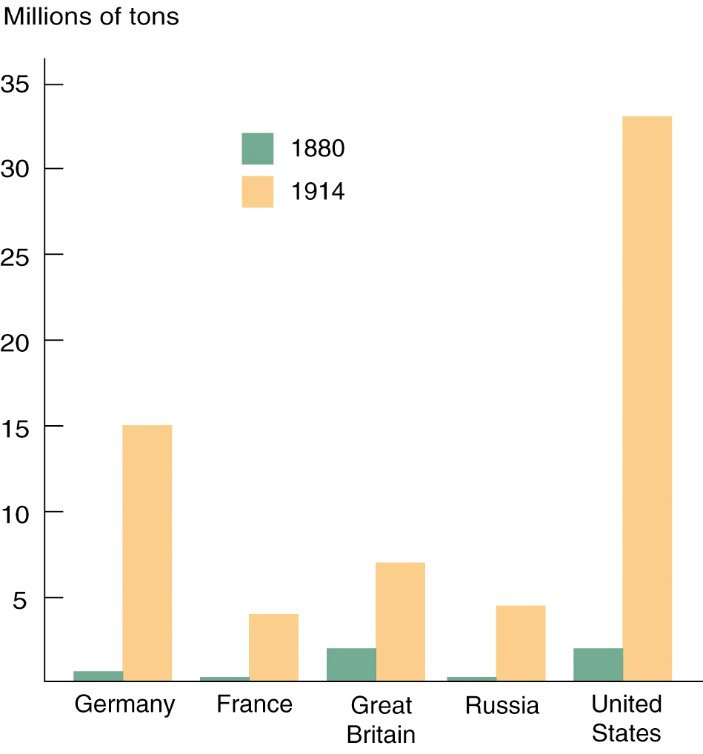
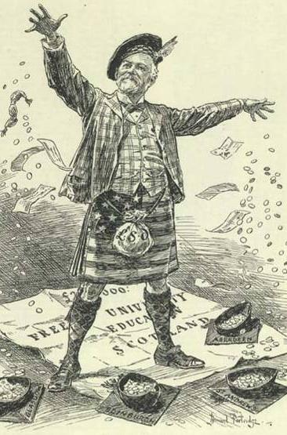
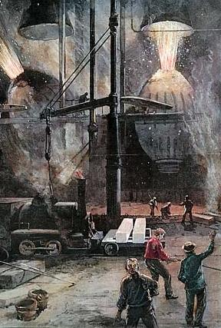
The iron and steel industries were dominated by Andrew Carnegie
Carnegie converted his mills to the Bessemer process and made the highest quality steel at the lowest price
Carnegie Steel Company produced more steel than all the steel factories in Great Britain combined
Carnegie best represented the American dream by rising from poor a immigrant to richest man in the world

Slide 15
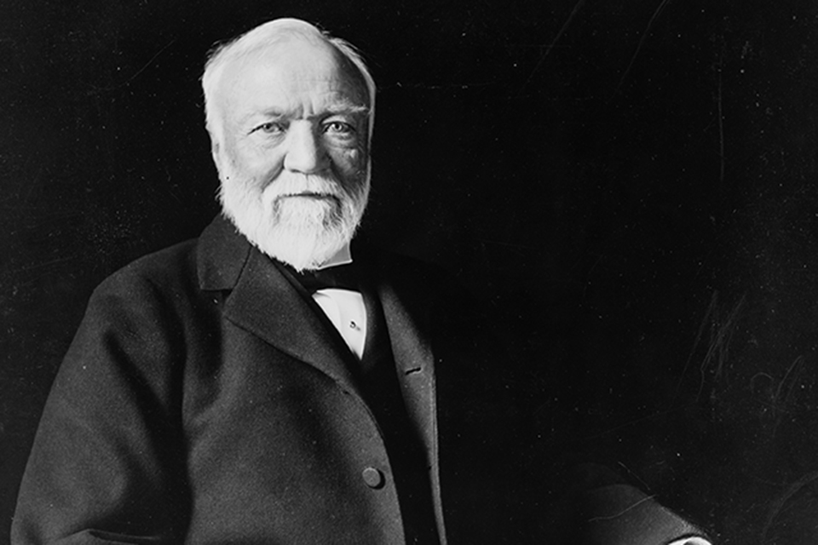

Slide 16
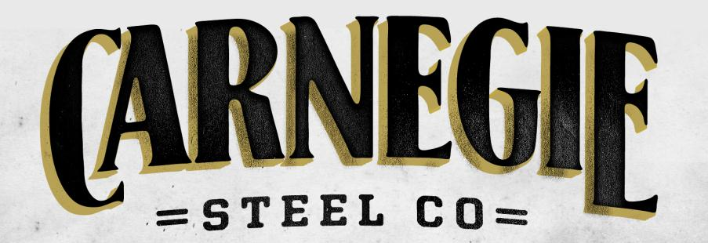
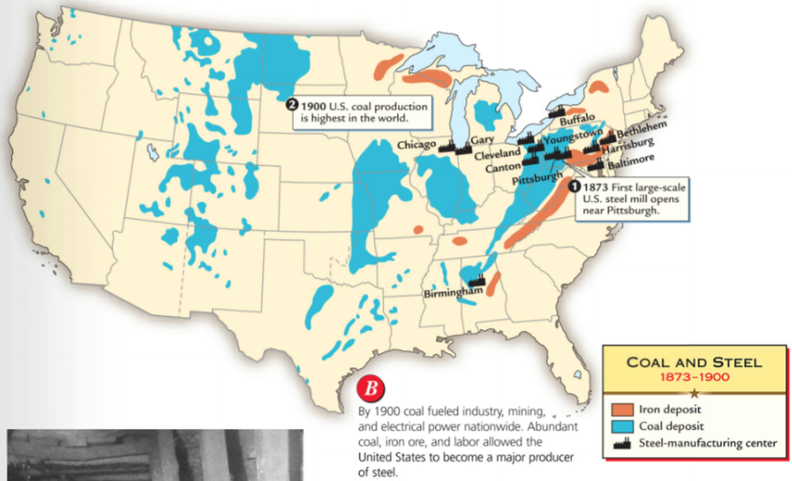
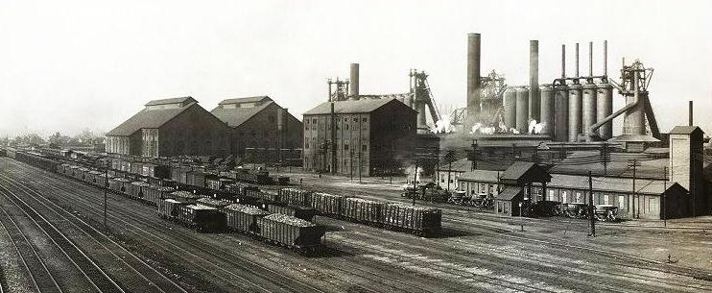

Slide 17
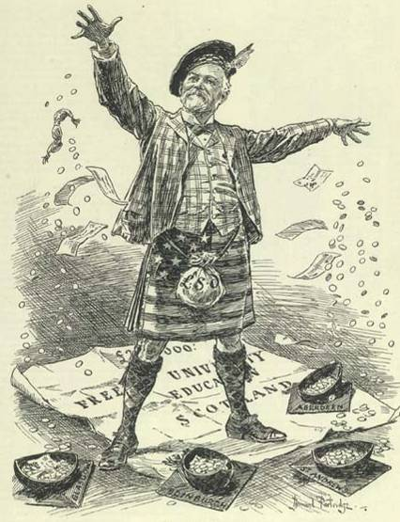
Robber Baron
Carnegie did not pay his employees very much and did not allow unions in his factories…
…but he was a philanthropist who gave money to libraries, colleges, and performing arts institutions
Captain of Industry
Notes:
9
Henry Bessemer (& William Kelly) turned iron into steel in 1850s—process allowed for mass production of steel

Slide 18
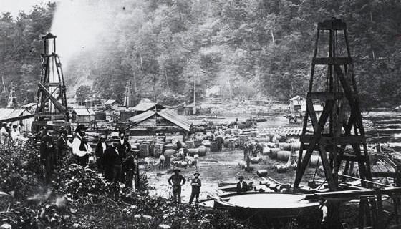
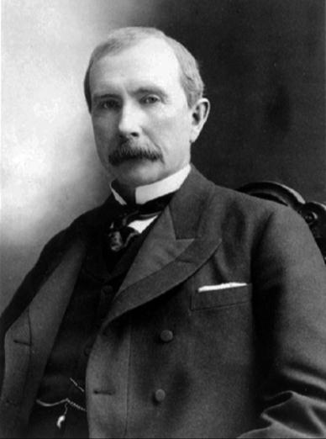
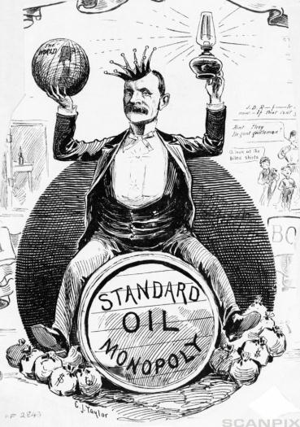
The oil industry during the Gilded Age was dominated John D. Rockefeller’s Standard Oil Company
Industrialization led to a demand for oil for lubrication and kerosene lighting
Rockefeller used ruthless tactics to buy out competing companies
Standard Oil lowered costs and improved the quality of its oil products
By 1879, Standard Oil sold 90% of the oil in America
Notes:
3
http://www.history.com/shows/men-who-built-america/videos/playlists/web-exclusives#the-men-who-built-america-monopoly (2.50)

Slide 19
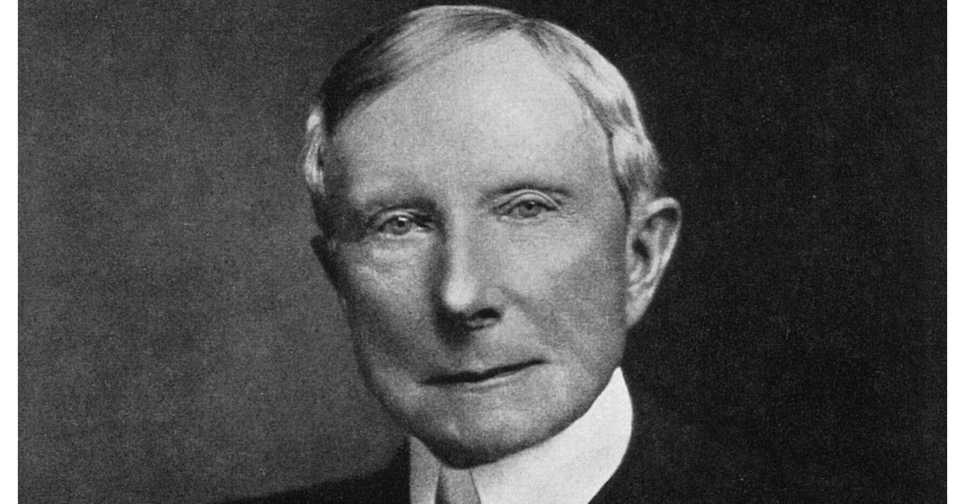

Slide 20
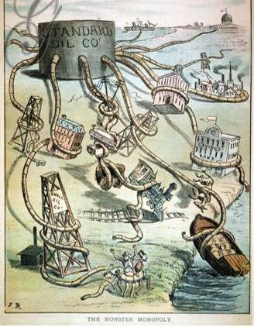
Robber Baron
Rockefeller took advantage of his workers and used his fortune to influence the national gov’t…
…but Rockefeller gave away $500 million to charities, created the Rockefeller Foundation, and founded the University of Chicago
Captain of Industry

Slide 22
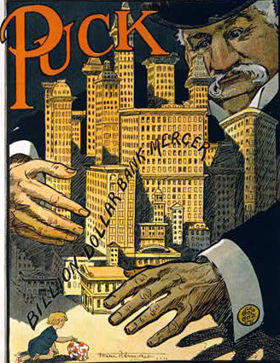
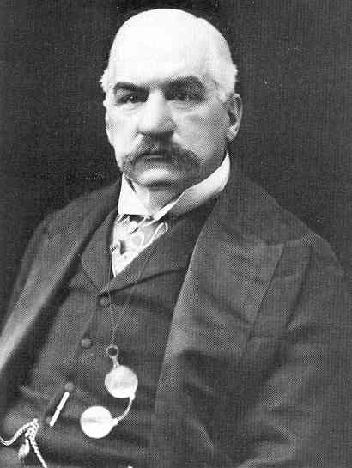
Industrialization led to a demand for financing so banking became a significant part of the Gilded Age
American finance was dominated by JP Morgan
He was so influential that he bailed out the railroad industry when companies were in trouble
He helped ease an economic depression during the Panic of 1907
JP Morgan (3.08)

Slide 23
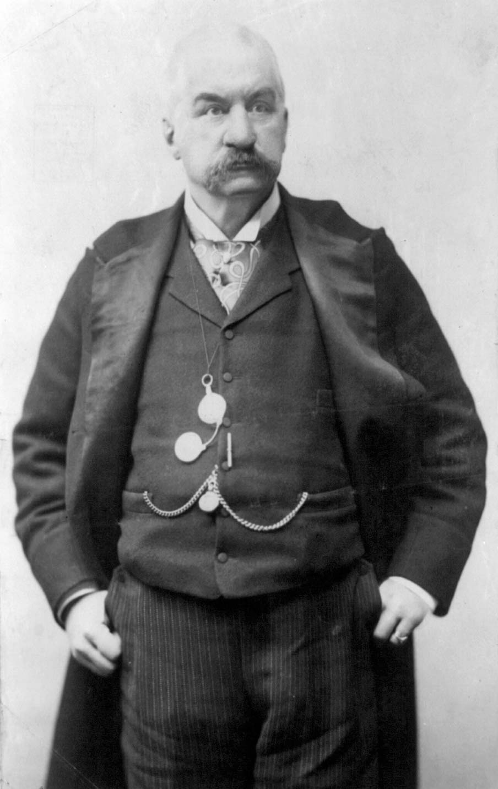
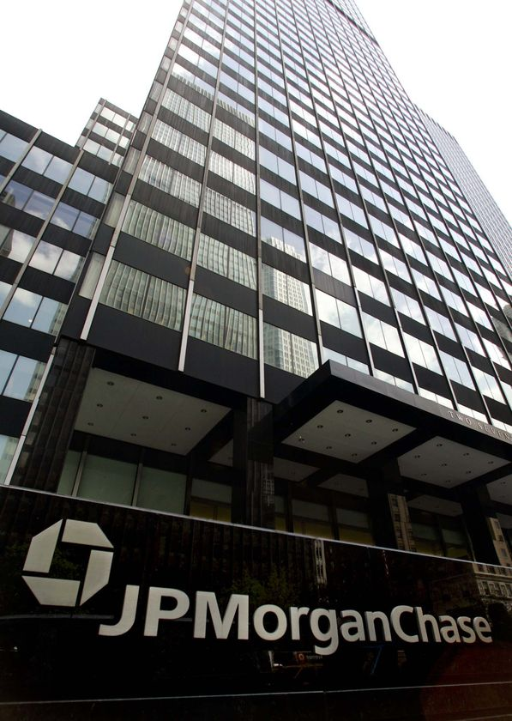

Slide 24
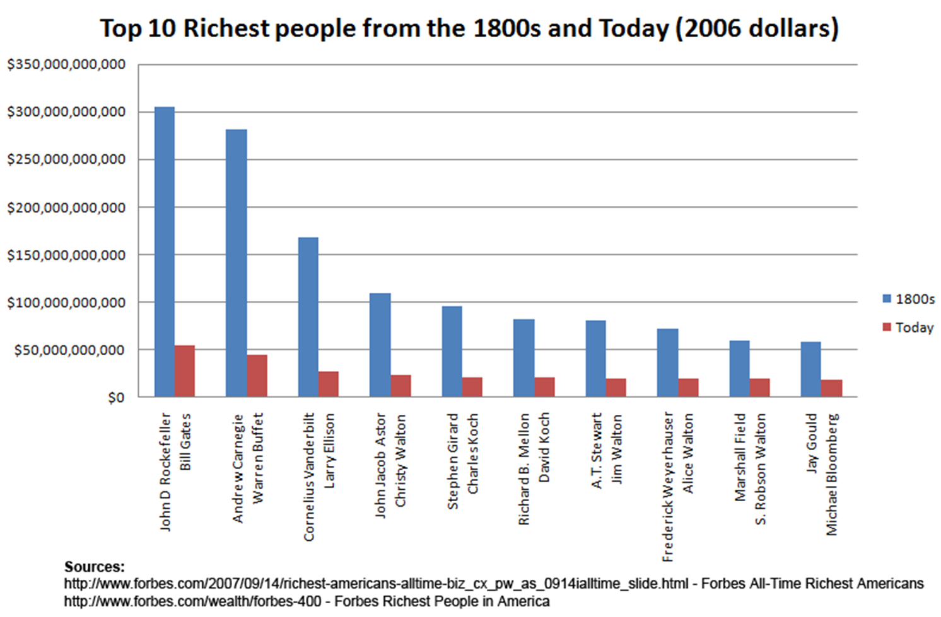

Slide 27
Industrialists like Vanderbilt, Carnegie, Rockefeller changed the way businesses were organized
Businesses hired professional managers to oversee employees, improve efficiency, and manage finances
Corporations became a more common business structure
Corporations used boards of trustees (“trusts”) to manage the company…
Holding Company
Board of Trustees
Company A
Company B
Company C
Company Manager
…and holding companies to manage other subsidiary companies
Employees
Company D
Company E
Employees
Company F
Employees
Company G
Employees
Company H

Slide 28
Industrialists changed the way businesses were organized
Goods made by family members
Families kept all profit but also all risk
Sold them in local and national markets
“Cottage” Industry (Colonial – 1800)

Slide 29
Industrialists changed the way businesses were organized
Goods made by hired workers in small factories
Usually owned by one person who was directly active in the manufacturing process
Hired workers used water-driven machines to mass produce items
Increased profit for owner
Paying jobs for workers
Potential for abuse against workers to maximize profit
Early Factory System
(1800-1860)
Lowell Mills

Slide 30
Industrialists changed the way businesses were organized
Goods mass-produced in large scale factories
Multiple owners share risk and profits but not directly involved in management
Board of Trustees – CEO and managers
Potential for abuse against workers to maximize profit
Corporation Model
(1860-Current)
Board of Trustees
Company Manager
Employees
Employees
Employees
Employees

Slide 31
Business Organization
Trust
Holding Company
Owners/Investors turn over control of corporation to a board of trustees who oversee the corporation. Profits go to the owners, but board of trustees operates the corporation
A parent company buys the majority of shares in subsidiary companies, which are then under the parent corporation’s control

Slide 33
Companies like Standard Oil used horizontal integration to buy similar companies to reduce competition

Slide 34
Companies like Carnegie Steel used vertical integration to buy companies in order to gain materials needed to make or deliver their products

Slide 36
Corporate mergers led to giant companies called monopolies that controlled the majority of an industry…
Because most monopolies were run by boards of trustees, monopolies became known as “trusts”

Slide 37
Monopolists justified their wealth in a variety of ways
The “Gospel of Wealth” argued that it is God's will for some men to gain great wealth so they could serve the public
Social Darwinism taught that natural competition weeds out the weak and allows the strong to survive
The government used laissez faire policies toward big business…
…the lack of regulation allowed businesses to become very powerful and exploitive

Slide 40
The Gilded Age was an era of political corruption in national, state, and urban governments

Slide 41
In the Gilded Age, presidents were seen as less powerful than monopolists like Carnegie, JP Morgan, and Rockefeller

