Slide 1
Industrialization and the Progressive Era
Paulding County U.S. History

Slide 2
Standards
SSUSH11 Examine connections between the rise of big business, the growth of labor unions, and technological innovations.
SSUSH12 Evaluate how westward expansion impacted the Plains Indians and fulfilled Manifest Destiny.
SSUSH13 Evaluate efforts to reform American society and politics in the Progressive Era.

Slide 3
Key Concepts
Railroads Industry
John D. Rockefeller
Andrew Carnegie
Telegraph
Telephone
Electric Light Bulb
Ellis Island
Angel Island
Labor Unions
American Federation of Labor
The Transcontinental Railroad
Immigrant Labor
Farming and Ranching
Wounded Knee
Progressives
Muckrakers
Jacob Riis
Upton Sinclair
Jane Addams
Ida Tarbell
Jim Crow Laws
NAACP
Plessy v. Ferguson
Empowering Voters
Labor Laws
Conservation Movement

Slide 4
The Impact of Railroads (SSUSH11a)
Railroad construction dramatically increased after the Civil War.
In fact, the United States went from having 35,000 miles of track in 1865 to over 193,000 miles of track by 1900.
Railroads connected vast regions of the United States and allowed for the efficient transport of goods.
The geographic connections railroads allowed created a national market.
No longer were goods and products regional.

Slide 5
Describe the importance of railroads based on the following map.

Slide 6
How did the growth of railroads impact individuals and businesses?

Slide 7
The Impact of Railroads (SSUSH11a)
Instead mass production and distribution of items created larger corporations and enormous profits.
As a result of the increase in railroad production other industries such as steel and oil grew at exponential rates.

Slide 10
Primary Source Analysis
God gave me my money.
Source: John D. Rockefeller

Slide 11
The Significance of John D. Rockefeller (SSUSH11b)
The most famous big business of the era was the Standard Oil Company, founded by John D. Rockefeller.
Rockefeller used the concepts of trust and monopoly to control more than 90% of America’s oil industry.
Trust: where several companies give one company the right to make financial decisions for them.
Monopoly: a single company that controlled virtually all the U.S. oil production and distribution.

Slide 12
What is the difference between vertical and Horizontal Integration?

Slide 13
Primary Source Analysis
“It will be a great mistake for the community to shoot the millionaires, for they are the bees that make the most honey, and contribute most to the hive even after they have gorged themselves full.”
Source: Andrew Carnegie, Wealth and its Uses

Slide 14
The Significance of Andrew Carnegie (SSUSH11b)
Another successful big business owner of the late 19th century was Andrew Carnegie.
The Carnegie Steel Company used the latest technology of the Bessemer process to forge steel more efficiently.
The increased production of steel and the use of vertical integration allowed Andrew Carnegie to amass the first billion dollar company.

Slide 15
The Significance of Andrew Carnegie (SSUSH11b)
Carnegie's use of vertical integration is similar to that of J.D. Rockefeller.
He controlled the entire production process from resource to finished product, which included mining the raw materials, industrial production of steel, and transportation for both resources and finished products.

Slide 16
What does the following graph tell you about U.S. Patents?

Slide 17
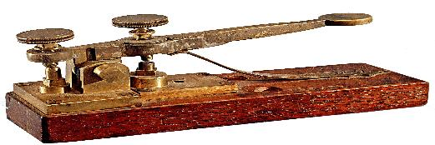
Why was this painting titled the Last Pony Express ride?

Slide 18
Technological Innovation (SSUSH11c)
Telegraph (SSUSH11c)
Samuel Morse invented the telegraph in 1832.
The telegraph machine received coded messages across electric wires connecting long distances.
With the development of telegraph technology, business could be more efficiently conducted between industrial centers in the East and their sources for raw materials in the South and West.

Slide 19
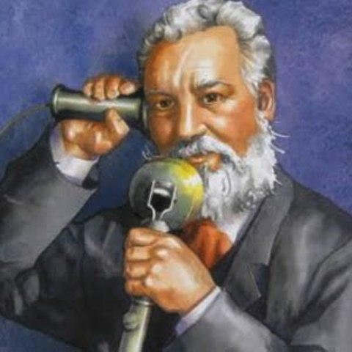

Slide 20
Technological Innovation (SSUSH11c)
Telephone (SSUSH11c)
In 1876, Alexander Graham Bell further expanded on the telegraph's capability for instant communication.
He invented the telephone, which allowed for voice - to - voice communication over electric wires.
As was true for the telegraph, the telephone impacted the United States by allowing instant communication.
With the invention of the telephone, conversations were more efficient and true discussion between individuals in distant locations was made possible.

Slide 21
Technological Innovation (SSUSH11c)
Electric Light Bulb (SSUSH11c)
One of Edison's most revolutionary inventions was the electric light bulb.
Not only did this development allow factories to be lit and operate twenty-four hours a day, but the light bulb also illuminated buildings, streets, and neighborhoods across the United States.
The light bulb was developed in the 1870s and quickly replaced the more dangerous and expensive lamp oils that burned for illumination.

Slide 22
Review Questions
What was the significance of the Railroad boom right after the Civil War?
What was the significance of John D. Rockefeller?
What was the significance of Andrew Carnegie?
How did Rockefeller and Carnegie impact American industry?
Define: Monopoly
Define: Trust
List three inventions that improved American Infrastructure during the Industrial era?

Slide 23
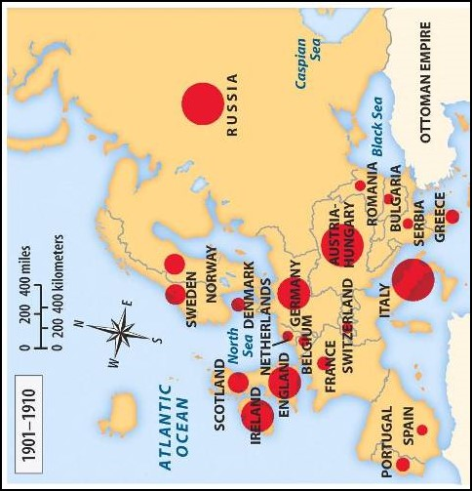

Slide 25
Changes in Immigration Patterns (SSUSH11d)
In the decades after the Civil War, more and more Europeans immigrated to America.
Early immigrant groups
Location: northern and western Europe
Religion: Protestant
Language: English

Slide 26
Changes in Immigration Patterns (SSUSH11d)
New immigrants
Location: eastern and southern Europe
Religion: Jewish or Catholic
Language: spoke no English

Slide 29
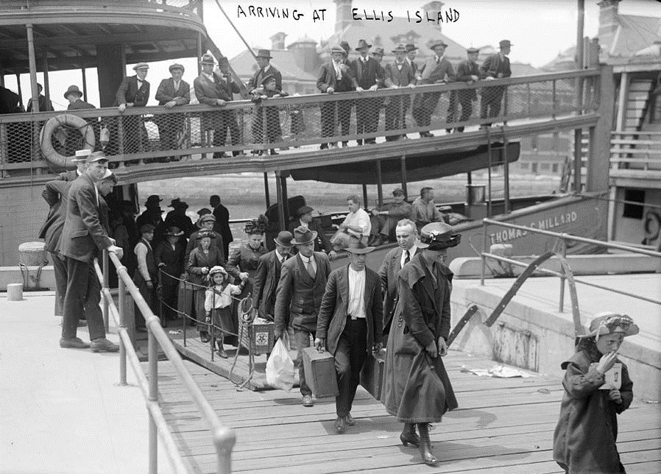

Slide 30
Significance of Ellis and Angel Islands (SSUSH11d)
At Ellis Island in New York and Angel Island in San Francisco new immigrants were forced pass health and welfare tests
The new immigrants were mostly poor, so they worked as unskilled laborers and lived mostly in cities.
They created communities to imitate the cultures of their home countries (little Italy and china).
Most of the new immigrants (Asia and Europe) to jobs in manufacturing and mining.

Slide 31
Primary Source Analysis
“To protect the workers in their inalienable rights to a higher and better life; to protect them, not only as equals before the law, but also in their health, their homes, their firesides, their liberties as men, as workers, and as citizens…to this workers are entitled…The attainment of these is the glorious mission of the trade unions.”
Source: Excerpt from Samuel Gompers’ Speech in 1898

Slide 32
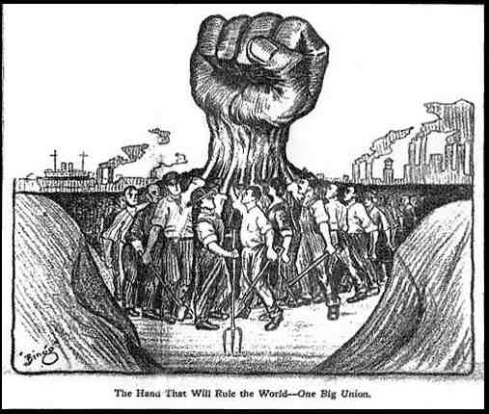

Slide 33
The Growth of Labor Unions (SSUSH11e)
The Growth of unskilled laborers who were subject to low wages, long workdays, no vacations, and unsafe workplaces led to an increase in labor unions.
Unskilled labors decided to band together in labor unions to demand better pay and working conditions.
The most famous labor union American Federation of Labor, was led by Samuel Gompers.
Labor Unions used strikes (work stoppages) to convince employers to give workers shorter workdays, better working conditions, higher wages, and greater control over how they carried out their workplace responsibilities.

Slide 34
Review Questions
What were the names of the two islands used to receive new immigrants?
Who were the new immigrants
From:__________________________________________
Spoke: _________________________________________
Religion:_______________________________________
What was the purpose of the American Federation of Labor?
What were some of the tactics used by the American Federation of Labor?

Slide 35
Primary Source Analysis
From the West, the railroads carried eastward such raw materials as lumber, minerals, livestock, and grain. In midwestern cities like St. Louis, Chicago, Minneapolis, and Cleveland, the raw materials were processed. Grain was milled into flour. Hogs became bacon and hams. Cattle became beef. Iron ore was converted into steel. Lumber was cut into wood for housing. The processed goods were shipped by rail to eastern cities. From eastern cities, in turn, came manufactured goods, which were sold to westerners. . . .
Source: Lorna Mason et al., America’s Past and Promise, McDougal Littell

Slide 36
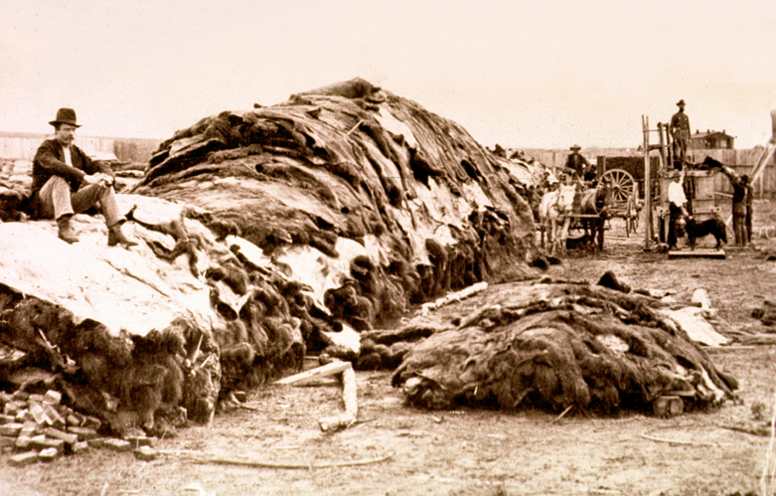

Slide 37
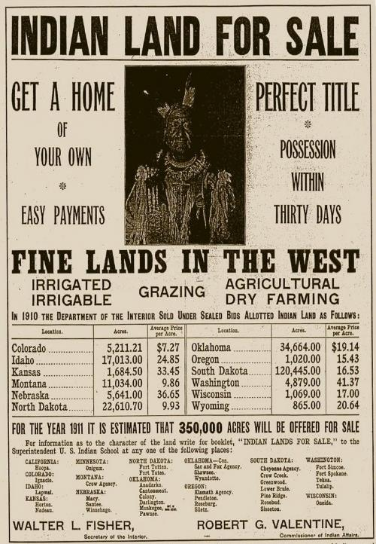

Slide 38
Transcontinental Railroad (SSUSH12a)
Railroads made life out west possible by allowing farmers, ranchers, and other settlers’ access to eastern markets and resources.
They also made it easier for people to move west and populate territories at a rapid rate.
In 1862, Congress coordinated an effort among the railroad companies to build a Transcontinental Railroad.

Slide 39
Transcontinental Railroad (SSUSH12a)
Union Pacific (an eastern rail company) and Central Pacific (a rail company from Sacramento, California) joined their tracks at Promontory, Utah, in 1869.
As a symbol of their union that now linked the nation east to west, representatives drove a gold spike to mark the occasion.

Slide 41
Primary Source Analysis
As a class, they [Chinese Laborers] are quiet, peaceable, patient, industrious, and economical. More prudent and economical [than white laborers], they are content with less wages. We find them organized for mutual aid and assistance. Without them, it would be impossible to complete the western portion of this great national enterprise [Transcontinental Railroad] within the time required by the Act of Congress.
Source: Leland Stanford, President of the Central Pacific Railroad, 1865

Slide 42
Construction of the Railroad
To build the Transcontinental Railroad businesses use thousands of immigrant laborers from Ireland and China.
These immigrants often worked under very dangerous conditions.
Laying railroad track could cause injury or even death.

Slide 43
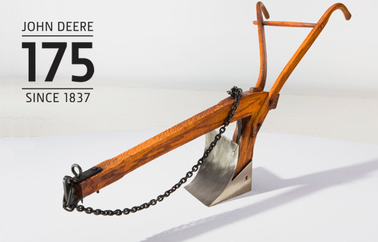

Slide 44
Growth of the Western Population (SSUSH12b)
Many settlers moved west intending to be farmers.
Meanwhile, a number of technological advances made western farming possible.
John Deere's steel plow allowed farmers to plant crops in the Midwest and plains by enabling them to cut through the tough prairie sod.
Another industry that became big in the West was cattle ranching.

Slide 45
Growth of the Western Population (SSUSH12b)
Barbed wire made it possible for farmers to cheaply and efficiently fence in their land and livestock.
The growth of the cattle industry contributed to the slaughter of buffalo that otherwise would have competed with cattle for food.
It also meant that even more land was taken from Native Americans.

Slide 46
Primary Source Analysis
“And so, at last, our fathers were steadily driven out, or killed, and we, their sons, but sorry remnants of tribes once mighty, are cornered in little spots of the earth all ours of right— cornered like guilty prisoners, and watched by men with guns, who are more than anxious to kill us off.
Source: Chief Washakie of the Shoshone tribe from a speech to Governor John W. Hoyt of the Wyoming Territory

Slide 47
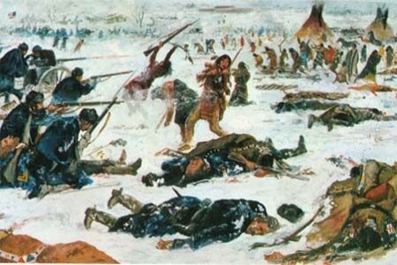

Slide 48
Plains Indian’s Resistance to Western Expansion (SSUSH12c)
As settlers and railroads ventured further west, The Plains Indians chose to accept being moved off of their land.
While Sioux Indians were being removed for their land, they were surrounded by the U.S. Army.
A brutal massacre followed, in which it’s estimated 150 Indians were killed (some historians put this number at twice as high), nearly half of them women and children.

Slide 49
Plains Indian’s Resistance to Western Expansion (SSUSH12c)
The cavalry lost 25 men.
The conflict (Massacre) at Wounded Knee was originally referred to as a battle, but in reality it was a tragic and avoidable massacre.
Wounded Knee makes the end of the Plains Indians resistance to Westward Expansion

Slide 50
Review Questions
What immigrant groups helped build the transcontinental railroad?
How did the Transcontinental railroad impact western population?
List three innovations that impacted farming and ranching in the West?
How did the Plains Indians’ resist westward expansion?
What one consequence of the Plains Indians’ resistance to western expansion?

Slide 51
What are the artists trying to summarize with the following images?

Slide 55
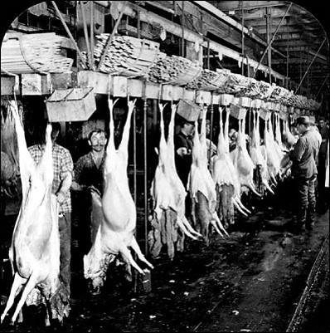

Slide 56
Primary Source Documents
Progressivism: The political orientation of those who favor progress toward better conditions in government and society (http://define.ansme.com/words/p/progressivism.html)
Progressive: A person believing in moderate political change and social improvement through political action (Merriam-Webster Dictionary)

Slide 57
The Role of Muckrakers (SSUSH13a)
Muckrakers were journalists that investigated and exposed political corruption, child labor, slum conditions, and other social issues.
Two famous Muckrakers
Jacob Riis
Jacob Riis wrote How the Other Half Lives
Significance: Exposed the horrible conditions under which immigrants worked and lived.
Result: Riis' efforts contributed largely to New York passing its first laws aimed at improving urban tenements.

Slide 58
Primary Source Analysis
The clamor that rang throughout America was not, however, a response to the workers’ plight. Upton Sinclair also uncovered the contents of the products being sold to the general public. Spoiled meat was covered with chemicals to hide the smell. Skin, hair, stomach, ears, and nose were ground up and packaged as head cheese. Rats climbed over warehouse meat, leaving piles of excrement behind. Sinclair said that he aimed for America’s heart and instead hit its stomach. Even President Roosevelt, who coined the derisive term ‘muckraker,’ was propelled to act. Within months, Congress passed the Pure Food and Drug Act and the Meat Inspection Act to curb these sickening abuses.”
Source: ushistory.org

Slide 59
The Role of Muckrakers (SSUSH13a)
Upton Sinclair
Wrote: The Jungle (Book)
Significance: Exposed poor labor practices and unsanitary conditions that produced contaminated meat.
Result: Passage of the Meat Inspection Act and Pure Food and Drug Act

Slide 60
Primary Source Analysis
“As the early years at Hull House show, female participation in that area of reform grew out of a set of needs and values peculiar to middle-class women in the late nineteenth and early twentieth century. Settlement workers did not set out to become reformers. They were rather women trying to fulfill existing social expectations for self-sacrificing female service while at the same time satisfying their need for public recognition, authority, and independence. In the process of attempting to weave together a life of service and professional accomplishment, they became reformers as the wider world defined them.”
Source: Robyn Muncy, historian, Creating a Female Dominion in American Reform, 1890–1935, published in 1991.

Slide 61
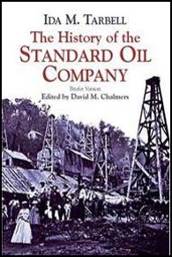

Slide 62
The Role of Women in Reform Movements. (SSUSH13b)
Ida Tarbell
Wrote: The History of the Standard Oil Company
Significance: She criticized Standard Oil Company’s unfair business practices.
Result: Standard Oil Company convicted of violating the Sherman Antitrust Act. Forced the company to split up into 32 “baby Standards”.

Slide 63
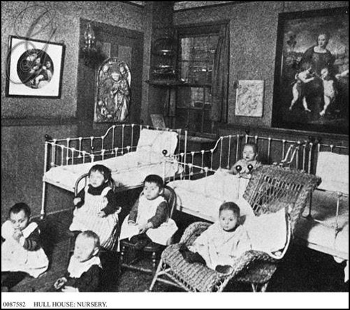
The Role of Women in Reform Movements. (SSUSH13b)
Jane Addams established Hull House in Chicago.
Hull House was a social service agency that provided help to recent immigrants about home economics, basic medical care, the English language and legal rights.

Slide 65
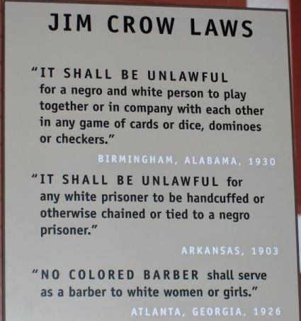

Slide 66
African American Rights (SSUSH13c)
During this time racial discrimination and segregation continued to decline in the South.
The decline of African American rights.
Jim Crow laws were established in the South and resulted in inferior education, health care, and transportation systems for African Americans.
In Plessy v. Ferguson, the U.S. Supreme Court ruled that the Jim Crow laws were constitutional. Under the “separate but equal” doctrine, the court ruled racial segregation was legal in public facilities.

Slide 67
African American Rights (SSUSH13c)
To legally fight against the loss of their civil rights, African Americans created the National Association for the Advancement of Colored People (NAACP).

Slide 68
Review Questions
What was the significance of the Progressive Era?
Define: Muckrakers
How did the muckrakers impact society?
What was the role of women during the Progressive Era?
What were the Jim Crow laws?
What was the significance of Plessy v. Ferguson?
What was the purpose of the NAACP?

Slide 69
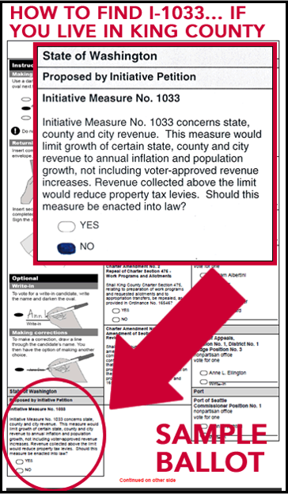

Slide 70
Progressive Legislative Actions (SSUSH13d)
Empowerment of Voters (SSUSH13d)
Initiative is a means by which a petition signed by a certain number of voters can force a public vote.
Referendum is a vote in which the voting population is asked to accept or reject a particular proposal.
Recall is a procedure to remove an elected official from office before his or her term has ended.
17th Amendment: Direct election of Senators

Slide 71
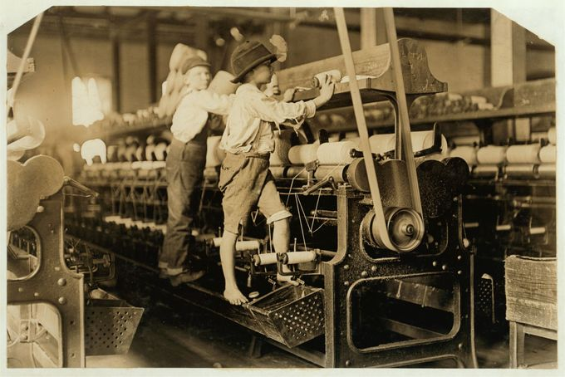

Slide 72
Progressive Legislative Actions (SSUSH13d)
Labor Laws (SSUSH13d)
Most workers' wages were low.
As a result, men, women, and even children often had to work long hours for little pay.
In addition, workdays tended to run from sunrise to sundown and usually involved dangerous conditions.
Many progressives called for shorter workdays, higher wages, and safer work environments for employees.
Eventually, reformers succeeded in convincing a number of states to pass minimum age laws.

Slide 73
Primary Source Analysis
“I recognize the right and duty of this generation to develop and use the natural resources of our land; but I do not recognize the right to waste them, or to rob, by wasteful use, the generations that come after us.”
Former president Theodore Roosevelt, 1910

Slide 74
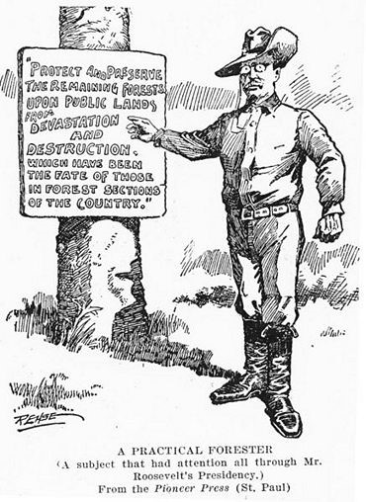

Slide 76
Progressive Legislative Actions (SSUSH13d)
The Conservation Movement (SSUSH13d)
Theodore Roosevelt supported the conservation movement.
The conservation movement helped save millions of acres of wilderness land and created the national park system
Examples: Yellowstone and the Grand Canyon

Slide 78
Review Questions
List 3 ways progressives improved citizen’s political power?
What was the significance of Teddy Roosevelt’s Conservation Movement?

