Slide 1
JFK and Johnson Administrations
U.S. History

Slide 2
Standards
SSUSH21 Analyze U.S. international and domestic policies including their influences on technological advancements and social changes during the Kennedy and Johnson administrations

Slide 3
Key Concepts
Cuban Missile Crises
Vietnam War
Gulf of Tonkin Resolution
Assassination of John F. Kennedy
Civil Rights Act
Voting Rights Act
Lyndon B. Johnson
Great Society
Television
Kennedy/Nixon Presidential Debate
Civil Rights Movement
Martin Luther King
Letter from a Birmingham Jail
I Have a Dream Speech
Southern Christian Leadership Conference
Student Non-Violent Coordinating Committee
Cesar Chavez
Assassination of Martin Luther King, Jr.
Assassination of Robert F. Kennedy
Tet Offensive
Presidential Election of 1968
Vietnam War

Slide 4
Review Questions
What political dictator started a revolution in Cuba that led to the country becoming Communist?
What was the significance of the Bay of Pigs Invasion?
What was the significance of the Cuban Missile Crisis?
What did the Soviet Union agree to do as a result of the Cuban Missile Crisis?
What did the United States agree to do as a result of the Cuban Missile Crisis?
Why did the United States participate the Vietnam War?
What was the significance of the Gulf of Tonkin Resolution?

Slide 5
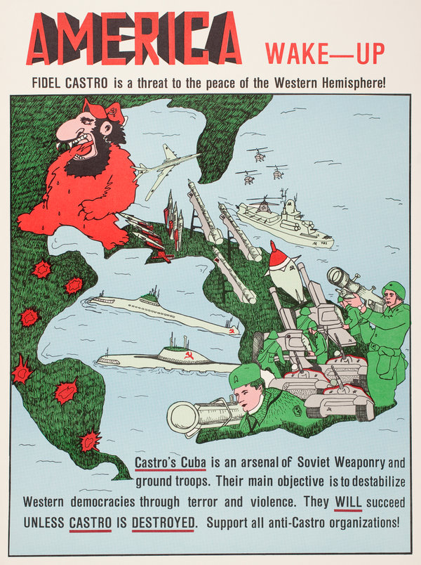

Slide 6
Document Analysis
Secondly, it is clear that this Nation… must take an even closer and more realistic look at the menace of external Communist intervention…in Cuba. The American people are not complacent about Iron Curtain tanks and planes less than 90 miles from our shores…. We and our Latin friends will have to face the fact that we cannot postpone any longer the real issue of the survival of freedom in the hemisphere itself….
Source: Speech delivered by President Kennedy before the American Society of Newspapers Editors at Washington, D.C., April 20, 1961

Slide 7
The Cold War Continued (SSUSH21a)
U.S. Involvement in Cuba (SSUSH21a)
With U.S. support, Fidel Castro led the Cuban Revolution in 1956
Later, Castro allied himself and Cuba with the Soviet Union (communism)
The U.S. used it’s containment policy to stop the spread of communism in Cuba (90 miles for America)

Slide 8
The Cold War Continued (SSUSH21a)
Bay of Pigs invasion of Cuba
Cuban exiles trained by the U.S attempt to invade communist Cuba
Biggest failure of President Kennedy
Invasion fails because Kennedy would not us the U.S. military
The United States was forced to give $53 million worth of food and supplies to Cuba for release of the 1,200 captives.

Slide 9
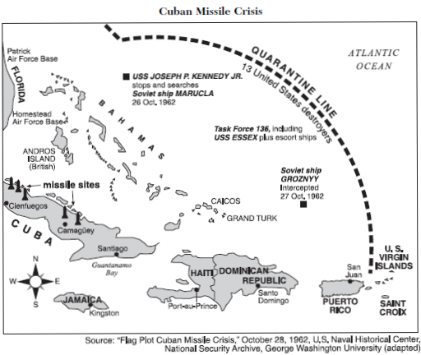

Slide 10
The Cold War Continued (SSUSH21a)
Cuban Missile Crisis
To stop future invasion of Cuba, the Soviet Union build military missile launch sites in Cuba.
American spy planes take photos of a Soviet missile site in Cuba and Kennedy immediately began planning a response.
Soviet missiles 90 miles from the U.S. posed a serious threat to American security.

Slide 11
The Cold War Continued (SSUSH21a)
Cuban Missile Crisis
Kennedy’s plan was to create a blockade of Cuba and threatened to invade unless the Soviets promised to withdraw from Cuba.
Soviets agree to remove missiles if the U.S. removed its nuclear missiles from Turkey.

Slide 12
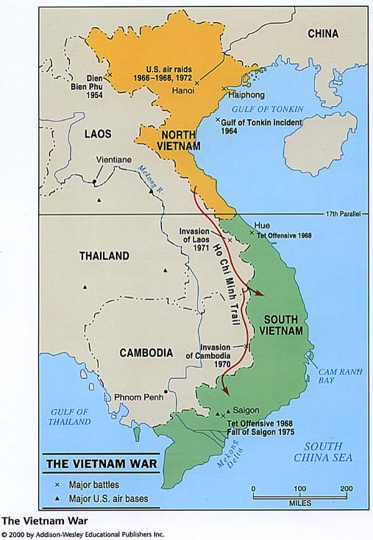

Slide 14
The Cold War Continued (SSUSH21a)
The War in Vietnam (SSUSH21a)
In early August 1964, two U.S. destroyers stationed in the Gulf of Tonkin in Vietnam radioed that they had been fired upon by North Vietnamese forces.
In response to these reported incidents, President Lyndon B. Johnson requested permission from the U.S. Congress to increase the U.S. military presence in Indochina.

Slide 15
The Cold War Continued (SSUSH21a)
On August 7, 1964, Congress passed the Gulf of Tonkin Resolution, authorizing President Johnson to take any measures he believed were necessary to retaliate and to promote the maintenance of international peace and security in Southeast Asia.
This resolution became the legal basis for the Johnson and Nixon Administrations prosecution of the Vietnam War.

Slide 16
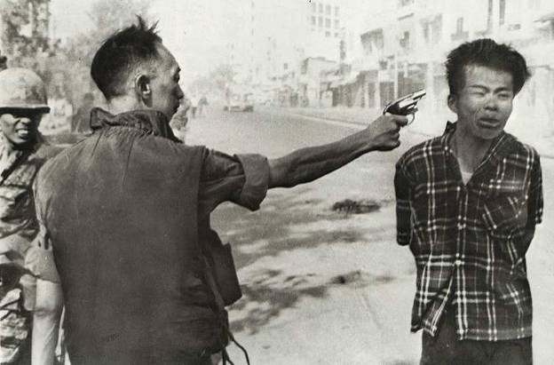

Slide 17
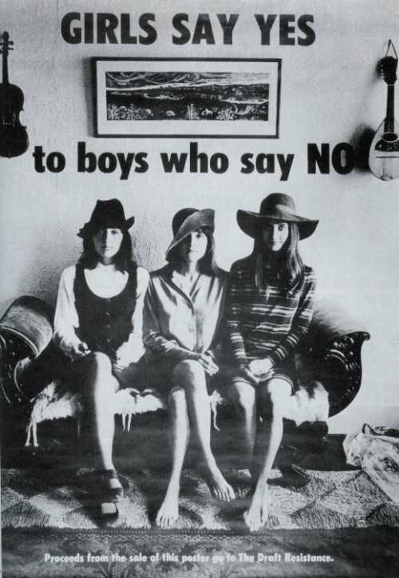

Slide 18
The Cold War Continued (SSUSH21a)
Tet-Offensive (1968)
The largest Vietcong campaign of the war (8 months)
Tet Offensive fails to drive American out of Vietnam
It did inspire Vietnam protesters to question why the U.S. was in the war and if we were winning the war.
Most protesters favored ending the draft and removing all American troops from Vietnam.

Slide 19
Review Questions
What political dictator started a revolution in Cuba that led to the country becoming Communist?
What was the significance of the Bay of Pigs Invasion?
What was the significance of the Cuban Missile Crisis?
What did the Soviet Union agree to do as a result of the Cuban Missile Crisis?
What did the United States agree to do as a result of the Cuban Missile Crisis?
Why did the United States participate the Vietnam War?
What was the significance of the Gulf of Tonkin Resolution?

Slide 20
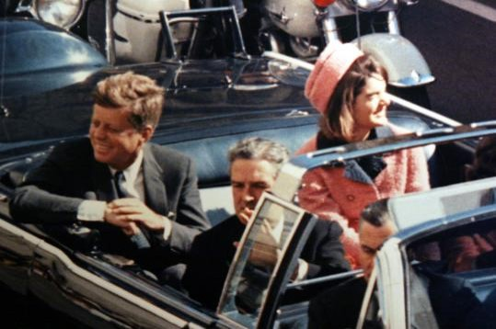

Slide 21
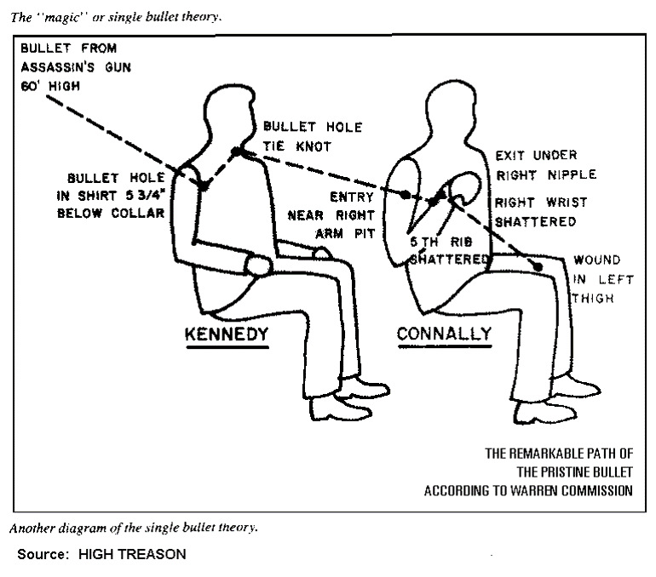

Slide 22
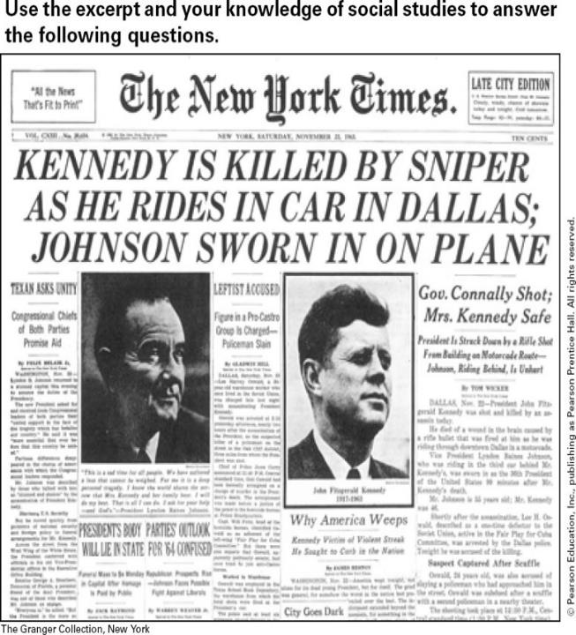

Slide 23
Impact of John F. Kennedy’s Assassination (SSUSH21d)
President Kennedy was Assassinated in Dallas, Texas, in November 1963
Showed Americans just how strong gov’t was because, although the president could be killed, the U.S. gov’t would live on. (Chain of Command)
The assassination gave the new president, Lyndon Johnson, the political capital to force three domestic legislative package through Congress.

Slide 24
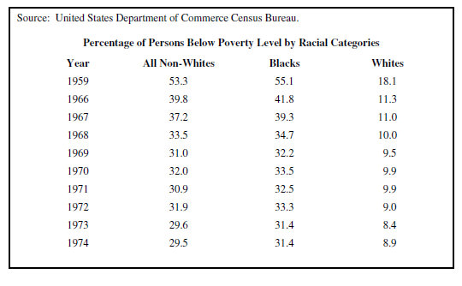

Slide 25
Document Analysis
“Our society will never be great until our cities are great… where…. we begin to build the Great Society is in our countryside. We have always prided ourselves on being…America the beautiful. Today that beauty is in danger. The water we drink. The food we eat, the very air that we breathe, are threatened… A third place to build the Great Society is in the classrooms of America…. Our society will not be great until every young mind is set free to scan the farthest reaches of thought and imagination. We are still far from that goal.
Source: President Lyndon B. Johnson, Great Society speech, (Commencement address to the University of Michigan, May 22, 1964)

Slide 26
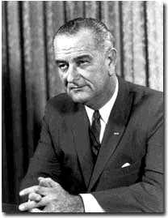

Slide 27
Lyndon Johnson’s Great Society (SSUSH21d)
A series of laws and programs that would later be called President Johnson’s “Great Society”
The Great Society programs were designed to improve Americans standard of living and give citizens greater opportunities regardless of their background.
Three Great Society laws
Economic Opportunity Act of 1964 (War on Poverty)
Civil Rights Act of 1964
Medicare: federal funding for the medical cost of the elderly

Slide 28
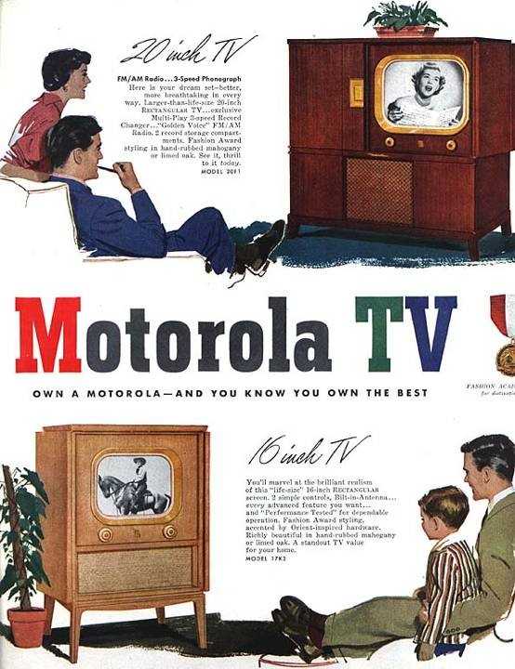

Slide 30
Impact of Television (SSUSH21c)
Kennedy/Nixon Presidential Debates (SSUSH21c)
Seventy million people watch the 1960 debate
Nixon seems more knowledgeable about foreign policy and other topics, but he looked sick
Kennedy was coached on how to look and speak during the debate by television producers
Kennedy’s performance on T.V. helped him win the presidency.

Slide 31
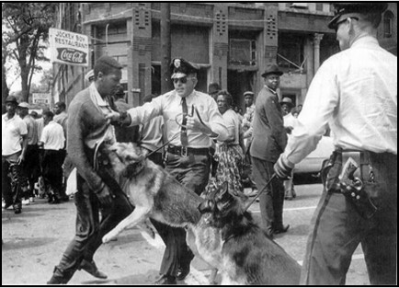

Slide 32
Impact of Television (SSUSH21c)
The Civil Rights Movement (SSUSH21c)
In the 1960’s, T.V. gave all American the chance to see civil rights demonstration
American witnessed African Americans being hit by high pressure fire hoses and attacked by police dogs.
Attacks encourage Americans and Kennedy to demand new civil rights laws. (Civil Rights Act of 1964 and Voting Rights Act of 1965)

Slide 33
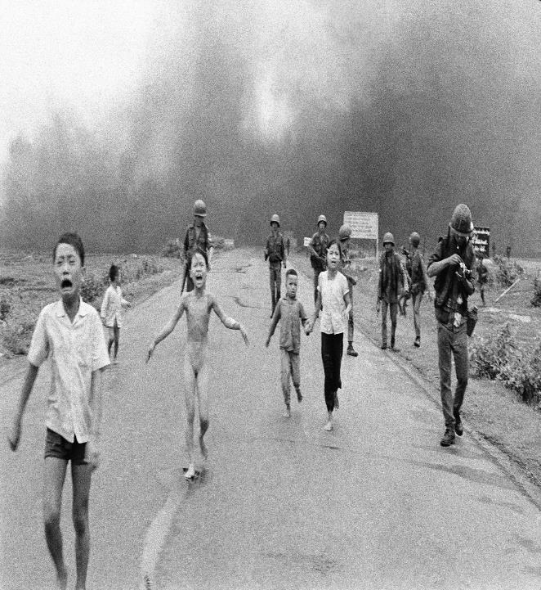

Slide 34
Impact of Television (SSUSH21c)
War in Vietnam (SSUSH21c)
In the 1960’s, T.V. gave all American the chance to see the Vietnam War.
The show of the Vietnam War on T.V. led to protests against the war.

Slide 35
Review Questions
What was the political result of the John F. Kennedy Assassination?
What was the purpose of Lyndon B. Johnson’s Great Society?
List 3 social programs that were part of Johnson’s Great Society?
List three events that were impacted by the creation of the Television?

Slide 36
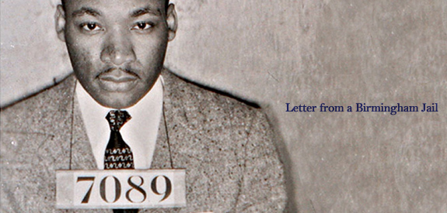
Just as Socrates felt that it was necessary to create a tension in the mind so that individuals could rise from the bondage of myths and half truths to the unfettered realm of creative analysis and objective appraisal, so must we see the need for nonviolent gadflies to create the kind of tension in society that will help men rise from the dark depths of prejudice and racism to the majestic heights of understanding and brotherhood. The purpose of our direct action program is to create a situation so crisis packed that it will inevitably open the door to negotiation. I therefore concur with you in your call for negotiation. Too long has our beloved Southland been bogged down in a tragic effort to live in monologue rather than dialogue.”
Source from Dr. King’s Letter from a Birmingham Jail, 1963

Slide 37
Martin Luther King Jr. (SSUSH21d)
Letter From Birmingham Jail” (letter)
MLK was arrested in Birmingham, Alabama, while demonstrating against racial segregation.
In Jail he wrote his “Letter from Birmingham Jail” to address fears white religious leaders had that he was moving too fast toward desegregation.
King explained why victims of segregation, violent attacks, and murder found it difficult to wait for those injustices to end.

Slide 38
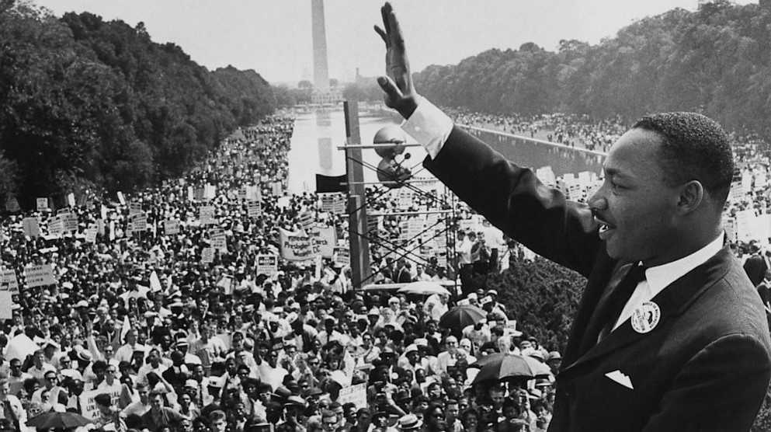
Document Analysis
“I have a dream that one day this nation will rise up and live out the true meaning of its creed: ‘We hold these truths to be self-evident; that all men are created equal.’”
Source Martin Luther King, Jr. Washington, D.C., 1963, March on Washington

Slide 39
Martin Luther King Jr. (SSUSH21d)
“I Have a Dream” (Speech)
MLK’s most famous speech
He spoke to over 250,000 people at the Lincoln Memorial in Washington, D.C.
In this speech, King asked for peace and racial harmony.

Slide 40
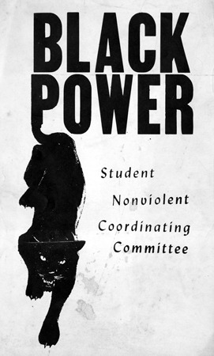

Slide 41
Two Civil Rights Groups (SSUSH21d)
The Southern Christian Leadership Conference (SCLC)
Founder: MLK Jr.
Goal: to carry on nonviolent crusades against African Americans
Tactics: marches and protests

Slide 42
Two Civil Rights Groups (SSUSH21d)
The Student Nonviolent Coordinating Committee (SNCC)
Founder: African American college students (Shaw University)
Goal: speed up the changes mandated by Brown v. Board of Education.
Tactics: Sit-ins, Freedom rides, registering African Americans to votes, later used violence

Slide 43
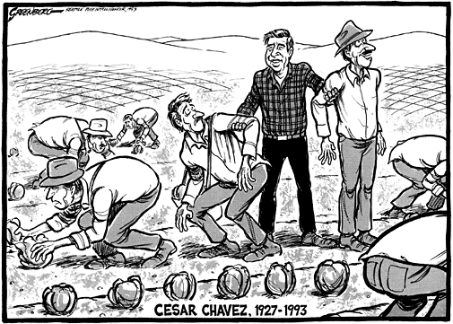

Slide 44
Cesar Chavez and the United Farm Workers (UFW) (SSUSH21d)
César Chávez and his United Farm Workers movement, protested for equal rights in the work place.
Chávez believed in nonviolent methods to achieve his goals.
In 1965, he started a nationwide boycott of California grapes, forcing grape growers to negotiate a contract with the United Farm Workers in 1970.
This contract gave farm workers higher wages and other benefits for which they had been protesting through the sixties.

Slide 45
Review Questions
List two tactics used by Civil Rights groups?
What was the significance of Martin Luther King Jr.’s Letter from a Birmingham Jail?
What was the significance of Martin Luther King Jr.’s I Have a Dream Speech?
What was the significance of Cesar Chavez?

Slide 46
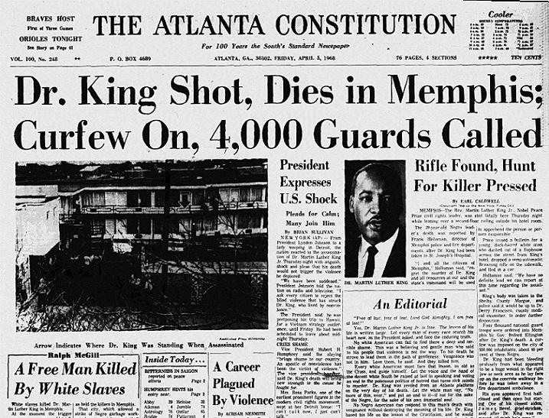

Slide 47
Social and Political Turmoil of 1968 (SSUSH21e)
Assassination of Martin Luther King, Jr. (SSUSH21e)
Caused riots in over 100 cities across America
One week after King’s death, Congress passed the Civil Rights Act of 1968, which prevented discrimination in housing.

Slide 48
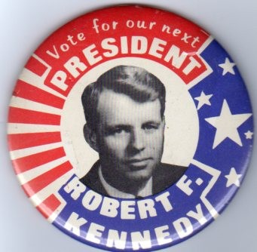

Slide 49
Social and Political Turmoil of 1968 (SSUSH21e)
Assassination of Robert F. Kennedy (SSUSH21e)
Robert Kennedy was running for president
He wanted new social reforms and he opposed the Vietnam War

Slide 51
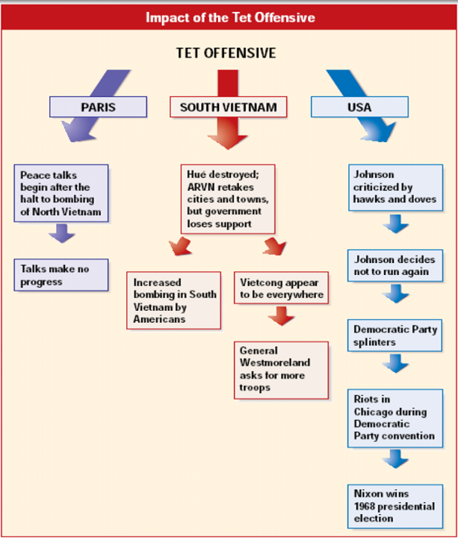
Social and Political Turmoil of 1968 (SSUSH21e)
The Tet Offensive (SSUSH21e)
Surprise attack against American Forces
Many Americans turned against the Vietnam War and against the Johnson administration, which had claimed the enemy was near defeat.

Slide 52
Document Analysis
I’m sick of crime everywhere. I’m sick of riots. I’m sick of “poor” people demonstrations (black, white, red, yellow, purple, green or any other color!)… I’m sick of the U.S. Supreme Court ruling for the good of a very small part rather than the whole of our society… I’m sick of the lack of law enforcement… But most of all, I’m sick of the constantly being kicked in the teeth for staying home, minding my own business, working steadily, paying my bills and taxes, raising my children to be decent citizens, managing my financial affairs so I will not become a ward of the City, County, or States, and footing the bill for the minuses mentioned herein.
Source: Letter from private citizen to Senator Sam Ervin of North Carolina, June 18, 1968.

Slide 53
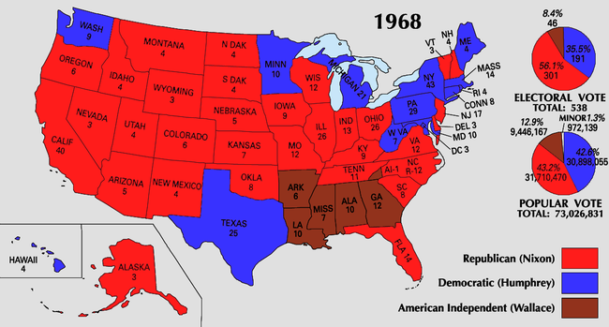

Slide 54
Social and Political Turmoil of 1968 (SSUSH21e)
The Presidential Election of 1968 (SSUSH21e)
President Johnson decides not to run due to Vietnam War
Robert Kennedy was assassinated while running for President
Richard Nixon wins Presidency because he runs on the return of law and order.

Slide 55
Review Questions
List 4 social and political problems of 1968?
What was the significance of the Tet-Offensive of 1968?
What was the significance of the 1968 Presidential Election?

