Slide 1
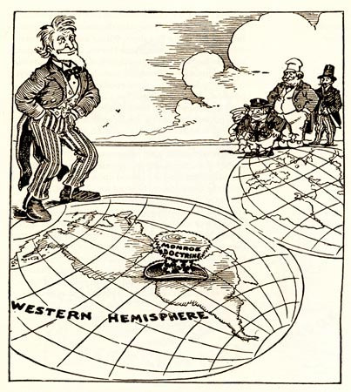
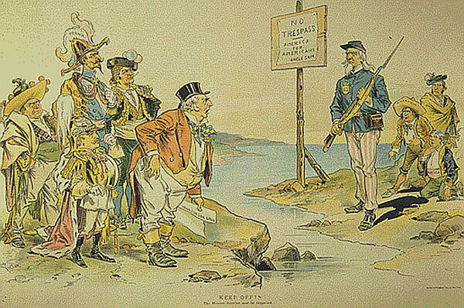
Political Cartoons - The Monroe Doctrine
Task 1: Evaluate the two (2) Political Cartoons above then answer questions 1-5 on your worksheet.

Slide 2
1. Cartoon A – Why does the sign say “No Trespass?” _________________________________________________________________________
_________________________________________________________________________
2. Cartoon A – Which person represents the United States? __________________________________________________________________________
__________________________________________________________________________
3. Cartoon A – What countries do you think are represented by the three people behind Uncle Sam? __________________________________________________________________________
__________________________________________________________________________
4. Cartoon A – How do the people on other side of the water appear? Do they appear happy, upset, worried, etc?
____________________________________________________________________________________________________________________________________________________
5. Cartoon B – Which part of the Americas appears protected by the Monroe Doctrine warning – North America, Central America, South America, or all them? __________________________________________________________________________
__________________________________________________________________________

Slide 3
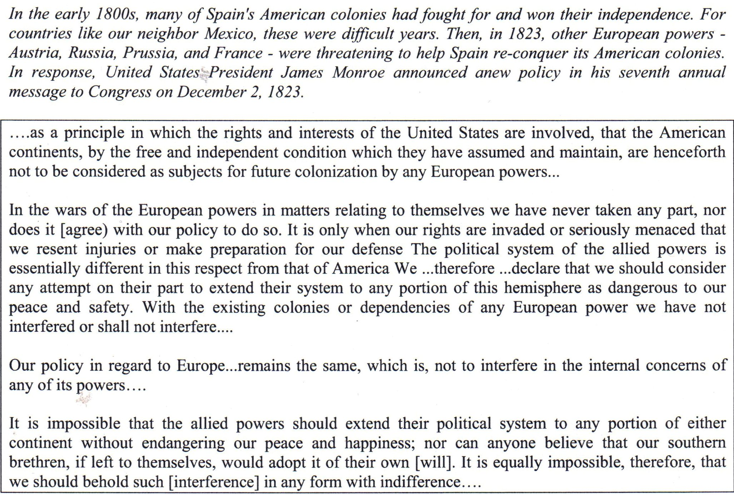

Slide 4
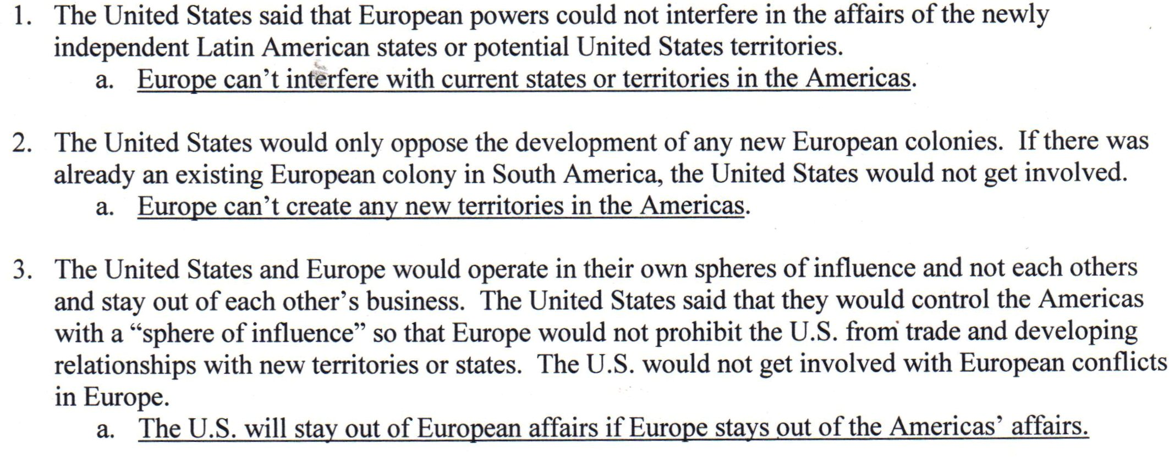
The Monroe Doctrine

Slide 5
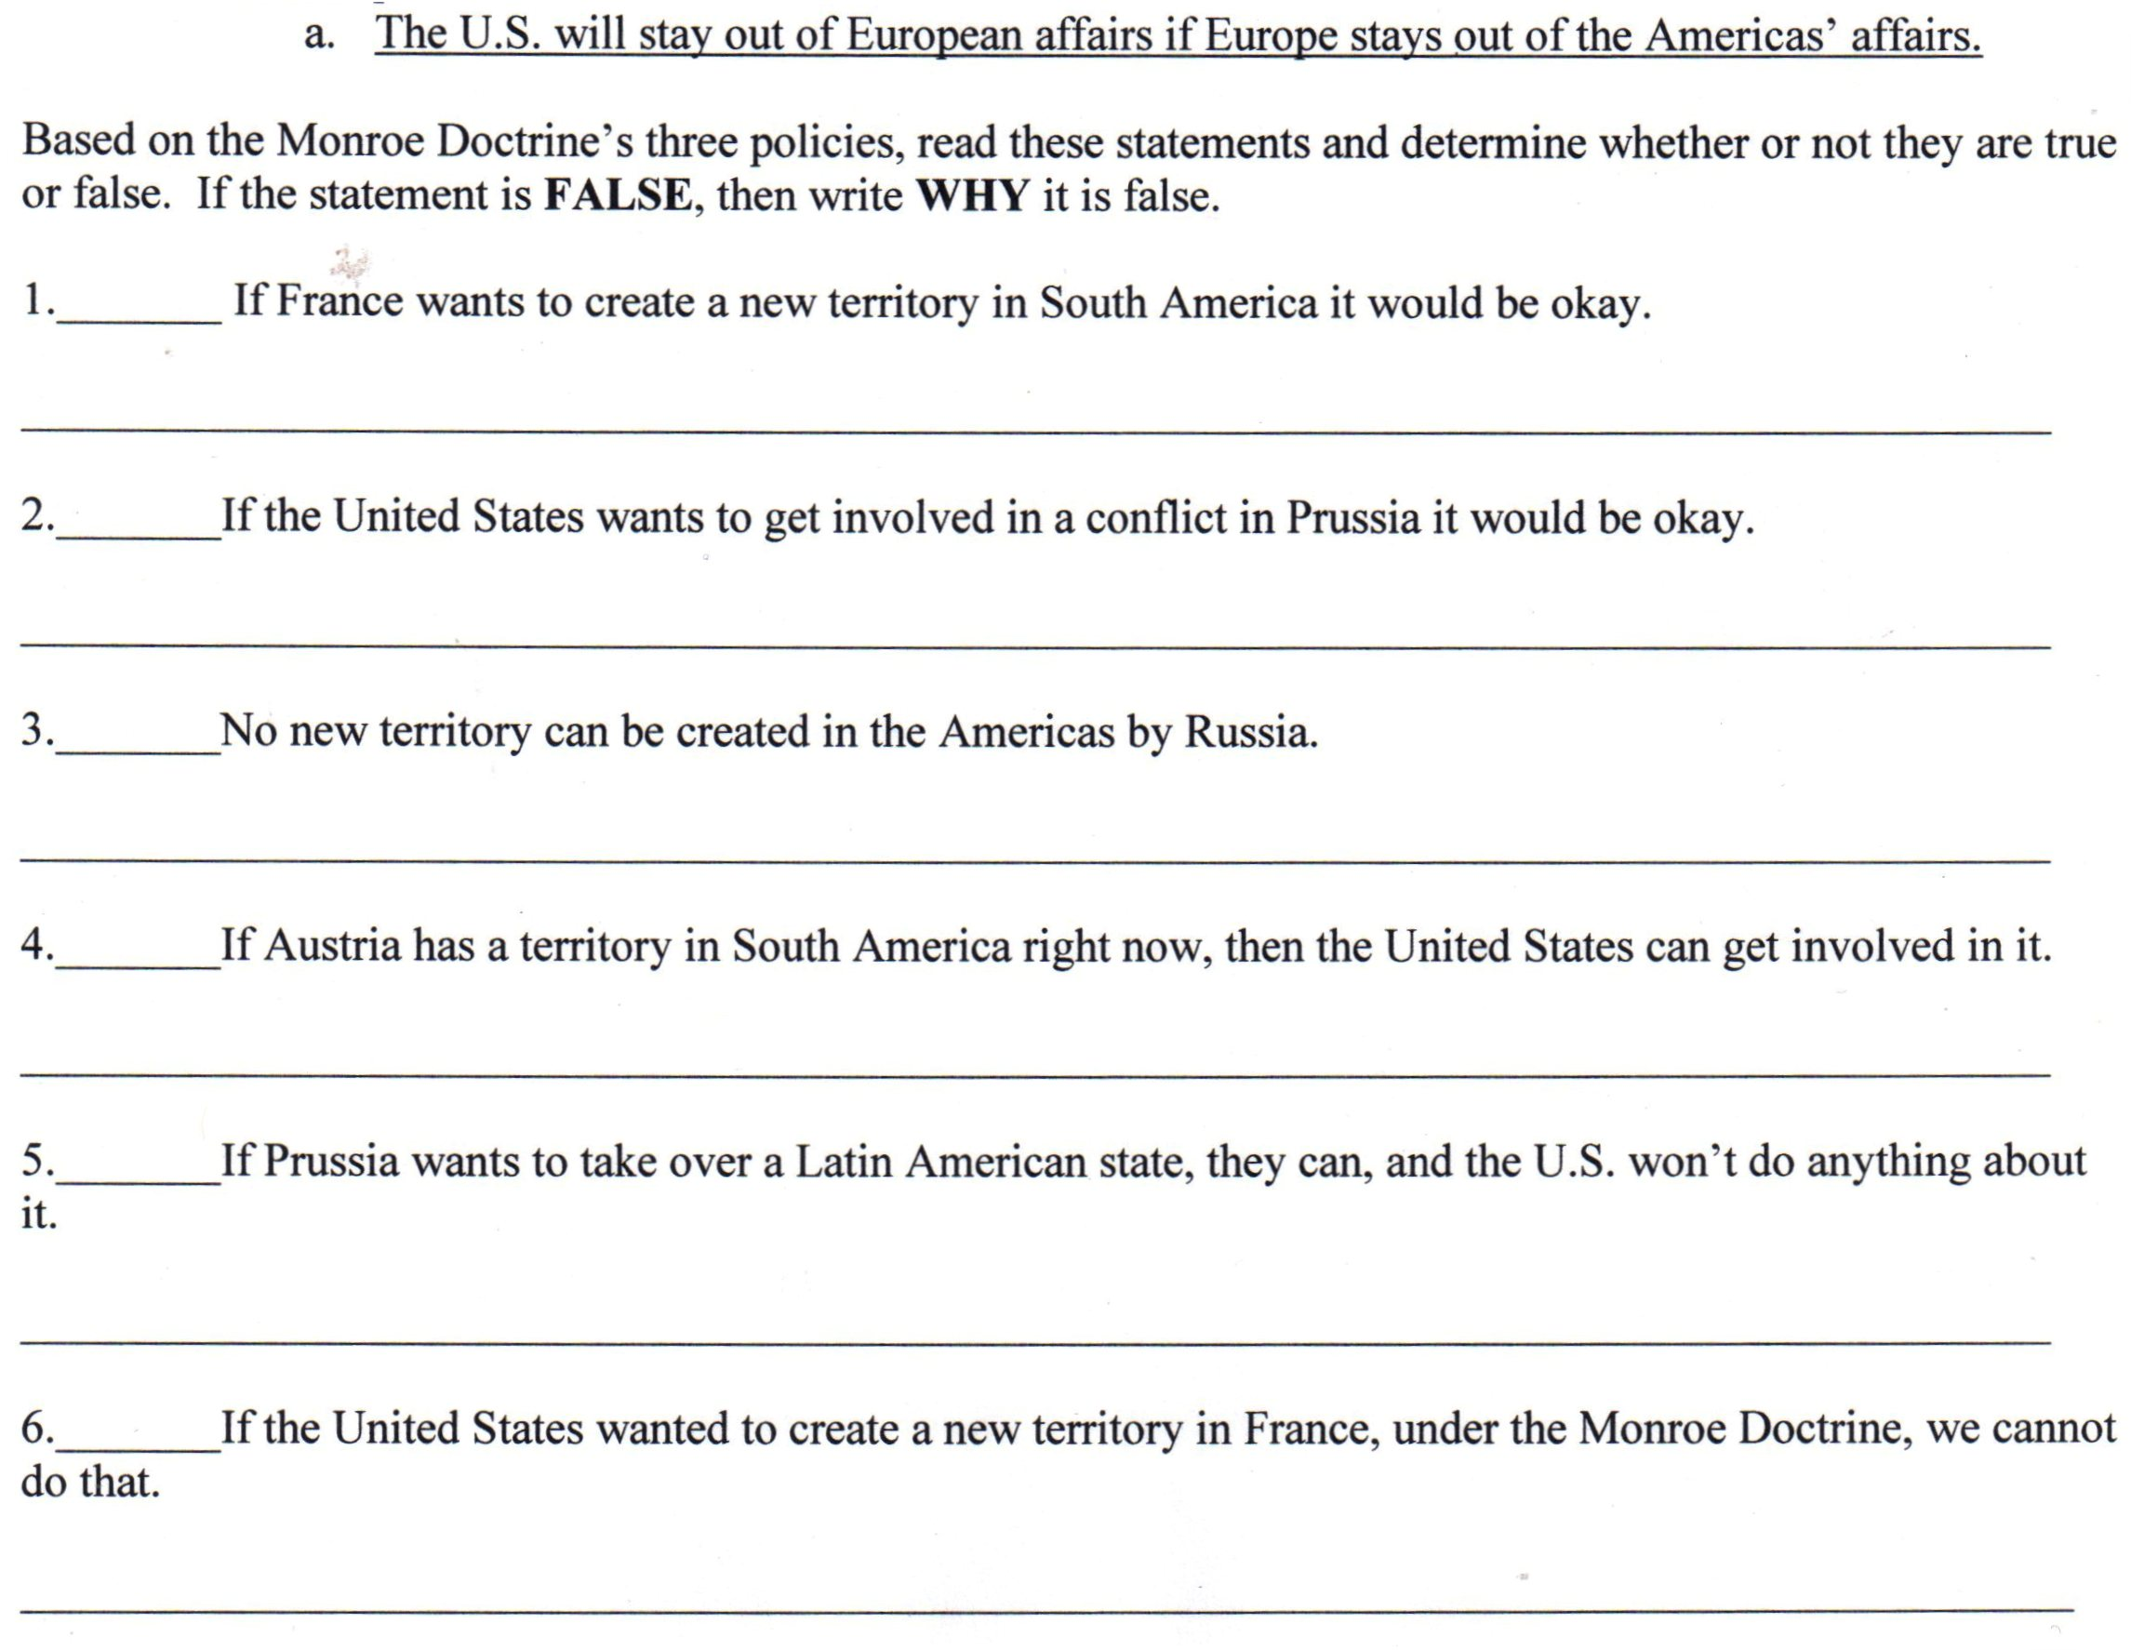
Task 2: Based on the reading and your notes, answer the questions below.

