Slide 1
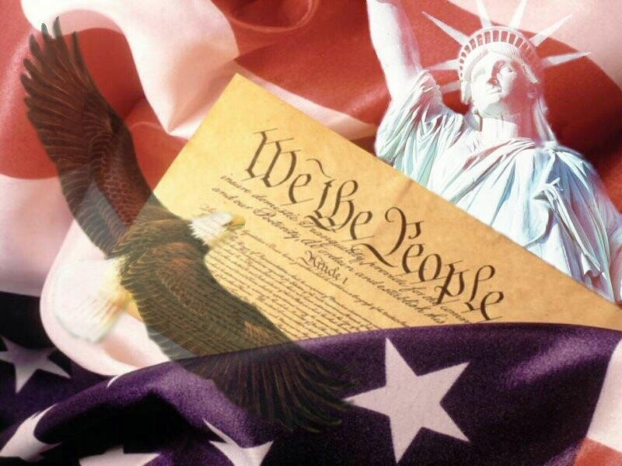
Post-WWII American Presidents
1948-2004
chapters 25 - 33

Slide 2
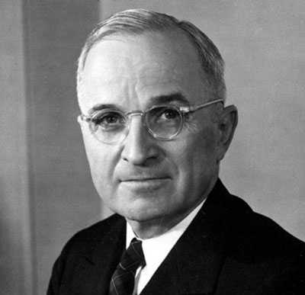
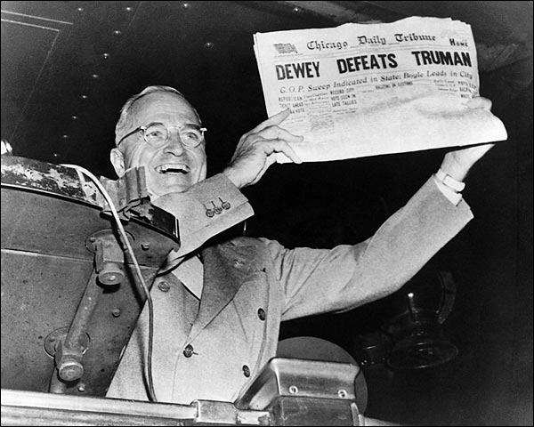
Election Year: 1948
Truman (D) v. Dewey (R) v. Thurmond (States’ Rights)

Slide 3
Truman’s Domestic Highlights
Integration of U.S. military in 1948
2nd “Red Scare” began: Joe McCarthy claims to have list of communists inside of the U.S. government, sets off “witch-hunt”

Slide 4
Truman’s Foreign Highlights
Decision to drop atomic bombs 1945
Beginning of Cold War:
Truman Doctrine (’47): Truman promises the U.S. will send aid to countries under threat form communism
Marshall Plan (’48): U.S. sends $13 billion dollars to help Western Europe recover from WWII
Berlin Airlift (’48-49)
Formation of NATO (’49): military alliance of democratic/capitalist nations against communism
China became communist (’49)
Korean War began (’50-53): communist North Korea invades democratic South Korea, U.S. sends troops to support South Korea

Slide 5
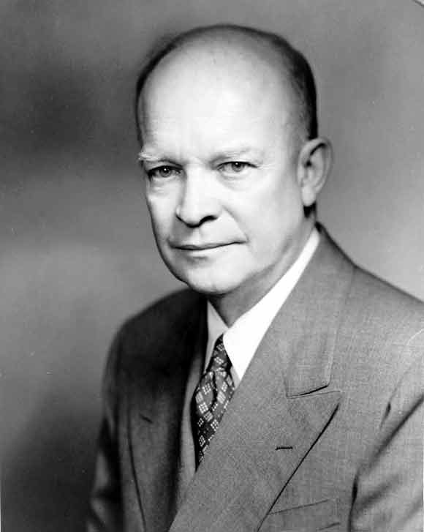
Elections of 1952 & ‘56
1952: Eisenhower (R) v.
Stevenson (D)
1956: Eisenhower (R) v.
Stevenson (D)

Slide 6
Eisenhower’s Domestic Highlights
Interstate Highway Act – authorized spending $32 billion to build 41,000 mi. of highway
Brown v. Board of Ed. decision (’54): Supreme Court rules that public schools should desegregate
Little Rock, Arkansas desegregation (’57)
2nd Red Scare / McCarthyism: McCarthyism is the practice of making reckless accusations without evidence

Slide 7
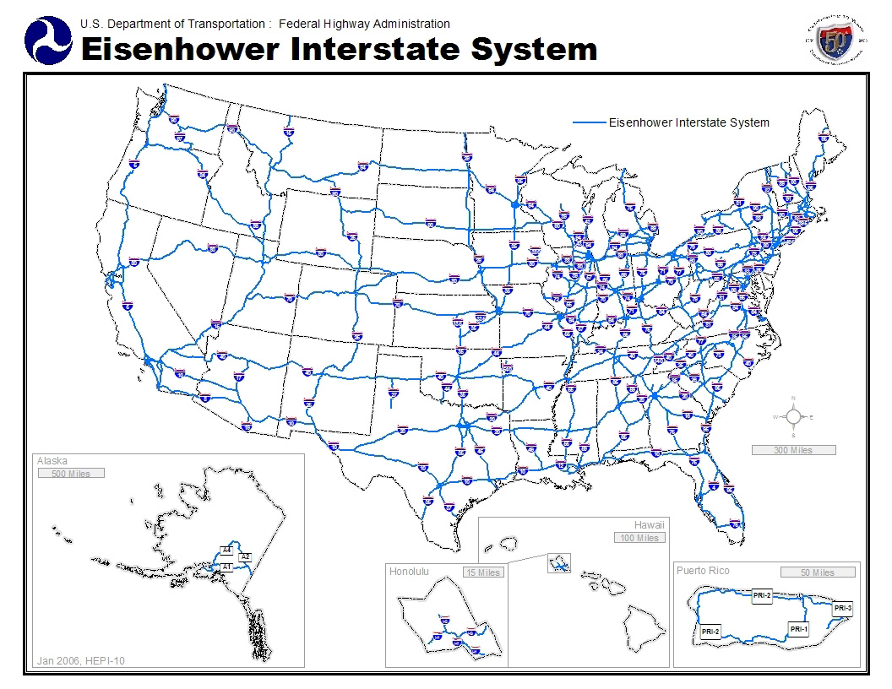
Interstate Highway Act

Slide 8
Eisenhower’s Foreign Highlights
Korean War ended w/ armistice (’53)
U.S. “advisors” sent to Vietnam (‘54): U.S. backs South Vietnam by sending military advisors to train South Vietnamese military
Sputnik launched by Soviets (’57): U.S. feels it is behind and responds by forming NASA and allocating millions of dollars to math and science in schools
Castro overthrew Batista in Cuba (’59): Cuba is now communist

Slide 9
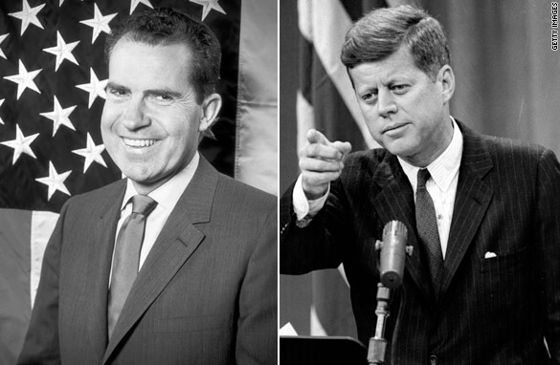
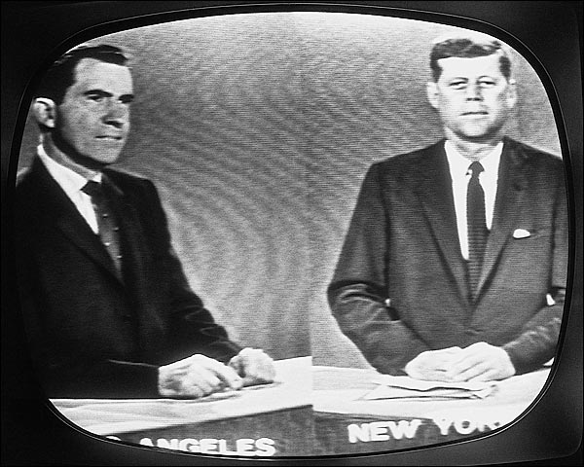
Election of 1960
Kennedy (D) v. Nixon (R)
first televised Presidential debates – benefited Kennedy & probably swayed election in his favor

Slide 10
Kennedy’s Domestic Highlights
Pushed for Civil Rights Act of 1964 before assassination
Space Race – called for man on the moon by end of decade
Assassinated in 1963 by Lee Harvey Oswald – Warren Commission determined there was no conspiracy; VP Lyndon Johnson becomes President

Slide 11
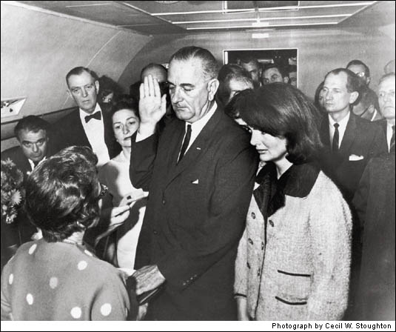

Slide 12
Kennedy’s Foreign Highlights
Bay of Pigs invasion (Apr ’61): CIA sends Cuban exiles to overthrow Fidel Castro, invasion is a disaster
Cuban Missile Crisis (Oct ’62): U.S. discovers that the Soviet Union is placing nuclear weapons in Cuba, Kennedy orders a naval blockade of the island, Soviets remove missiles from Cuba and U.S. removes missiles form Turkey
Increased # of American advisors in S. Vietnam
Berlin Crisis / Berlin Wall construction (’63): U.S. refuses to leave West Berlin, so Soviets begin constructing wall between East and West Berlin

Slide 13
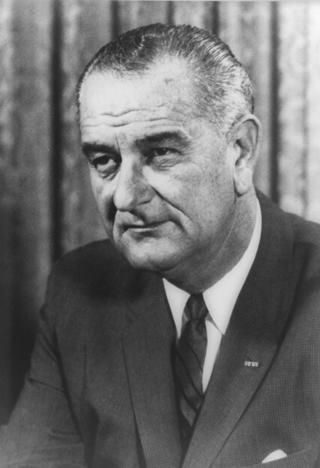
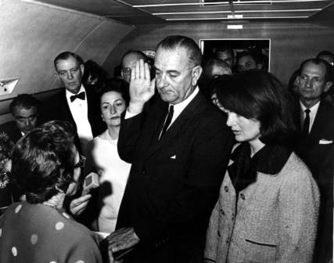
Election of 1964
L. Johnson (D) v. Goldwater (R)
did not seek
reelection in
‘68 due to
divisions over
Vietnam
Goldwater marks
rise of the
Conservative
movement

Slide 14
Johnson’s Domestic Highlights
“Great Society” – LBJ’s domestic program designed to eliminate poverty and discrimination in the U.S. and improve education, healthcare, and environmental protection
Medicare (hospital insurance for people over 65)
Medicaid (low-cost health insurance for poor)
“War on Poverty” declared – aimed at aiding country’s poor (education, job training, proper health care, & nutrition)
Signed Civil Rights Act of 1964 into law: outlaws discrimination based on race, sex, national origin, or religion and forbids segregation in public facilities
Signed Voting Rights Act of 1965 into law: outlaws discriminatory voting practices (i.e. poll taxes, literacy tests)

Slide 15
Johnson’s Foreign Highlights
Vietnam!
Gulf of Tonkin Resolution (’64): After alleged North Vietnamese attack on the USS Maddox, Congress grants President Johnson the authority to send military aid to South Vietnam
1st ground (combat) troops sent in ‘65
Tet Offensive (’68) – coordinated surprise attack by Communist forces on South Vietnam, public opinion began to turn against war

Slide 16
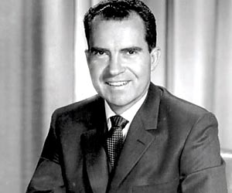
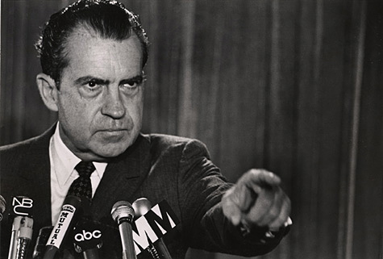
Elections of 1968 & ‘72
1968 Nixon (R)
v. Humphrey (D)
v. Wallace (Am Indep)
1972 Nixon (R) v. McGovern (D)

Slide 17
Nixon’s Domestic Highlights
EPA created (‘70)
Anti-war (Vietnam) protests:
Kent State (‘70) – student protesters threw rocks & bottles at National Guard, fired into protesters killing 4
Congress passes War Powers Act: limits president’s power to wage war without Congressional approval
Watergate Scandal – attempted break-in of Dem. Party headquarters (Watergate complex) connected to Nixon; reelection committee tried to bug office & record conversations of political opponents, Nixon interferes with investigation, facing impeachment charges
Nixon resigned in 1974; Ford became President and pardoned Nixon (unpopular – lost election in ‘76)

Slide 18
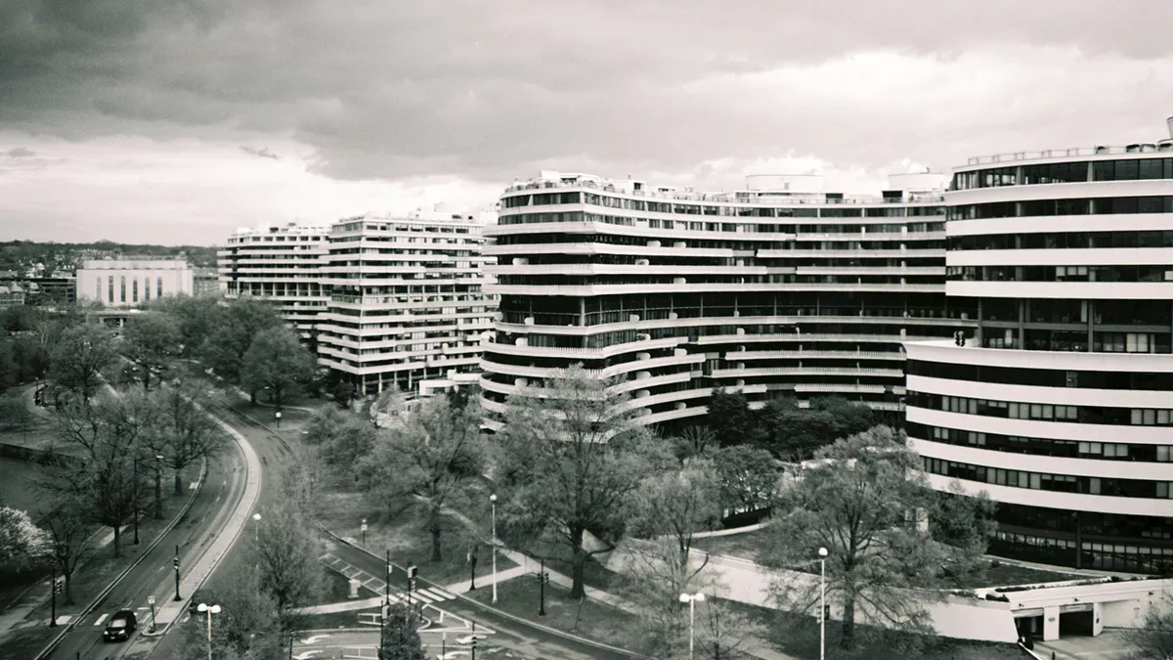

Slide 20
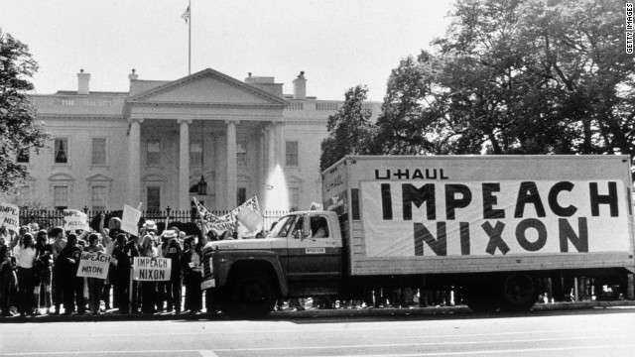

Slide 21
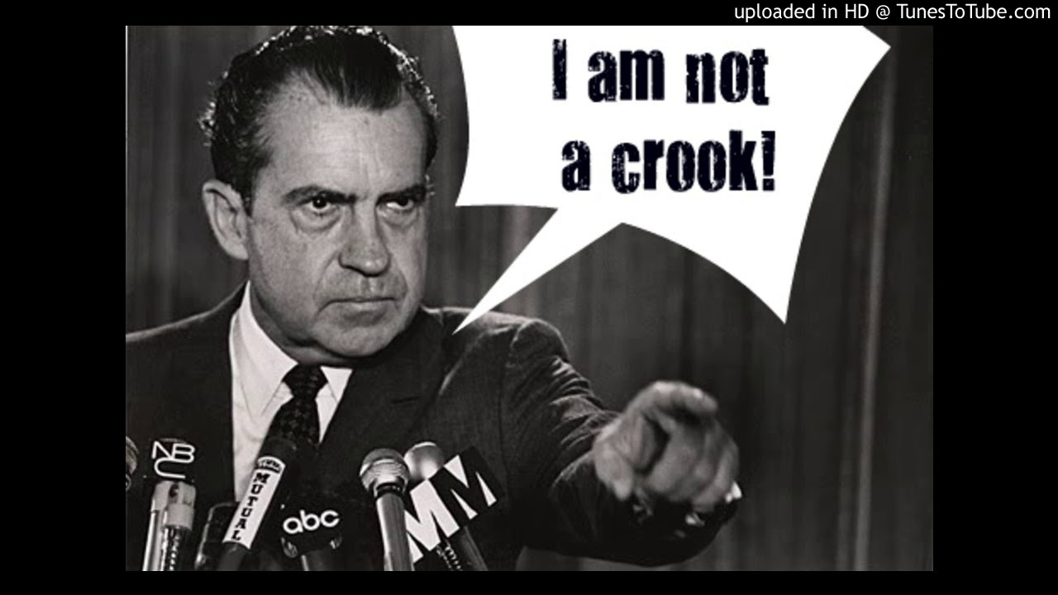

Slide 22
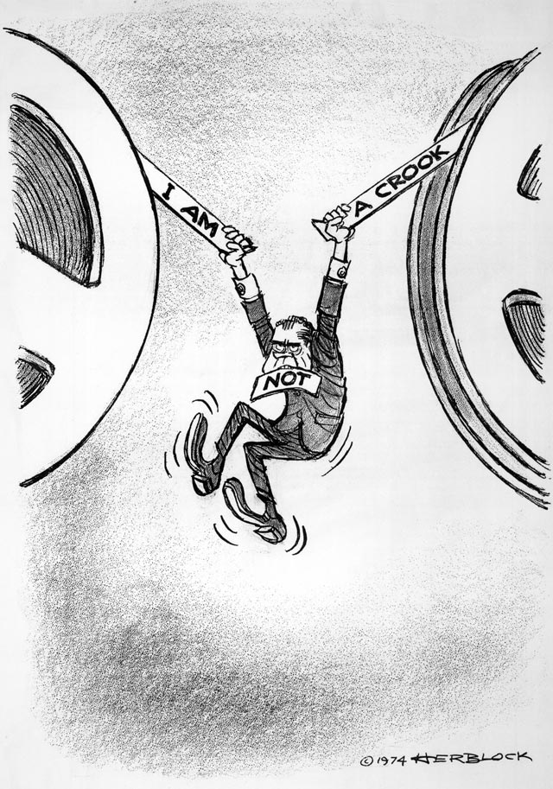

Slide 23
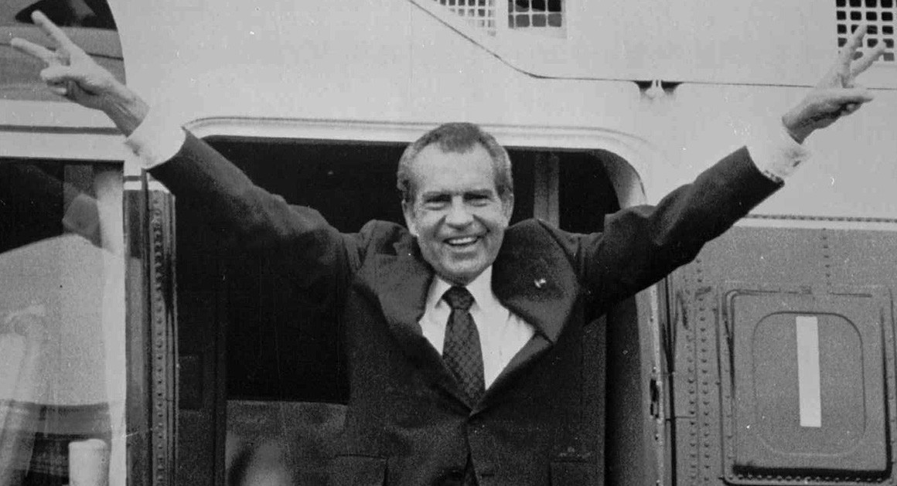

Slide 24
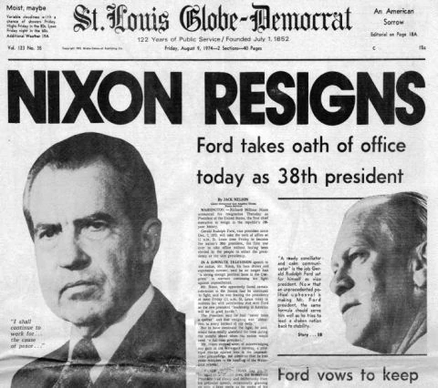

Slide 25
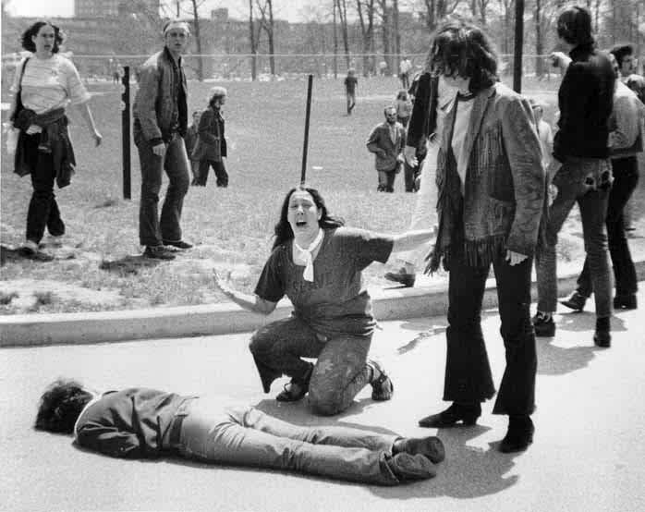
Violence at Kent State

Slide 26
Nixon’s Foreign Highlights
“Vietnamization”– turned responsibility for war over to South Vietnamese, began removing U.S. troops
Paris Peace Accords (‘73) – withdrew last American troops from Vietnam
Détente w/ Soviet Union & China
Détente: easing of Cold War tensions with communist nations
Visited China (’72): opened up political and economic relations with China (example of détente)
SALT I Treaty w/ Soviets (’72): agreement to limit production of missiles

Slide 27
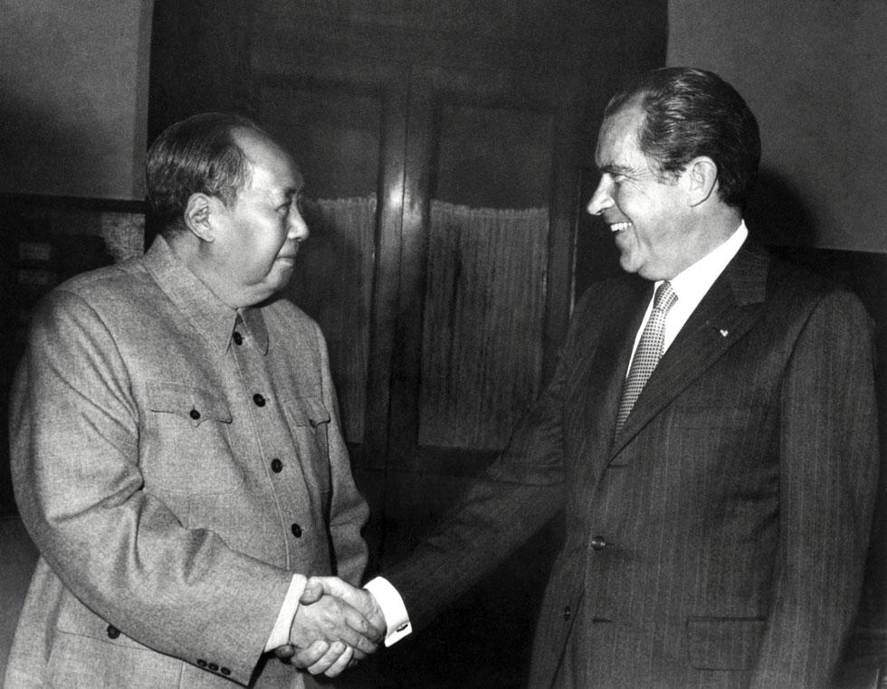

Slide 28
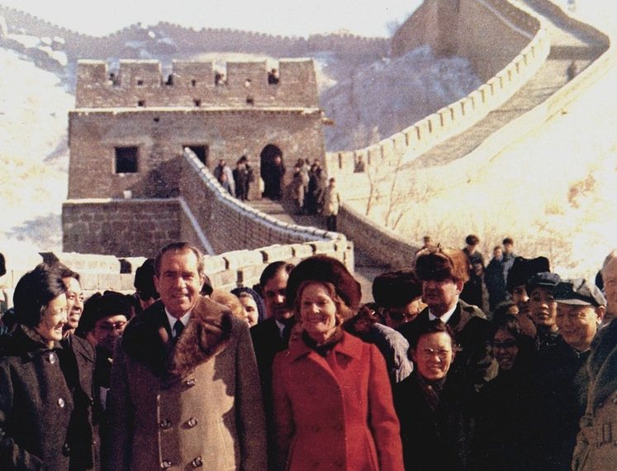

Slide 29
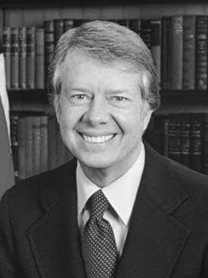
Election of 1976
Jimmy Carter (D) v. Gerald Ford (R)
benefited from distrust caused by Vietnam & Watergate
promised to restore honesty & public’s confidence in national gov’t

Slide 30
Carter’s Domestic Highlights
Economic instability: inflation and energy crisis (fuel shortages & rising oil prices – from .40 in ‘73 - $1.20 by ‘79)
Granted amnesty to Vietnam War “draft dodgers”

Slide 31
Carter’s Foreign Highlights
Camp David Accords (’78) - peace treaty between Egypt & Israel, Egypt recognized nation of Israel & Israel withdrew troops from Sinai Peninsula
SALT II Treaty w/ Soviets (’79)
Iranian Revolution (‘79) – opposition to Shah (emperor) of Iran led to the Ayatollah Khomeini seizing power, Shah fled to U.S. for cancer treatment
Iran-Hostage Crisis (Nov ’79-Jan ’81) – Iranian radicals responded by invading U.S. embassy & taking 66 Americans hostage, held for more than a year before being released – after Reagan’s election

Slide 32
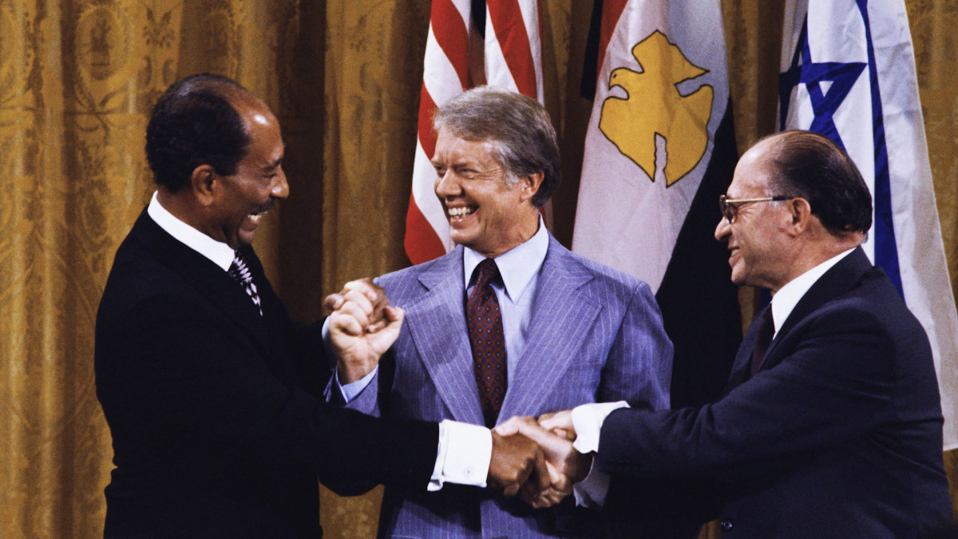

Slide 33
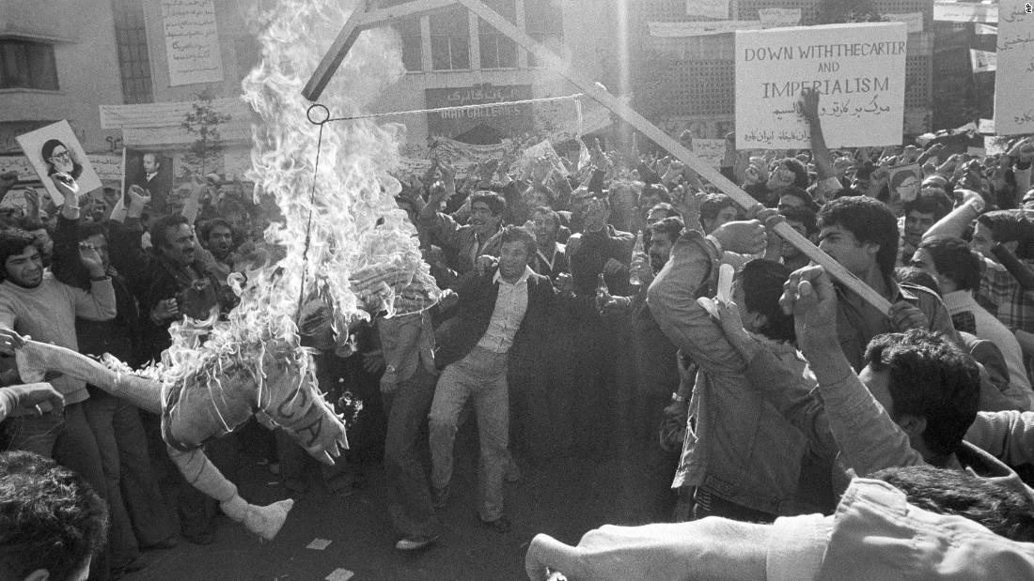

Slide 34
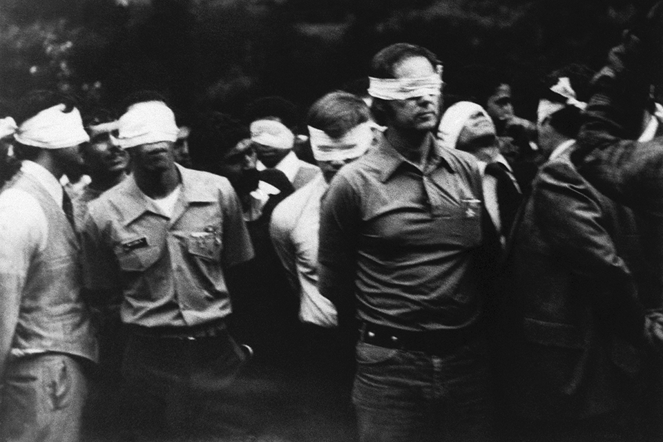

Slide 35
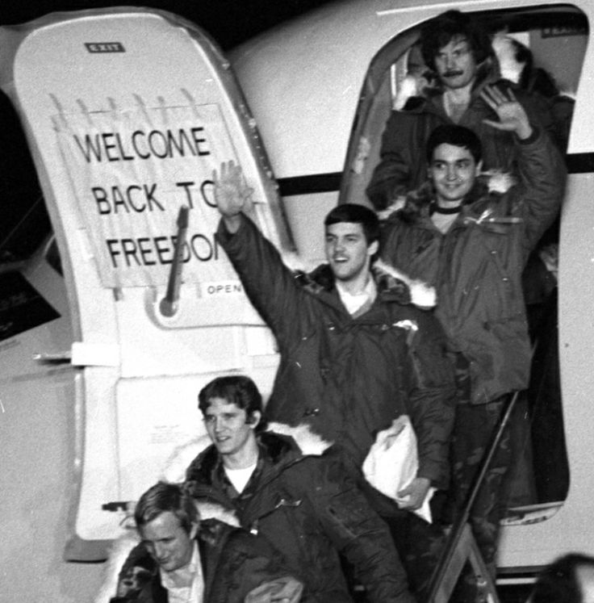

Slide 36
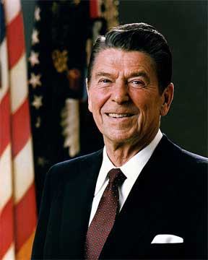
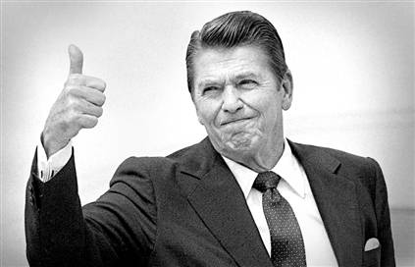
Elections of 1980 & 1984
1980: Reagan (R) v. Carter (D)
1984: Reagan (R) v. Mondale (D)

Slide 37
Reagan’s Domestic Highlights
“Reaganomics” – cut taxes on the upper class so they can invest more into the economy: creating businesses, hiring more workers, pay their workers more, etc. (called “trickle-down economics”)
Huge federal deficits built up because of spending on military

Slide 38
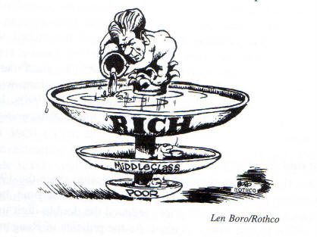

Slide 39
Reagan’s Foreign Highlights
Iran-Contra Scandal (’86) –
U.S. sold weapons to Iran in ’85
In exchange, Iran promised to pressure terrorist groups in Lebanon to release American hostages – plan not successful & contradicted policy of not negotiating w/ terrorists
Used money from illegal weapon sales to fund Contras (anticommunists) in Nicaragua – previously banned by Congress;
Reagan denies involvement
Oliver North & other aids took the blame

Slide 40
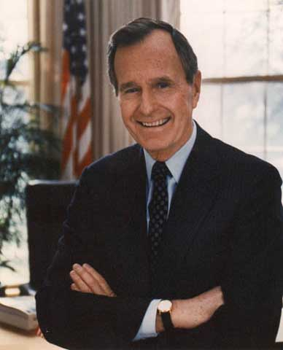
Election of 1988
GHW Bush (R) v. Dukakis (D)
Bush had been Reagan’s VP

Slide 41
Bush’s Domestic Policy Highlights
Cuts in size of federal gov’t
Tax Increase – broke his campaign pledge of “Read my lips; no new taxes”
’91-92 economic recession

Slide 42
Bush’s Foreign Policy Highlights
1989 Berlin Wall fell – Cold War ended
Iraq under Saddam Hussein invaded Kuwait to capture oil reserves - Persian Gulf War 1991- Iraqi troops surrendered

Slide 43
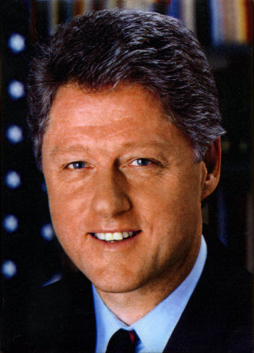
Elections of 1992 & 1996
1992: Clinton (D)
v. Bush (R)
v. Perot (I)
1996: Clinton (D)
v. Dole (R)

Slide 44
Clinton’s Domestic Highlights
Federal spending cuts & tax increases – left office w/ budget surplus
Scandals:
Whitewater – investments Bill & Hillary made in the Whitewater Development Corporation (Arkansas real estate company) – failed to uncover evidence of guilt
Lewinsky – Clinton’s affair with a White House intern, lied under oath about affair (perjury)
Impeached in ’98 - acquitted

Slide 45
Clinton’s Foreign Highlights
Free trade reappeared:
NAFTA (North American Free Trade Agreement) (‘92) – called for the gradual removal of trade restrictions among the U.S., Canada & Mexico

Slide 46
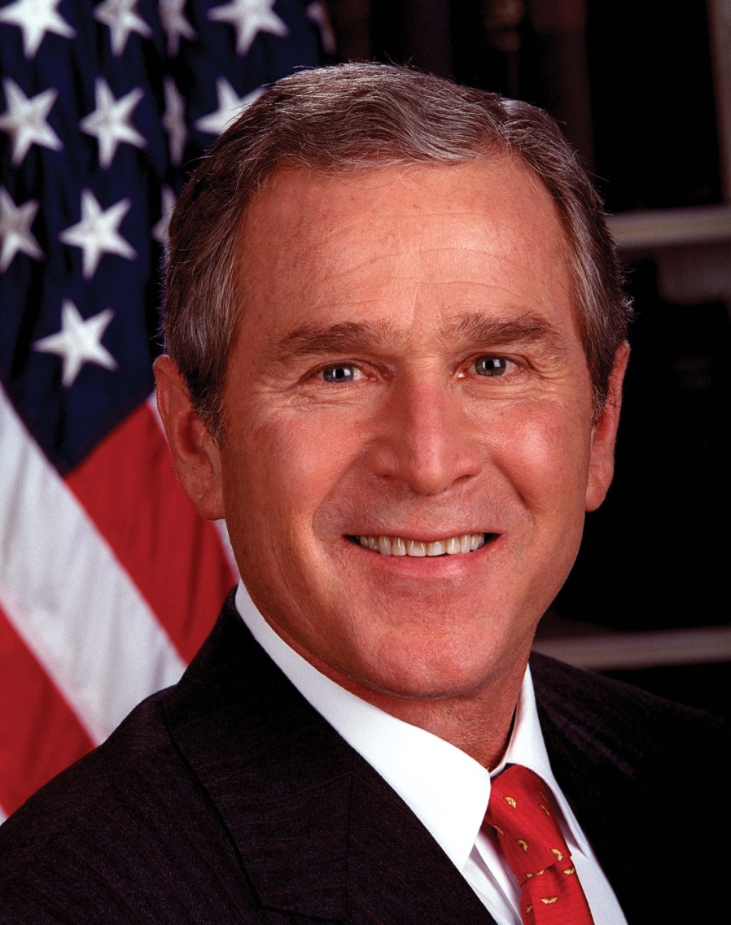
Election of 2000
G W Bush (R)
v. Gore (D)
Disputed election in Florida (25 Electoral College votes); Bush awarded victory in FL & therefore won Electoral College majority(by 1 vote) (Gore won popular vote)

Slide 47
September 11, 2001
Terrorist attack by Osama bin Laden’s al Qaeda network
More than 3,000 Americans died
Bush declares “war on terrorism”
In response to 9/11 attacks, U.S. passed Patriot Act: gave gov. broad powers to spy on Americans and search homes (to prevent terrorism)
American intervention:
Afghanistan: Bin Laden believed to be hiding in Afghanistan where Taliban government let them run terrorist training camps; U.S. overthrew Taliban gov’t; held free elections & wrote a new constitution
Iraq: believed Saddam Hussein was building & stockpiling Weapons of Mass Destruction (WMD); 2003 Operation Iraqi Freedom – U.S. forces invade; 2005 Iraq wrote new constitution

Slide 48
Election of 2004
Bush (R)
v. Kerry (D)

Slide 49
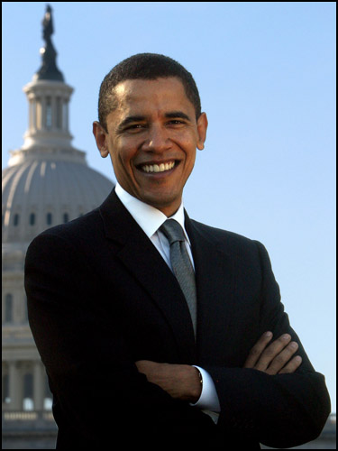
Election of 2008
Barack Obama (D)
v. John McCain (R)
Democrats gained majorities in both houses of Congress

Slide 50
Post-World War II America: Movements & Key Events
1948-2004
chapters 25 - 33

Slide 51
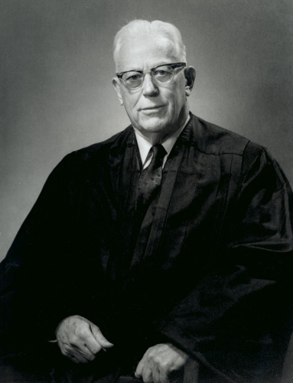
Warren Court
Chief Justice of Supreme Court - Earl Warren
nominated by Eisenhower
liberal rulings- helped expand individual rights
Brown v. Board of Ed. (’54)
Miranda v. Arizona (‘66)
Miranda Rights – accused criminals had to be informed of his/her Fifth (remaining silent) & Sixth Amendment rights (speed, public trial before jury) before being questioned

Slide 52
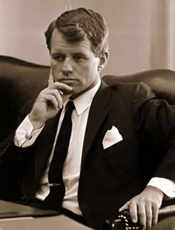
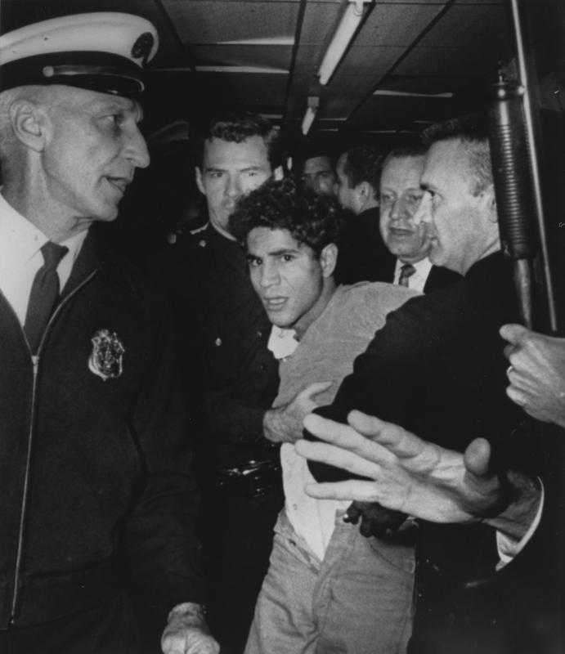
Robert Kennedy: Assassination
Robert Kennedy (RFK):
JFK’s little brother
politician & U.S. Attorney General
civil rights activist – Civil Rights Bill
opposed Vietnam War
1968 Presidential Candidate
Assassination
shot June 5, ‘68 (2 mo. after MLK) by Sirhan Sirhan, Palestinian immigrant
Democratic Nat’l Convention in Chicago (‘68) – debate Vietnam
Antiwar protesters are beaten by Police outside convention center

Slide 53
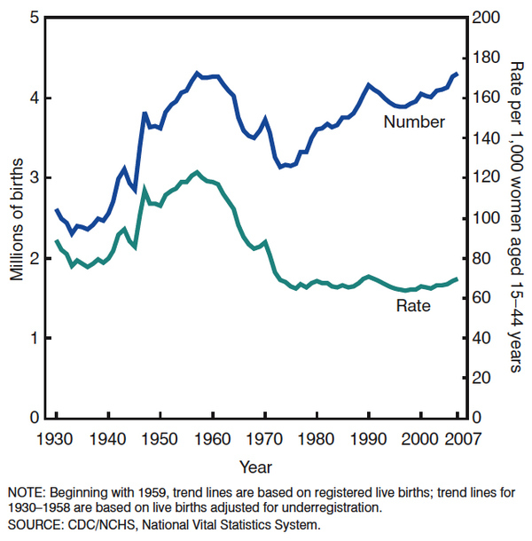
Baby Boom
increase in births between 1945 – 1964
families had put off having families during depression & war, but started having children when soldiers returned after WWII

Slide 54
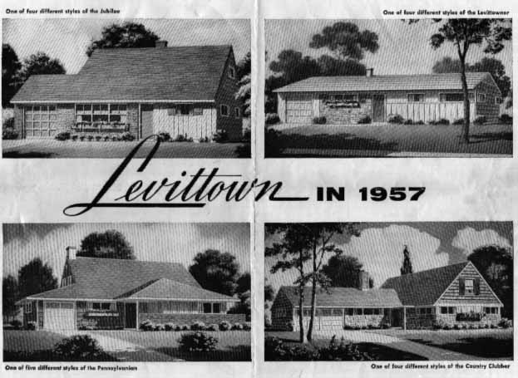
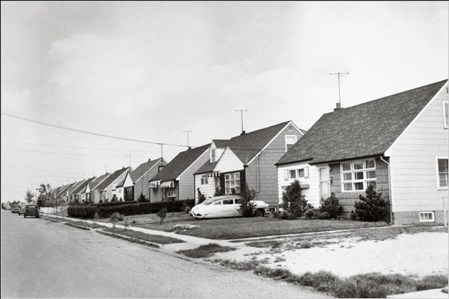
Levittown
William Levitt – mass produced suburban homes
Levittown – New York suburb that offered affordable homes ($8,000 each); demand increased & other Levittown's built

Slide 55
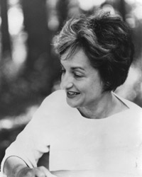
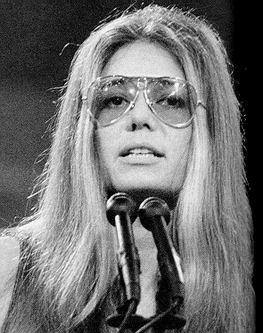
Women’s Rights Movement 1960s & ‘70s
feminism – political, social, & economic equality of men & women
Origins: began 1840s – Declaration of Sentiments, 1st feminism wave in ‘20s -Nineteenth Amendment
Nat’l Organization of Women
Goals: pass Equal Rights Amend. to guarantee gender equality; protect reproductive rights
Roe v. Wade (‘73) – right to legal abortions in first 3 mo. of pregnancy
Betty Friedan
The Feminine Mystique
Gloria Steinem

Slide 56
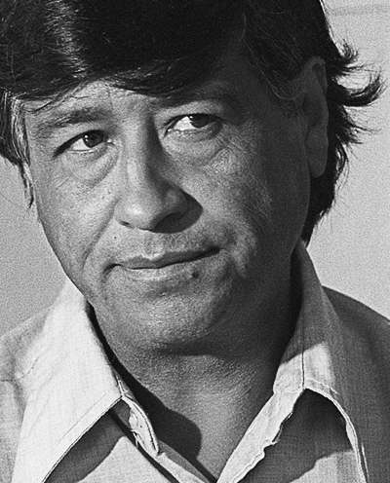
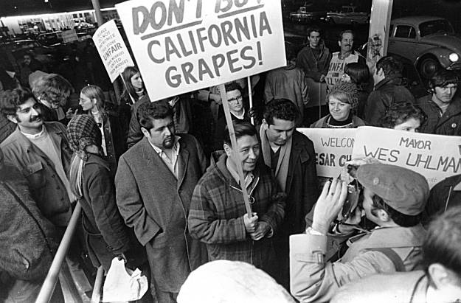
Cesar Chavez & United Farm Workers’ movement
Chavez – migrant farmworker & Latino activist, fought for rights for farm laborers (often exploited) – better working conditions
United Farm Workers – used nonviolent tactics; started
worker’s strike &
consumer boycott of grapes
successful – ’75 CA passed
law requiring collective
bargaining between
growers & union reps.

Slide 57
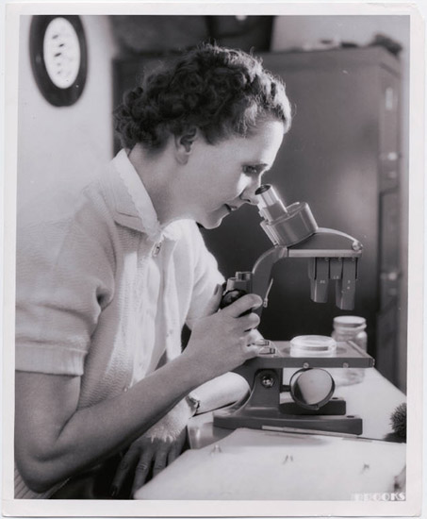
Environmental Movement
Rachel Carson – biologist, wrote Silent Spring (‘62) – described deadly impact pesticides were having on birds & other animals; Congress restricted use of pesticide DDT (eagles)
Earth Day – April 22, ‘70 nationwide protest org. by WI senator Gaylord Nelson; 20 million Americans participated
EPA – gov’t agency created by Congress in ’70 to clean up & protect the environment

Slide 58
Affirmative Action
affirmative action – policy that gives special consideration to women & minorities to make up for past discrimination; ’70s - special focus on employers & schools
Bakke decision:
Regents of the University of California v. Bakke (‘78)
Medical school reserved spots in class for minorities
Bakke (white, stronger academic record) not accepted & claimed racial discrimination
Supreme Court required Bakke’s admission but did not overturn affirmative action

