Slide 1
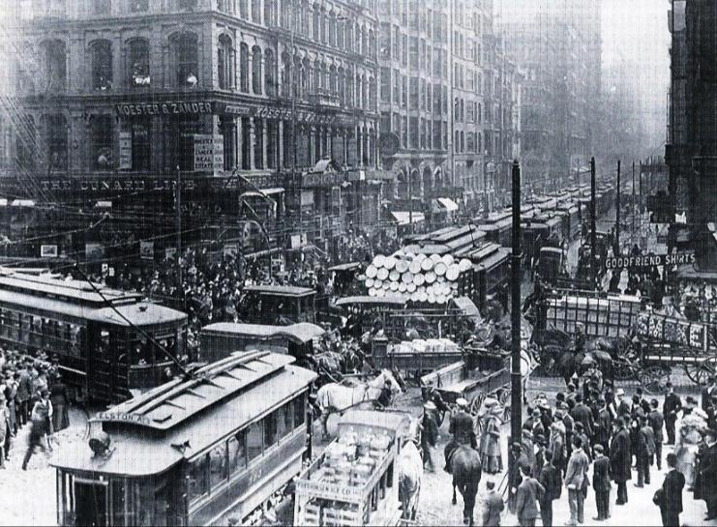
The United States entered the Progressive Era from 1890 to 1920 when a variety of reformers tried to clean up problems created during the Gilded Age
What problems existed in the Gilded Age?

Slide 2
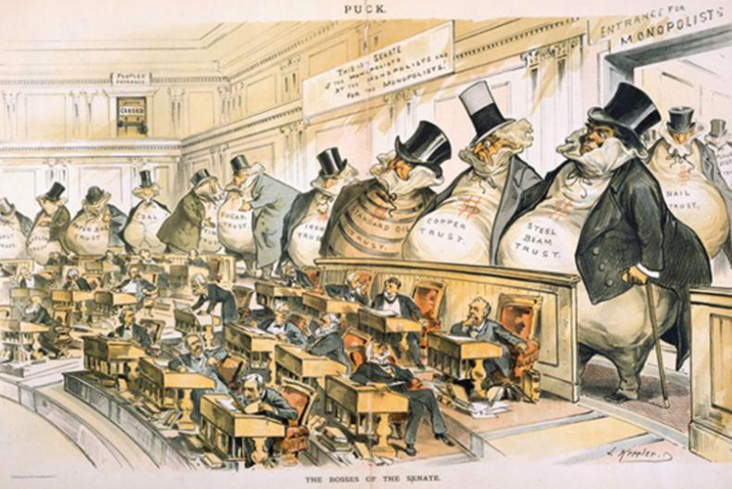
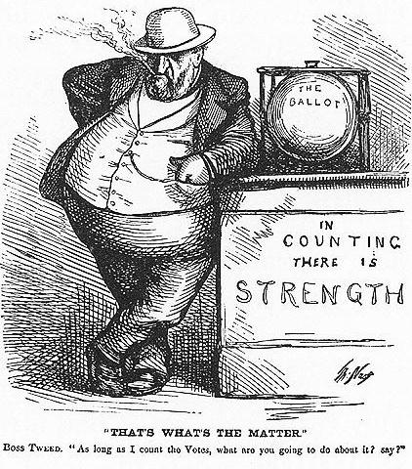
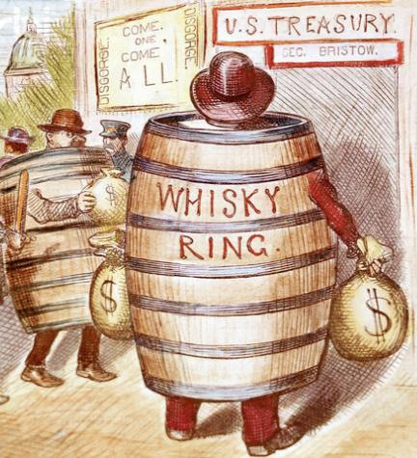
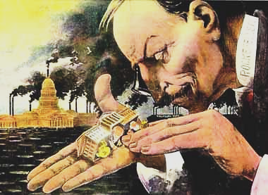
During the Gilded Age, city, state, and national governments were in need of reform
Corrupt political machines controlled city gov’ts
Political positions were gained based on patronage not merit
Corruption scandals plagued the national gov’t
Monopolists used their wealth and power to influence politicians to favor big business

Slide 3
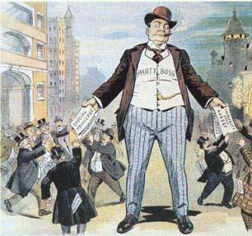
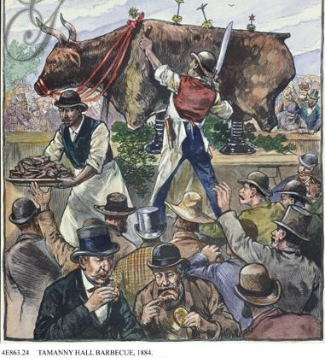
Many city governments were run by political machines
Political machines were parties led by a powerful boss who controlled a network of politicians
Machines politicians rallied citizens, especially immigrants, to vote for them by offering services

Slide 4
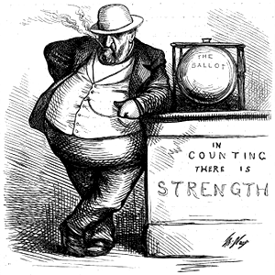
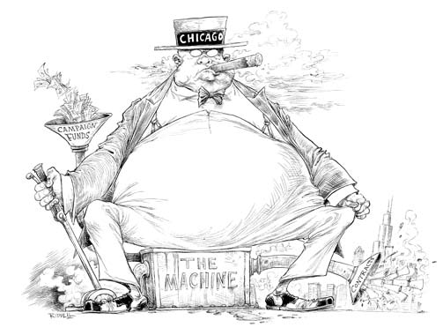
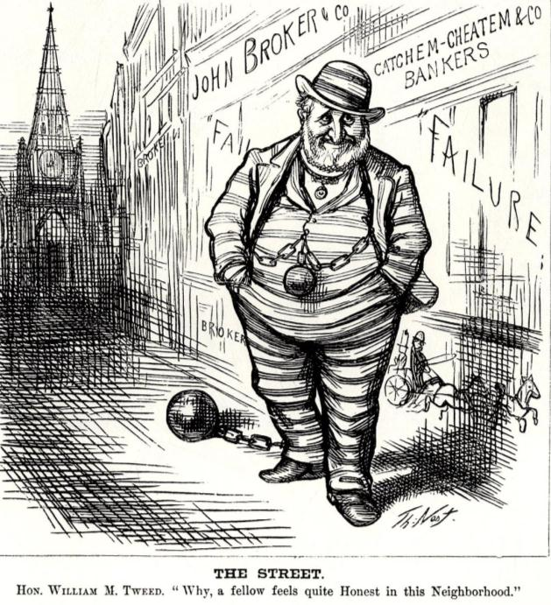
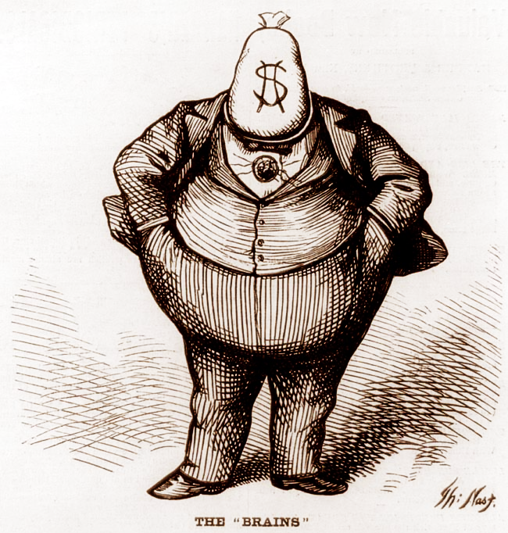
Many city governments were run by political machines
Because machine politicians controlled access to city jobs, business licenses, and building projects, they tended to be corrupt
Many politicians used fraud to win elections, used their influence for personal gain (graft), or took bribes
The most notorious urban politician was Boss Tweed of New York’s Tammany Hall political machine
The “Tweed Ring” defrauded New York City of millions of dollars until it was exposed by reporter Thomas Nast
Notes:
“Tweed Courthouse”—NY County Courthouse was supposed to cost $250,000 but cost $13 million

Slide 5
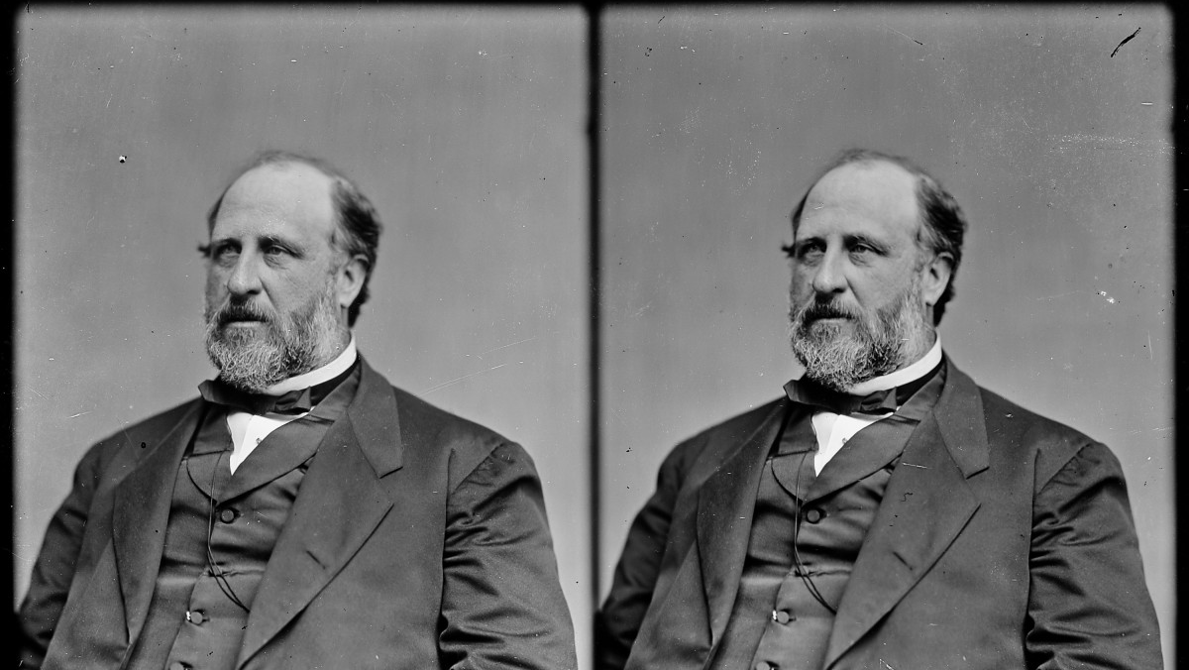

Slide 6
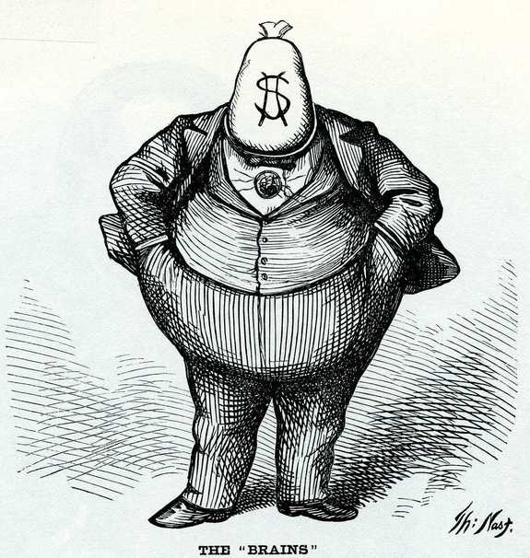

Slide 7
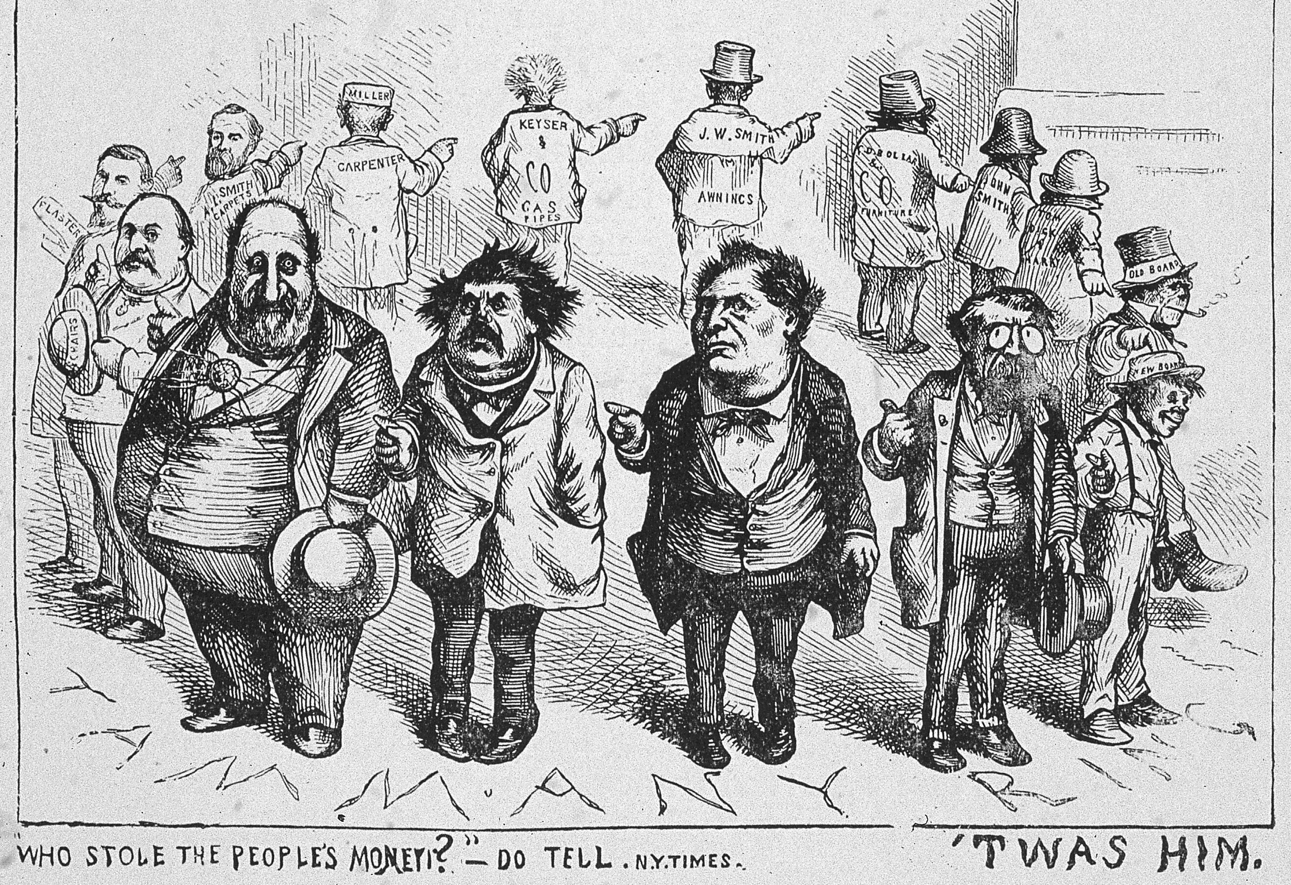

Slide 8
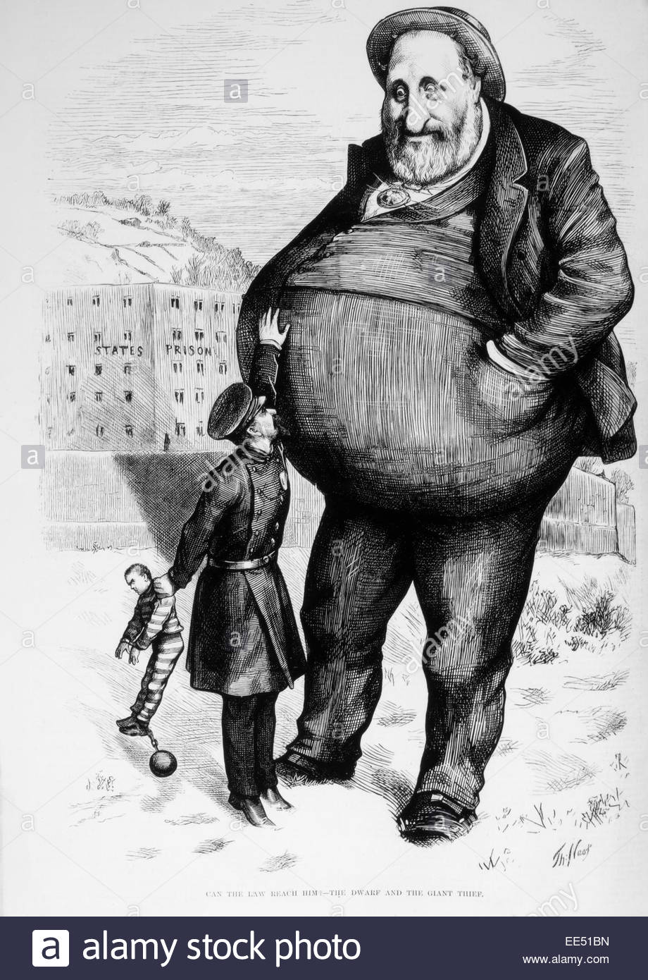

Slide 9
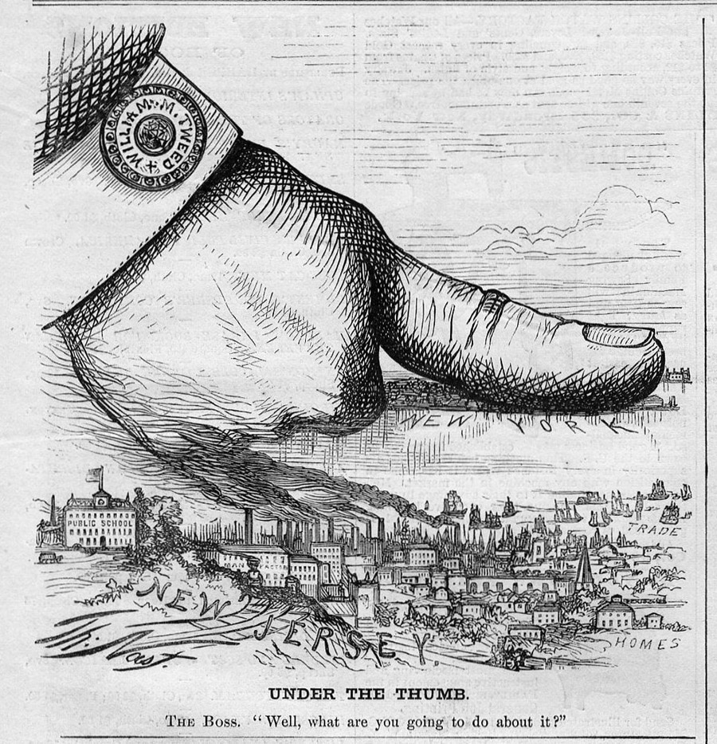

Slide 10
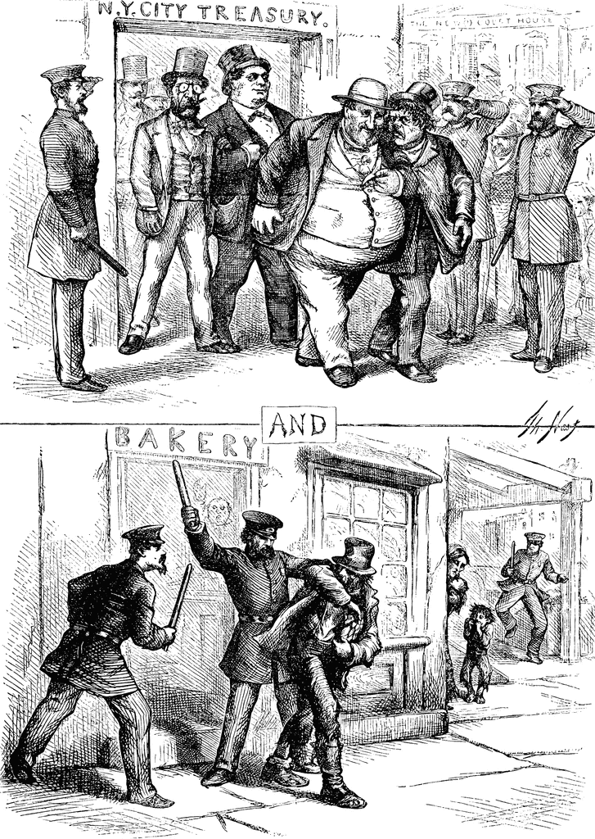

Slide 11
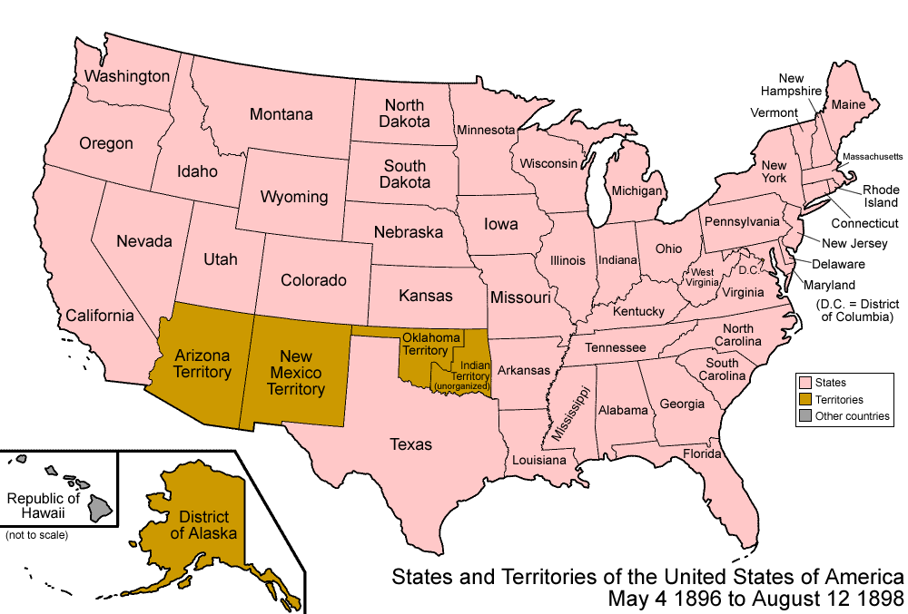
Progressive reforms helped make state governments more democratic

Slide 12
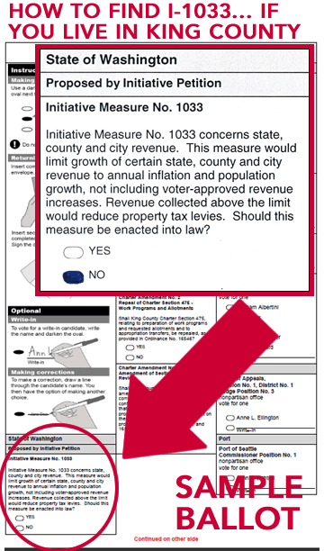
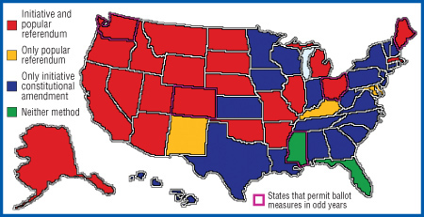
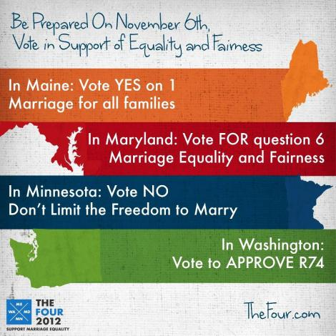
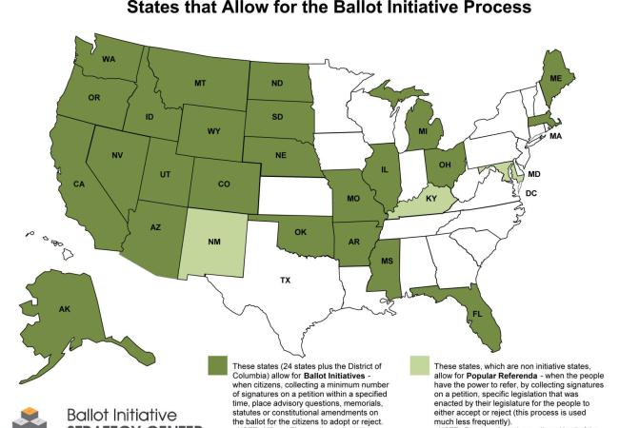
Initiatives allow citizens to bypass the state legislature by putting an issue on a state ballot and voting to make it a law

Slide 13
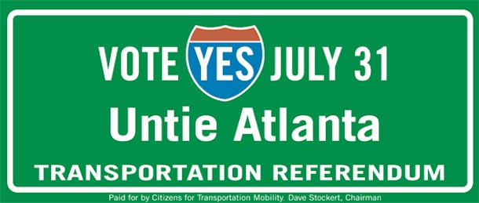
Referendum forces legislators to place a proposed bill on the ballot for citizen approval

Slide 14
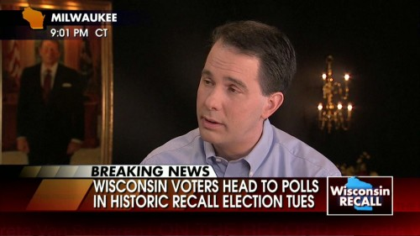
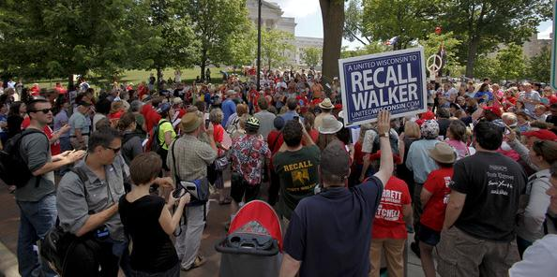
Recalls allow citizens to vote to remove an elected official

Slide 15
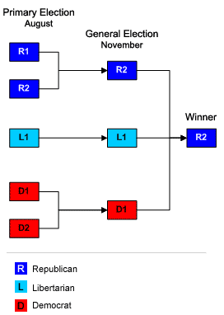
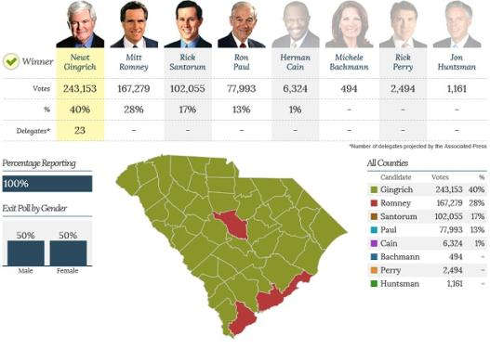
States began using direct primary elections to allow voters to choose party candidates

Slide 16
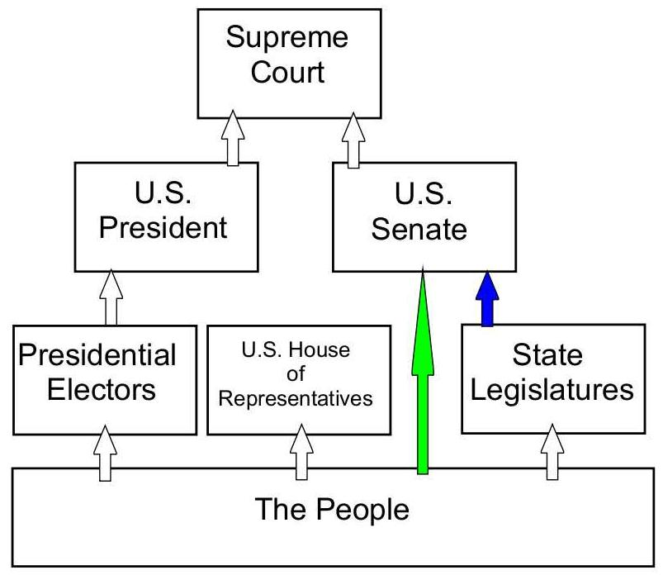
In 1913, the 17th Amendment was ratified allowing citizens to directly elect their U.S. Senators

Slide 17
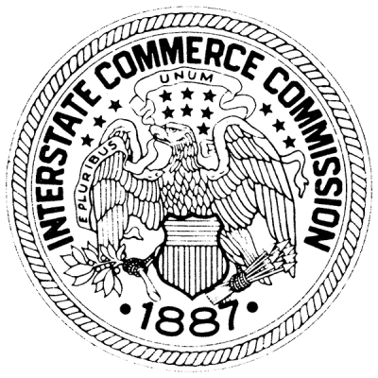
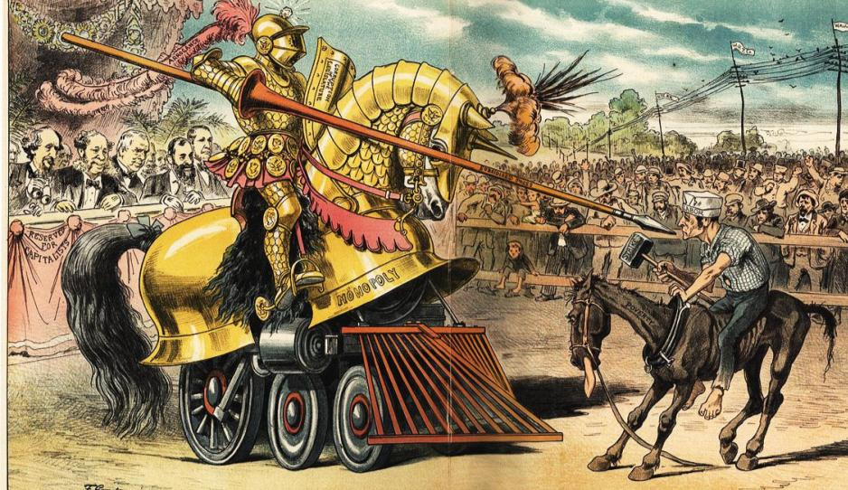
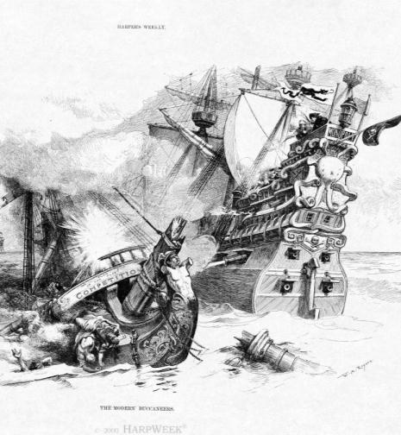
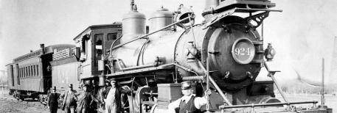
Throughout the Gilded Age, laissez-faire policies by the national government led to powerful monopolies and unfair working conditions for laborers
Congress created the Interstate Commerce Commission (ICC) in 1886 to regulate railroads…
…and passed the Sherman Anti-Trust Act in 1890 to regulate companies that restrict trade
But neither was used to control monopolies during the Gilded Age
REGULATION

Slide 18
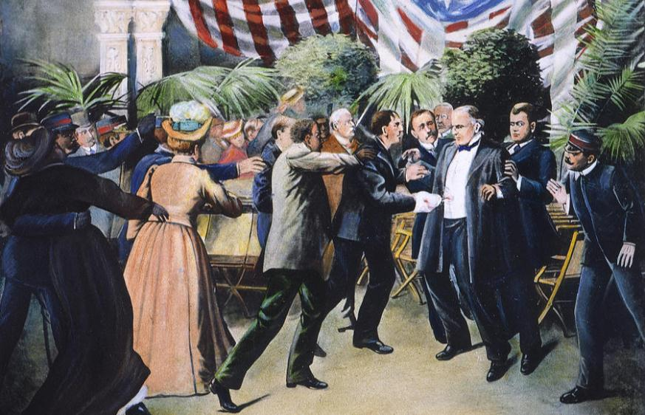
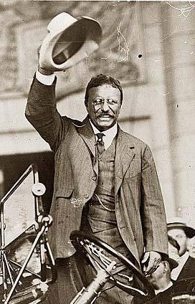
In 1901, Republican President William McKinley was assassinated...
…Vice President Theodore Roosevelt became president

Slide 19
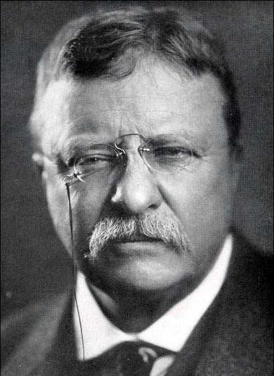
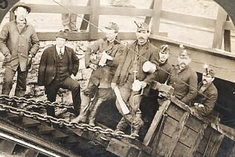
Theodore Roosevelt was a different kind of president because he thought the gov’t ought to take responsibility for the welfare of the people
In 1902, TR negotiated a “Square Deal” between striking anthracite coal miners and management
Notes:
In 1902, the United Mine Workers went on strike to demand higher pay & an eight-hour work day
(a) The anthracite coal strike lasted 11 months & threatened the nation as winter approached
(b) Unlike the Gilded Age presidents, TR did not side with the owners & break up the strike
(c) TR forced both sides to arbitrate or face gov’t seizure of the coal mine
(d) The result was a “square deal” for labor (higher wages) & owners (no formal recognition of the union)

Slide 20
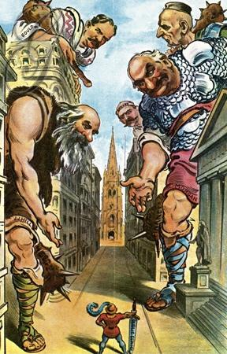
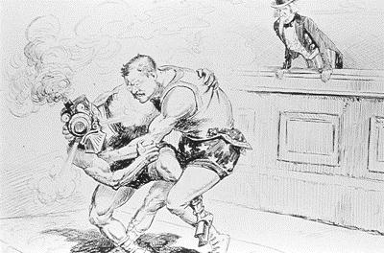
Roosevelt was the first president to regulate big business and break up corporate monopolies
He became known as a “trustbuster” when he used the Sherman Anti-Trust Act to break up the Northern Securities Company in 1902

Slide 21
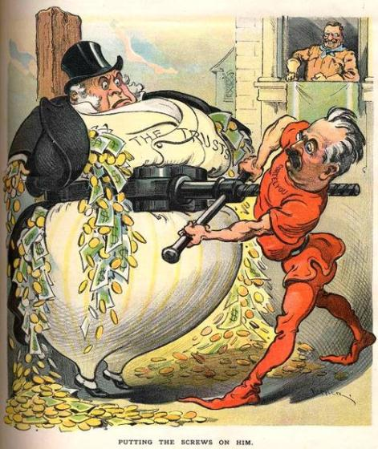
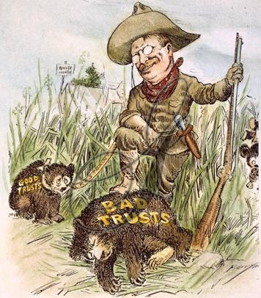
TR “busted” 25 other corporate monopolies during his presidency
But, he saw the benefit of efficient monopolies, but wanted to control bad trusts
RESTRAINT

Slide 22
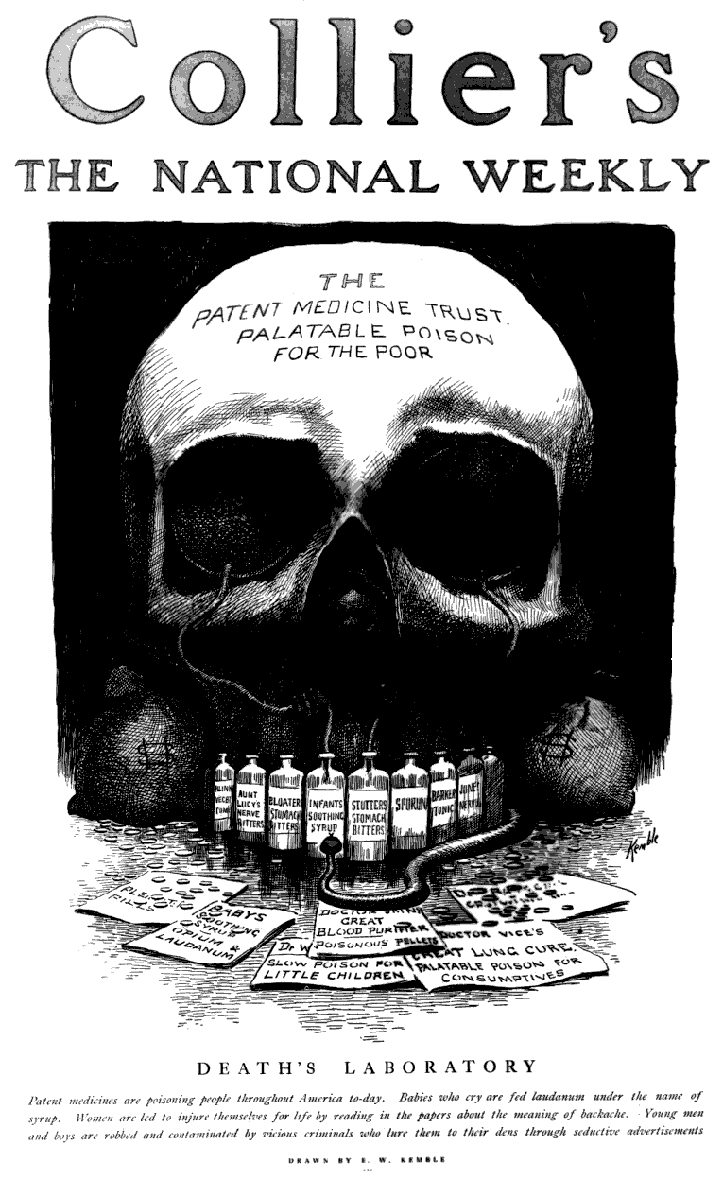
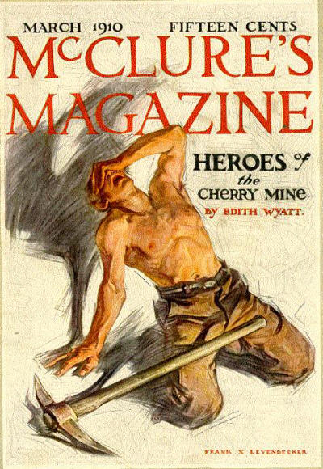
Investigative journalists known as muckrakers exposed corruption, poverty, health hazards, and monopolies

Slide 23
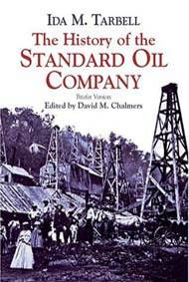
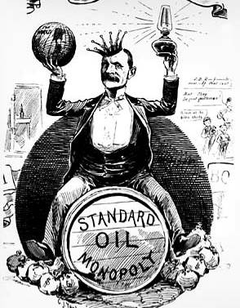
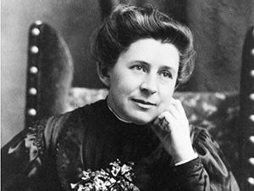
What did Ida Tarbell’s The History of Standard Oil (1904) expose?
Ida Tarbell’s The History of Standard Oil (1904) revealed Rockefeller’s ruthless business practices and called for the break-up of large monopolies

Slide 24
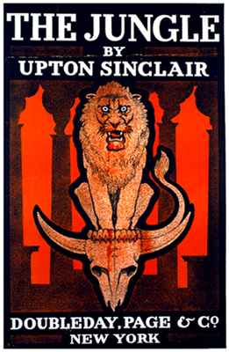
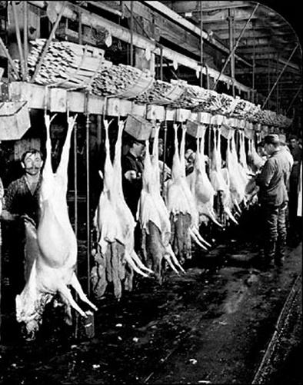
What did Upton Sinclair’s The Jungle (1906) expose?
Upton Sinclair’s The Jungle (1906) revealed the unsanitary conditions of slaughterhouses and led to government regulation of food industries

Slide 25
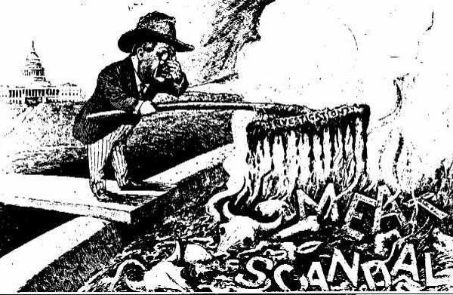
When Upton Sinclair wrote The Jungle in 1906, President Roosevelt pressured Congress to create consumer safety laws
Congress passed the Meat Inspection Act in 1906

Slide 26
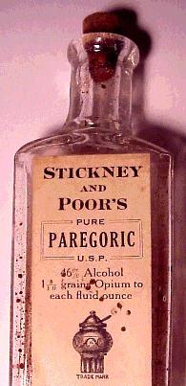
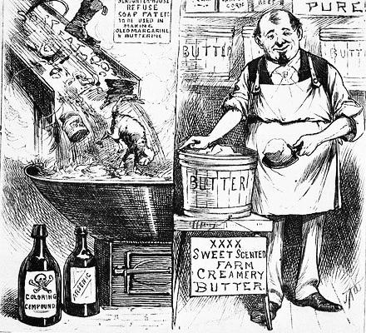
Congress passed the Pure Food and Drug Act in 1906 to ban harmful products and end false medical claims

Slide 27
During the Gilded Age, corporations clear-cut forests and exploited America’s natural resources

Slide 28
Theodore Roosevelt began the first national environmental conservation program
The government protected 195 million acres of land as national parks or forests

Slide 29
The Reclamation Service placed natural resources (oil, trees, coal) under federal protection

Slide 30
Progressive reform began in American cities in response to slums, tenements, child labor, alcohol abuse, prostitution, and political corruption
An early reformer was Jane Addams who created Hull House in Chicago
Hull House was the first settlement house which offered baths, cheap food, child care, job training, health care to help the poor
Jane Addams’ efforts inspired reformers in other cities to build settlement houses to assist the poor

Slide 31
Urban reformers tried to improve the lives of poor workers and children
The YMCA created gyms and libraries to help young men and children
The Salvation Army created nurseries and soup kitchens
Florence Kelley fought to create child labor laws and laws limiting women to a 10 hour day

Slide 32
What did Jacob Riis’ How the Other Half Lives (1890) expose?
Jacob Riis’ How the Other Half Lives (1890) exposed urban poverty and life in the slums
America: The Story of Us Jacob Riis video
Notes:
http://www.history.com/shows/america-the-story-of-us/videos/playlists/exclusive-video#jacob-riis

Slide 33
Many reformers saw alcohol abuse as serious problem
Frances Willard
Temperance reformers hoped that ending alcohol would reduce corruption, crime, assimilate immigrants
Reformers Frances Willard and Carrie Nation led the Women’s Christian Temperance Union (WCTU) to fight for prohibition laws
Carrie Nation

Slide 34
Reformers gained prohibition laws in rural areas and states in the South and West
In 1919, the states ratified the 18th Amendment which outlawed alcohol throughout the USA

Slide 35
The Progressive Era led to demands for equal rights by African Americans
Quick Class Discussion: In what ways were blacks discriminated against?
80% of lived in rural areas in the South, most as sharecroppers
Lynching and violence were common
Literacy tests and poll taxes limited black voting
Jim Crow laws segregated blacks in schools, hotels, restaurants, trains, and other public facilities
Plessy v Ferguson (1896) declared that segregation did not violate the 14th amendment

Slide 36
Black civil rights leaders were divided on how to address racial problems
Booker T. Washington was born a slave in Virginia and used hard work and education to become a teacher after the Civil War
He founded the Tuskegee Institute, a school to train black workers and teachers
On race relations, he argued in favor of accommodation: Blacks should work hard, educate themselves, and earn the rights they wanted

Slide 37
“Our greatest danger is that in the great leap from slavery to freedom, we may overlook the fact that the masses of us are to live by the productions of our hands and fail to keep in our mind that we shall prosper as we learn to dignify and glorify common labor…It is at the bottom of life we should begin and not the top…In all things that are purely social, we can be as separate as the fingers, yet one as the hand in all things essential to mutual progress.”
—Booker T. Washington
”Atlanta Compromise” (1895) Atlanta Cotton States Exposition

Slide 38
WEB DuBois had a very different view of race relations than Booker T. Washington
DuBois was born in Massachusetts and was the first black man to earn a doctorate from Harvard
He opposed Washington’s “Atlanta Compromise” and…
…called for immediate civil rights and the promotion of the “Talented Tenth” of young black leaders

Slide 39
WEB DuBois had a very different view of race relations than Booker T. Washington
We claim for ourselves every single right that belongs to a free American, political, civil and social, and until we get these rights we will never cease to protest and assail the ears of America
—W.E.B. DuBois

Slide 40
In 1905, DuBois and other black leaders led the Niagara Movement
…They demanded an end to segregation and discrimination and economic and educational equality
The meeting led to the formation of the National Association for the Advancement of Colored People (NAACP) in 1909 to fight for black equality

Slide 41
The NAACP fought voting restrictions and segregation laws by using the 14th Amendment to file lawsuits
WEB DuBois was the most outspoken early member of the NAACP by using The Crisis newsletter to call attention to black causes

Slide 42
While women gained voting rights and labor laws…
…African Americans were unable to end Jim Crow segregation, stop lynching, or gain economic equality
But, black leaders in the Progressive Era inspired later generations to demand changes

Slide 43
The Progressive Era led to demands for equal rights by women
Quick Class Discussion: In what ways were women discriminated against?
In most states, married women could not divorce or own property
Women could not vote, but black, immigrant, and illiterate men could
Women workers were paid less than men
Women were expected to remain at home as wives and mothers

Slide 44
During the Progressive Era, many women took the lead and played important roles as reformers
Jane Addams created the first settlement house
Muckraker Ida Tarbell exposed corporate monopolies
The WCTU fought for prohibition laws
Florence Kelley helped bring about child and women labor laws

Slide 45
Women reformers gained laws that banned prostitution
Margaret Sanger promoted birth control for poor and middle-class women and opened the first birth control clinic in the U.S. in 1915

Slide 46
The most significant reform for women was the demand for suffrage (voting rights)
Women demanded property and voting rights in 1848 at the Seneca Falls Convention
Women were frustrated after the Civil War in when black men gained the right to vote (15th Amendment) but women did not
In 1890, Susan B. Anthony and Elizabeth Stanton formed the National American Women Suffrage Association (NAWSA)

Slide 47
NAWSA leaders pressured states to let women vote and called for a national suffrage amendment

Slide 48
By the early 1900s, most western states allowed women to vote but women in the East could not vote

Slide 49
In 1920, the states ratified the 19th Amendment giving women to right to vote

Slide 50
In 1908, TR decided not to run for a third term
Roosevelt’s presidency from 1901 to 1909 changed the United States
First time, the government assumed responsibility for the welfare of all citizens, regulated big business, and protected the environment
His foreign policy helped increase American influence in the world and led to the construction of the Panama Canal
We will learn about TR’s foreign policy in Unit 9

Slide 51
When Theodore Roosevelt did not to run for a third term in 1908, he helped William Howard Taft win the presidency to continue his progressive agenda

Slide 52
Like TR, Taft pushed for progressive reforms
As president, Taft broke up twice as many monopolies as Roosevelt
Taft helped establish the Children’s Bureau, the Department of Labor, and child labor laws
He helped create safety codes for coal miners and railroad workers

Slide 53
But, Taft sometimes sided with the conservative wing of the Republican Party
Taft angered progressive Republicans when he supported a high tariff which helped large corporations
Taft allowed 1 million acres of Roosevelt had set aside as conservation forests to be sold to businesses

Slide 54
The election of 1912 was a three way race
William Howard Taft can on the Republican ticket
Democrats ran New Jersey governor Woodrow Wilson
TR ran as a Progressive Bull Moose

Slide 55
President Woodrow Wilson oversaw a great wave of progressive reforms
16th Amendment created the first national income tax
17th Amendment allowed for the direct-election of U.S. Senators
18th Amendment outlawed alcohol (prohibition)
19th Amendment granted women’s suffrage
“Progressive Amendments”

