Slide 1
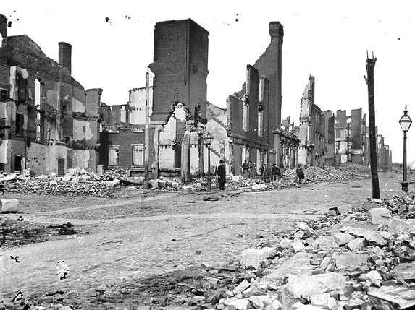
Reconstruction
1865-1877

Slide 2
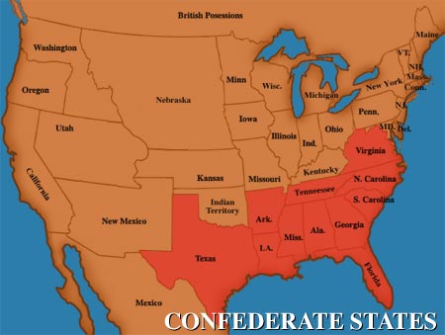
Reconstruction is the era from 1865 to 1877
when the U.S. government attempted
to rebuild the nation after the Civil War
Quick Class Discussion: What were the three goals of the federal government during Reconstruction?

Slide 3
Key Questions
1. How do we
bring the South
back into the
Union?
4. What branch
of government
should control
the process of
Reconstruction?
2. How do we
rebuild the
South after its
destruction
during the war?
3. How do we
integrate and
protect newly-
emancipated
black freedmen?

Slide 4
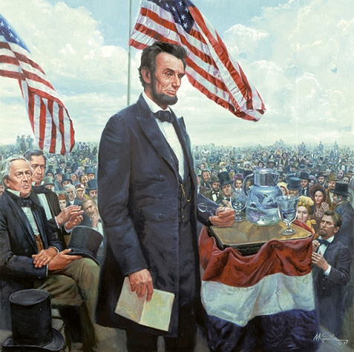
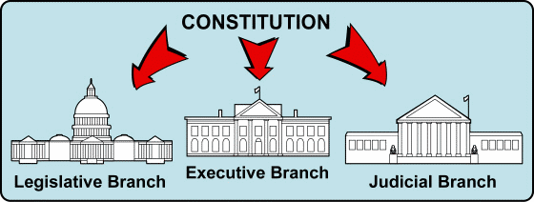
As the Civil War was ending, President Lincoln promised a Reconstruction Plan for the Union with “malice towards none and charity for all”
But, the Constitution gave no guidelines on how to readmit states to the Union
The President and Congress disagreed over how to
treat the Southern states
Abraham Lincoln’s
Second Inaugural Address

Slide 5
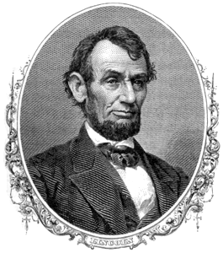
Lincoln favored a plan that would quickly re-admit the Confederate states once
10% of the people swore an
oath of loyalty and states
ratified the 13th Amendment
to abolish slavery in America

Slide 6
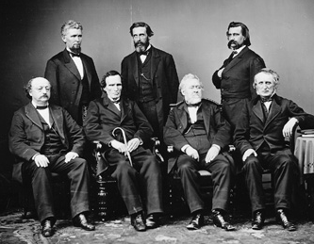
“Radical Republicans” in Congress rejected Lincoln’s plan because it was too lenient on ex-Confederates
They favored a plan that protected blacks, required 50% of state citizens to swear a loyalty oath, and banned ex-Confederate leaders from serving in gov’t
(Wade-Davis Bill)
When the Civil War ended and Lincoln was assassinated, the government did not have
a Reconstruction Plan in place

Slide 7
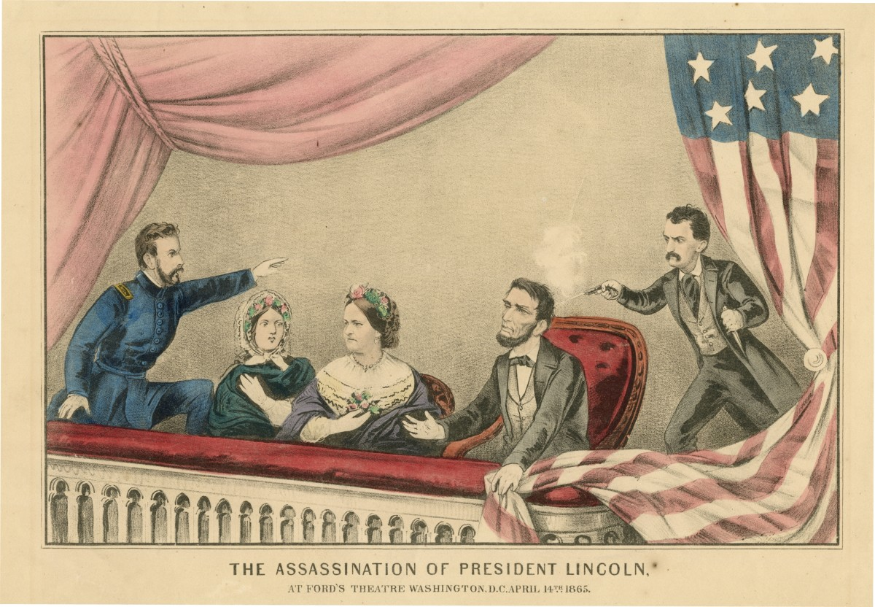

Slide 8
Phase 1: Presidential Reconstruction (1865-1867)

Slide 9
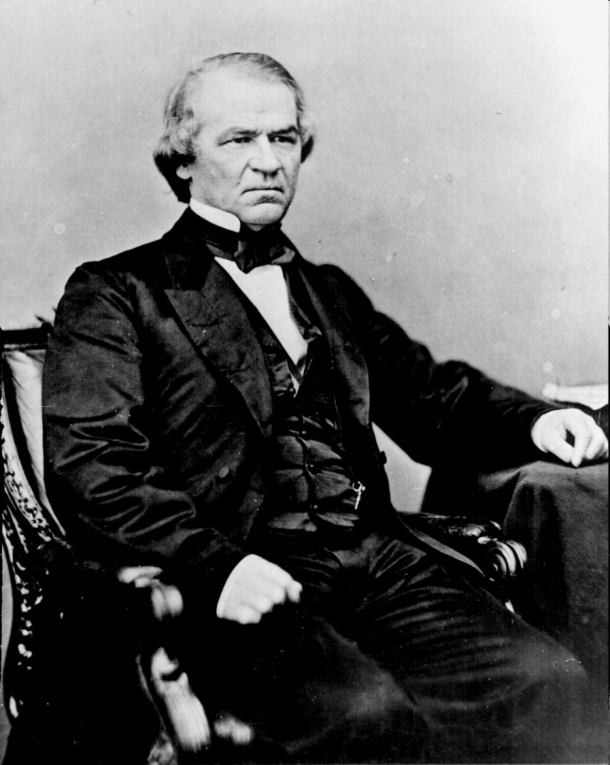
President Andrew Johnson’s
Plan for Reconstruction
Lenient
If 10% pledge allegiance to Union they could set up a new gov’t.
Required southern states to ratify 13th Amendment & draft state constitutions abolishing slavery
Required former Confederates write to him personally and apply for a pardon
* Did not want African Americans to have the right to vote

Slide 10
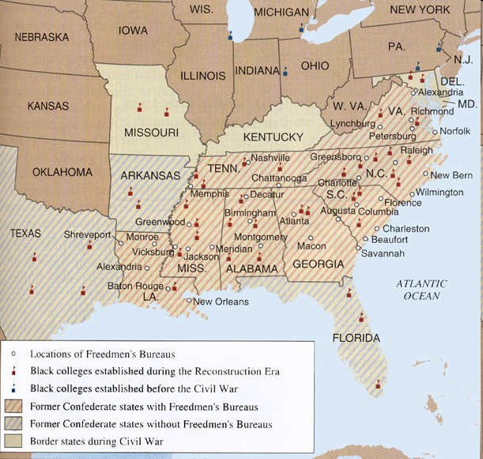
Freedmen’s Bureau
Radical Republican plan supported by Lincoln
Created by Congress in 1865
Goals:
  Provided necessities & education for black & white refugees in the South
  helped reunite families separated by slavery and war
  negotiated fair labor contracts between former slaves and white landowners

Slide 11
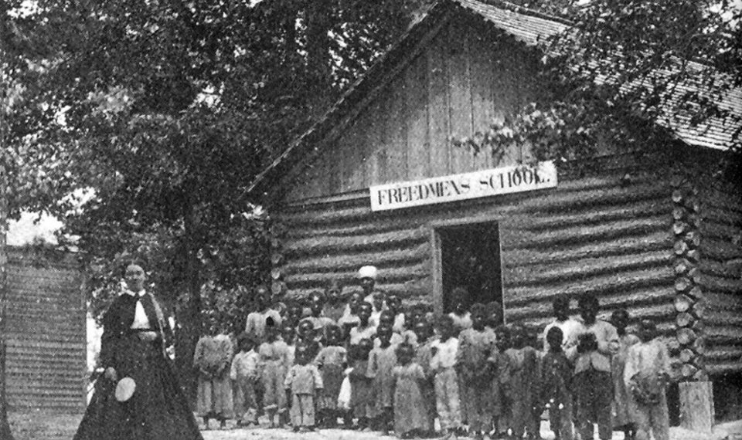

Slide 12
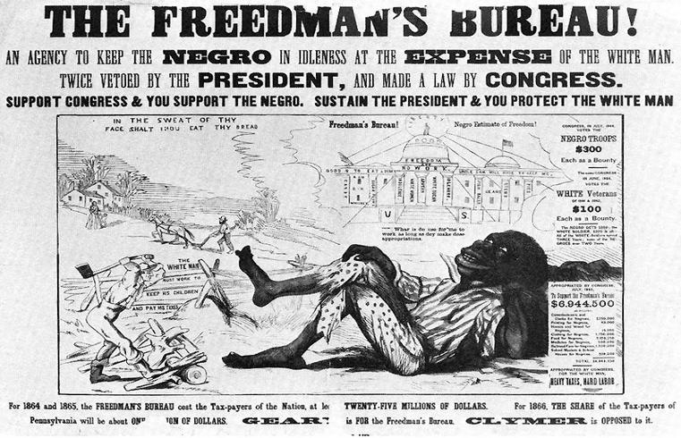

Slide 13
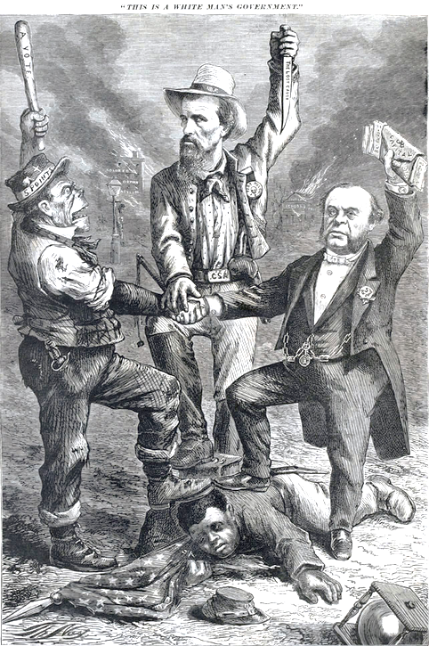
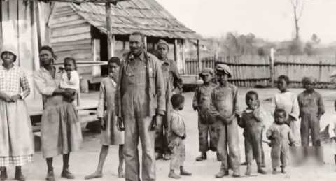
Andrew Johnson’s Reconstruction plan did not require Southern state governments to protect former slaves
Johnson pardoned most ex-Confederates, allowing them to return to power in the southern states
  Southern states passed black codes to keep
  African Americans from gaining land, jobs, and protection under the law

Slide 14
Black Codes
issued by all southern states during the Presidential Reconstruction phase (1865-1867)
laws that sought to limit the rights of African Americans and keep them as landless workers
African Americans could only work in a limited number of occupations: servants or farm laborers
Angered Republicans in Congress
Black Code Examples
Curfew - Generally, black people could not gather after sunset.
Vagrancy laws - Freedmen convicted of vagrancy (not having a job) could be fined, whipped, or sold for a year’s labor.
Labor contracts - Freedmen had to sign agreements in January for a year of work. Those who quit in the middle of a contract often lost all that wages they had earned.
Limits on women’s rights - Mothers who wanted to stay home and care for their families were forced instead to do farm labor.
Land restrictions - Freed people could rent land or homes only in rural areas.

Slide 15
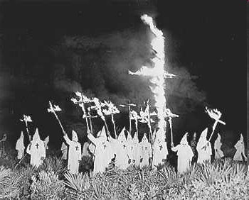
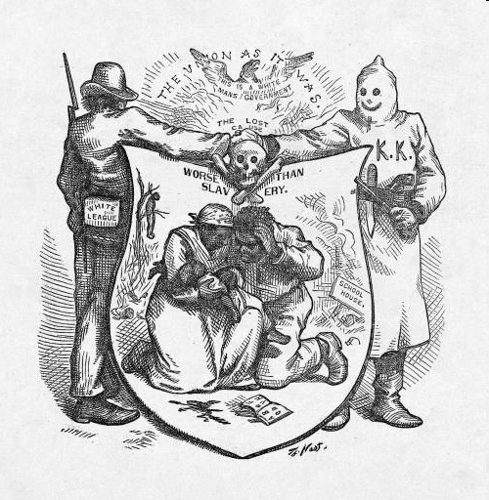
Ku Klux Klan
Formed in Tennessee in 1866
Burned homes, schools, and churches, and beat, maimed, or killed African Americans and their white allies
Dressed in white robes and hoods
Goals: scare freed people from voting

Slide 16
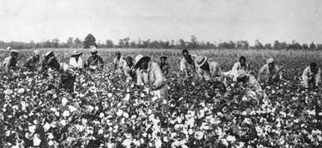
The Civil War ended slavery, but African-Americans had little job training or money for farm land
With few other options, most ex-slaves
returned to the plantation to work

Slide 17
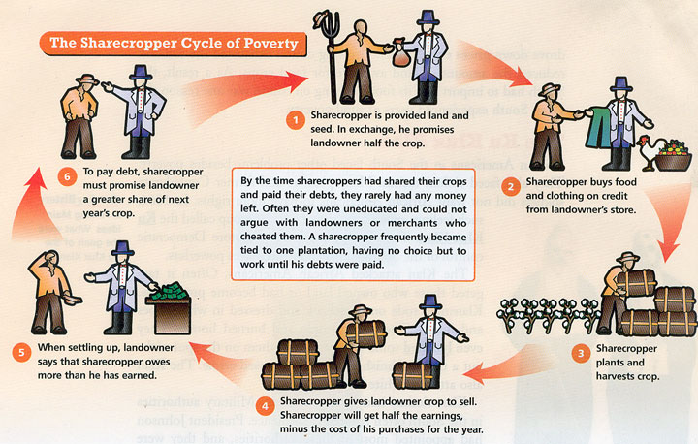
After the Civil War, slavery was replaced by sharecropping, also known as the tenant farming

Slide 18
White land owners would rent parcels of their fields to blacks and poor whites in exchange for ½ to ¼ of the cotton they produced

Slide 19
But, tenants had no money for tools or seeds so
they used lines of credit from the land owner in exchange for more of their cotton (crop lien system)

Slide 20
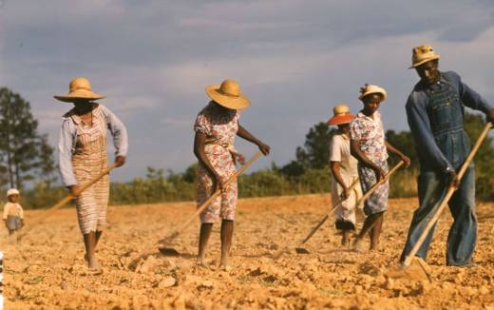
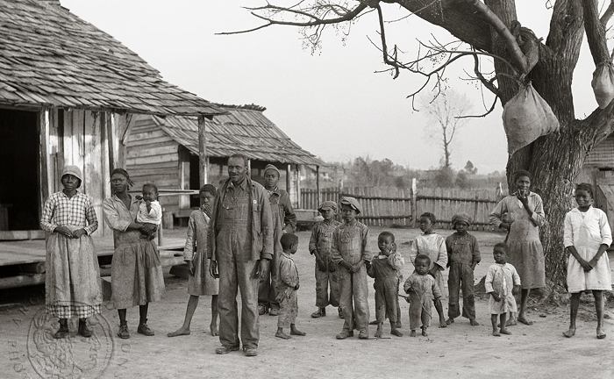
By the end of 1865, most freedmen had
returned to work on the same plantations
on which they were previously enslaved
Sharecropping remained in place until late in the 20th century

Slide 22
Phase 2: Congressional Reconstruction (1867-1877)

Slide 23
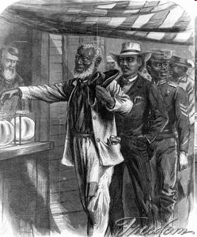
Civil Rights Act of 1866
Congress fought back against the Black Codes with the Civil Rights Act of 1866 – guaranteed civil rights even though states might try to limit them
Johnson vetoed
Congress overturned Johnson’s veto
This 1867 sketch by Alfred R. Waud depicts blacks voting freely in the first open elections in the South. The Civil Rights Act of 1866 had mandated these rights.

Slide 24
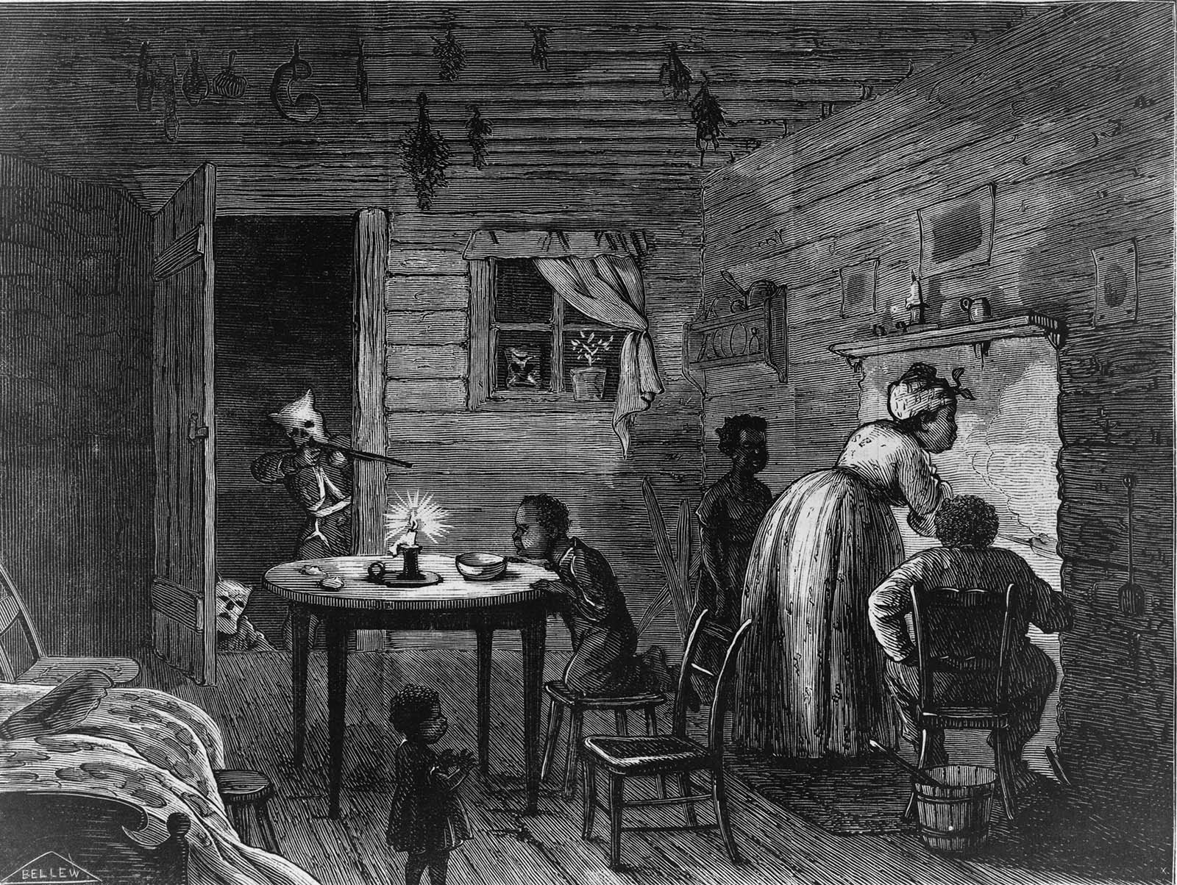

Slide 26
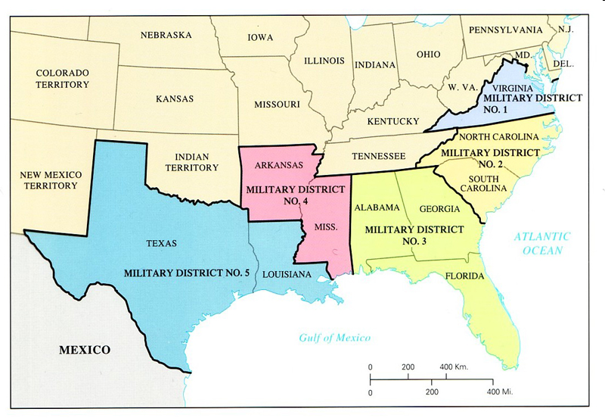
5 Military Districts

Slide 27
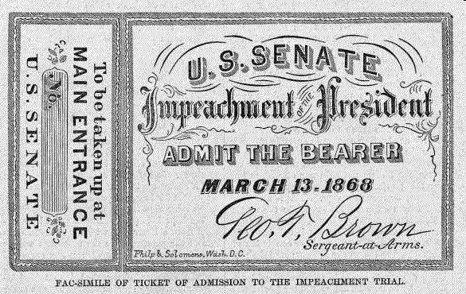
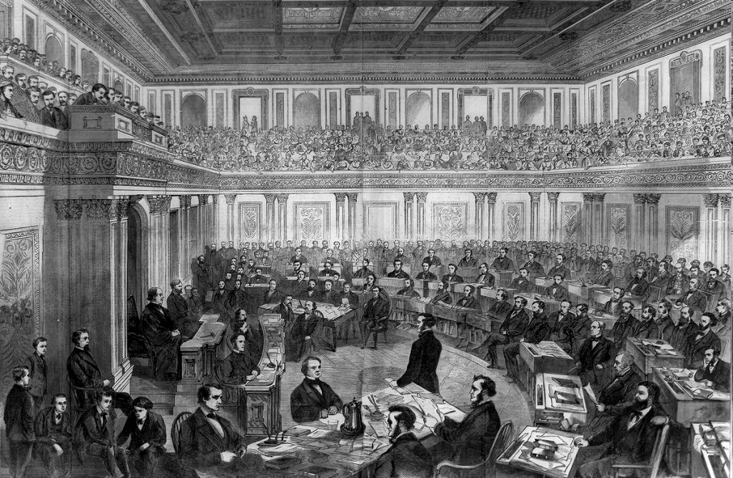
Johnson’s Impeachment
To limit the President’s power, Congress passed the Tenure of Office Act – President needed Senate approval to remove certain officials from office
Johnson tried to fire Sec. of War Edwin Stanton (Radical Republican)
House of Reps voted to impeach Johnson (charge him with wrongdoing in office)
Trial in Senate – failed and Johnson stayed President by only one vote

Slide 28
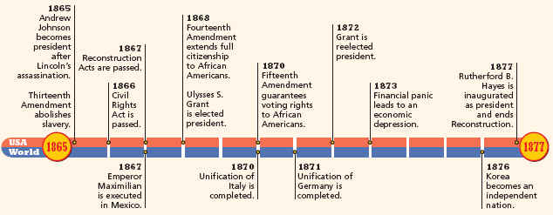
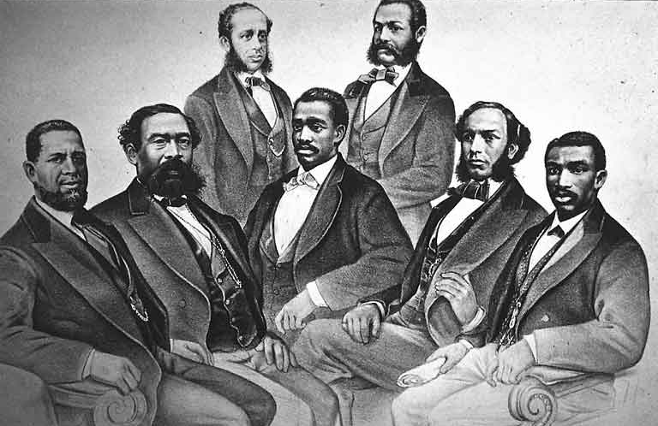
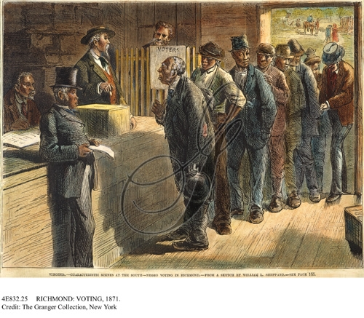
During Congressional Reconstruction,
African Americans experienced unprecedented rights
The 15th Amendment gave black men the right to vote in 1870
The 1st black politicians were elected to state and national offices

Slide 29
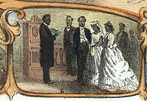
During Congressional Reconstruction,
African Americans experienced unprecedented rights
Literacy and education increased among blacks
Black families were reunited, marriages were legally recognized, and black workers could make their own money

Slide 30
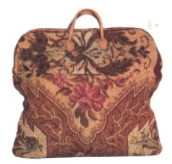
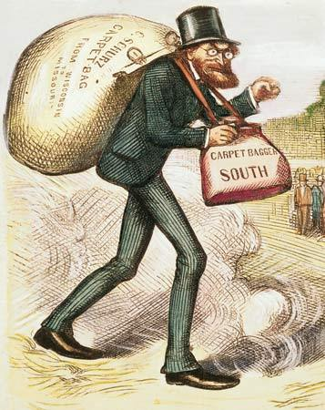
Scalawags & Carpetbaggers
Scalawag – Southern whites who supported Republicans
Carpetbagger – Northerners who moved to the South after the Civil War
Both targeted by opposition groups such as the KKK

Slide 31
Reconstruction Amendments
(1865) Thirteenth - FREE
(1868) Fourteenth - CITIZENS
(1870) Fifteenth - VOTE

Slide 32
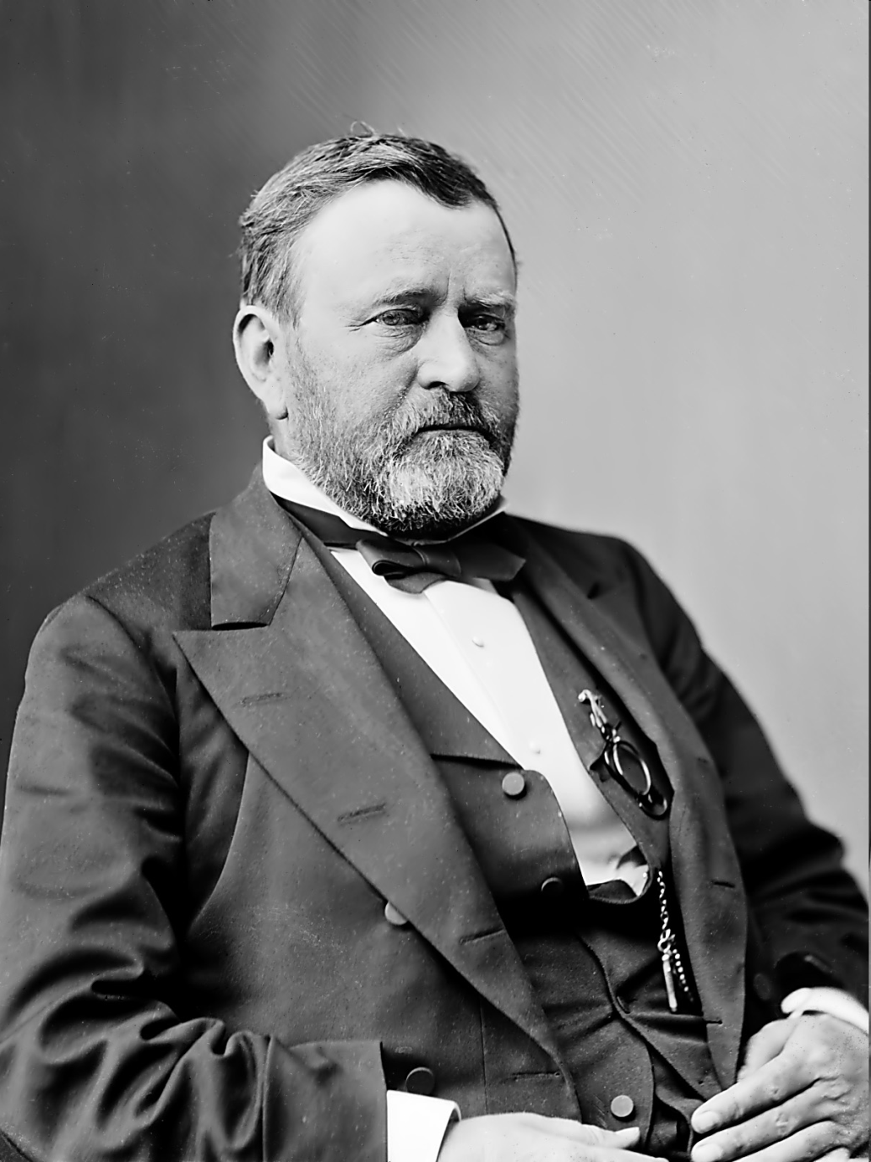
Election of 1868
1868 – Ulysses S. Grant (Republican) elected president
Presidency characterized by corruption

Slide 33
Reasons for the end of Reconstruction:
North turned attention to other things: reforming politics and the economy
Cost of military operations worried many

Slide 34
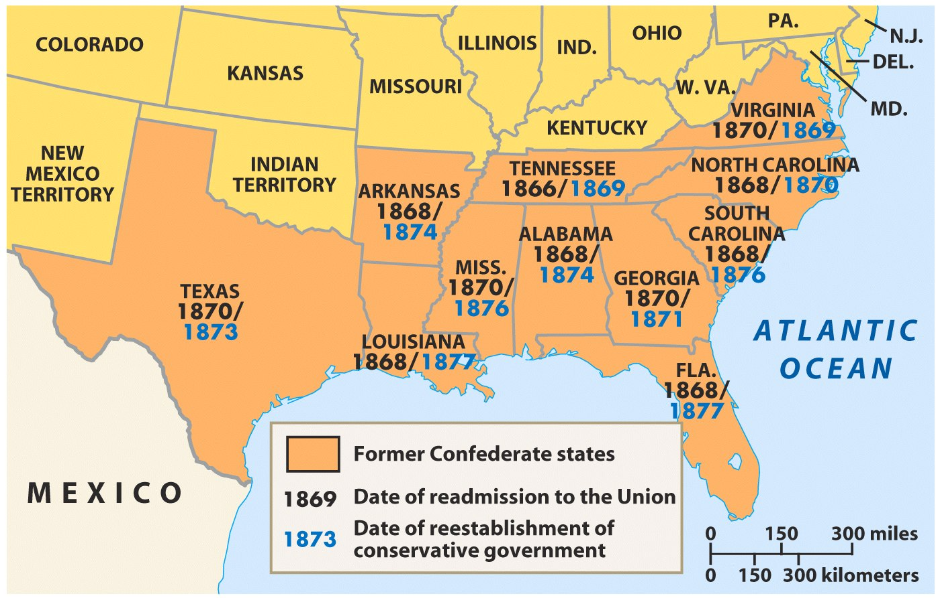
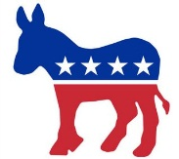

One-by-one, Southern state governments shifted from Republican control to the Democratic Party
Notes:
By 1876, only SC, FL, & LA were controlled by Republicans

Slide 35
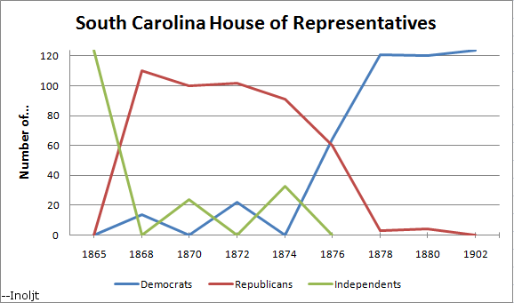
These “Redeemer Democrats” hoped to restore the “Old South”

Slide 36
Phase 3: End of Reconstruction

Slide 37
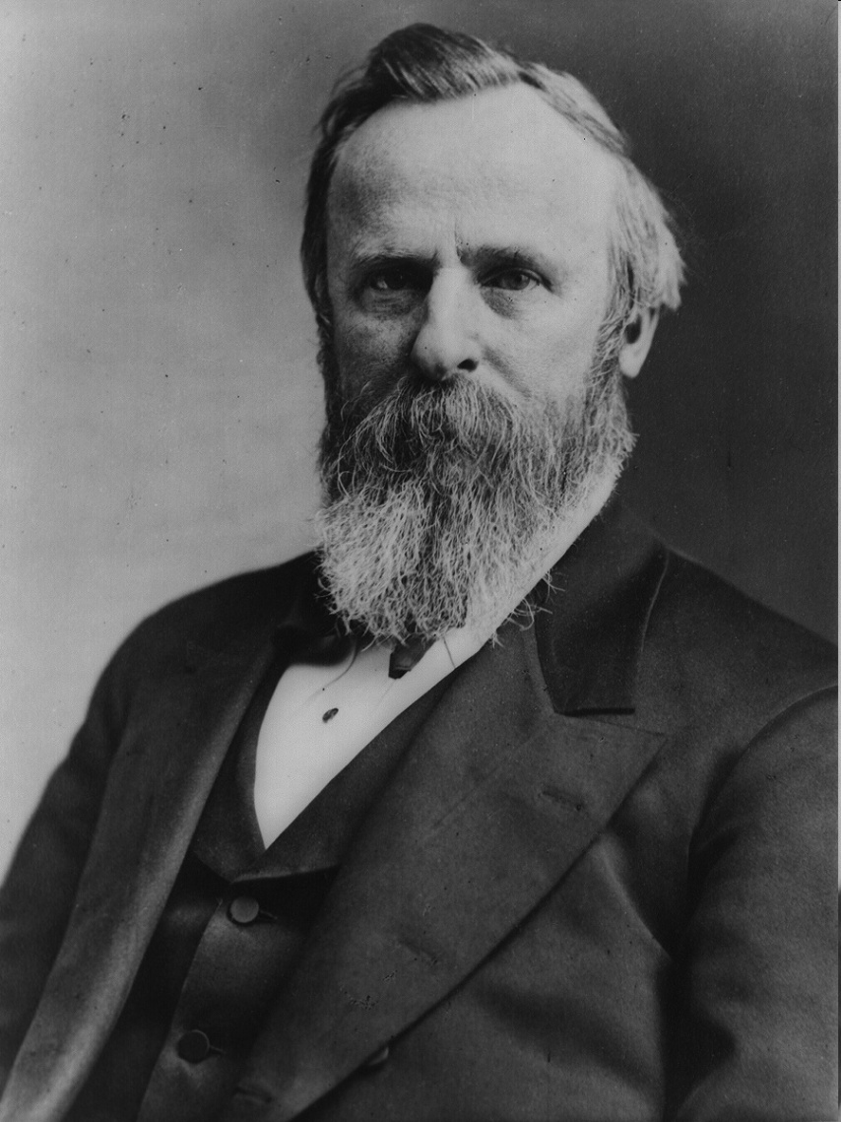
End of Reconstruction
1876 election:
  Republican Rutherford B. Hayes
  Democrat Samuel Tilden
  Tilden won popular vote & Southern states; in recount Hayes won by 1 electoral vote
  Election was so close it had to be decided by Congress
Compromise of 1877
  Hayes elected President
  In return, the remaining troops were removed from South = End of Reconstruction

Slide 38
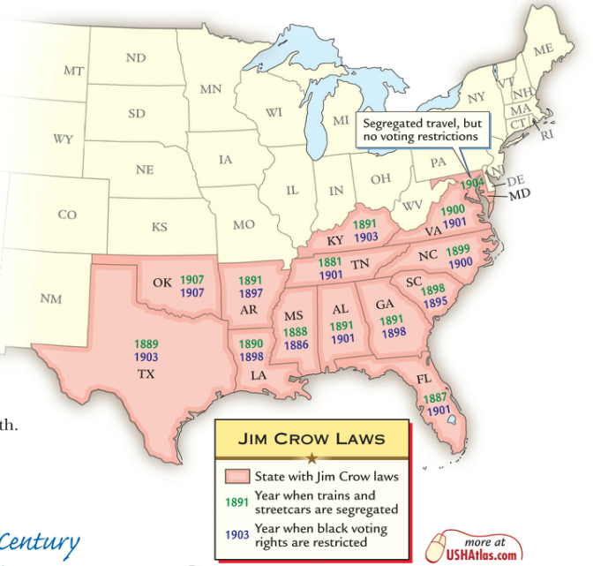
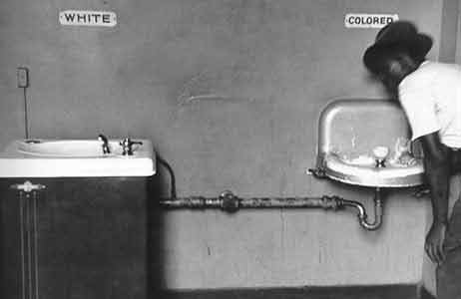

When Reconstruction ended, the Jim Crow era began (1877-1954)
Jim Crow laws segregated Southern society and restricted blacks from voting with
poll taxes and literacy tests

Slide 40
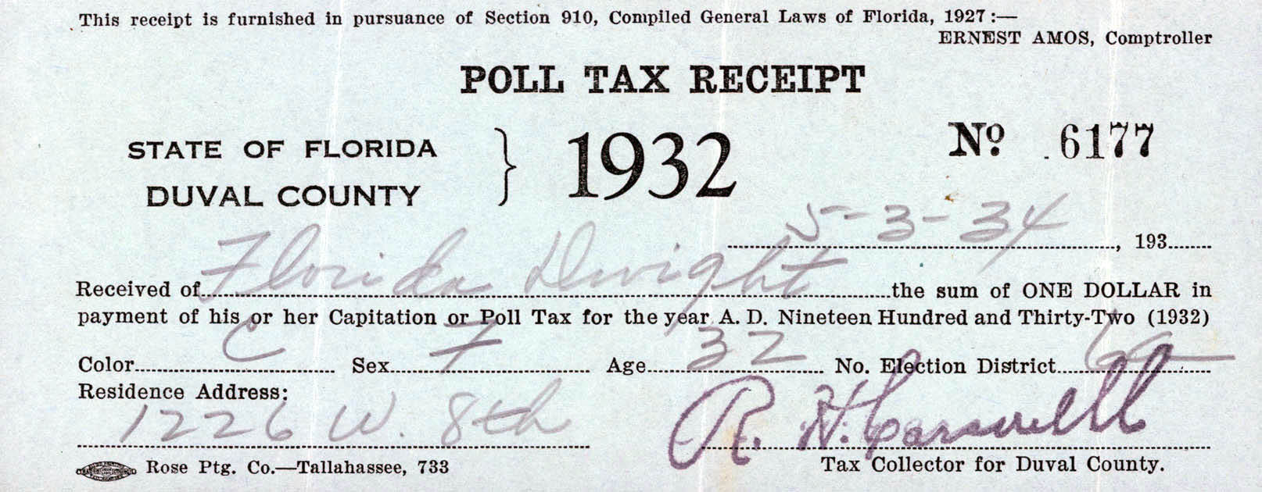

Slide 41
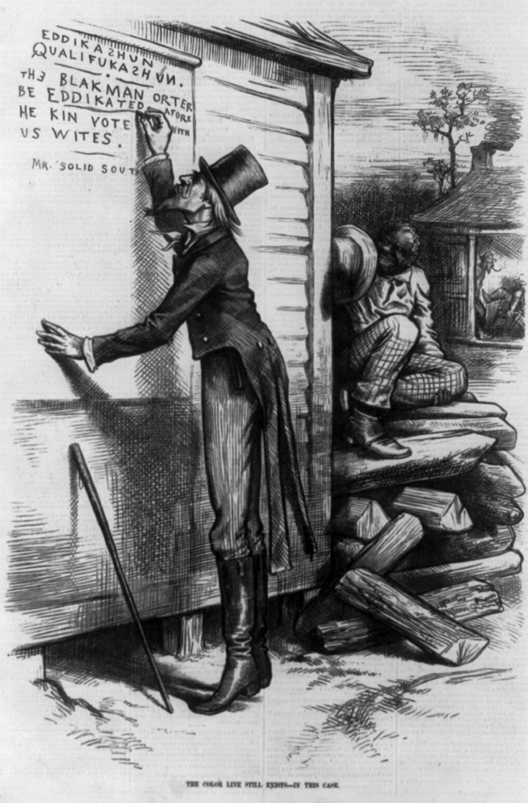

Slide 42
