Slide 1
Rise of Gilded Age Unions
In order to improve the abysmal labor conditions that arose from Gilded Age industrialization, workers began to organize
Union: an organization of workers dedicated to protecting members’ interests and improving wages, hours, and working conditions for all
Early labor unions were small, temporary organizations formed at the local level (often the workers from a single factory)
With the rapid industrial growth of the Gilded Age, labor unions soon became large, national organizations that represented entire industries or even workers across industries

Slide 2
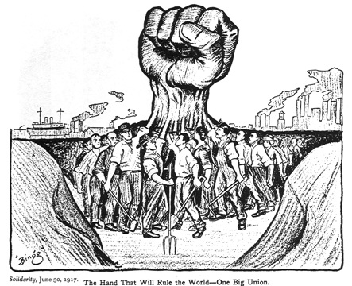

Slide 3
Labor Union Methods
Collective bargaining: negotiation between employers and representatives of a labor union that establish wage scales, working hours, health and safety standards, etc.
Arbitration: process of bringing a business dispute before a disinterested third party for resolution
Slowdown: employees continue to come to work but they do them more slowly, reducing productivity (often used as prelude or alternative to more risky strike)
Strike: a refusal to work, organized by a body of employees as a form of protest, in an attempt to gain concessions from their employer

Slide 4
Resistance to Unions
Yellow Dog Contract: workers were required to sign contracts promising not to join a union before being hired
Blacklists: denying an individual employment based on past union involvement
Lockouts: opposite of a strike, employers deny employees entry to workplace
Strikebreakers/Scabs: replacement workers hired by employers to replace strikers during a labor dispute (often immigrants and minorities that were not allowed in unions)
Injunctions: Court order obtained by employer ordering the breakup of strikes. Police or national guard would be brought in to end strike if workers did not comply

Slide 5
Knights of Labor
Founded in 1869 and led by Terence Powderly
Open to skilled and unskilled workers
Open to women, African-Americans, Mexican-Americans, immigrants, white-males
Goals were to set up cooperatives and get pro-labor legislation passed : 8 hour work day
Powderly did not approve of the use of strikes, thought it would turn public opinion against KoL
After violent Haymarket Riot of 1886, the public blamed the KoL for the death of 7 police officers, ruining the union

Slide 6
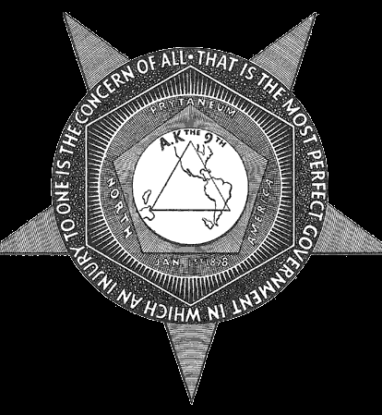
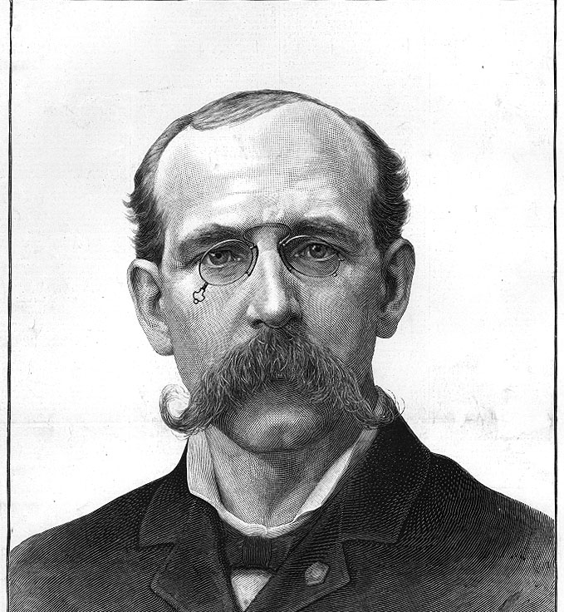

Slide 7
American Federation of Labor (AFL)
Founded in 1886 and led by Samuel Gompers
Open only to skilled workers (worker with special training, education)
Mainly composed of native born, white male workers
Primary goal was to concentrate on “bread and butter” issues such as length of work day, higher wages, and safety conditions
AFL used collective bargaining and strikes to gain its demands
Grew to 2 million members by 1901, achieved moderate success in improving wages and working conditions of its members

Slide 8
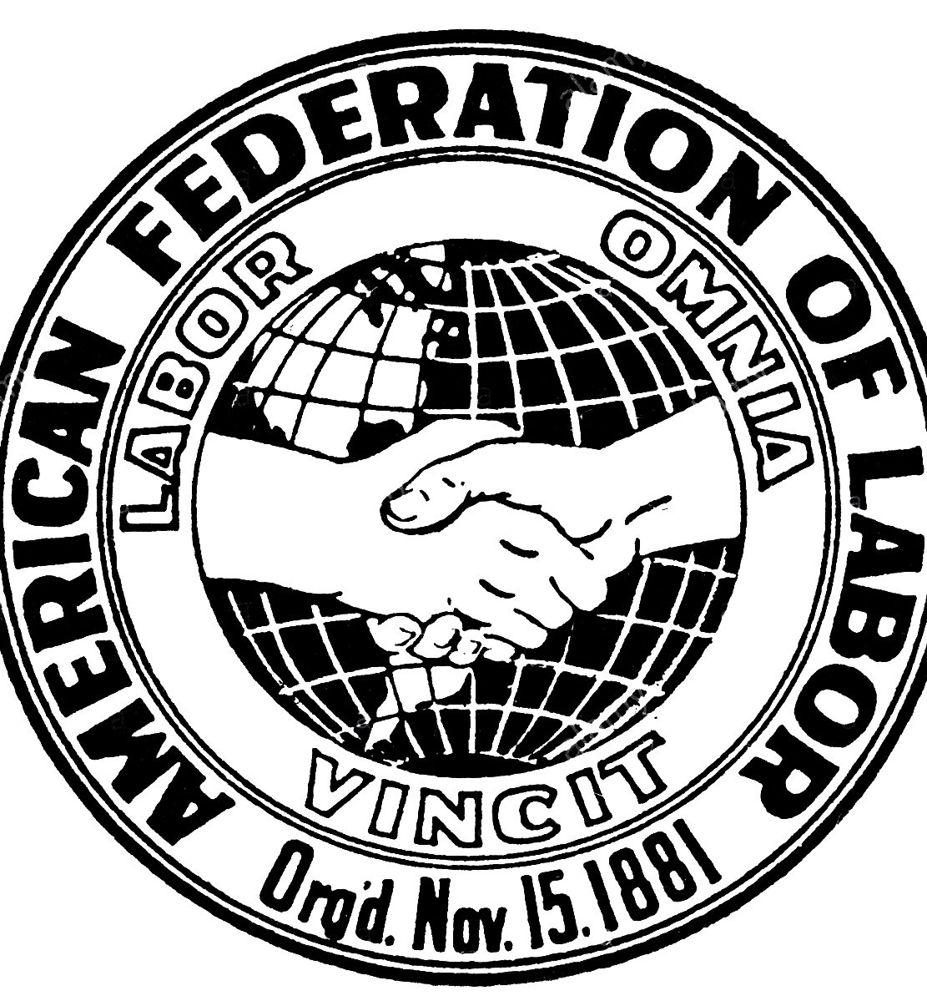
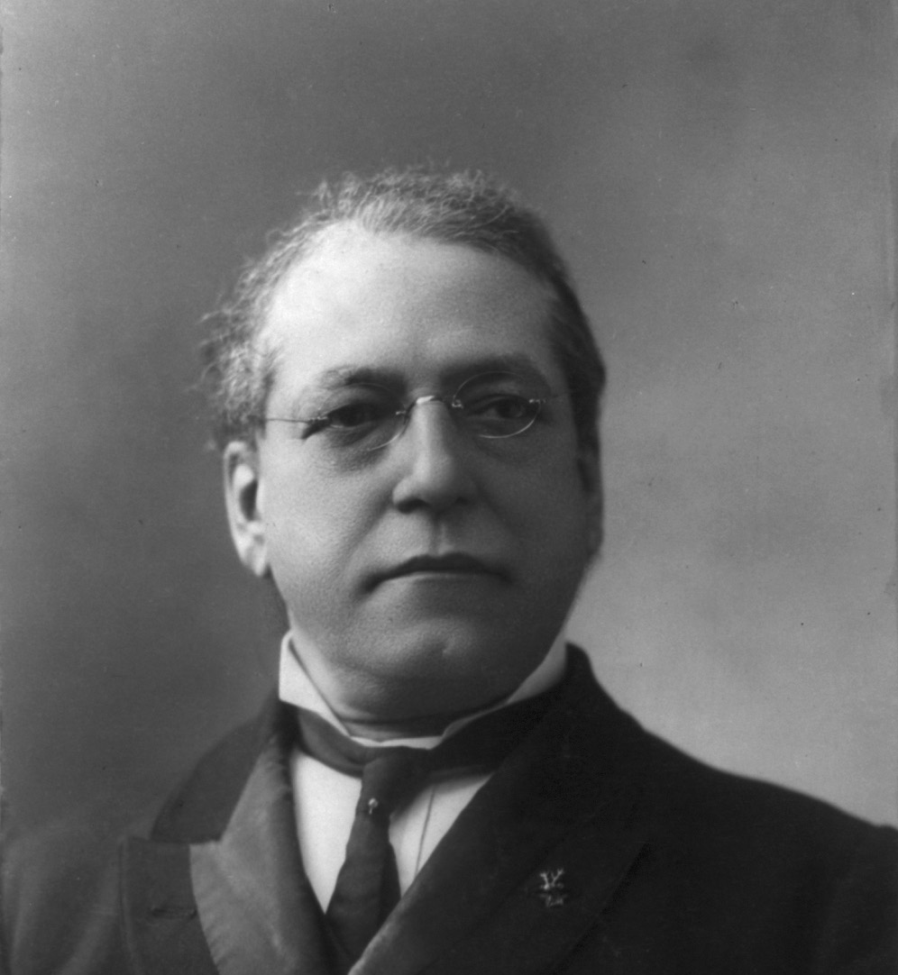

Slide 9
Industrial Workers of the World (IWW/Wobblies)
Founded in 1905 and led by William Haywood
Open to all laborers (women, immigrants, African-Americans, etc.)
Goal was to unite all workers and to overthrow the employing class and abolish capitalist wage labor = socialism
Used strikes and work slowdowns to improve wages and conditions
Membership declined dramatically in the 1920’s due to conflict with AFL and condemnation of the groups extremism by politicians and press… But still in existence

Slide 10
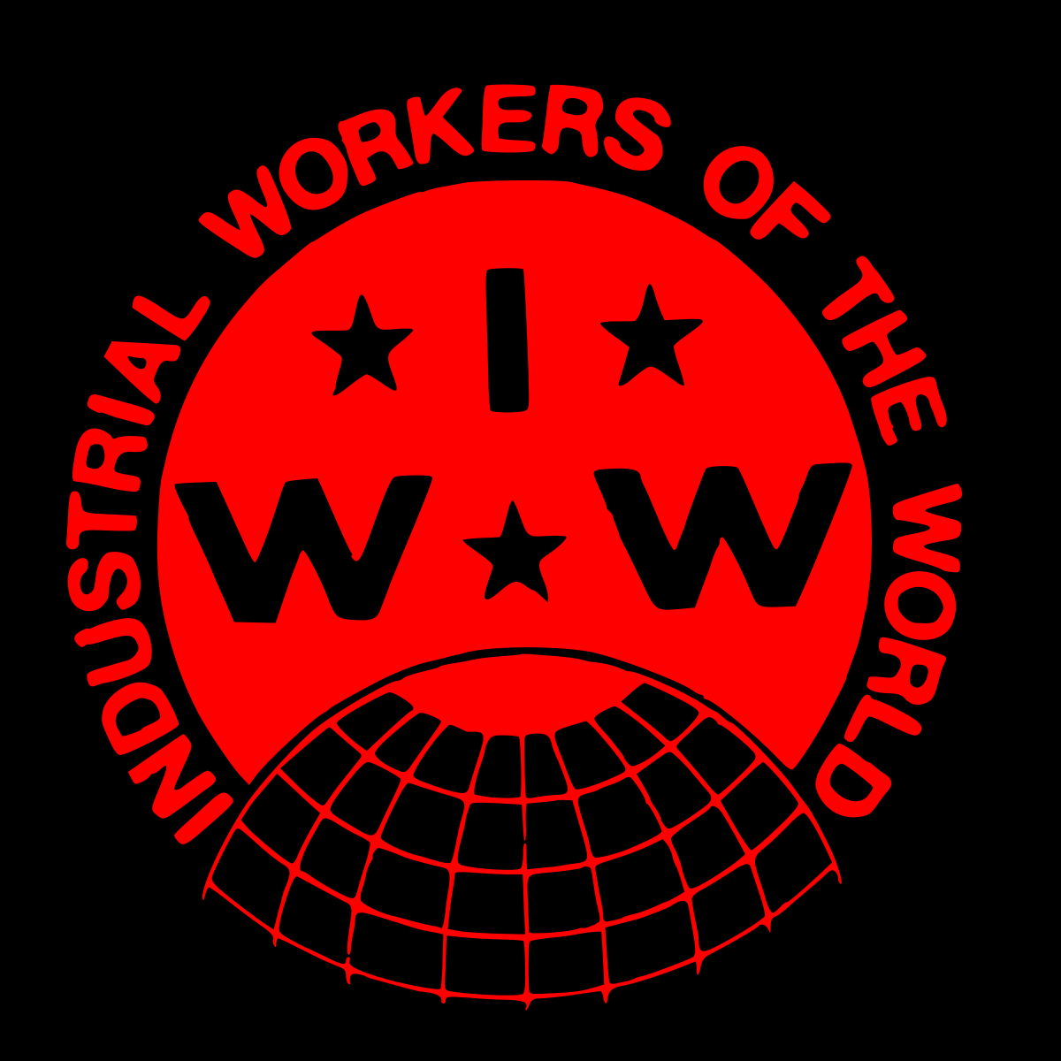
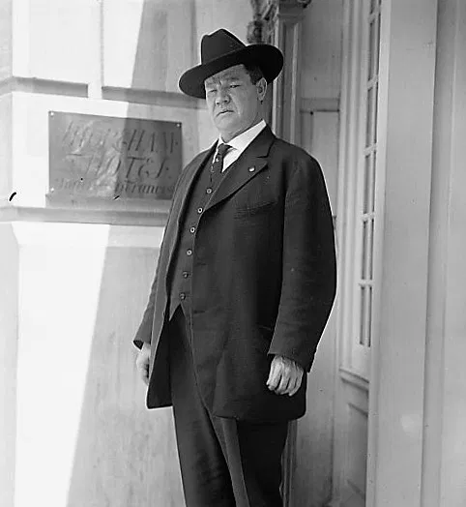

Slide 11
Haymarket Riot (1886)
1400 workers went on strike in Chicago against McCormick Harvester Company, demanding an 8 hour-workday
During the strike, the police shot and killed a striker
The next day, the Knights of Labor sponsored a large rally in Haymarket Square in support of the striking workers
Police tried to stop the rally, and someone set of a bomb killing seven policemen
Newspapers blamed the killings on the Knights of Labor, turning many people against the union
By 1890, membership had fallen from 700,000 to 100,00

Slide 12
Pullman Strike (1894)
The Pullman Car Company (made railroad sleeping and dining cars) workers went on strike when their wages were cut, but the Pullman Company refused to lower their rent
Pullman Company refused to negotiate with its workers
The American Railway Union supported the striking workers by refusing to operate any trains will Pullman Cars
This crippled the nations railroads
Railroad companies appealed to the government for help
The courts ruled that the union had to stop the strike and federal troops were sent to Chicago
Several strikers were killed in a battle with the troops and within a month the strike was stopped with the workers gaining nothing

