Slide 1
The Colonial Era
Paulding County: U.S. History

Slide 2
Standards
SSUSH1 Compare and contrast the development of English settlement and colonization during the 17th Century.
SSUSH2 Describe the early English colonial society and investigate the development of its governance.

Slide 3
Key Concepts
Mercantilism:
Trans-Atlantic Trade:
Southern Colonies:
New England Colonies:
Mid-Atlantic Colonies:
European Cultural Diversity:
Foodways:
Middle Passage:
Self-governance:
Salutary Neglect:
The Great Awakening:
Traditional Authority:

Slide 5
What’s the purpose of the following political cartoon?

Slide 7
Mercantilism (SSUSH1a)
The founders of the British colonies were greatly influenced by an economic theory known as mercantilism.
Mercantilism is an economic concept where the colonies served only to provide raw materials to the English businesses.
Then, the English businesses used the raw materials to make finished goods and then sell the finished goods back to the colonist.

Slide 9
Mercantilism (SSUSH1a)
Consequently, the English and its businesses became stronger and wealthier, and the colonies became poorer and weaker.

Slide 11
Trans-Atlantic Trade (SSUSH1a)
Mercantilism also inspired Britain to control trans-Atlantic trade with its American colonies.
Trans-Atlantic trade or the Triangular Trade connected Europe, the Americas, and Africa through trade.
All goods shipped to or from British North America had to travel in British ships, and any goods exported to Europe had to land first in Britain to pay British taxes.
Some goods could be exported to Britain only.
These restrictions were designed to keep the colonies from competing against Britain.

Slide 12
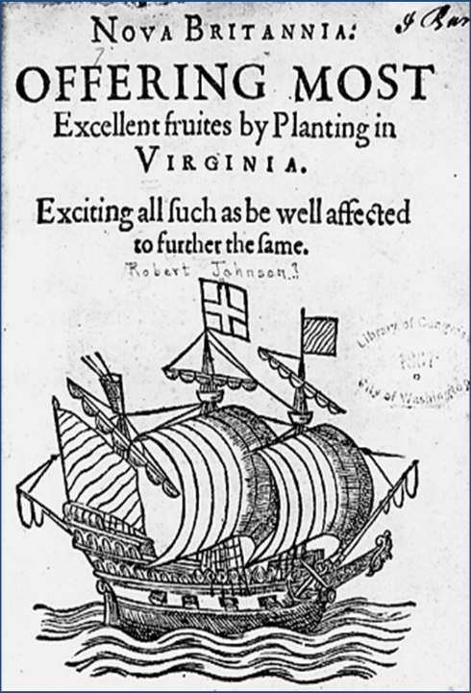

Slide 13
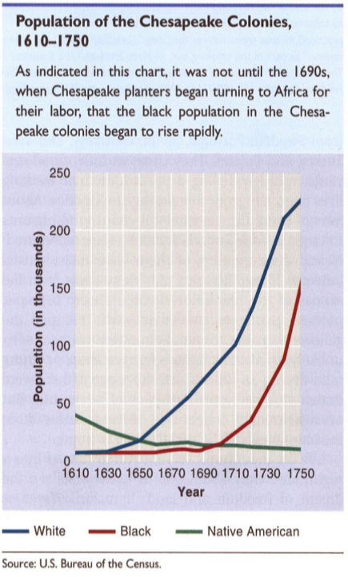
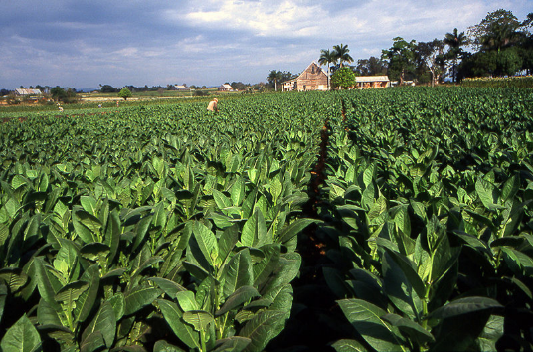

Slide 14
Southern Colonies (SSUSH1b)
Included: Virginia, Maryland, South Carolina, North Carolina and Georgia
Reason established: Colonist searching for gold and other financial resource
Impact of location and place: The location of the Southern Colonies, with the region’s rich soil and long growing season, fostered the development of strong agricultural producing colonies.

Slide 15
Southern Colonies (SSUSH1b)
Relations with American Indians: Relations with American Indians in the Southern Colonies began somewhat as a peaceful coexistence. As more English colonists began to arrive and encroach further into native lands, the relationship became more violent.
Economic development: Economy based on Agricultures, development of cash-crops (tobacco, rice, indigo and cotton)

Slide 16
Review Questions
How did mercantilism impact the Colonist?
How did mercantilism impact the British?
What was the significance of the trans-Atlantic trade on the Colonies?
What three continents were included in trans-Atlantic trade?
Explain the development of the Southern Colonies
Reason established: _________________________________
Impact of location and place: _______________________
Relations with American Indians: _______________________
Economic development: _______________________________

Slide 17
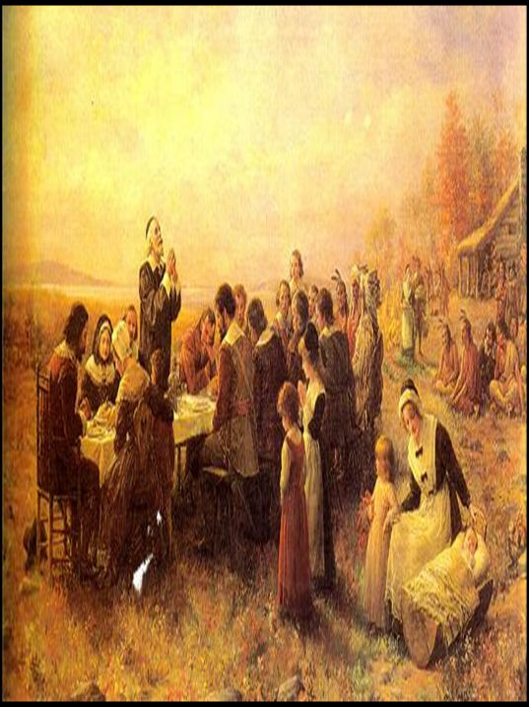

Slide 18
What does this map tell you about the Southern and New England Colonies?

Slide 19
New England Colonies (SSUSH1c)
Included: Massachusetts, Rhode Island, Connecticut and New Hampshire
Reason established: Puritans settle the colonies for religious reasons
Impact of location and place: The poor, thin, rocky soils and a relatively short growing season that made farming difficult. However, plentiful forests and proximity to the sea led New Englanders to eventually develop a thriving ship building industry.

Slide 20
New England Colonies (SSUSH1c)
Relations with American Indians: The New Englanders did not openly embrace the American Indians but relied on them for help in the difficult early years for survival. As the English population increased, the colonist had conflict with American Indians due to settlement and ownership of land.
Economic development: Economy base on trading, small business and fishing industry shipping of goods

Slide 21
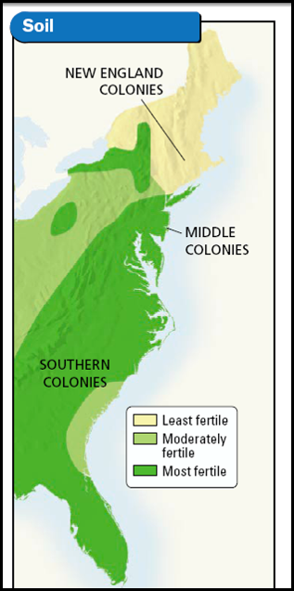

Slide 22
Compare and contrast the Mid-Atlantic, New England, and Southern Colonies base of the following map

Slide 23
Mid-Atlantic Colonies (SSUSH1d)
Included: New York, New Jersey, Pennsylvania, Delaware and Maryland
Reason established: For religious (religious tolerance) and economic reasons
Impact of location and place: The colonies were geographically fortunate to have good harbors and river systems that significantly shaped their trade based economy. However, the Mid-Atlantic Colonies also farmed significant quantities of wheat and corn, similar to the cash crop production of their southern neighbors.

Slide 24
Mid-Atlantic Colonies (SSUSH1d)
Relations with American Indians: The natives who resided there were typically relied upon for trade with the English and not the target of war, as was often the case in the other English colonial regions
Economic development: Trading and agriculture based economies

Slide 25
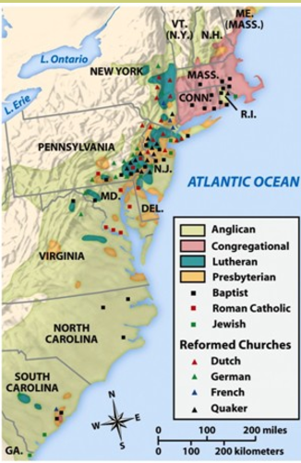
Describe how these charts impacted the Colonies?

Slide 26
European Cultural Diversity (SSUSH2a)
Various European cultures came to be represented in England’s American Colonies
Immigrants traveled from Scotland, Ireland, Netherlands, and Germany.
Religious immigrants included Protestant sects, Catholicism, Judaism, and Quakerism.
The Mid-Atlantic Colonies were the most diverse because there was no dominant culture.

Slide 27
Review Questions
Explain the development of the New England Colonies
Reason established:________________________
Impact of location and place: __________________
Relations with American Indians: ________________
Economic development: _____________________
Explain the development of the Mid-Atlantic Colonies
Reason established: ____________________
Impact of location and place: _______________
Relations with American Indians: _____________
Economic development: _______________________
How did the European immigrants impact colonial society?

Slide 28
Primary Source Analysis
“When we have had some of these slaves on board my master's vessels to carry them to other islands, or to America, I have known our mates to commit these acts most shamefully, to the disgrace, not of Christians only, but of men. I have even known them gratify their brutal passion with females not ten years old; and these abominations some of them practised to such scandalous excess, that one of our captains discharged the mate and others on that account.”
― By Olaudah Equiano

Slide 29
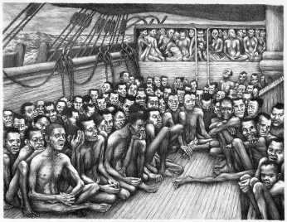

Slide 30
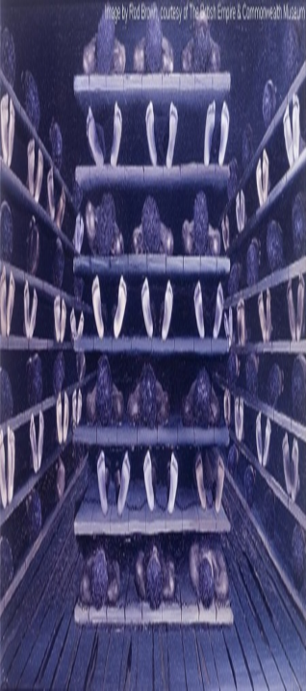

Slide 31
The Middle Passage (SSUSH2b)
The Middle Passage: the portion of the Trans-Atlantic trade route were slaves were transported from Africa to the Americas.
Slaves were brought to the Americas on dangerous slaves ships.
Once in the Americas slaves were force to fill the labor roles in the colonies
West Africans sold Slaves to the Americas for rum, cloth, weapons, and other manufactured goods.

Slide 32
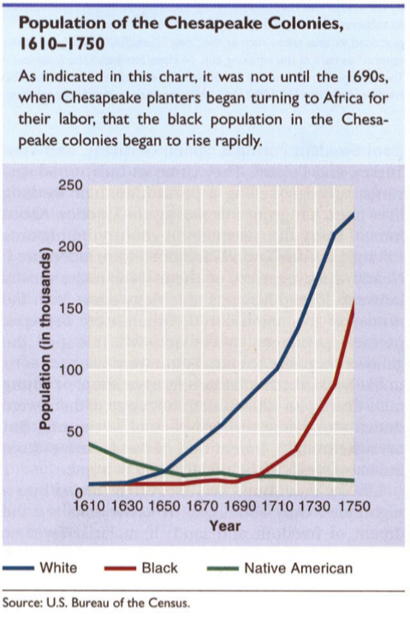

Slide 33
African American Population (SSUSH2b)
African American culture grew as a result of increase in need for unskilled labor.
The population had its greatest increase in the Southern Colonies due to the need for unskilled labor in the cash-crop fields such as tobacco.

Slide 34
Cultural Contribution of African Americans (SSUSH2b)
There was not one African American culture, slaves represented a large number of different cultures.
Slave owners attempted to strip away the cultural identity of slaves by placing them with African Americans brought from different cultures.
However, slave on plantations started to develop their own culture

Slide 35
Cultural Contribution of African Americans (SSUSH2b)
Examples of African American culture
Architecture: Shotgun House Plan
Agriculture: Okra, watermelon, sweet potatoes,
Foodways: Methods of cooking such as BBQ

Slide 36
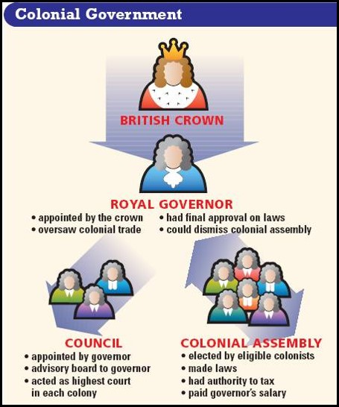

Slide 37
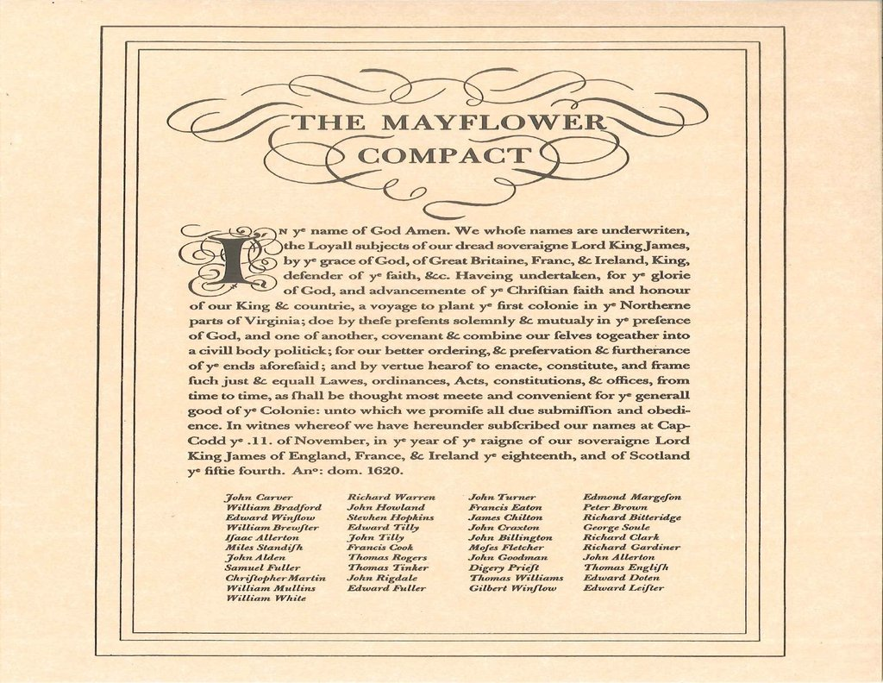
Salutary Neglect (SSUSH2c)
Salutary Neglect: British policy that believed the colonies would become more economically productive if they were not restricted by British policies that limited their ability to trade and govern.

Slide 38
Salutary Neglect (SSUSH2c)
Early Examples of American Self-Governance
House of Burgess: In Virginia, he first representative form of government in the colonies
Mayflower Compact: First governing document of the New England colonies
Town Meetings: In New England colonies, citizens voted on a variety of political issues.

Slide 39
Why would an artist draw the following picture?

Slide 40
What is happening to the number of Churches in the Colonies? Is this a positive or negative situation?

Slide 41
Primary Source Analysis
“The Enlightenment slowly helped undermine the power of traditional authority---- something the Great Awakening did as well, But unlike the Great Awakening, the Enlightenment encouraged men and women to look to themselves—not to God---- for guidance as to how to live their lives and to shape society. Enlightenment thought, with its emphasis on human rationality, encouraged a new emphasis on education and a heightened interest in politics and government. Most Enlightenment figures did not challenge religion and insisted that rational inquiry would support not undermine, Christianity.”
Source: American History, 14th Edition, By Alan Brinkley, McGraw-Hill

Slide 42
The Great Awakening (SSUSH2d)
The Great Awakening was a religious revival that encourage colonist to develop their own personal relationship with God.
Preachers stressed the power of the individual and to resist the power of the Church of England
As a result of the Great Awakening, colonist began questioning traditional authority.
Which leads colonist to rebel against the British government and inspires the American Revolution.

Slide 43
Review Questions
Define Middle Passage
What was the significance of the Middle Passage?
What are 3 contributions of African Americans during the Colonial Era?
Define Salutary Neglect
How did Salutary Neglect impact colonist?
List 3 example of Salutary Neglect
________________________________________________
________________________________________________
_____________________________________________
Define the Great Awakening
What was the significance of the Great Awakening?

