Slide 1
World War II and Cold War
Paulding County: U.S. History

Slide 2
Standards
SSUSH19 Examine the origins, major developments, and the domestic impact of World War II, including the growth of the federal government.
SSUSH20 Analyze the U.S. international and domestic policies including their influences on technological advancements and social changes during the Truman and Eisenhower administrations.

Slide 3
Key Concepts
Japanese Attack on Pearl Harbor
The Battle of Midway
The Manhattan Project
The Dropping of the Atomic Bombs
D-Day
Fall of Berlin
War Mobilization
Rationing
Roosevelt’s Executive Powers
Integration of Defense Industries
Internment of Japanese-Americans
The Cold War
Containment
The Marshall Plan
The Truman Doctrine
The Korean War
G.I. Bill
Truman’s Integration Policies
McCarthyism
The National Interstate and Defense Highway Act
Brown v. Board of Education
Sputnik
Cuba
Fidel Castro
Bay of Pigs Invasion

Slide 5
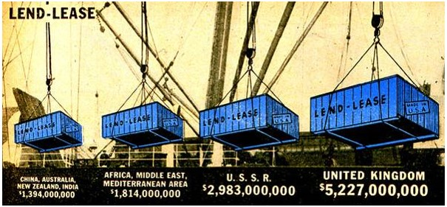

Slide 6
World War II (SSUSH19a)
Lend-Lease Act (SSUSH19a)
Congress passed the act to amend the Neutrality Acts
The U.S. could lend military equipment and supplies to any nation the president said was vital to the defense of the United States.
United States lends $50 billion worth of equipment and supplies to Britain, France, the Soviet Union, and China.

Slide 7
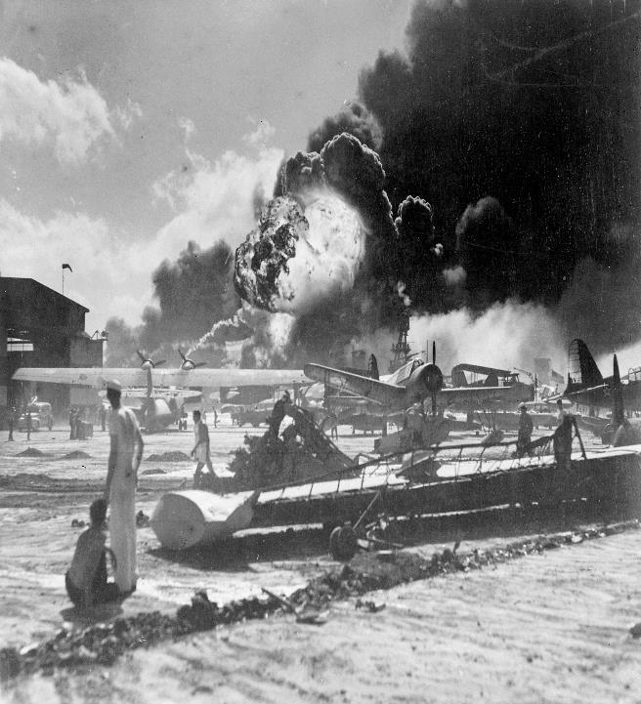

Slide 8
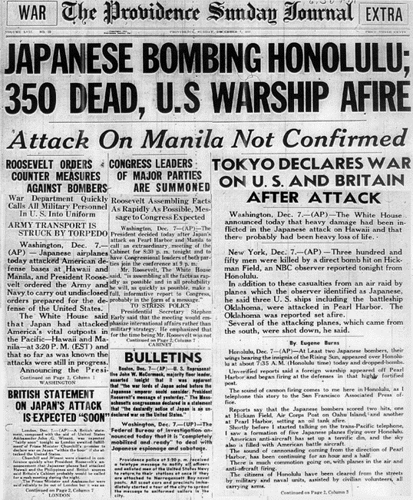

Slide 9
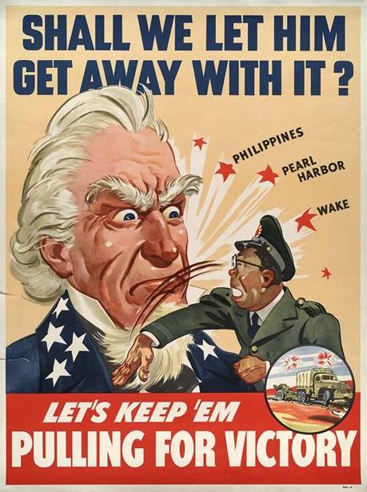

Slide 10
Document Analysis
Yesterday, Dec. 7, 1941 - a date which will live in infamy - the United States of America was suddenly and deliberately attacked by naval and air forces of the Empire of Japan… The attack yesterday on the Hawaiian Islands has caused severe damage to American naval and military forces. Very many American lives have been lost. In addition, American ships have been reported torpedoed on the high seas between San Francisco and Honolulu…
Source: President Franklin D. Roosevelt’s Pearl Harbor Speech December 8, 1941, To the Congress of the United States

Slide 11
World War II (SSUSH19a)
Japanese Attack on Pearl Harbor (SSUSH19a)
Japanese surprise attack on the United States
Over 2,400 Americans were killed
Result: United States officially enters World War II

Slide 13
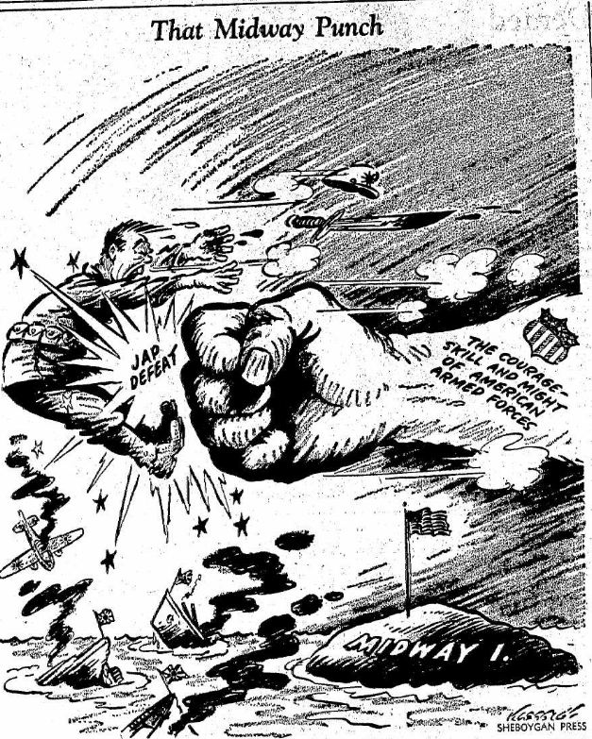

Slide 14
The Pacific Theater (SSUSH19b)
The Battle of Midway (SSUSH19b)
Major turning point in the Pacific Theater
The U.S. Navy win sea battle against Japanese Navy
Results
U.S. destroyed Japan’s offensive power and they never recovered.
American wins control of refueling station (Island of Midway) for ships and airplanes
U.S. gains geographic control of the Pacific Ocean.

Slide 15
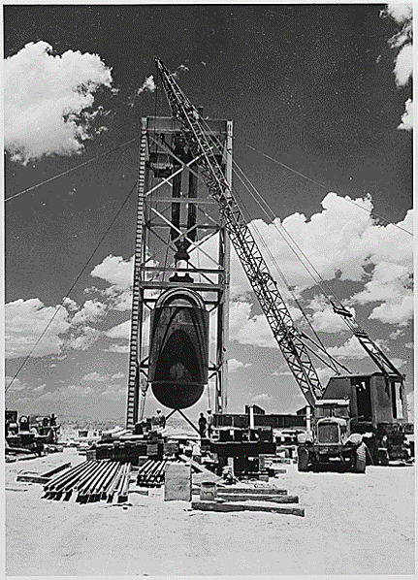

Slide 16
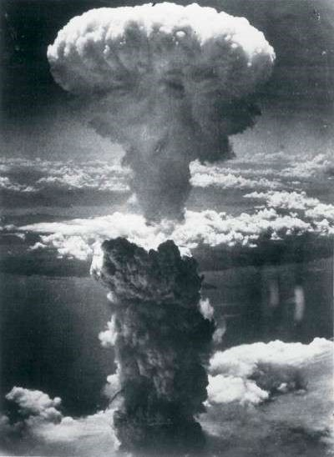

Slide 18
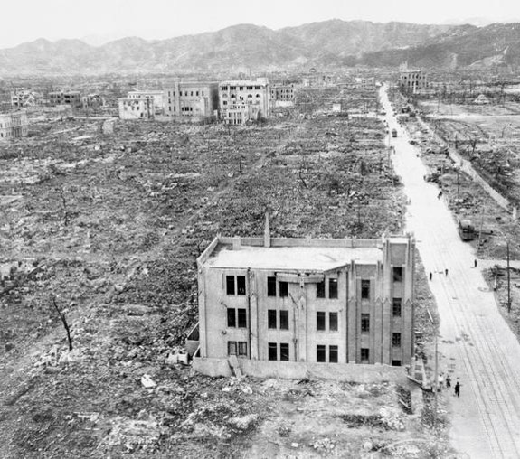

Slide 19
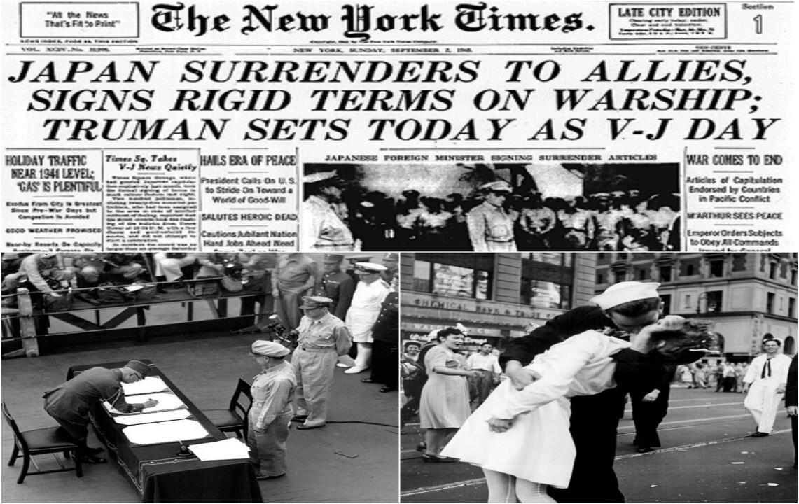

Slide 20
The Pacific Theater (SSUSH19b)
The Manhattan Project (SSUSH19b)
Code name for building the bomb was “The Manhattan Project”
U.S. assembles two atomic bombs in a secret laboratory in Los Alamos, New Mexico

Slide 21
The Pacific Theater (SSUSH19b)
The Dropping of the Atomic Bombs (SSUSH19b)
The U.S. had defeated the Japanese navy in the Pacific Ocean
The U.S. feared they would lose millions of people in an invasion of Japan
President Truman decides to drop the Atomic bomb on Japan (August 1945)
Result: V-J Day and end of the World War II (Sept. 2, 1945)

Slide 22
Review Questions
War II, including the growth of the federal government.
What was the significance of the Lend-Lease Act?
What was the significance of the Japanese attack on Pearl Harbor?
List 3 difficulties U.S. troops faced during World War II
In the Pacific Theater, what was the significance of the Battle of Midway?
In the Pacific Theater, what was the significances of dropping the atomic bomb on Hiroshima and Nagasaki?
What was the significance of the Manhattan Project?

Slide 23
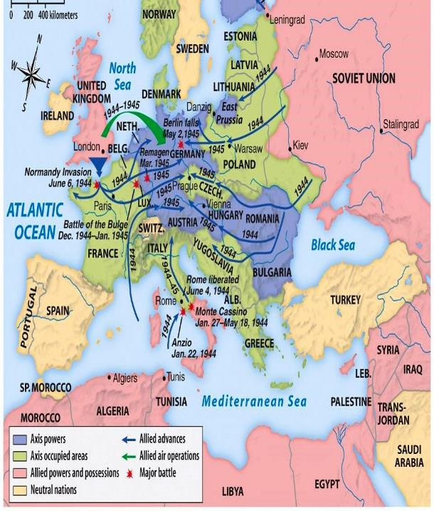
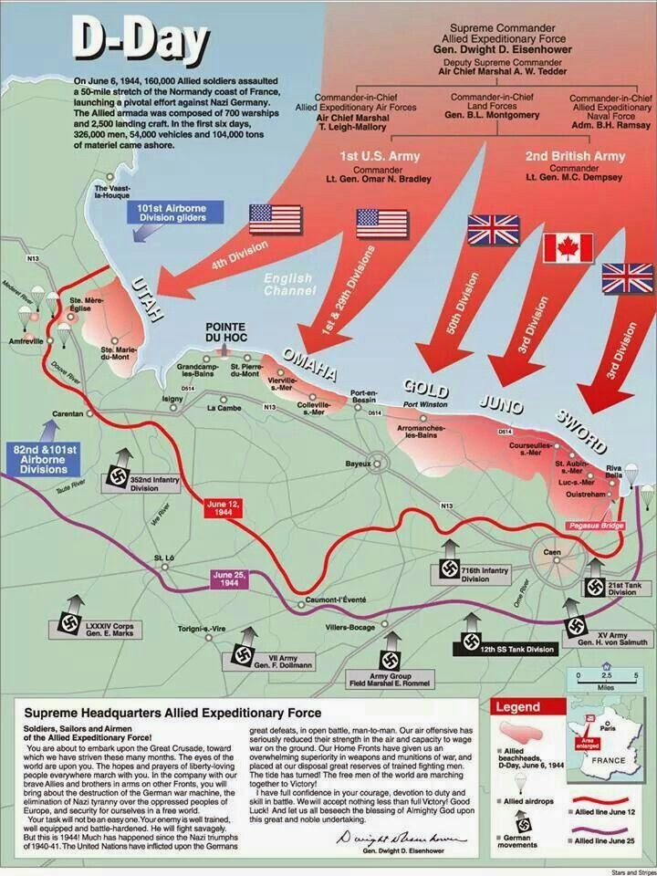

Slide 24
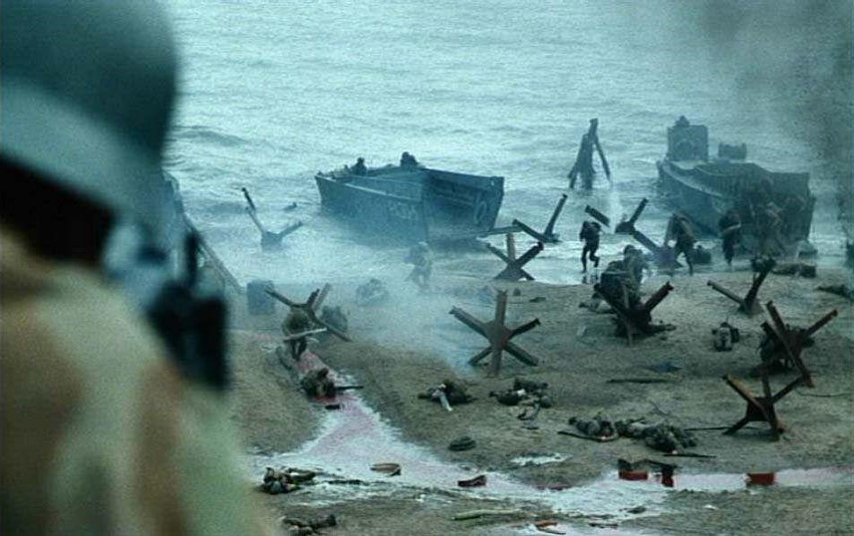

Slide 27
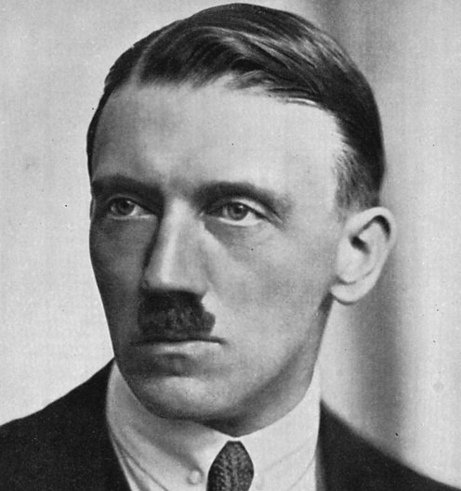

Slide 28
The European Theater (SSUSH19c)
D-Day (SSUSH19c)
Major turning point in the European Theater
The code name for the first day of Operation Overlord, the mass Allied invasion of Nazi-occupied France
Allies met heavy resistance in small areas, the invasion went almost exactly according to plan
U.S. and Allies gains geographic control of part of Europe, so they could resupply their forces and push east to Germany

Slide 29
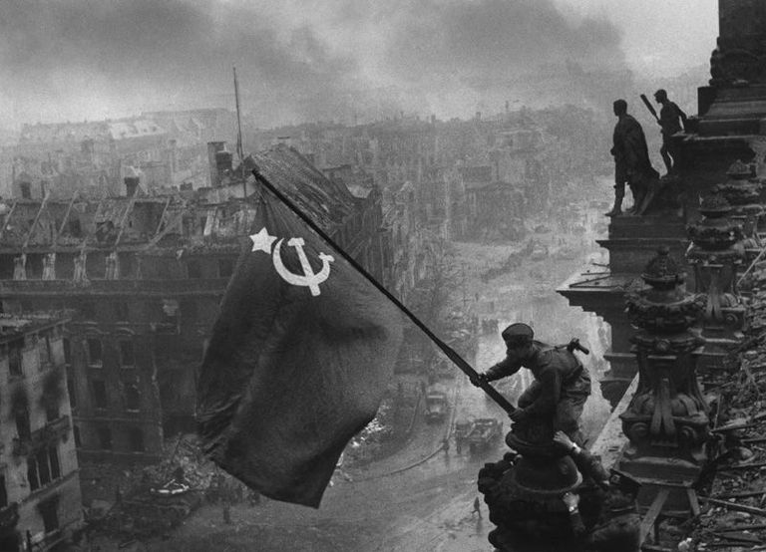

Slide 30
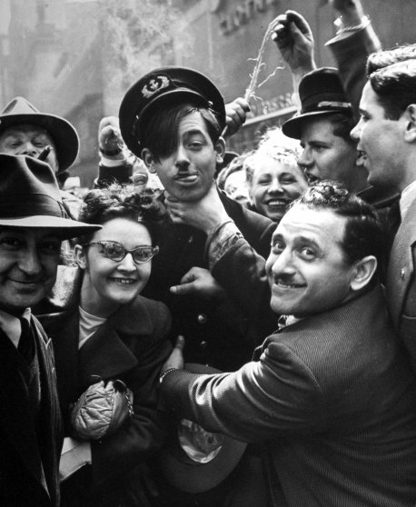

Slide 31
The European Theater (SSUSH19c)
The Fall of Berlin (SSUSH19c)
One of the final battles of the European theater during WWII
Soviet army groups attacked Berlin from the east and west
Historically one of the bloodiest battles of all time
German leader Adolf Hitler committed suicide during battle
Result: V-E Day and end of WWII in Europe

Slide 32
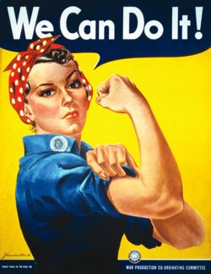

Slide 33
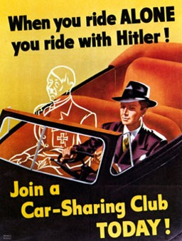
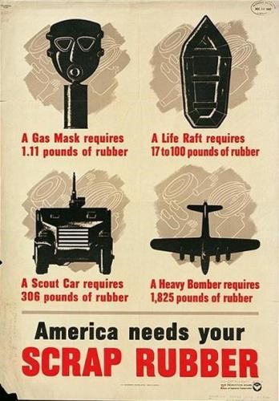

Slide 35
Domestic Impact of World War II (SSUSH19d)
After Pearl Harbor, the War at Home begins
5 million men volunteered for military service
The Selective Service System expanded the draft, and 10 million more men joined the ranks of the American armed forces.

Slide 36
Domestic Impact of World War II (SSUSH19d)
The Women’s Auxiliary Army Corps was formed to fill noncombat positions otherwise filled by men.
Women at home volunteered to work in plants and factors to build tanks, planes, ships, guns, bullets and boots.

Slide 37
Domestic Impact of World War II (SSUSH19d)
Wartime conservation leads people to carpool to work and a nation-wide collection of resources (scrap iron, newspapers, cooking grease)
The government rationing system was created. Each household received a “c book” with coupons that were used to buy scarce items such as meat, sugar, coffee and gasoline.
Eventually, it was the hard work at home that helped America win World War II.

Slide 38
The Call to Negro America to March on Washington (1941), A. Philip Randolph
we propose that ten thousand Negroes MARCH ON WASHINGTON FOR JOBS IN NATIONAL DEFENSE AND EQUAL INTEGRATION IN THE FIGHTING FORCES OF THE UNITED STATES.
An "all-out" thundering march on Washington, ending in a monster and huge demonstration at Lincoln's Monument will shake up white America. It will shake up official Washington. It will give encouragement to our white friends to fight all the harder by our side, with us, for our righteous cause. It will gain respect for the Negro people. It will create a new sense of self-respect among Negroes. But what of national unity? We believe in national unity which recognizes equal opportunity of black and white citizens to jobs in national defense and the armed forces, and in all other institutions and endeavors in America. We condemn all dictatorships, Fascist, Nazi and Communist. We are loyal, patriotic Americans all.
Source: From A. Philip Randolph, "Call to Negro America to March on Washington for Jobs and Equal Participation in National Defense," Black Worker 14 (May 1941):n.p.],

Slide 39
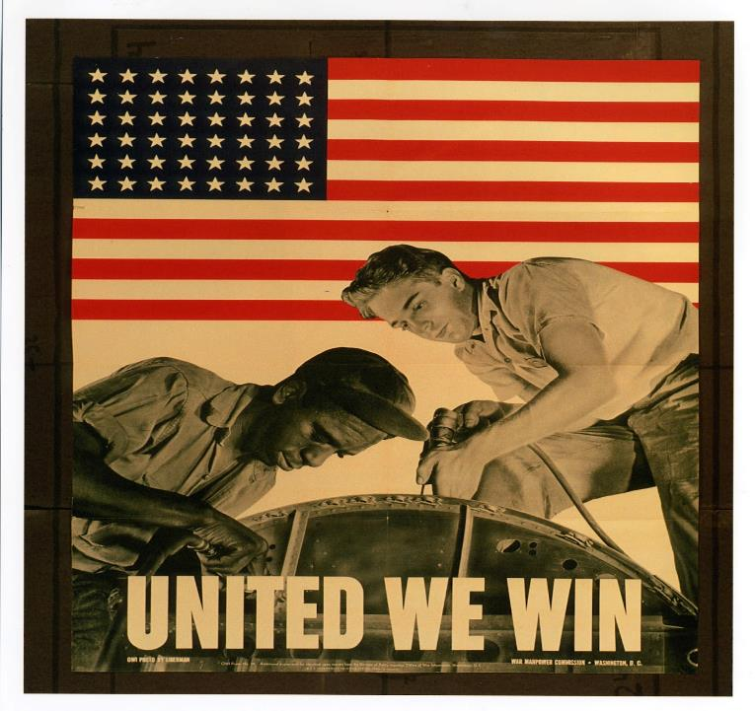

Slide 41
Roosevelt’s use of Executive Powers (SSUSH19e)
In 1941, A. Philip Randolph, the founder of the Brotherhood of Sleeping Car Porters, proposed a march on Washington, D.C., to protest discrimination in the military and in industry.
He called on African Americans from all over the United States to come to Washington and join him.
President Roosevelt, afraid the march might cause unrest among whites, summoned Randolph to the White House and asked him to call off the march.

Slide 42
Roosevelt’s use of Executive Powers (SSUSH19e)
When Randolph refused, Roosevelt issued Executive Order 8802 that called on employers and labor unions to cease discrimination in hiring practices in industries related to defense.
As a result of Roosevelt’s actions, the march was canceled.

Slide 44
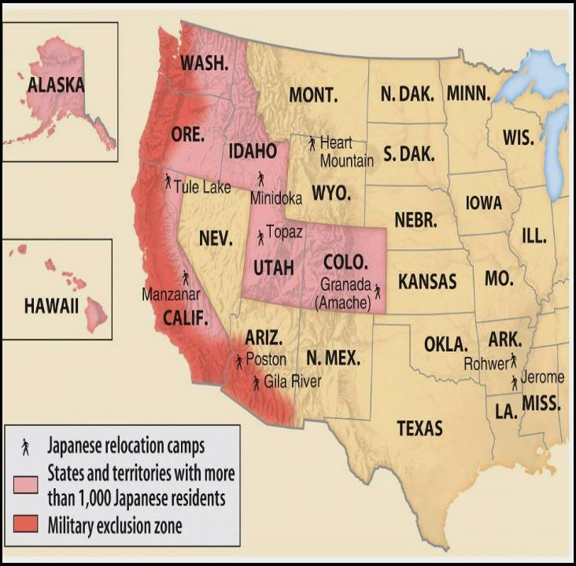

Slide 45
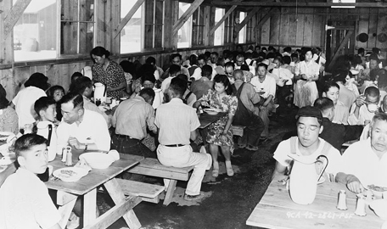

Slide 46
Roosevelt’s use of Executive Powers (SSUSH19e)
Internment of Japanese-Americans (SSUSH19e)
The Japanese attack on Pearl Harbor fueled suspicion and fear among US citizens.
Many suspected that Japanese, German, and Italian Americans would end up supporting the Axis Powers.
Roosevelt then issued Executive Order 9066, this US military order forced more than 100,000 Japanese Americans from their homes and businesses during the war and placed them in one of the various camps

Slide 47
Review Questions
In the European Theater, what was the significance of D-Day?
In the European Theater, what was the significance of the Fall of Berlin?
How did rationing impact war time mobilization?
How did women impact war time mobilization?
How did blacks impact war time mobilization?
How did Roosevelt use his executive power to impact defense industries?
How did Roosevelt use his executive power to impact Japanese-Americans?

Slide 51
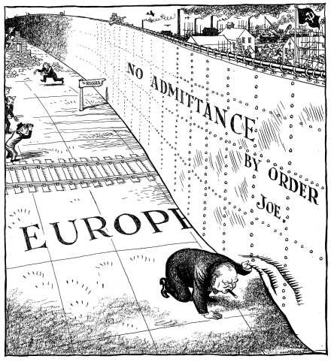

Slide 52
The Cold War (SSUSH20a)
In 1945, one major war ended and another began.
The Cold War lasted about 45 years. There were no direct military campaigns between the two main antagonists, the United States and the Soviet Union.
Yet billions of dollars and millions of lives were lost in the fight.

Slide 53
Document Analysis
“the main element of any United States policy toward the Soviet Union must be that of a long-term patient but firm and vigilant containment of Russian expansive tendencies.”
George Kennan on U.S. foreign policy of Containment

Slide 54
Cold War Foreign Policy (SSUSH20a)
Containment (SSUSH20a)
U.S. foreign policy to stop the spread of communism
U.S. scared that Soviet Union was tried to spread communism throughout the world

Slide 56
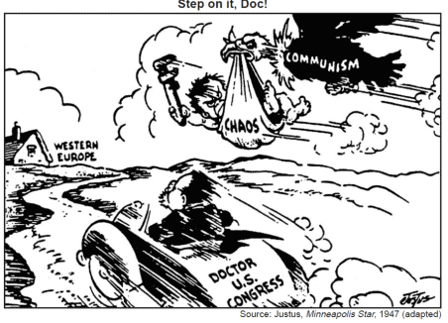

Slide 57
Cold War Foreign Policy (SSUSH20a)
The Marshall Plan (SSUSH20a)
America’s foreign aid program to rebuild Western Europe and opposing communism after World War II.
From 1947 to 1951, the United States spent $13 billion on economic and technical assistance for Western European countries that had been nearly destroyed during World War II.
The plan offered foreign aid to the Soviet Union and Eastern Europe if they made political reforms and accept certain outside controls; however, the Soviets rejected this proposal.

Slide 58
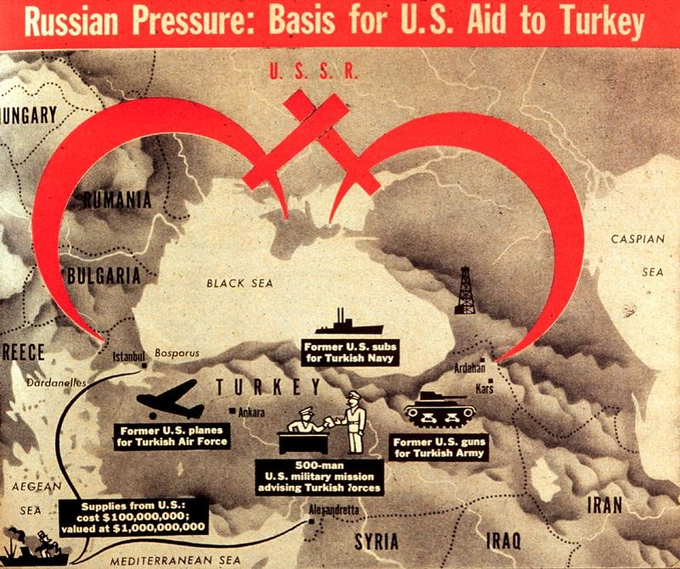

Slide 59
Cold War Foreign Policy (SSUSH20a)
The Truman Doctrine (SSUSH20a)
Foreign policy named after President Harry S. Truman
The plan said the United States would supply any nation with economic and military aid to prevent its falling under the Soviet sphere of influence.
Truman called upon the United States to “support free peoples who are resisting attempted subjugation by armed minorities or by outside pressures (Soviet Union).”

Slide 60
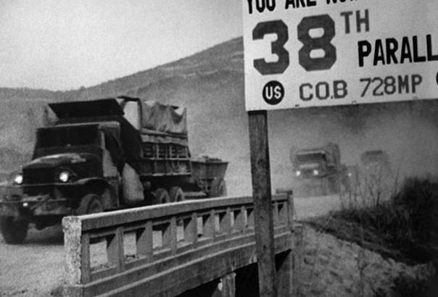

Slide 61
Cold War Foreign Policy (SSUSH20a)
The Korean War (SSUSH20a)
In 1950, the U.S. and South Korean went to war against the communist government of North Korea and China
The U.S. used the containment policy to justify its attempt to stop the spread of communism in Korea
Result: Neither side could gain control of the Korean peninsula, North and South Korea was created with the 38th parallel as the border between the nations.

Slide 62
Review Questions
What was the significance of the Cold War?
What was the significance of the Containment Policy?
What was the significance of the Marshall Plan?
What was the significance of the Truman Doctrine?
What was the significance of the Korean War?
What was the geographic significance of the Korean War?

Slide 63
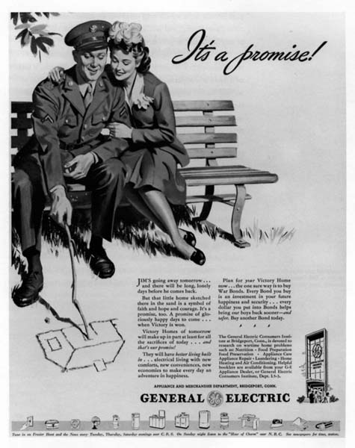
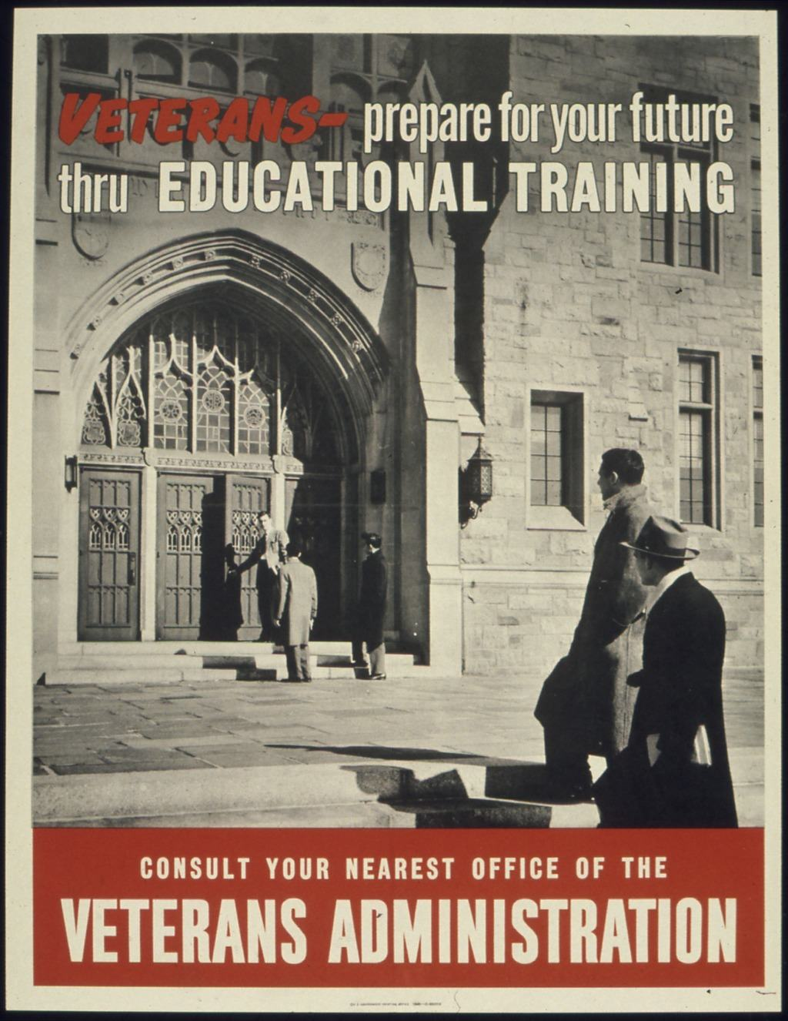

Slide 64
Major Domestic Issues (SSUSH20b)
The G.I Bill (SSUSH20b)
The G.I. Bill of Rights was passed by Congress to protect and reward returning servicemen.
The provisions included giving low interest loans for homes and starting new businesses to former soldiers.
Financial grants were also given to the returning soldiers who wanted to attend college.
The stimulus of money into housing caused a housing boom characterized by the development of the first suburban housing developments, such as Levittown, New York.

Slide 65
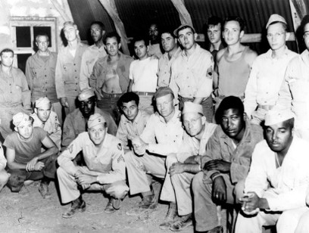

Slide 66
Major Domestic Issues (SSUSH20b)
Truman’s Integration Policies (SSUSH20b)
President Truman issued an executive order to integrate the U.S. armed forces and to end discrimination in the hiring of U.S. government employees.

Slide 67
Document Analysis
“…we find ourselves in a position of impotency because of the traitorous actions of those who have been treated so well by this Nation. It has not been the less fortunate…. But rather those who have had all the benefits that the wealthiest Nation on earth has had to offer.
I have here in my hand a list of 205… a list of names that were made known to the Secretary of State as being members of the Communist Party and who nevertheless are still working and shaping policy in the State Department…”
Source: Joseph McCarthy, Enemies from Within speech, February
9, 1950, Wheeling, WV.

Slide 68
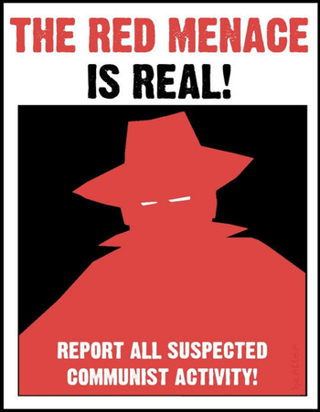
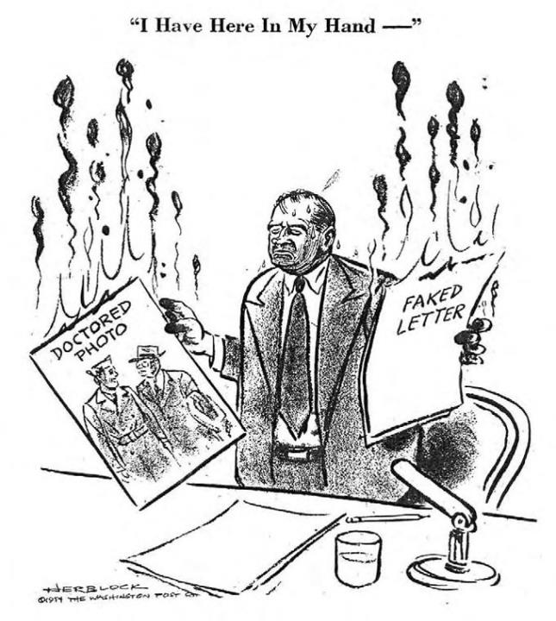

Slide 69
Major Domestic Issues (SSUSH20b)
McCarthyism (SSUSH20b)
Senator Joseph McCarthy’s wanted to stop the spread of communism in the U.S.
McCarthy made statements about alleged communist infiltration of the U.S. government and U.S. Army
Ultimately McCarthy’s statements violated the rights of many U.S. citizens (even communists) and many of his accusations were wrong.
McCarthyism is when someone makes unfair accusations of guilt but he or she uses improper investigative practices to prove the guilt.

Slide 70
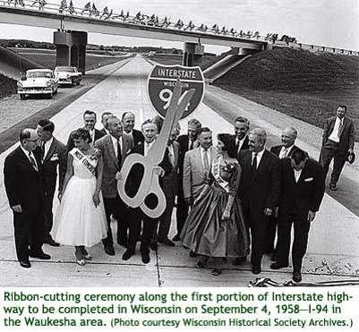

Slide 71
Major Domestic Issues (SSUSH20b)
National Intestate and Defense Highways Act (SSUSH20b)
The baby boom and Levittowns led to a need for more cars and roads.
Congress passed the Interstate Highway Act, authorizing the construction of a national network of highways to connect every major city in America.
In all, 41,000 miles of new expressways, or freeways, were built.
It was also create as a system of highways for strategic transportation of troops and supplies.

Slide 72
Review Questions
How did the G. I. Bill impact Americans?
How President Truman impact the Civil Rights Movement?
How did Joseph McCarthy impact the Cold War?
Define: McCarthyism
What was the significance of the National Interstate and Defense Highways Act?

Slide 74
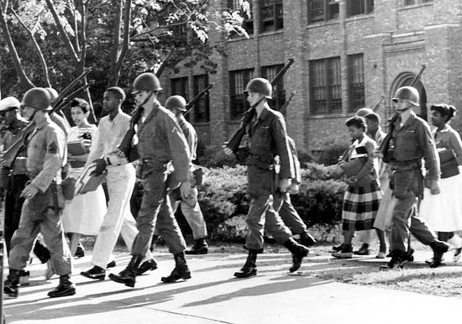
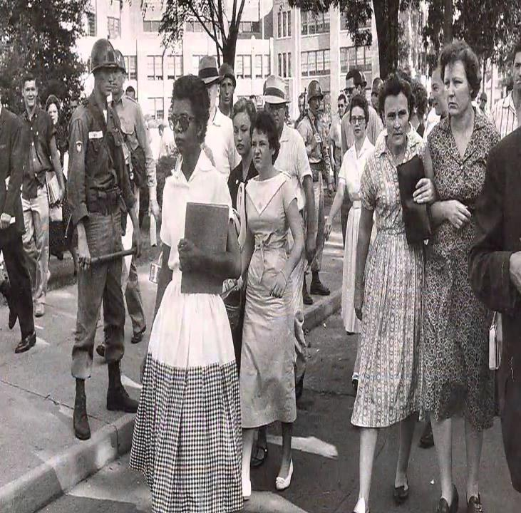

Slide 75
Major Domestic Issues (SSUSH20b)
Brown v. Board of Education (SSUSH20b)
U.S. Supreme Court declared that state laws establishing “separate but equal” public schools denied African American students the equal education
The decision reversed the Plessy v. Ferguson case in 1896.

Slide 76
Major Domestic Issues (SSUSH20b)
The governor of Arkansas refused to follow the decision and ordered the National Guard to keep nine African American students from attending Little Rock’s Central High School
President Eisenhower sent federal troops to Little Rock to force the high school to integrate

Slide 77
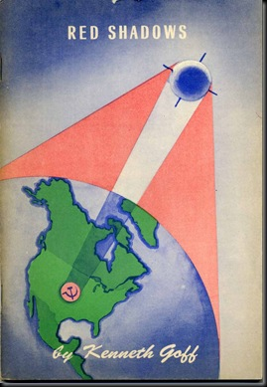

Slide 78
The Influence of Sputnik (SSUSH20c)
In 1957, the Soviet Union launched the first artificial satellite called Sputnik.
Americans believed the United States had “fallen behind” the Soviet Union in terms of understanding science and the uses of technology.
Americans also feared that the Soviet Union could use rockets to launch nuclear weapons
U.S. government increases spending on education, especially in mathematics and science, and on national military defense programs

Slide 79
Review Questions
What was the significance of Brown v. Board of Education?
What court case was overruled by Brown v. Board of Education?
What was Sputnik?
How did Sputnik impact American Society?

